Slide 1
Lesson 5-2
Congruent Polygons

Slide 2
Objectives
Identify and use corresponding parts
Use the Third Angles Theorem

Slide 3
Vocabulary
Corresponding parts – corresponding parts map onto each other from a rigid motion mapping or from a statement of congruence or similarity by order
CPCTC – Corresponding Parts of Congruent Triangles are Congruent

Slide 4
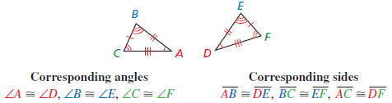
Congruent Triangles
Order Rules!!! – When matching congruent statements: △DEF is the image of △ABC or △DEF ≅ △ABC, order of appearance tells you which parts are corresponding.
3 angles congruent to 3 angles and
3 sides congruent to 3 sides

Slide 5
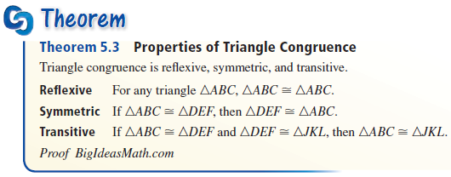
Triangle Theorems
Like angles and segments, triangles have Reflexive, Symmetric and Transitive properties of congruence

Slide 6
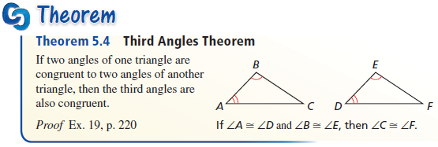
Triangle Theorems
Since all three angles in any triangle always add to 180, this theorem is really another corollary to the Angle Sum Theorem from lesson 5-1.

Slide 7
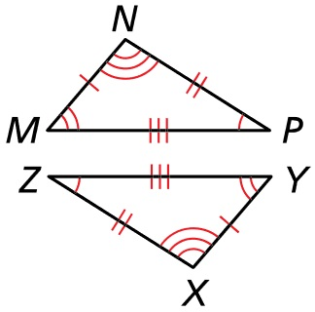
Example 1
Write a congruence statement for the triangles. Identify all pairs of congruent corresponding parts (sides and angles)
Answer:
Sides:
Angles:
MN ≅ YX
MP ≅ YZ
PN ≅ ZX
∠M ≅ ∠Y
∠ P ≅ ∠ Z
∠ N ≅ ∠ X

Slide 8
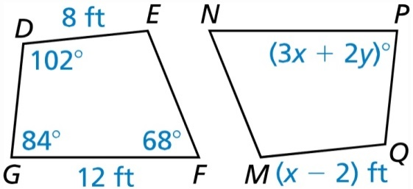
Example 2a
In the diagram,
◊DEFG ≅ ◊QMNP
Find the value of x.
Answer: MQ corresponds to ED
x – 2 = 8
x = 10

Slide 9
Example 2b
In the diagram,
◊DEFG ≅ ◊QMNP
Find the value of y.
Answer: ∠P corresponds to ∠G
3x + 2y = 84 but x = 10 from part a
30 + 2y = 84
2y = 54
y = 27

Slide 10
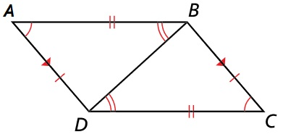
Example 3
Show that
ΔABD ≅ ΔCDB.
Explain your reasoning
Answer:
For two triangles to be congruent, 3 sides and 3 angles must be congruent. Two angles are marked congruent and the third angle is congruent because of a hidden feature of parallel sides, alternate interior angles. Two sides are marked congruent and the third side is congruent because of a hidden feature of shared sides (reflexive property)

Slide 11
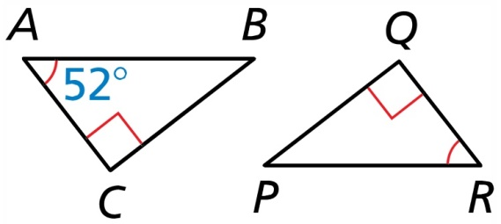

Example 4
Find $m∠P$.
Answer:
Angle R congruent (equal) to angle A
180 = sum of triangle’s angles
180 = 90 + 52 + ∠P
180 = 142 + ∠P
38 = ∠P

Slide 12
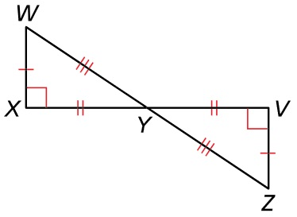

Example 5
Use the information in the figure to prove that $∆WXY≅∆ZVY$
Answer:
Statement | Reason
XW ≅ VZ Marked in picture
XY ≅ VY Marked in picture
WY ≅ ZY Marked in picture
∠X ≅ ∠V All right angles congruent
∠Y ≅ ∠Y Vertical angles congruent
∠W ≅ ∠Z Third angle Thrm
$∆WXY≅∆ZVY$ All angles and sides congruent

Slide 13
Summary & Homework
Summary:
  Triangles can be classified by their angles as acute, obtuse or right
  Triangles can be classified by their sides as scalene, isosceles or equilateral
  Exterior angle = sum of remote interiors
  Interior angles sum to 180
  Exterior angles sum to 360
Homework:
  Triangle Classification WS

