Slide 1
Lesson 5-3
Proving Triangle Congruence by SAS

Slide 2
Objectives
Use the Side-Angle-Side (SAS) Congruence Theorem
Solve real-life problems

Slide 3
Vocabulary
Included angle – the angle formed by the two sides (angle between the two connected sides)

Slide 4
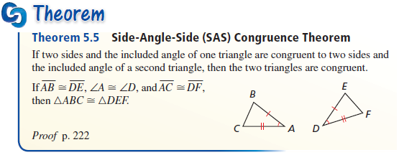
Triangle Congruence Theorems
Instead of proving 3 sides and 3 angles congruent to get triangle congruence, this gives us a short-cut
Angle must be between the two congruent sides!!

Slide 5

Side – Angle – Side (SAS)
Given: AC = CD
BC = CE
Prove: ABC = DEC
Statements
Reasons
AC = CD Given
BC = CE Given
∠ACB ≅ ∠DCE (included angle)
Vertical Angles Theorem
ABC ≅ DEC
SAS Theorem

Slide 6
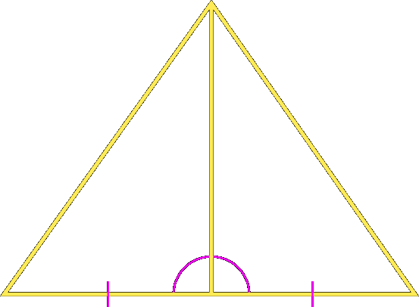
Determine which theorem can be used to prove that the triangles are congruent. If it is not possible to prove that they are congruent, write not possible.
a.
Answer: SAS

Slide 7
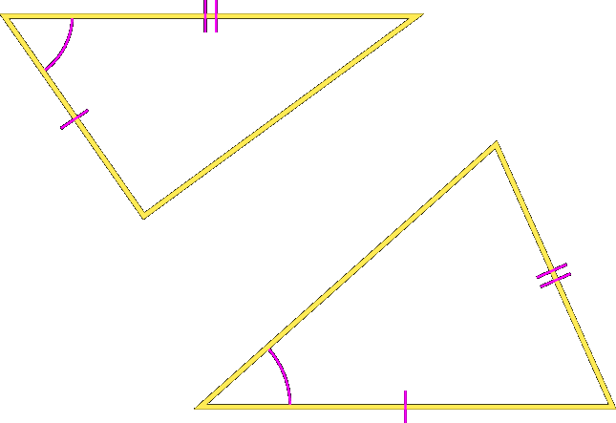
Determine which theorem can be used to prove that the triangles are congruent. If it is not possible to prove that they are congruent, write not possible.
b.
Answer: not possible

Slide 8
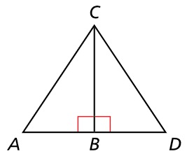


Example 1
Given: B is the midpoint of $\overline{AD}$. $∠ABC$ and $∠DBC$ are right angles
Prove: $∆ABC≅∆DBC$
Answer:
Statement | Reason
B is midpoint of AD Given
AB ≅ BD Dfn of Midpoint
∠ABC, ∠DBC right Given
∠ABC ≅ ∠DBC Right Angle Theorem
BC ≅ BC Reflexive POC (shared side)
$∆ABC≅∆DBC$ SAS

Slide 9
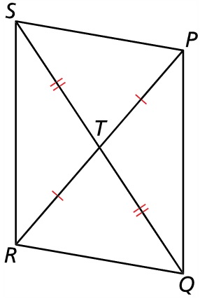

Example 2
What can you conclude about $∆PTS$ and $∆RTQ$? Explain
Answer:
Two sides marked congruent
Included angle:
∠STP and ∠QTR are vertical angles (so congruent)
Δ PTS and ΔRTQ are congruent by SAS

Slide 10
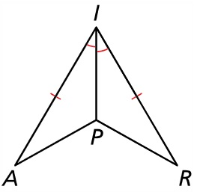


Example 3
The wings of a paper airplane have two congruent sides and two congruent angles. Use the SAS Congruence Theorem to show that $∆IPA≅∆IPR$.
Answer:
Statement | Reason
AI ≅ RI Given
∠AIP ≅ ∠RIP Given
IP ≅ IP Reflexive POC (shared side)
$∆IPA≅∆IPR$ SAS

Slide 11
Summary & Homework
Summary:
  SAS is the first of several “short-cut” theorems for triangle congruence
  Angle must be between the two sides
    Angle will be the letter the two sides have in common
    Must be the same in both triangles
Homework:
  Triangle Congruence WS 2

