Slide 1
Lesson 5-4
Equilateral and Isosceles Triangles

Slide 2
Objectives
Use the Base Angles Theorem
Use isosceles and equilateral triangles

Slide 3
Vocabulary
Base – the non-equal side of an isosceles triangle
Base angles – angles adjacent to the base
Legs – the two equal sides of an isosceles triangle
Vertex angle – angle formed by the legs of an isosceles triangle

Slide 4
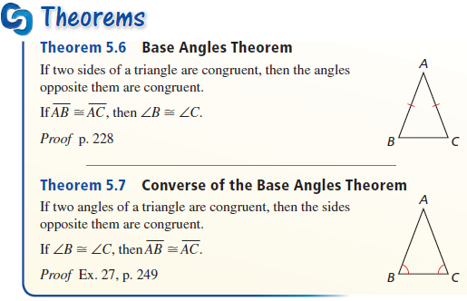
Isosceles Triangle Theorems
Opposite equal sides are equal angles
Opposite equal angles are equal sides

Slide 5
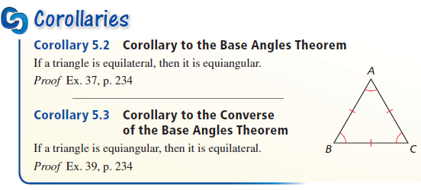
Equalateral Triangle Theorems
Equilateral if and only if equiangular

Slide 6
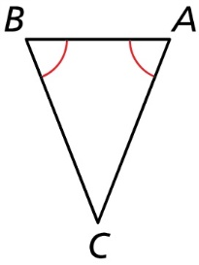

Example 1
In the figure, $∠A≅∠B$. Name two congruent sides.
Answer:
Opposite equal angles are equal sides
CB ≅ CA

Slide 7
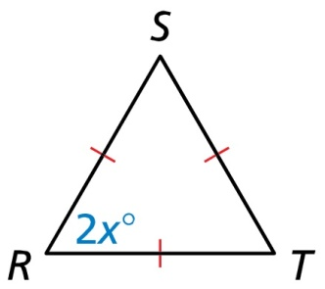
Example 2
Find the value of x.
Answer:
Equilateral triangle so equiangular
60 = 2x
30 = x

Slide 8
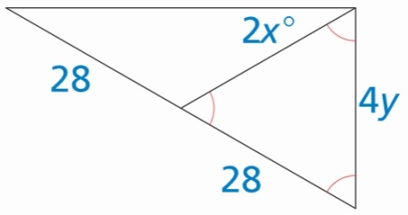
Example 3
Find the values of x and y.
Answer:
4y and 28 are sides in an equilateral triangle so
4y = 28 y = 7
2x is a base angle in an isosceles triangle
2x + 2x + 120 = 180 x = 15

Slide 9
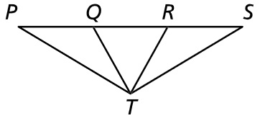


Example 4
In the diagram, $\overline{PT}≅\overline{ST}$ and $\overline{PQ}≅\overline{SR}$.
Prove $∆PQT≅∆SRT$
Explain why $∆QRT$ is isosceles.
Answer:
Statement | Reason
PT ≅ ST Given
PQ ≅ SR Given
∠P ≅ ∠S Opposite equal sides are equal angles
$∆PQT≅∆SRT$ SAS
CPCTC from the sides of the congruent triangles

Slide 10
Summary & Homework
Summary:
  Two sides of a triangle are congruent if, and only if, the angles opposite those sides are congruent
  A triangle is equilateral if, and only if, it is equiangular
Homework:
  Isosceles Triangle WS 1

