Slide 1
Lesson 5-5
Proving Triangle Congruence by SSS

Slide 2
Objectives
Use the Side-Side-Side (SSS) Congruence Theorem
Use the Hypotenuse-Leg (HL) Congruence Theorem

Slide 3
Vocabulary
Hypotenuse – side opposite of the right angle in a right triangle
Legs – sides that form the right angle in a right triangle
Stable – angles in the figure are fixed cannot change

Slide 4
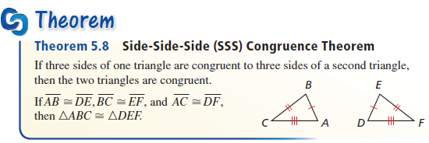
Triangle Congruence Theorems
Instead of proving 3 sides and 3 angles congruent to get triangle congruence, this gives us a short-cut

Slide 5
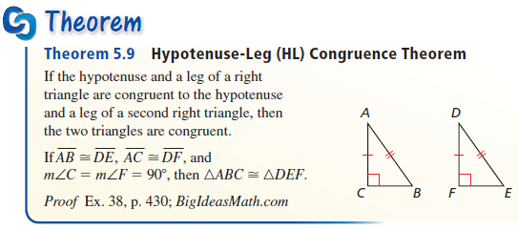
Triangle Congruence Theorems
Because it’s a right triangle, the Pythagorean Theorem applies and the other leg must be congruent. Makes it a special case of the SSS congruence theorem

Slide 6
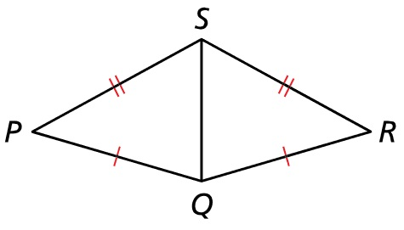


Example 1
Write a proof
Given: $\overline{PQ}≅\overline{RQ}$, $\overline{PS}≅\overline{RS}$
Prove: $∆PQT≅∆SRT$
Answer:
Statement | Reason
PQ ≅ RQ Given
PS ≅ RS Given
SQ ≅ SQ Reflexive POC (shared side)
$∆PQT≅∆SRT$ SSS

Slide 7
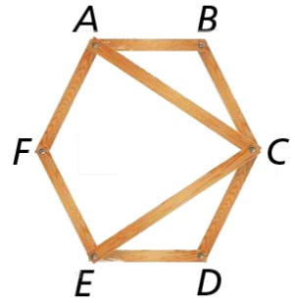
Example 2
Determine whether the hexagon is stable. Explain your reasoning.
Answer:
Not stable.
Diagonals AC and EC fix part of the hexagon, but a lack of a diagonal from A to E allows angle AFE to change.

Slide 8
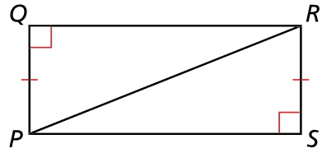

Example 3
Write a proof.
Given: $\overline{PQ}≅\overline{RS}$,
∠Q and ∠S are right angles.
Prove: $∆PQR≅∆RSP$
Answer:
Statement | Reason
PQ ≅ RS Given [Leg]
∠Q, ∠S are right Given
ΔPQR and ΔRSP are right triangles Right triangle Dfn
RP ≅ RP Reflexive POC (shared side) [Hyp]
$∆PQR≅∆RSP$ HL

Slide 9
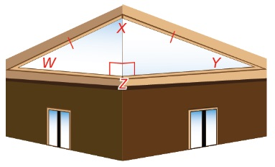

Example 4
Two windows in a building are right triangles, with $\overline{WX}≅\overline{XY}$. Prove that the triangles are congruent.
Given: $∆WXZ$ and $∆YXZ$ are right triangles; $\overline{WX}≅\overline{XY}$
Prove: $∆WXZ≅∆YXZ$
Answer:
Statement | Reason
WX ≅ XY Given [Hyp]
∠Z’s are right Given
ΔWXZ and ΔYXZ are right triangles Right triangle Dfn
XZ ≅ XZ Reflexive POC (shared side) [Leg]
$∆WXZ≅∆YXZ$ HL

Slide 10
Summary & Homework
Summary:
  SSS is the second of several “short-cut” theorems for triangle congruence
  HL is a special case of SSS
    Only works in right triangles
Homework:
  Triangle Congruence WS 2

