Slide 1
Lesson 5-6
Proving Triangle Congruence by ASA and AAS

Slide 2
Objectives
Use the ASA and AAS Congruence Theorems

Slide 3
Vocabulary
Included side – the side in common between two angles (the end points are the vertexes)

Slide 4
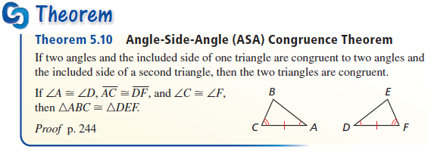
Triangle Congruence Theorems
Third short-cut Theorem
Side must be between the two angles
(angles define the side)

Slide 5
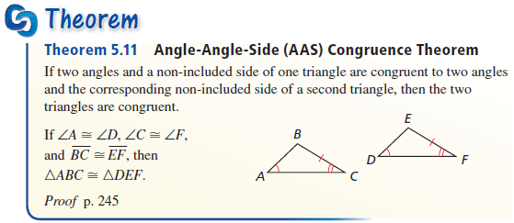
Triangle Congruence Theorems
Because of the Third Angle Theorem discussed earlier, it makes this a special case of the ASA congruence theorem
AAS is listed as a corollary to ASA in some books because of the third angle theorem.

Slide 6
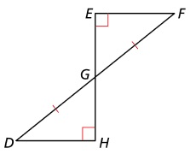
Example 1a
Can the triangles be proven congruent with the information given in the diagram? If so, state the theorem you would use.
Answer:
AAS (vertical angles)
“bowtie”

Slide 7
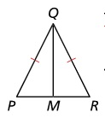
Example 1b
Can the triangles be proven congruent with the information given in the diagram? If so, state the theorem you would use.
Answer:
Not possible (SS)
“shared side”

Slide 8
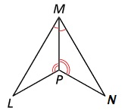
Example 1c
Can the triangles be proven congruent with the information given in the diagram? If so, state the theorem you would use.
Answer:
ASA (“shared side”)

Slide 9
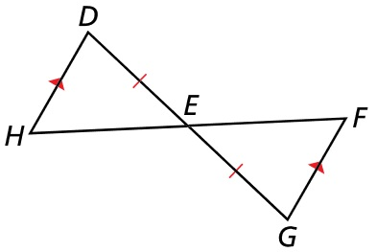


Example 2
Write a proof.
Given: $\overline{DH}∥\overline{FG}$, $\overline{DE}≅\overline{EG}$
Prove: $∆LMP≅∆NMP$
Answer:
Statement | Reason
DH || FG Given
∠D ≅ ∠G Alt Interior Angle Thrm (“parallel”)
DE ≅ EG Given
∠DEH ≅ ∠GEF Vertical angle Thrm (“bowtie”)
$∆PQT≅∆SRT$ ASA

Slide 10
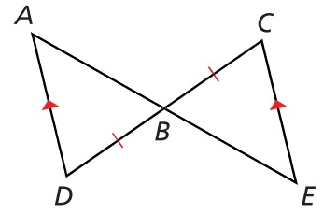


Example 3
Write a proof.
Given: $\overline{AD}∥\overline{EC}$, $\overline{BD}≅\overline{BC}$
Prove: $∆ABD≅∆EBC$ using AAS Congruence Theorem
Answer:
Statement | Reason
AD || EC Given
∠A ≅ ∠E Alt Interior Angle Thrm (“parallel”)
∠D ≅ ∠C Alt Interior Angle Thrm (“parallel”)
BD ≅ BC Given
$∆ABD≅∆EBC$ AAS

Slide 11
Summary & Homework
Summary:
  ASA is the second of several “short-cut” theorems for triangle congruence
  AAS is a special case of ASA
    From third angle theorem
  SSS, SAS, HL, ASA, ASA are the triangle congruence theorems
    AAA, SSA or ASS are not possibles
Homework:
  Triangle Congruence WS 2

