Slide 1
Lesson 5-7
Using Congruent Triangles

Slide 2
Objectives
Use congruent triangles
Prove constructions

Slide 3
Vocabulary
None new

Slide 4
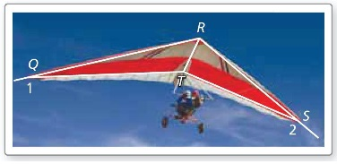


Example 1
Write a proof.
Given: $∠QRT≅∠SRT$,
$∠RTQ≅∠RTS$
Prove: $\overline{QT}≅\overline{ST}$
Answer:
Statement | Reason
DH || FG Given
∠D ≅ ∠G Alt Interior Angle Thrm (“parallel”)
DE ≅ EG Given
∠DEH ≅ ∠GEF Vertical angle Thrm (“bowtie”)
$∆PQT≅∆SRT$ ASA

Slide 5
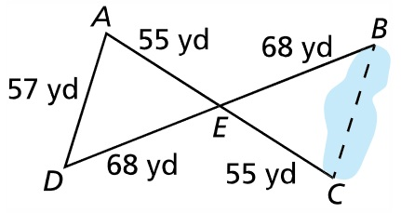
Example 2
Explain how to use the measurements in the diagram to find the distance across the pond.
Answer:

Slide 6
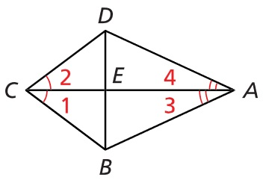


Example 3
Write a plan to prove
$$∆ADE≅∆ABE$$
Answer:
Statement | Reason
AD || EC Given
∠A ≅ ∠E Alt Interior Angle Thrm (“parallel”)
∠D ≅ ∠C Alt Interior Angle Thrm (“parallel”)
BD ≅ BC Given
$∆ABD≅∆EBC$ AAS

Slide 7
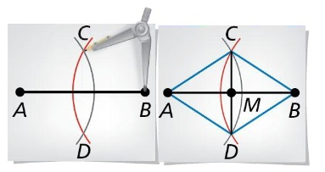
Example 4
Write a proof to verify that the construction of the midpoint of a segment is valid.
Answer:
Statement | Reason
AD || EC Given
∠A ≅ ∠E Alt Interior Angle Thrm (“parallel”)
∠D ≅ ∠C Alt Interior Angle Thrm (“parallel”)
BD ≅ BC Given
$∆ABD≅∆EBC$ AAS

Slide 8
Summary & Homework
Summary:
  Remember to look for hidden features
  Isosceles triangles make up many constructions
Homework:
  Triangle Congruence WS 2

