Slide 1
Lesson 5-8
Proving Triangle Congruence by ASA and AAS

Slide 2
Objectives
Place figures in a coordinate plane
Write coordinate proofs

Slide 3
Vocabulary
Coordinate proof -- involves placing geometric figures in a coordinate plane.

Slide 4
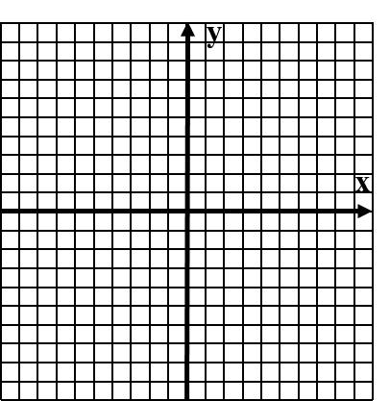
Example 1a
Place each figure in a coordinate plane in a way that is convenient for finding side lengths. Assign coordinates to each vertex.
a) Scalene right triangle
Answer:

Slide 5
Example 1b
Place each figure in a coordinate plane in a way that is convenient for finding side lengths. Assign coordinates to each vertex.
b) Isosceles trapezoid
Answer:

Slide 6
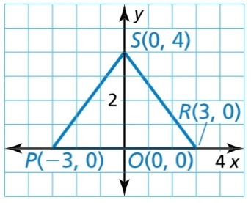

Example 2
Write a plan for a proof that used the SAS Congruence Theorem
Answer:
Statement | Reason
DH || FG Given
∠D ≅ ∠G Alt Interior Angle Thrm (“parallel”)
DE ≅ EG Given
∠DEH ≅ ∠GEF Vertical angle Thrm (“bowtie”)
$∆PQT≅∆SRT$ ASA

Slide 7
Example 3
Place an isosceles triangle on a coordinate plane with vertices P(-2a, 0), Q(0, a), and R(2a, 0). Find the length of each side
Answer:

Slide 8
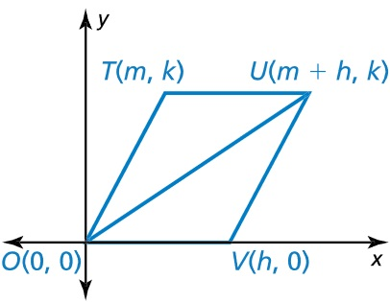

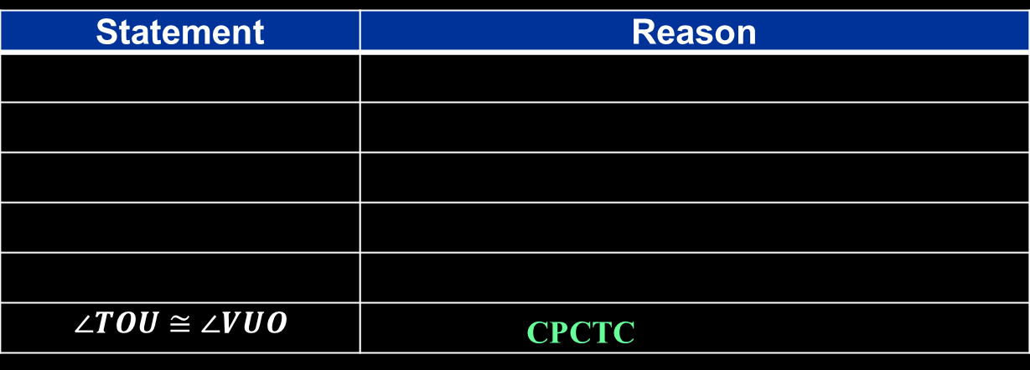

Example 4
Write a coordinate proof.
Prove that $∠TOU≅∠VUO$
Answer:
Statement | Reason
$$∠TOU≅∠VUO$$ | CPCTC
DH || FG Given
∠D ≅ ∠G Alt Interior Angle Thrm (“parallel”)
DE ≅ EG Given
∠DEH ≅ ∠GEF Shared Side
$∆TOU≅∆VUO$ SSS

Slide 9
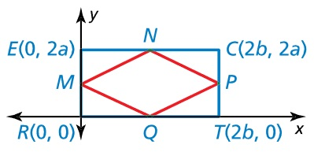
Example 5
As part of a graphic design, you draw a rectangle and then connect the midpoints of the sides. Prove that the quadrilateral MNPQ has four congruent sides.
Answer:

Slide 10
Summary & Homework
Summary:
  Coordinate plane proofs use HL, SAS and SSS with distance formulas
Homework:
  Triangle Congruence WS 2

