Slide 1
Lesson 6-1
Perpendicular and Angle Bisectors

Slide 2
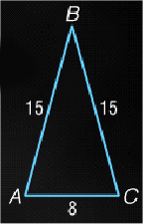
5-Minute Check on Chapter 5
Refer to the figure.
1. Classify the triangle as scalene, isosceles, or equilateral.
2. Find x if m∠A = 10x + 15, m∠B = 8x – 18, and
m∠C = 12x + 3.
3. Name the corresponding congruent angles if
ΔRST ≅ ΔUVW.
4. Name the corresponding congruent sides if ΔLMN ≅ ΔOPQ.
5. Find y if ΔDEF is an equilateral triangle and m∠F = 8y + 4.
6. What is the slope of a line that contains
(–2, 5) and (1, 3)?
Standardized Test Practice:
A
–2/3
B
2/3
C
–3/2
D
3/2

Slide 3
5-Minute Check on Chapter 5
Refer to the figure.
1. Classify the triangle as scalene, isosceles, or equilateral.
isosceles
2. Find x if m∠A = 10x + 15, m∠B = 8x – 18, and
m∠C = 12x + 3. 6
3. Name the corresponding congruent angles if
ΔRST ≅ ΔUVW. ∠R ≅ ∠U; ∠S ≅ ∠V; ∠T ≅ ∠W
4. Name the corresponding congruent sides if ΔLMN ≅ ΔOPQ.
LM ≅ OP; MN ≅ PQ; LN ≅ OQ
5. Find y if ΔDEF is an equilateral triangle and m∠F = 8y + 4. 7
6. What is the slope of a line that contains
(–2, 5) and (1, 3)?
Standardized Test Practice:
A
–2/3
B
2/3
C
–3/2
D
3/2

Slide 4
Objectives
Use perpendicular bisectors to find measures
Use angle bisectors to find measures and distance relationships
Write equation for perpendicular bisectors

Slide 5
Vocabulary
Angle Bisector – a ray that cuts an angle in halves
Equidistant – same distance from both (if points, then it could be a midpoint)
Point of concurrency – the intersection point of three or more lines
Perpendicular bisector – passes through the midpoint of the segment (triangle side) and is perpendicular to the segment

Slide 6
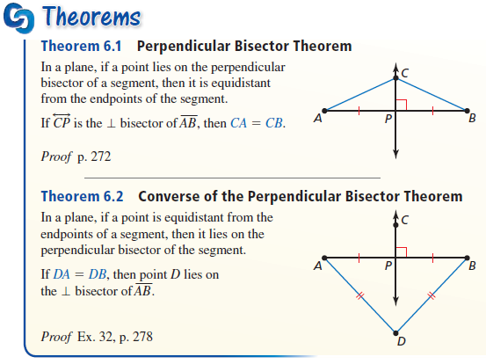
Theorems
Points on the perpendicular bisector are equidistant from the vertices (corners) of the triangle

Slide 7
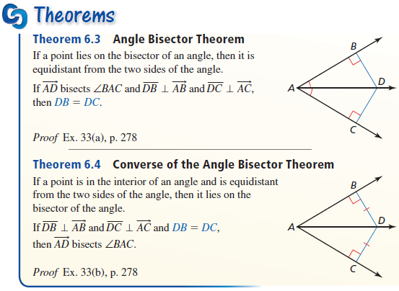
Theorems
Points on the angle bisector are equidistant from the sides of the triangle

Slide 8
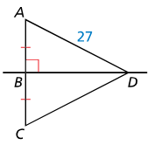
Example 1A
A. Find each measure, CD.
AD = DC Perpendicular Bisector Theorem
DC = 27 Substitution
Answer: 27

Slide 9
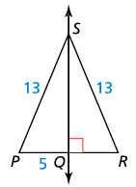
Example 1B
B. Find each measure, PR.
Answer:
Since SQ is a perpendicular bisector (since SP = SR) and PQ = 5, then 10

Slide 10
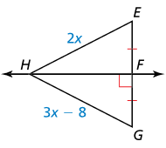
Example 1C
C. Find GH.
Answer:
From the information in the diagram, we know that line HF is the perpendicular bisector of line segment EG.
HE = HG Perpendicular Bisector Theorem
2x = 3x – 8 Substitution
2x + 8 = 3x Add 8 to both sides.
8 = x Subtract 2x form both sides.
So, GH= 3(8) – 8 = 16.

Slide 11
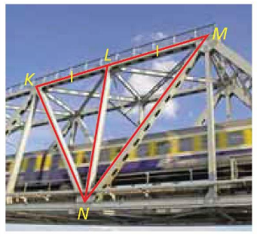

Example 2
Is there enough information given in the diagram to conclude that point $L$ lies on the perpendicular bisector of $\overline{KM}$?
Answer: Yes, L is the midpoint, so it must lie on the perpendicular bisector, but without a right angle marker on NL, NL may not be the perpendicular bisector.

Slide 12
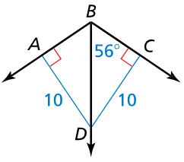

Example 3A
A. Find each measure: $m∠ABC$
Answer:
From the information in the diagram, we know that ray BD is the angle bisector of ∠ ABC.
m∠ ABC = 2(56) = 112°

Slide 13
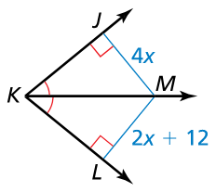
Example 3B
B. Find JM
Answer:
4x = 2x + 12 equidistant from sides
2x = 12
x = 6

Slide 14
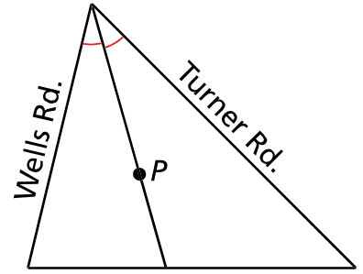

Example 4
A parachutist lands in a triangular field at point $P$, and then walks to a road. Will he have to walk further to Wells Road or to Turner Road?
Answer:
Since P is on the angle bisector, then it is equidistant from the sides of the triangle. So the roads are equidistant from point P.
Remember distance is measured at 90° angles

Slide 15


Example 5
Write an equation of the perpendicular bisector of the segment with endpoints $D(5, −1)$ and $E(−11, 3)$.
Answer:
Slope: $m=\frac{y_{2}−y_{1}}{x_{2}−x_{1}}=\frac{3−(−1)}{−11−5}=\frac{4}{−16}=\frac{−1}{4}$ so m⊥ = 4
Midpoint: $\left(\frac{5+−11}{2},\frac{−1+3}{2}\right)=\left(\frac{−6}{2},\frac{2}{2}\right)=(−3,1)$
Point – Slope: $y−1=4(x−\left(−3\right))$
Slope intercept: $y=4x+13$

Slide 16
Special Segments in Triangles
Name | Type | Point of Concurrency | Center Special Quality | From / To
Perpendicular bisector | Line, segment or ray | Circumcenter | Equidistant from vertices | None midpoint of segment
Angle bisector | Line, segment or ray | Incenter | Equidistant from sides | Vertex none

Slide 17
Summary & Homework
Summary:
  Perpendicular bisectors and angle bisectors of a triangle are all special segments in triangles
  Perpendiculars bisectors:
    form right angles
    divide a segment in half – go through midpoints
    equal distance from the vertexes of the triangle
  Angle bisector:
    cuts angle in half
    equal distance from the sides of the triangle
Homework:
  xxxx

