Slide 1
Lesson 6-2
Bisectors of Triangles

Slide 2
Objectives
Use and find the circumcenter of a triangle
Use and find the incenter of a triangle

Slide 3
Vocabulary
Circumcenter – the point of concurrency of perpendicular bisectors in a triangle;
center of the circle drawn that contains the three vertices of a triangle;
equidistant from the vertices of the triangle
Concurrent – three or more lines, rays or segments that intersect (come together) at a single point
Incenter – the point of concurrency of the angle bisectors in a triangle;
center of the largest circle drawn within the triangle;
equidistant from the sides of the triangle
Point of Concurrency – the point of intersection of concurrent lines, rays or segments

Slide 4
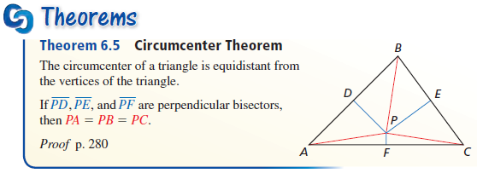
Theorems
Points on the perpendicular bisector are equidistant from the vertices (corners) of the triangle
Circumcenter is equidistant from the vertices

Slide 5
Triangles – Perpendicular Bisectors
A
Note: AP = BP = CP
Midpoint
of AC
Z
Circumcenter
Midpoint
of AB
P
X
C
Midpoint
of BC
Y
B
Circumcenter is equidistant from the vertices

Slide 6
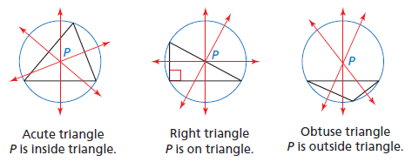
Circumcenter Location
Circumcenter can be inside, on the edge or outside the triangle (depending on the largest angle in the triangle)

Slide 7
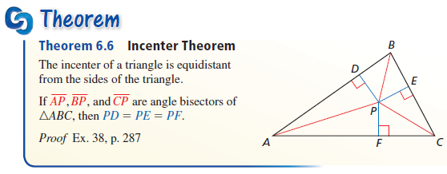
Theorems
Points on the angle bisector are equidistant from the sides of the triangle
The incenter is equidistant from the sides

Slide 8
Triangles – Angle Bisectors
A
Note: QX = QY = QZ
Z
Q
Incenter
X
C
Y
B
Incenter is equidistant from the sides

Slide 9
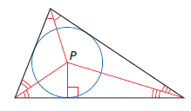
Incenter Location
Incenter by its name is always inside a triangle, no matter what its angles are

Slide 10
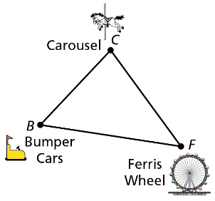

Example 1
A carnival operator wants to locate a food stand so that it is the same distance from the carousel $(C)$, the Ferris wheel $(F)$, and the bumper cars $(B)$. Find the location of the food stand $(S)$.
Answer:
Find the circumcenter (its equal distance from the vertices)

Slide 11

Example 2
Find the coordinates of the circumcenter of $∆DEF$ with vertices $D(6, 4)$, $E(−2, 4)$, and $F(−2, −2)$.
y
Answer:
x

Slide 12
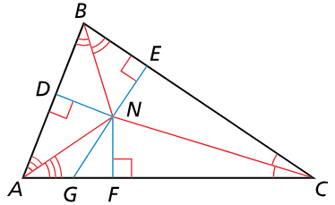

Example 3A
In the figure shown, $NE=6x+1$ and $NF=4x+15$. Find ND.
Answer:
N is the incenter, so it is equal distance from the sides of the triangle:
4x + 15 = 6x + 1
14 = 2x
7 = x
ND = NE = NF = 43

Slide 13

Example 3B
Can $NB=40$? Explain your reasoning
Answer:
NB is the hypotenuse, the longest side of a triangle. If NE = 43, then NB must be greater than 43.
ND = NE = NF = 43
So No.

Slide 14
Example 4
A school has fenced in an area in the shape of a scalene triangle to use for a new playground. The school wants to place a swing set where it will be the same distance from all three fences. Should the swing set be placed at the circumcenter or the incenter of the triangular playground? Explain.
Answer: Incenter
The fences are the sides of the triangle and the incenter is equal distance from the sides.

Slide 15
Special Segments in Triangles
Name | Type | Point of Concurrency | Center Special Quality | From / To
Perpendicular bisector | Line, segment or ray | Circumcenter | Equidistant from vertices | None midpoint of segment
Angle bisector | Line, segment or ray | Incenter | Equidistant from sides | Vertex none

Slide 16
Location of Point of Concurrency
Name | Point of Concurrency | Triangle Classification
 |  | Acute | Right | Obtuse
Perpendicular bisector | Circumcenter | Inside | hypotenuse | Outside
Angle bisector | Incenter | Inside | Inside | Inside

Slide 17
Summary & Homework
Summary:
  Perpendicular bisectors and angle bisectors of a triangle are all special segments in triangles
  Perpendiculars bisectors:
    form right angles
    divide a segment in half – go through midpoints
    equal distance from the vertexes of the triangle
  Angle bisector:
    cuts angle in half
    equal distance from the sides of the triangle
Homework:
  xxxx

