Slide 1
Lesson 6-3
Medians and Altitudes of Triangles

Slide 2
Objectives
Use medians and find the centroid of triangles
Use altitudes and find the orthocenter of triangles

Slide 3
Vocabulary
Concurrent lines – three or more lines that intersect at a common point
Point of concurrency – the intersection point of three or more lines
Altitude of a triangle – the perpendicular segment from a vertex to the opposite side or to the line that contains the opposite side
Centroid – the point of concurrency of the medians of a triangle; also known as the center of gravity; point of balance for any triangle
Median of a triangle – the segment from a vertex to the midpoint of the opposite side.
Orthocenter – the point of concurrency of the altitudes of a triangle; no special significance

Slide 4
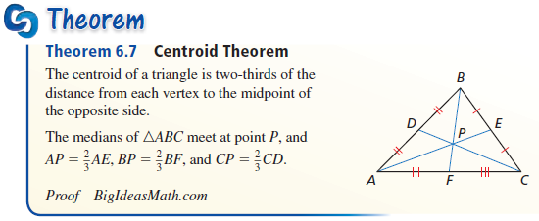
Theorems
Centroid Theorem – The centroid of a triangle is located two thirds of the distance from a vertex to the midpoint of the side opposite the vertex on a median. Median is split 2/3 (from vertex) and 1/3 (from side)

Slide 5
Triangles – Medians
A
Note: from Centroid theorem BM = 2/3 BZ
Midpoint
of AC
Z
Midpoint
of AB
Centroid
X
M
C
Median
from B
Y
Midpoint
of BC
B
Centroid is the point of balance in any triangle

Slide 6
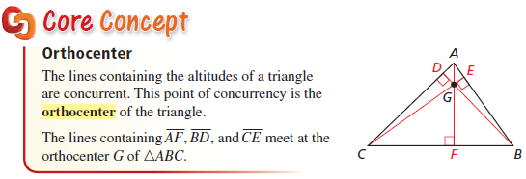
Orthocenter
Orthocenter – holds no special interest for us

Slide 7
Triangles – Altitudes
A
Note: Altitude is the shortest distance from a vertex to the line opposite it
Z
Altitude
from B
C
Orthocenter
X
Y
B
Orthocenter has no special significance for us

Slide 8
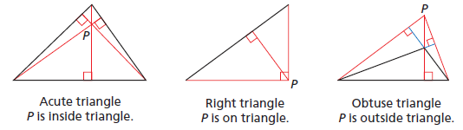
Orthocenter Location
Location: Inside triangle for acute triangles
At 90 angle vertex for right triangles
Outside triangle for obtuse triangles

Slide 9
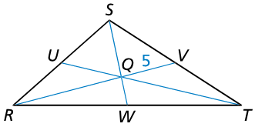

Example 1
In $∆RST$, point $Q$ is the centroid, and $VQ=5$. Find $RQ$ and $RV$.
Answer:
If VQ (1/3) = 5,
then RQ (2/3) = 10
and RV = 5 + 10 = 15

Slide 10

Example 2
Find the coordinates of the centroid of $∆ABC$ with vertices $A(0, 4)$, $B(−4, −2)$, and $C(7, 1)$.
y
Answer:
Find Midpoints:
AB: (-2, 1)
BC: (1.5, -0.5)
AC: (3.5, 2.5)
Use convenient one to find centroid
C to AB is 9
1/3(9) = 3
A
x
C
B

Slide 11

Example 3
Find the coordinates of the orthocenter of $∆DEF$ with vertices $D(0, 6)$, $E(−4, −2)$, and $F(4, 6)$.
y
Answer:
x

Slide 12
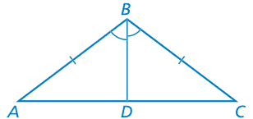
Example 4
Prove that the bisector of the vertex angle of an isosceles triangle is an altitude.
Answer:
Statements | Reasons
ABC is isosceles | Given
AB ≅ AC | Definition of Isosceles
BD is an angle bisector | Given
∠ABD ≅ ∠DBC | Definition of Angle Bisector
BD ≅ BD | Reflexive
ΔABD ≅ ΔCBD | SAS
∠ABD ≅ ∠DBC | CPCTC
∠ABD and ∠DBC are linear pairs | Linear Pair Definition
∠ABD = ∠DBC = 90 | 2 congruent angles add to 180
BD is an altitude | Altitude Definition

Slide 13
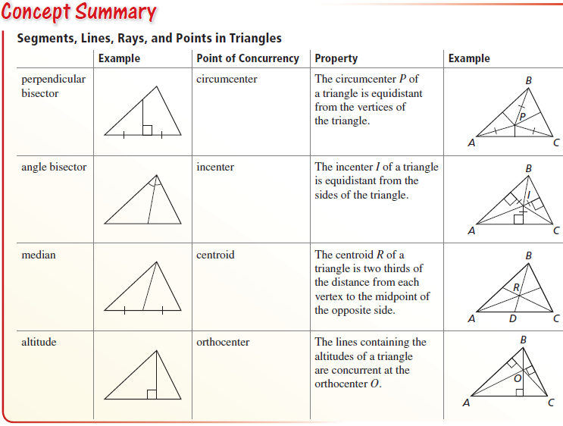
Summary of Special Segments

Slide 14
Special Segments in Triangles
Name | Type | Point of Concurrency | Center Special Quality | From / To
Perpendicular bisector | Line, segment or ray | Circumcenter | Equidistant from vertices | None midpoint of segment
Angle bisector | Line, segment or ray | Incenter | Equidistant from sides | Vertex none
Median | segment | Centroid | Center of Gravity | Vertex midpoint of segment
Altitude | segment | Orthocenter | none | Vertex none

Slide 15
Location of Point of Concurrency
Name | Point of Concurrency | Triangle Classification
 |  | Acute | Right | Obtuse
Perpendicular bisector | Circumcenter | Inside | hypotenuse | Outside
Angle bisector | Incenter | Inside | Inside | Inside
Median | Centroid | Inside | Inside | Inside
Altitude | Orthocenter | Inside | Vertex - 90 | Outside

Slide 16
Example 5
Identify each special segment in the triangle
Perpendicular bisector
Angle bisector
Median
Altitude
D
RM
right angle at a midpoint
DT
M
R
cuts angle in half
S
FM
from vertex to midpoint
E
T
F
ES
from vertex with right angle

Slide 17
Summary & Homework
Summary:
  Medians and altitudes of a triangle are all special segments in triangles
  Altitudes form right angles
  Medians go to midpoints
    Centroid is the balance point or center of gravity
    Located 2/3 the distance from the vertex
Homework:
  Part 2 of Special Segments WS

