Slide 1
Lesson 6-4
Using Triangle Midsegment Theorem

Slide 2
Objectives
Use midsegments of triangles in the coordinate plane
Use the Triangle Midsegment Theorem to find distances

Slide 3
Vocabulary
Midsegment of a triangle – a segment that connects the midpoints of two sides of the triangle

Slide 4
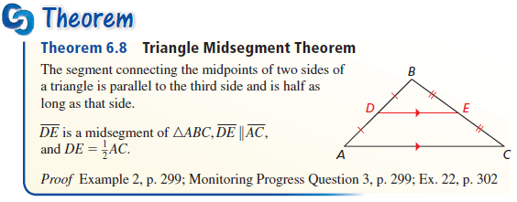
Theorems
Midsegment
  is half the base that it is parallel to
  Makes a triangle that is half the size of the original
  Seen again in similar triangles chapter

Slide 5
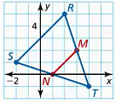
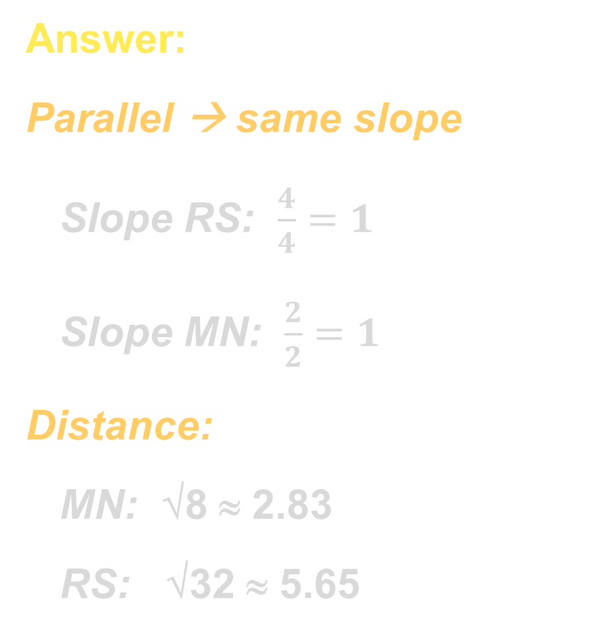

Example 1
In $∆RST$, show that midsegment $\overline{MN}$ is parallel to $\overline{RS}$ and that $MN=\frac{1}{2}RS$.
Answer:
Parallel → same slope
Slope RS: $\frac{4}{4}=1$
Slope MN: $\frac{2}{2}=1$
Distance:
MN: √8 ≈ 2.83
RS: √32 ≈ 5.65

Slide 6
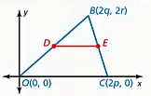

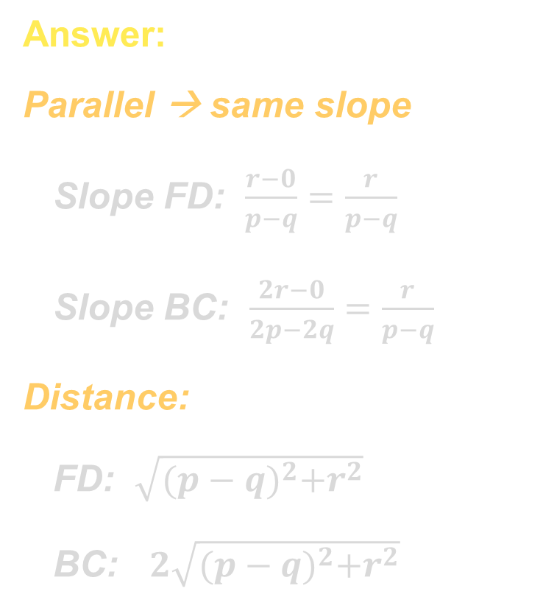
Example 2
Use the diagram to find the coordinates of $F$, the midpoint of $\overline{OC}$. Show that $\overline{FD}∥\overline{BC}$ and $FD=\frac{1}{2}BC$.
Answer:
Parallel → same slope
Slope FD: $\frac{r−0}{p−q}=\frac{r}{p−q}$
Slope BC: $\frac{2r−0}{2p−2q}=\frac{r}{p−q}$
Distance:
FD: $\sqrt{{(p−q)}^{2}+r^{2}}$
BC: $2\sqrt{{(p−q)}^{2}+r^{2}}$
D (q, r)
F (p, 0)

Slide 7
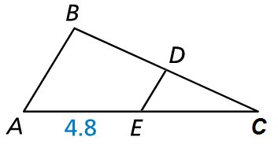
Example 3
$\overline{DE}$ is a midsegment of $∆ABC$. Find $AC$.
Answer:
E is the midpoint of AC,
So AC = 2AE = 9.6

Slide 8
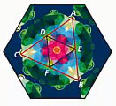

Example 4
In the figure, $CF=FB$ and $CD=DA$. Which segments must be parallel?
Answer:
DF is a midsegment and must be parallel to AB
We know nothing about E as a midpoint, so that’s it.

Slide 9
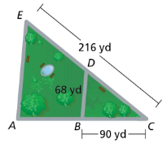

Example 5
A walking path $\overline{BD}$ in a park intersects the sides of the park at their midpoints. You walk from park corner $A$ to walking path $\overline{BD}$, over the path to the other side of the park, up to corner $E$, and then back down to your starting point. How many yards do you walk?
Answer:
Path = AB + BD + DE + EA
Path = 90 + 68 + (216/2) + 2(68)
= 90 + 68 + 108 + 136
= 402 yds

Slide 10
Summary & Homework
Summary:
  Midsegments are parallel to the side that they don’t intersect
  Midsegements are half the side that they are parallel to
  Divide triangle into a triangle half the size of the original triangle (and a trapezoid)
Homework:
  Part 2 of Special Segments WS

