Slide 1
Lesson 6-5
Indirect Proof and Inequalities in One Triangle

Slide 2
Objectives
Write indirect proofs
List sides and angles of a triangle in order by size
Use the Triangle Inequality Theorem to find possible side lengths of triangle

Slide 3
Vocabulary
Indirect proof – make a temporary assumption that the desired conclusion is false

Slide 4
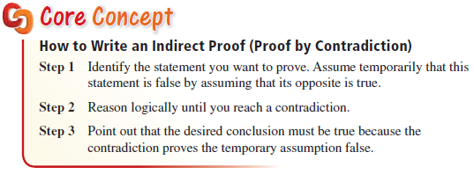
Indirect Proof
Indirect Proof
  Not seen in SOL

Slide 5
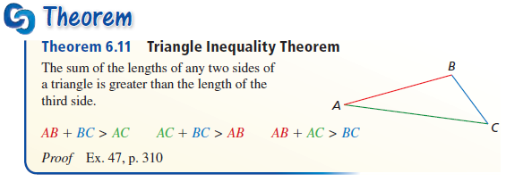
Theorem
When given three sides, to see if it makes a triangle,
small + medium > large
When given two sides, then the third side must be between
large – small < 3rd side < large + small

Slide 6
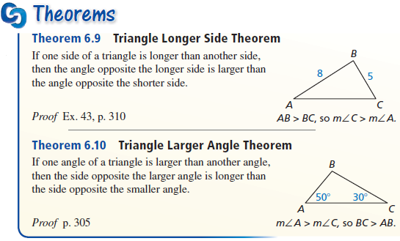
Theorem
See method on next slide

Slide 7
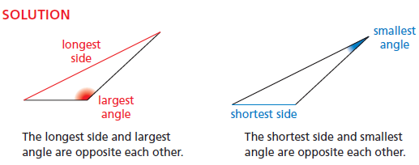
Sides and Angles in Triangles
Order the given in requested order (sm to lg or lg to sm)
Sub (in letters) what those numbers mean
Replace letter(s) with the missing letter(s) of triangle

Slide 8
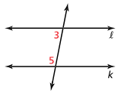
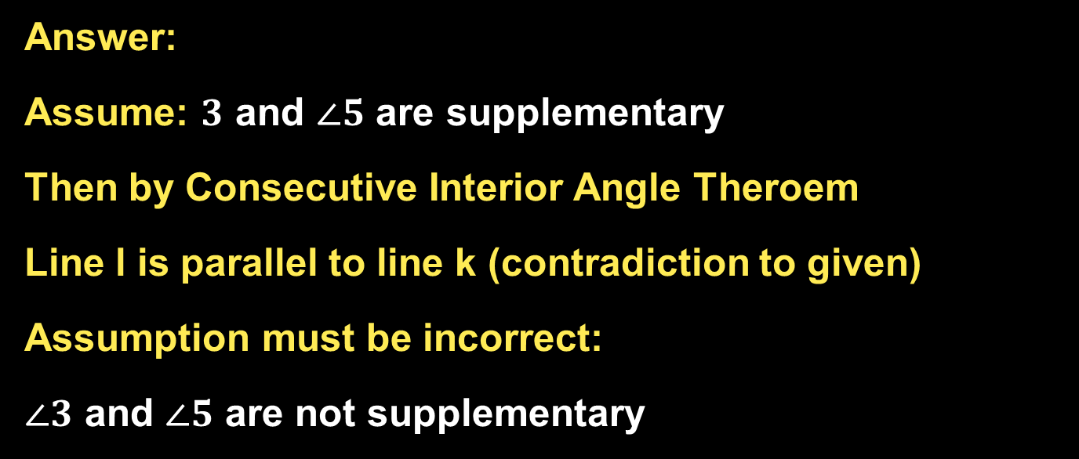

Example 1
Write an indirect proof.
Given: Line $l$ is not parallel to line $k$.
Prove: $∠3$ and $∠5$ are not supplementary.
Answer:
Assume: $3$ and $∠5$ are supplementary
Then by Consecutive Interior Angle Theroem
Line l is parallel to line k (contradiction to given)
Assumption must be incorrect:
$∠3$ and $∠5$ are not supplementary

Slide 9
Example 2
Draw an obtuse triangle. Find the largest angle and longest side and mark them in red. Find the smallest angle and shortest side and mark them in blue. What do you notice?
Answer:
They are opposite each other

Slide 10
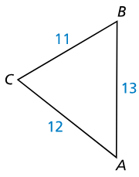

Example 3
List the angles of $∆ABC$ in order from smallest to largest.
Answer:
11 < 12 < 13
BC < AC < AB
∠A < ∠B < ∠C

Slide 11
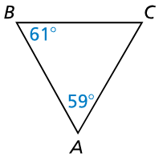

Example 4
List the sides of $∆ABC$ in order from shortest to longest.
Answer:
Find missing angle, C
180 – 59 – 61 = 60
59 < 60 < 61
A < C < B
BC < AB < AC

Slide 12
Example 5
A triangle has one side length 6 and another side of length 15. Describe the possible lengths of the third side.
Answer:
15 – 6 < third side < 15 + 6
9 < third side < 21

Slide 13
Summary & Homework
Summary:
  When given three sides, to see if it makes a triangle, make sure small + medium > large
  When given two sides, then the third side must be between
  large – small < 3rd side < large + small
Homework:
  SOL Worksheet

