Slide 1
Lesson 6-6
Inequalities in Two Triangles

Slide 2
Objectives
Compare measure in triangles
Solve real-life problems using the Hinge Theorem

Slide 3
Vocabulary
None new

Slide 4
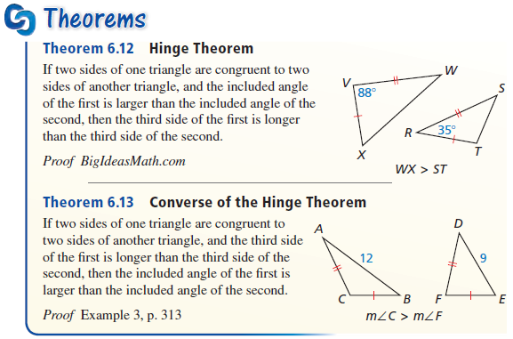
Theorems

Slide 5
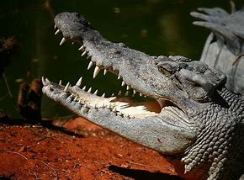
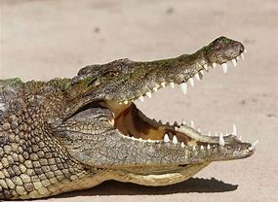
Hinge Theorem
“Virtual Alligator”

Slide 6
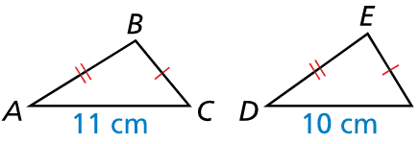

Example 1
Given that $\overline{AB}≅\overline{DE}$ and $\overline{BC}≅\overline{EF}$, how does $m∠B$ compare to $m∠E$?
Answer:
∠B is opposite a larger side (11 > 10) so it is bigger

Slide 7
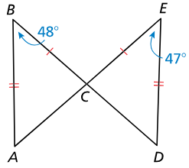

Example 2
Given that $\overline{AB}≅\overline{DE}$ and $\overline{BC}≅\overline{EC}$, how does $AC$ compare to $DC$?
Answer:
Since AC is opposite a bigger angle (48 > 47), then it is bigger

Slide 8
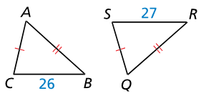

Example 3
What can you conclude about the measures of $∠A$ and $∠Q$ in this figure? Explain.
Answer:
∠Q is opposite a larger side (27 > 26) so it is bigger

Slide 9
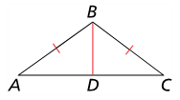

Example 4
Write a paragraph proof.
Given: $\overline{AB}≅\overline{BC}$, $AD>CD$
Prove: $m∠ABD>m∠CBD$
Answer:
Since AB congruent to BC and BD is congruent to itself, then the converse of the hinge theorem would apply. Since AD > CD, then the angle opposite AD must be greater than the angle opposite CD --- m∠ABD > m∠CBD

Slide 10

Example 5
Three groups of bikers leave the same camp heading in different directions. Group A travels $2$ miles due east, then turns $45°$ toward north and travels $1.2$ miles. Group B travels $2$ miles due west, then turns $30°$ toward south and travels $1.2$ miles. Group D travels $2$ miles due south, then turns $25°$ toward east and travels $1.2$ miles. Is Group D farther from camp than Group A, Group B, both groups, or neither group? Explain your reasoning.
Answer:
Since they all have traveled the same first two distances, just at different angles, then the hinge theorem should apply and Group D is farthest (180-25=155), then Group B (180-30=150) and Group A (180-45=135) is the closest.

Slide 11
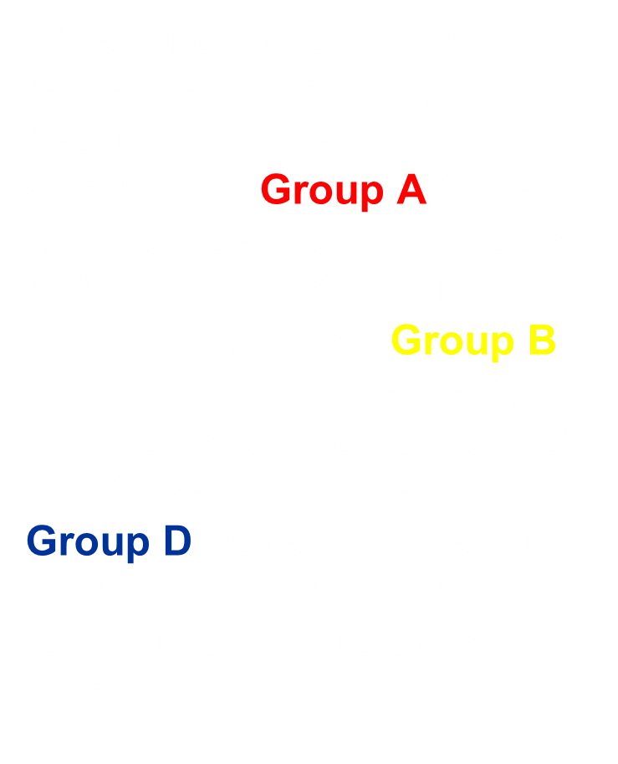
Example 5 cont
Three groups of bikers leave the same camp heading in different directions. Group A travels $2$ miles due east, then turns $45°$ toward north and travels $1.2$ miles. Group B travels $2$ miles due west, then turns $30°$ toward south and travels $1.2$ miles. Group D travels $2$ miles due south, then turns $25°$ toward east and travels $1.2$ miles.
Answer:
y
x

Slide 12
Summary & Homework
Summary:
  All things (sides of angles) being equal in two triangles, then opposite the larger angle is the larger side
  Converse of that is true as well (opposite the larger side must be the larger angle)
Homework:
  Part 2 of Special Segments WS

