Slide 1





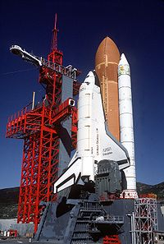




Slide 2
Years ago, the day I taught this lesson, the Big E, the nuclear powered aircraft carrier USS Enterprise retired from active duty and was decommissioned.
These pictures are of ships call the Enterprise, from Revolutionary war days into the future as seen in Star Trek.

Slide 3
Lesson 7-1
Angles of Polygons

Slide 4
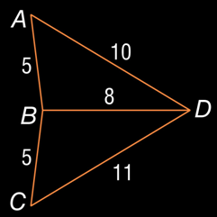
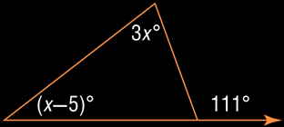
5-Minute Check on Chapter 5
State whether this sentence is always, sometimes, or never true. The three altitudes of a triangle intersect at a point inside the triangle.
Find n and list the sides of ΔPQR in order from shortest to longest if m∠P = 12n – 15, m∠Q = 7n + 26, and m∠R = 8n – 47.
State the assumption you would make to start an indirect proof of the statement. If –2x ≥ 18, then x ≤ –9.
Find the range for the measure of the third side of a triangle given that the measures of two sides are 43 and 29.
Write an inequality relating m∠ABD and m∠CBD.
Write an equation that you can use to find
the measures of the angles of the triangle.
Sometimes – when all angles are acute
all angle add to 180 so n = 8; PQ < QR < PR
x > -9
43 – 29 = 14 < n < 72 = 29 + 43
Since 11 > 10, then m∠ABD < m∠CBD
111 = 3x + (x – 5)
Click the mouse button or press the
Space Bar to display the answers.

Slide 5
Khan Academy Videos for this Lesson
Sum of interior angles of a polygon
Sum of exterior angles of a polygon

Slide 6
Objectives
Use the interior angle measures of polygons
  Sum of Interior angles = (n-2) • 180
  One Interior angle = (n-2) • 180 / n
Use the exterior angle measures of polygons
  Sum of Exterior angles = 360
  One Exterior angle = 360/n
  Exterior angle + Interior angle = 180 (linear pair)

Slide 7
Vocabulary
Convex – no line that contains a side of the polygon goes into the interior of the polygon
Diagonal – a segment of a polygon that joins two nonconsecutive vertices
Equilateral polygon – all sides of the polygon are congruent
Equiangular polygon – all interior angles of the polygon are congruent
Exterior angles – angle outside the polygon formed by an extended side
Interior angles – an angle inside the polygon
Regular polygon – convex polygon that is both equilateral and equiangular

Slide 8
Angles in a Polygon
3
2
4
1
5
Octagon
n = 8
8
6
7
8 triangles @ 180° - 360° (center angles)
= (8-2) • 180 = 1080
Sum of Interior angles = (n-2) • 180

Slide 9
Angles in a Polygon
Sum of Interior Angles:
(n – 2) * 180 where n is number of sides
so each interior angle is (n – 2) * 180
n
Octagon
n = 8
Interior Angle
Sum of Exterior Angles: 360
so each exterior angle is 360
n
Interior Angle + Exterior Angle = 180
Exterior Angle
Octagon
Sum of Exterior Angles: 360
Sum of Interior Angles: 1080
One Interior Angle: 135
One Exterior Angle: 45

Slide 10
Polygons
Sides | Name | Sum of Interior Angles | One Interior Angle | Sum Of Exterior Angles | One Exterior Angles
3 | Triangle | 180 | 60 | 360 | 120
4 | Quadrilateral | 360 | 90 | 360 | 90
5 | Pentagon | 540 | 108 | 360 | 72
6 | Hexagon | 720 | 120 | 360 | 60
7 | Heptagon | 900 | 129 | 360 | 51
8 | Octagon | 1080 | 135 | 360 | 45
9 | Nonagon | 1260 | 140 | 360 | 40
10 | Decagon | 1440 | 144 | 360 | 36
12 | Dodecagon | 1800 | 150 | 360 | 30
n | N - gon | (n-2) * 180 | 180 – Ext ∠ | 360 | 360 ∕ n =

Slide 11
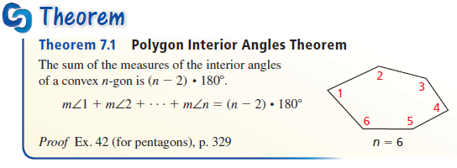
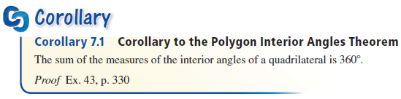
Angle Theorems
Note: Sum of interior angles in a polygon is found by S = (n – 2) × 180°

Slide 12
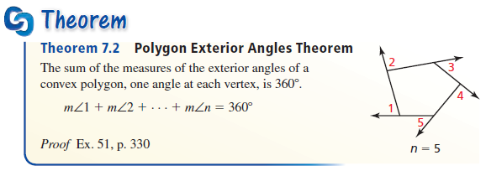
Angle Theorems
Note: Sum of exterior angles in any polygon is 360°

Slide 13
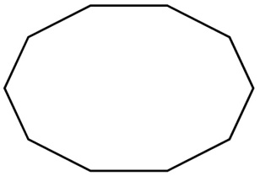
Example 1
Find the sum of the measures of the interior angles of the figure.
Since the figure is a convex decagon, we can use the Polygon Interior Angles Theorem.
$$S = \left(n – 2\right)×180=\left(10−2\right)×180=1440$$
Answer: The sum of the measures of the angles is 1440.

Slide 14

Example 2
The sum of the measures of the interior angles of a convex polygon is 1800°. Classify the polygon by the number of sides.
Since the figure is a convex decagon, we can use the Polygon Interior Angles Theorem.
$$S = \left(n – 2\right)×180 \\ 1800=(n−2)×180 \\ 10=(n−2) \\ 12 = n$$
Answer: The figure is a dodecagon, 12-sided figure.

Slide 15
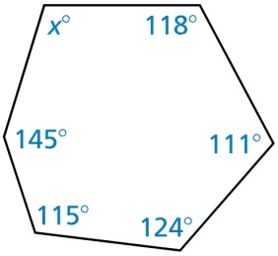
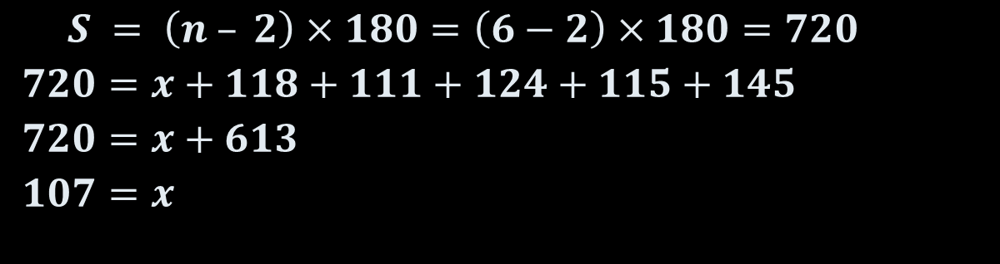
Example 3
Find the value of x in the diagram.
Since the figure is a convex decagon, we can use the Polygon Interior Angles Theorem.
$$S = \left(n – 2\right)×180=\left(6−2\right)×180=720$$
$$720=x+118+111+124+115+145$$
$$720=x+613$$
$$107=x$$
Answer: x = 107.

Slide 16
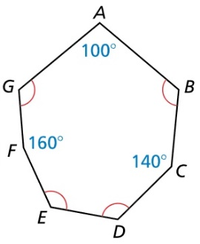
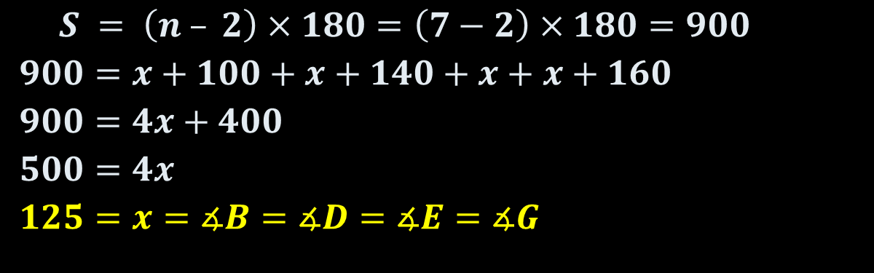
Example 4
Is the polygon regular?
Explain your reasoning
Find the measures of
∠B, ∠D, ∠E, and ∠G.
Answer: no – not all angles =
$$S = \left(n – 2\right)×180=\left(7−2\right)×180=900$$
$$900=x+100+x+140+x+x+160$$
$$900=4x+400$$
$$500=4x$$
$$125=x=∡B=∡D=∡E=∡G$$

Slide 17
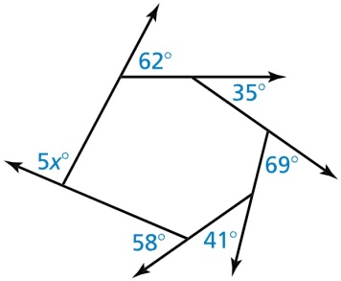
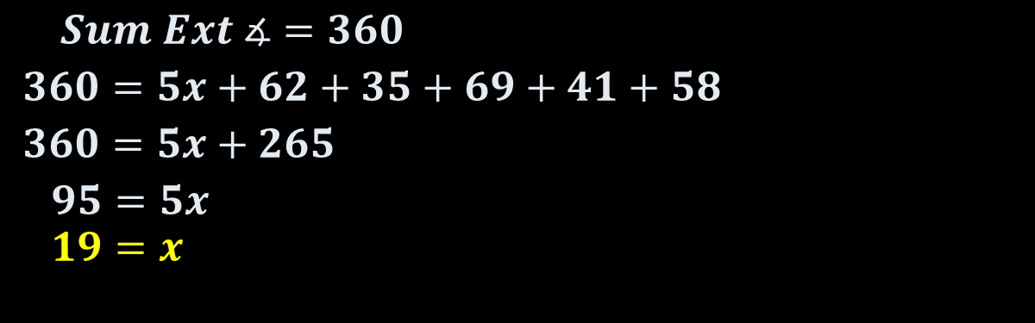
Example 5
Find the value of x in the diagram.
$$Sum Ext ∡=360$$
$$360=5x+62+35+69+41+58$$
$$360=5x+265$$
$$95=5x$$
$$19=x$$
Answer: x = 19

Slide 18

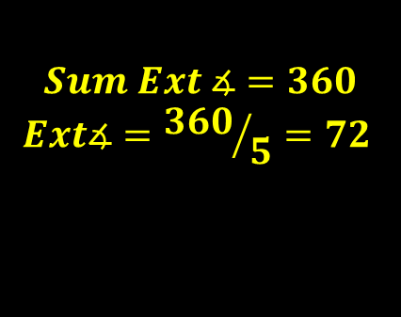

Example 6
Each face of the dodecahedron
is shaped like a regular pentagon.
Find the measure of each interior angle of a regular pentagon.
Find the measure of each exterior angle of a regular pentagon.
$$Int ∡+Ext ∡=180$$
$$Int ∡+72=180$$
$$Int ∡=108$$
$$Sum Ext ∡=360$$
$$Ext∡={360}/5=72$$

Slide 19
Polygon Hierarchy
Polygons
Quadrilaterals
Parallelograms
Kites
Trapezoids
Isosceles
Trapezoids
Rectangles
Rhombi
Squares

Slide 20
Quadrilaterals Venn Diagram
Quadrilaterals
Trapezoids
Parallelograms
Isosceles
Trapezoids
Rhombi
Squares
Rectangles
Kites

Slide 21
Quadrilateral Characteristics Summary
Convex Quadrilaterals
4 sided polygon
4 interior angles sum to 360
4 exterior angles sum to 360
Parallelograms
Trapezoids
Opposite sides parallel and congruent
Opposite angles congruent
Consecutive angles supplementary
Diagonals bisect each other
Bases Parallel
Legs are not Parallel
Leg angles are supplementary
Median is parallel to bases
Median = ½ (base + base)
Rectangles
Rhombi
Isosceles
Trapezoids
Angles all 90°
Diagonals congruent
All sides congruent
Diagonals perpendicular
Diagonals bisect opposite angles
Legs are congruent
Base angle pairs congruent
Diagonals are congruent
Squares
Diagonals divide into 4 congruent triangles

Slide 22
Summary & Homework
Summary:
  If a convex polygon has n sides and sum of the measures of its interior angles is S, then
  S = 180(n-2)°
  The sum of the measures of the exterior angles of a convex polygon is 360°
  Interior angle + Exterior angle = 180 (linear pair)
Homework:
  SOL Polygon’s Angles WS

