Slide 1
Lesson 7-2
Properties of Parallelograms

Slide 2


5-Minute Check on Lesson 6-1
Find the measure of an interior angle given the number of sides of a regular polygon.
10 2. 12
Find the measure of the sums of the interior angles of each convex polygon
3. 20-gon 4. 16-gon
5. Find x, if QRSTU is a regular pentagon
6. What is the measure of an interior angle of a regular hexagon?
8x+12°
Standardized Test Practice:
A
90
B
108
C
120
D
135
Click the mouse button or press the
Space Bar to display the answers.

Slide 3
5-Minute Check on Lesson 6-1
Find the measure of an interior angle given the number of sides of a regular polygon.
10 2. 12
Find the measure of the sums of the interior angles of each convex polygon
3. 20-gon 4. 16-gon
5. Find x, if QRSTU is a regular pentagon
6. What is the measure of an interior angle of a regular hexagon?
144
150
3240
2520
8x+12°
8x + 12 = 108 8x = 96 x = 12
Standardized Test Practice:
A
90
B
108
C
120
D
135
Click the mouse button or press the
Space Bar to display the answers.

Slide 4
Khan Academy Videos for this Lesson
Introduction to Quadrilaterals
Quadrilateral properties

Slide 5
Polygon Hierarchy
Polygons
Quadrilaterals
Parallelograms
Kites
Trapezoids
Isosceles
Trapezoids
Rectangles
Rhombi
Squares

Slide 6
Objectives
Use properties to find side lengths and angles of parallelograms
  Opposite sides equal
  Opposite angles equal
  Consecutive angles supplementary
  Diagonals bisect each other
Use parallelograms in the coordinate plane

Slide 7
Vocabulary
Parallelogram – a quadrilateral with both pairs of opposite sides parallel

Slide 8
Triangles vs Quadrilaterals
In triangles we had 3 sides and 3 angles
In Quadrilaterals we have 4 sides and 4 angles; but we also have something new – 2 diagonals (going from opposite corner to opposite corner)

Slide 9
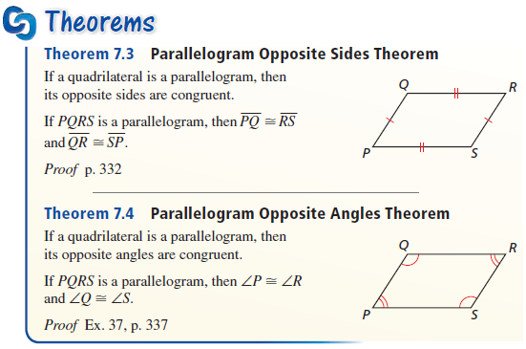
Theorems
Opposite sides or angles congruent

Slide 10
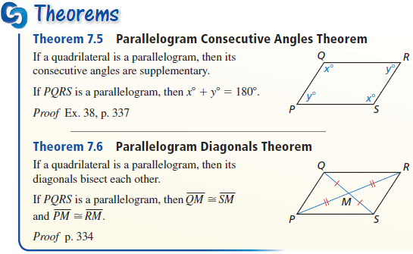
Theorems
Consecutive angles supplementary
Diagonals bisect (cut in half) each other

Slide 11
Parallelograms
A
B
Parallelogram Characteristics
Opposite Sides Parallel
and Congruent
Opposite Angles Congruent
Consecutive ∠’s Supplementary
C
D
A
B
Diagonal Characteristics
Bisect each other (AM=DM, CM=BM)
Not necessarily equal length (AD ≠ BC)
Share a common midpoint (M)
Separates into two congruent ∆’s
(for example ∆ADC ≅ ∆DAB)
M
C
D

Slide 12
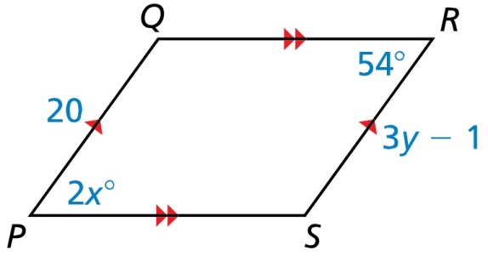
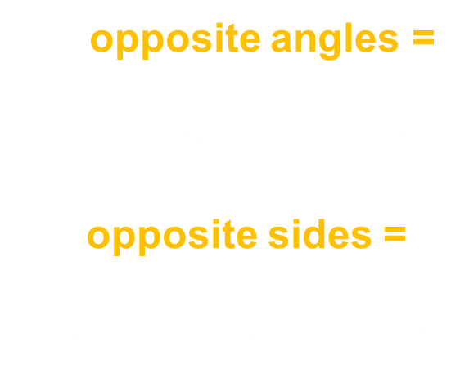
Example 1
Find the values of x and y
X: opposite angles =
$$2x=54 x=27$$
Y: opposite sides =
$$3y−1=20 y=7$$
Answer: x = 27 and y = 7.

Slide 13

Example 2
In parallelogram PQRS, m∠P is four times m∠Q. Find m∠P.
Since they are consecutive angles, they must be supplementary.
$$180 =m∡Q+m∡P \\ 180=x+4x \\ 180=5x \\ 36 =x$$
Answer: m∠P = 144°.

Slide 14
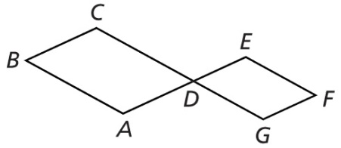

Example 3
Write a two-column proof.
Given: ABCD and GDEF are
parallelograms
Prove: $∠C≅∠G$
Answer:
Statements | Reasons
ABCD is a parallelogram Given
∠C and ∠D are supplementary Properties of Parallelograms
GDEF is a parallelogram Given
∠D and ∠G are supplementary Properties of Parallelograms
∠CDA ≅ ∠EDG Vertical Angle Theorem
∠C ≅ ∠G Supplements Theorem

Slide 15
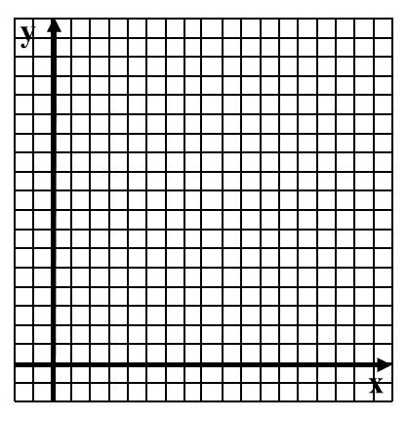
Example 4
Find the coordinates of the intersection of the diagonals of parallelogram ABCD with vertices A(1,0), B(6,0), C(5,3), and D(0,3).
Answer:
(3, 1.5)
6
5
4
3
2
1
1 2 3 4 5 6

Slide 16
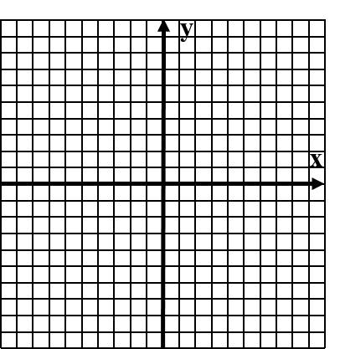
Example 5
Three vertices of parallelogram DEFG are D(-1,4), E(2,3), and F(4,-2). Find the coordinates of vertex G.
Slope from E to D is -1/3
So slope from F to G must be -1/3
G is left 3 and up 1 from F
Answer:
(1 , -1)

Slide 17
Quadrilateral Family Tree
Just like in biology, the characteristics of the parents are passed down to the children, grandchildren, etc.
So the 3 Quadrilateral characteristics:
4 sided polygon
4 interior angles that sum to 360
4 exterior angles that sum to 360
(this last one is true for all polygons)
Are passed down to all children (parallelograms, kites (not on this tree) and trapezoids)

Slide 18
Quadrilateral Characteristics Summary
Convex Quadrilaterals
4 sided polygon
4 interior angles sum to 360
4 exterior angles sum to 360
Parallelograms
Trapezoids
Opposite sides parallel and congruent
Opposite angles congruent
Consecutive angles supplementary
Diagonals bisect each other
Bases Parallel
Legs are not Parallel
Leg angles are supplementary
Median is parallel to bases
Median = ½ (base + base)
Rectangles
Rhombi
Isosceles
Trapezoids
Angles all 90°
Diagonals congruent
All sides congruent
Diagonals perpendicular
Diagonals bisect opposite angles
Legs are congruent
Base angle pairs congruent
Diagonals are congruent
Squares
Diagonals divide into 4 congruent triangles

Slide 19
Summary & Homework
Summary:
  In a parallelogram:
  opposite sides are parallel and congruent,
  opposite angles are congruent, and consecutive angles are supplementary
  Diagonals of a parallelogram bisect each other.
Homework:
  Parallelogram Characteristics and Problems on Quadrilateral Worksheet

