Slide 1
Lesson 7-3
Proving a Quadrilateral is a Parallelogram

Slide 2


5-Minute Check on Lesson 6-2
Complete each statement about parallelogram ABCD
1. AB ≅ ______
2. AD ≅ ______
3. ∠D ≅ ______
In the figure RSTU is a parallelogram
Find the indicated value.
4. x 5. y
6. Which congruence statement is not necessarily true, if WXYZ is a parallelogram?
A
B
D
C
R
6(x+5)
S
(12y+19)°
(8y+1)°
T
U
12x+6
Standardized Test Practice:
W
X
A
WZ ≅ XZ
B
WX ≅ YZ
C
∠W ≅ ∠Y
D
∠X ≅ ∠Z
Z
Y
Click the mouse button or press the
Space Bar to display the answers.

Slide 3
5-Minute Check on Lesson 6-2
Complete each statement about parallelogram ABCD
1. AB ≅ ______
2. AD ≅ ______
3. ∠D ≅ ______
In the figure RSTU is a parallelogram
Find the indicated value.
4. x 5. y
6. Which congruence statement is not necessarily true, if WXYZ is a parallelogram?
A
B
DC
Opposite sides are congruent
BC
Opposite sides are congruent
D
C
∠D
Opposite angles are congruent
R
6(x+5)
S
(12y+19)°
(8y+1)°
T
4
8
U
12x+6
Standardized Test Practice:
W
X
A
WZ ≅ XZ
B
WX ≅ YZ
C
∠W ≅ ∠Y
D
∠X ≅ ∠Z
Z
Y
Click the mouse button or press the
Space Bar to display the answers.

Slide 4
Objectives
Identify and verify parallelograms
Show that a quadrilateral is a parallelogram in the coordinate plane
  A quadrilateral is a parallelogram if any of the following is true:
    Both pairs of opposite sides are parallel
    Both pairs of opposite sides are congruent
    Both pairs of opposite angles are congruent
    Diagonals bisect each other
    A pair of opposite sides is both parallel and congruent

Slide 5
Khan Academy Videos for this Lesson
Opposite sides of a parallelogram proof
Opposite angles of a parallelogram proof

Slide 6
Vocabulary
None new

Slide 7
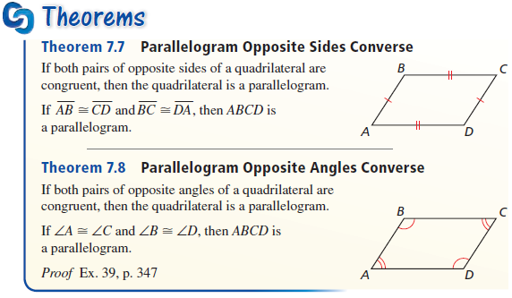
Theorems
If both pairs of opposite sides or angles are congruent, then it’s a parallelogram

Slide 8
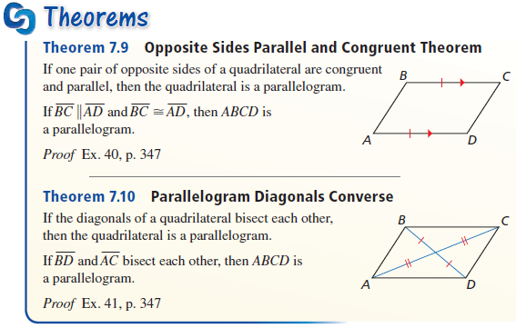
Theorems
If opposite sides are both parallel and congruent or if diagonals bisect each other, then it’s a parallelogram

Slide 9
Tests for Parallelograms
A
B
M
Quadrilateral is a Parallelogram
(if any of the following are true):
a) Both Pairs of Opposite Sides Are Parallel
b) Both Pairs of Opposite Sides Are Congruent
c) A Pair of Opposite Sides Is Both Parallel and Congruent
d) Both Pairs of Opposite Angles Are Congruent
e) Diagonals Bisect Each Other
C
D

Slide 10
Example 1
In quadrilateral ABCD, AB = BC and CD = AD. Is ABCD a parallelogram? Explain your reasoning.
Consecutive sides are equal, not opposite sides; might be a kite.
Answer: no

Slide 11
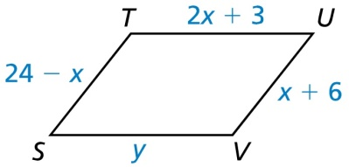
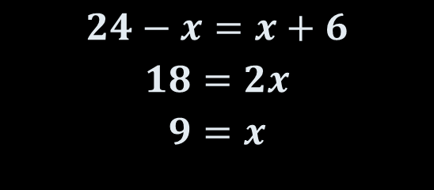
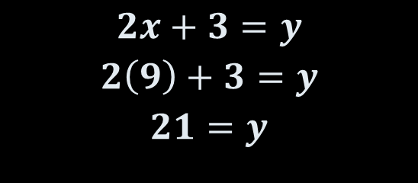
Example 2
For what values of x and y is quadrilateral STUV a parallelogram?
$$24−x=x+6$$
$$18=2x$$
$$9=x$$
$$2x+3=y$$
$$2\left(9\right)+3=y$$
$$21=y$$
Answer: x = 9; y = 21

Slide 12
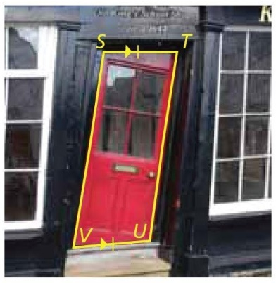
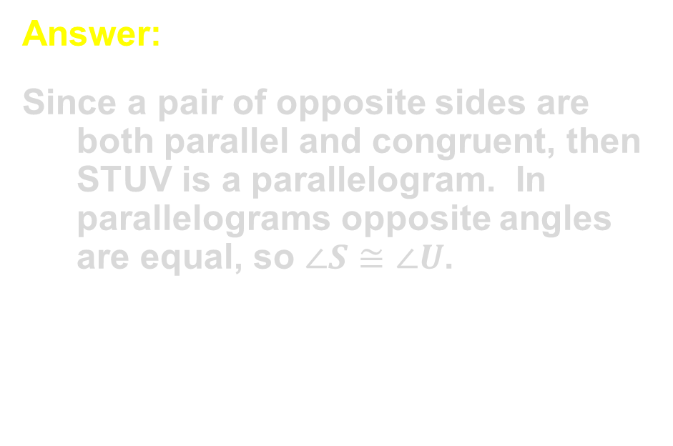

Example 3
Use the photograph to the right. Explain how you know that $∠S≅∠U$.
Answer:
Since a pair of opposite sides are both parallel and congruent, then STUV is a parallelogram. In parallelograms opposite angles are equal, so $∠S≅∠U$.

Slide 13
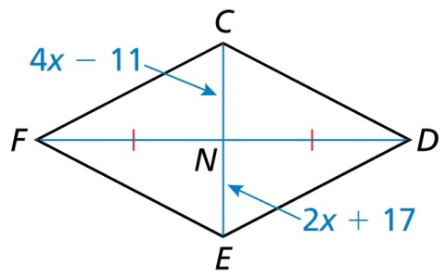
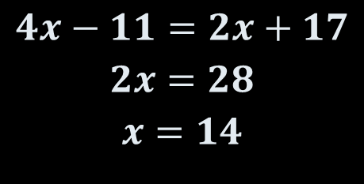
Example 4
For what value of x is quadrilateral CDEF a parallelogram?
$$4x−11=2x+17$$
$$2x=28$$
$$x=14$$
Answer: x = 14; diagonals have to bisect each other.

Slide 14
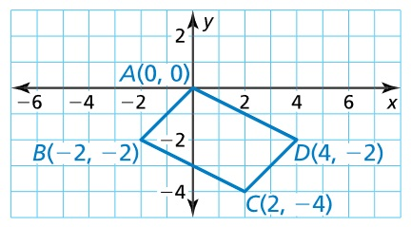
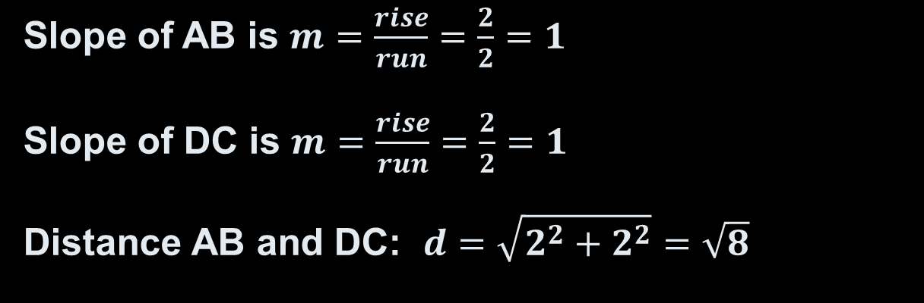
Example 5
Show that quadrilateral ABCD is a parallelogram.
Answer:
Opposite sides parallel (same slope) and congruent
Slope of AB is $m=\frac{rise}{run}=\frac{2}{2}=1$
Slope of DC is $m=\frac{rise}{run}=\frac{2}{2}=1$
Distance AB and DC: $d=\sqrt{2^{2}+2^{2}}=\sqrt{8}$

Slide 15
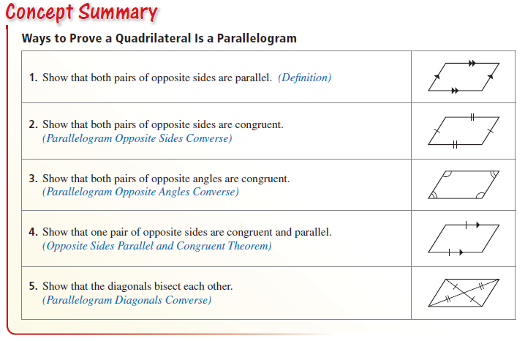
Concept Summary

Slide 16
Summary & Homework
Summary:
  A quadrilateral is a parallelogram if any of the following is true:
    Both pairs of opposite sides are parallel and congruent
    Both pairs of opposite angles are congruent
    Diagonals bisect each other
    A pair of opposite sides is both parallel and congruent
Homework:
  Quadrilateral WS

