Slide 1
Lesson 7-4
Properties of Special Parallelograms:
Rectangles, Squares and Rhombi

Slide 2
5-Minute Check on Lesson 6-3
Determine whether each quadrilateral is a parallelogram.
Justify your answer.
2.
Determine whether the quadrilateral with the given vertices is a parallelogram using the method indicated.
3. A(,), B(,), C(,), D(,) Distance formula
4. R(,), S(,), T(,), U(,) Slope formula
5. Which set of statements
will prove LMNO a parallelogram?
L
M
Standardized Test Practice:
O
N
A
LM // NO and LO ≅ MN
B
LO // MN and LO ≅ MN
C
LM ≅ LO and ON ≅ MN
D
LO ≅ MN and LO ≅ ON
Click the mouse button or press the
Space Bar to display the answers.

Slide 3
5-Minute Check on Lesson 6-3
Determine whether each quadrilateral is a parallelogram.
Justify your answer.
2.
Determine whether the quadrilateral with the given vertices is a parallelogram using the method indicated.
3. A(,), B(,), C(,), D(,) Distance formula
4. R(,), S(,), T(,), U(,) Slope formula
5. Which set of statements
will prove LMNO a parallelogram?
Yes, diagonal bisect each other
Yes, opposite angles congruent
Yes, opposite sides equal
No, RS not // UT
L
M
Standardized Test Practice:
O
N
A
LM // NO and LO ≅ MN
B
LO // MN and LO ≅ MN
C
LM ≅ LO and ON ≅ MN
D
LO ≅ MN and LO ≅ ON
Click the mouse button or press the
Space Bar to display the answers.

Slide 4
Khan Academy Videos
None currently pertain to this lesson

Slide 5
Objectives
Use properties of special parallelograms
Use properties of diagonals of special parallelograms
Use coordinate geometry to identify special types of parallelograms

Slide 6
Vocabulary
Rectangle – a parallelogram with four right angles
Rhombus – a parallelogram with four congruent sides
Square – a parallelogram with four congruent sides and four right angles

Slide 7
Polygon Hierarchy
Polygons
Quadrilaterals
Parallelograms
Kites
Trapezoids
Isosceles
Trapezoids
Rectangles
Rhombi
Squares

Slide 8
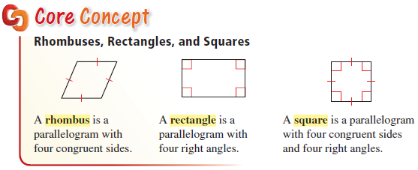
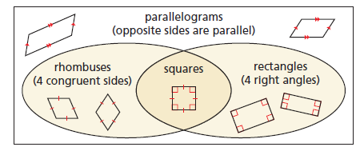
Special Parallelograms

Slide 9
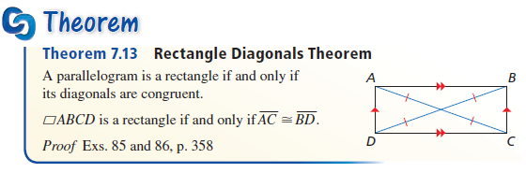
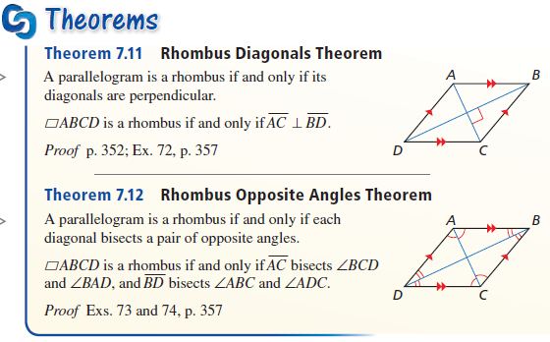
Diagonal Theorems

Slide 10
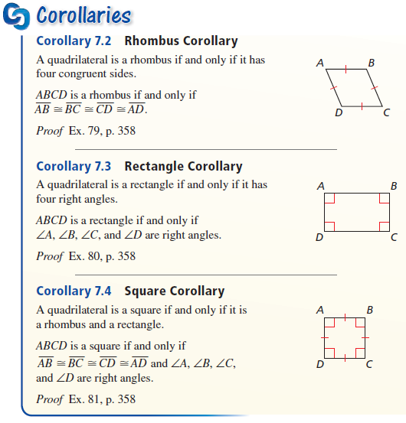
Corollaries

Slide 11
Example 1
For any rectangle ABCD, decide whether the statement is always or sometimes true. Explain your reasoning.
AB = BC
AB = CD
Only true if the rectangle is a square.
Always true; opposite sides congruent
Answer: Maybe and always

Slide 12
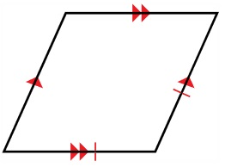
Example 2
Classify the special quadrilateral. Explain your reasoning.
Opposite sides are parallel → parallelogram
Consecutive sides are congruent → all four sides are congruent, but corner angles are not right angles ➔ rhombus
Answer: Rhombus

Slide 13
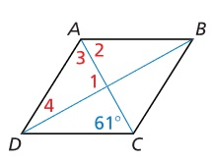
Example 3
Find the m∠ABC and m∠ACB in the rhombus ABCD
Answer:
∠ABC = 180 – 2(61) = 180 – 122 = 58°
∠ACB = 61° diagonals are angle bisectors

Slide 14
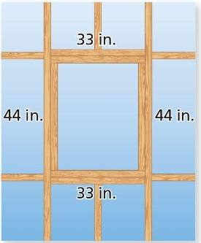
Example 4
Suppose you measure one angle of the window opening and its measure is 90°. Can you conclude that the shape of the opening is a rectangle? Explain.
Answer:
Since opposite sides have been measured congruent, it is a parallelogram. Parallelograms have opposite angles congruent and consecutive angles supplementary, so if one angle is 90°, then all angles have to be 90°

Slide 15
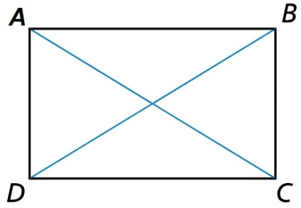

Example 5
In rectangle ABCD,
AC = 7x – 15 and BD = 2x + 25. Find the lengths of the diagonals of ABCD.
$$7x−15=2x+25$$
$$5x=40$$
$$x=8$$
Diagonals congruent:
Answer: AC = 41 = BD

Slide 16
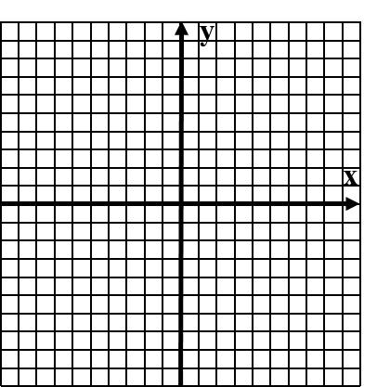
Example 6
Decide whether quadrilateral ABCD with vertices A(-2,3), B(2,2), C(1,-2), and D(-3,-1) is a rectangle, a rhombus, or a square. Give all names that apply.
Answer:
Opposite sides parallel (same slopes) → parallelogram
All four sides congruent → rhombus
Consecutive sides are perpendicular (negative reciprocals of each other) → corner angles are 90° → square
And must be rectangle as well

Slide 17
Quadrilateral Family Tree
In the following chart, remember that a figure has its own unique characteristics and all of the characteristics above it in the family tree.
Quadrilaterals: 3 unique and 2 from all polygons (5)
Parallelograms: 4 unique and 5 from “parents” (9)
Rectangles: 2 unique and 9 from “parents” (11)
Rhombi: 4 unique and 9 from “parents” (13)
Squares: no unique and 15 from “parents” (15)
Remember this when filling out the 85 checkmarks on the Quadrilateral Characteristics worksheet.

Slide 18
Quadrilateral Characteristics Summary
Convex Quadrilaterals
4 sided polygon
4 interior angles sum to 360
4 exterior angles sum to 360
Parallelograms
Trapezoids
Opposite sides parallel and congruent
Opposite angles congruent
Consecutive angles supplementary
Diagonals bisect each other
Bases Parallel
Legs are not Parallel
Leg angles are supplementary
Median is parallel to bases
Median = ½ (base + base)
Rectangles
Rhombi
Isosceles
Trapezoids
Angles all 90°
Diagonals congruent
All sides congruent
Diagonals perpendicular
Diagonals bisect opposite angles
Diagonals divide into 4 congruent triangles
Legs are congruent
Base angle pairs congruent
Diagonals are congruent
Squares

Slide 19
Summary & Homework
Summary:
  Rectangle: A parallelogram with four right angles and congruent diagonals
  Rhombus: A parallelogram with four congruent sides, diagonals that are perpendicular bisectors to each other and angle bisectors of corner angles
  Square: All rectangle and a rhombus characteristics
Homework:
  Quadrilateral Worksheet

