Slide 1
Lesson 7-5
Properties of Trapezoids and Kites

Slide 2
5-Minute Check on Lesson 6-5
LMNO is a rhombus.
Find x
Find y
QRST is a square.
Find n if m∠TQR = 8n + 8.
Find w if QR = 5w + 4 and RS = 2(4w – 7).
Find QU if QS = 16t – 14 and QU = 6t + 11.
6. What property applies to a square, but not to a rhombus?
L
(3x + 12)°
(8y – 6)°
7
O
P
M
12
(5x – 2)°
N
10.25
Q
R
6
U
65
T
S
Standardized Test Practice:
A
Opposite sides are congruent
C
Diagonals bisect each other
B
D
Opposite angles are congruent
D
All angles are right angles
Click the mouse button or press the
Space Bar to display the answers.

Slide 3
Khan Academy Videos for this lesson
Kites as a geometric shape

Slide 4
Objectives
Use properties of trapezoids
Use the Trapezoid Midsegment Theorem to find distance
Use properties of kites
Identify quadrilaterals

Slide 5
Vocabulary
Bases – parallel sides of a trapezoid
Base angles – consecutive angles whose common side is the base of the trapezoid
Isosceles trapezoid – legs of the trapezoid are congruent
Kite – a quadrilateral that has two pairs of consecutive congruent sides, but opposite sides are not congruent
Legs – nonparallel sides of the trapezoid
Midsegment of a trapezoid – segment that connects the legs of the trapezoid; parallel to the bases
Trapezoid – a quadrilateral with exactly one pair of parallel sides

Slide 6
Polygon Hierarchy
Polygons
Quadrilaterals
Parallelograms
Kites
Trapezoids
Isosceles
Trapezoids
Rectangles
Rhombi
Squares

Slide 7
Trapezoids
Trapezoid Characteristics
Bases Parallel
Legs are not Parallel
Leg angles are supplementary
(m∠A + m∠C = 180, m∠B + m∠D = 180)
Midsegment is parallel to bases
Midsegment = ½ (base + base)
½(AB + CD)
A
base
B
leg
midpoint
leg
midpoint
midsegment
C
D
base
Base angles
A
B
Isosceles Trapezoid Characteristics
Legs are congruent (AC ≅ BD)
Base angle pairs congruent (∠A ≅ ∠B, ∠C ≅ ∠D)
Diagonals are congruent (AD ≅ BC)
M
C
D
Base angles

Slide 8
Kites Characteristics
A
Two pairs of consecutive sides congruent
AB ≅ AD and CB ≅ CD
Diagonals are perpendicular AC ⊥ BD
Diagonals are angle bisectors
∠BAC ≅ ∠DAC and ∠ABD ≅ ∠CBD
∠ADB ≅ ∠BDC and ∠BCA ≅ ∠DCA
Diagonal from noncongruent angles bisects other
diagonal diagonal BD is cut in half
Only one pair of opposite angles are congruent
(the pair of angles formed by the non-congruent sides)
∠ABC ≅ ∠ADC
B
D
C

Slide 9
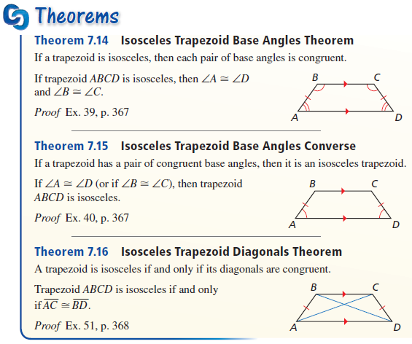
Theorems

Slide 10
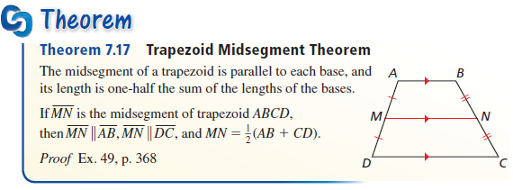
Theorems
Midsegment is:
Parallel to the bases
Halfway between the bases
The average of the bases – ½ (b1 + b2)

Slide 11
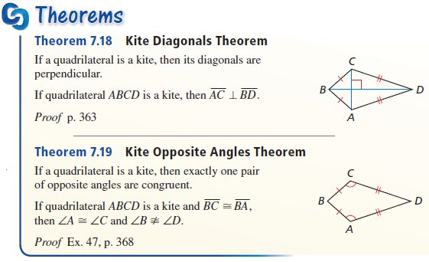
Kite Theorems

Slide 12
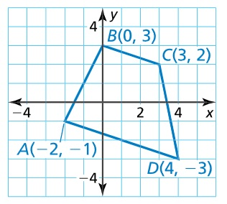

Example 1
Show that ABCD is a trapezoid and decide whether it is isosceles.
Bases have to be parallel; slope of $BC = \frac{−1}{3}$
Slope of $AD =\frac{−2}{6}=\frac{−1}{3}$ ; slopes are equal
Not isosceles; sides not equal $AB=\sqrt{20}, DC=\sqrt{26}$
Answer: Trapezoid, but not isosceles

Slide 13
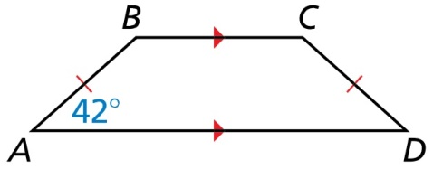
Example 2
ABCD is an isosceles trapezoid, and m∠A = 42°. Find m∠B, m∠C, and m∠D.
Answer:
Isosceles means base angles congruent;
m∠A = m∠D and m∠B = m∠C
Leg angles are supplementary; m∠B = 180 – m∠A
m∠B = 138°, m∠C = 138°, and m∠D = 42°

Slide 14
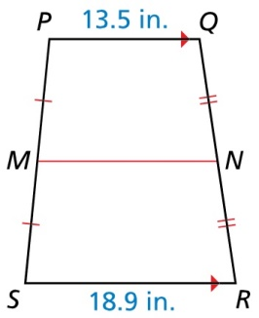


Example 3
In the diagram, $\overline{MN}$ is the midsegment of trapezoid PQRS. Find MN.
Answer:
$$MN = \frac{18.9+13.5}{2}=\frac{32.4}{2}=16.2$$

Slide 15
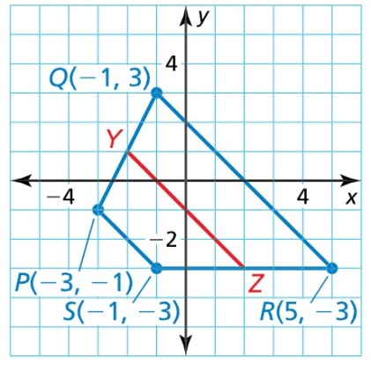




Example 4
Find the length of midsegment $\overline{YZ}$ in trapezoid PQRS
Answer:
$$QR=\sqrt{6^{2}+6^{2}}=\sqrt{72}=8.49$$
$$PS=\sqrt{2^{2}+2^{2}}=\sqrt{8}=2.83$$
$$YZ =\frac{PS+QR}{2}=\frac{2.83+8.49}{2}=\frac{11.32}{2}=5.66$$

Slide 16
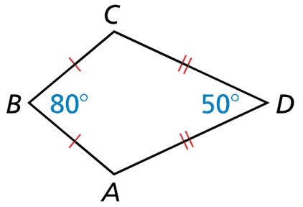

Example 5
Find m∠C in the kite shown.
Answer:
$$∠C=\frac{360−(80+50)}{2}=115°$$

Slide 17
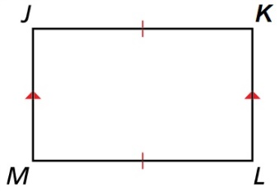
Example 6
What is the most specific name for quadrilateral JKLM?
Answer:
Isosceles Trapezoid → bases parallel (not marked congruent); and legs are marked congruent

Slide 18
Quadrilateral Family Tree
In the following chart, remember that a figure has its own unique characteristics and all of the characteristics above it in the family tree.
Kites: 2 unique and 5 from “parents” (7)
Trapezoids: 5 unique and 5 from “parents” (10)
Isosceles Trapeziod: 3 unique and 10 from “parents” (13)
Remember this when filling out the 85 checkmarks on the Quadrilateral Characteristics worksheet.

Slide 19
Quadrilateral Characteristics Summary
Convex Quadrilaterals
4 sided polygon
4 interior angles sum to 360
4 exterior angles sum to 360
Parallelograms
Trapezoids
Opposite sides parallel and congruent
Opposite angles congruent
Consecutive angles supplementary
Diagonals bisect each other
Kites
Bases Parallel
Legs are not Parallel
Leg angles are supplementary
Median is parallel to bases
Median = ½ (base + base)
2 congruent sides (consecutive)
Diagonals perpendicular
Diagonals bisect opposite angles
One diagonal bisected
One pair of opposite angle congruent
Rectangles
Rhombi
Isosceles
Trapezoids
Angles all 90°
Diagonals congruent
All sides congruent
Diagonals perpendicular
Diagonals bisect opposite angles
Squares
Legs are congruent
Base angle pairs congruent
Diagonals are congruent
Diagonals divide into 4 congruent triangles

Slide 20
Summary & Homework
Summary:
  In an isosceles trapezoid, both pairs of base angles are congruent and the diagonals are congruent.
  The median of a trapezoid is parallel to the bases and its measure is one-half the sum of the measures of the bases
  Kites have diagonals perpendicular and “arm” angles congruent
Homework:
  Quadrilateral Worksheet

