Slide 1
Lesson 7-6
Tessellations

Slide 2
Khan Academy Videos for this Lesson
None currently

Slide 3
Objectives
Determine whether a shape tessellates
Find angle measures in tessellations of polygons
Determine whether a regular polygon tessellates a plane

Slide 4
Vocabulary
Regular tessellation – a transformation that enlarges or reduces an image
Tessellation – the covering of a plane with figures so that there are no gaps or overlaps

Slide 5
Tessellations
Tessellation – a pattern using polygons that covers a plane so that there are no overlapping or empty spaces
“Squares” on the
coordinate plane
Hexagons from many
board games
Tiles on a bathroom floor
y
x
Not a regular or semi-regular tessellation because the figures
are not regular polygons

Slide 6
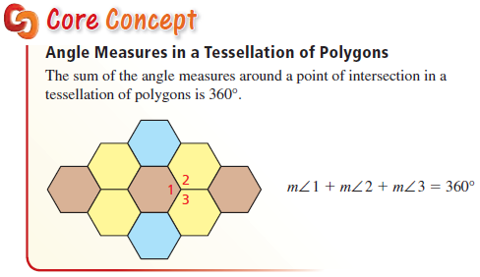
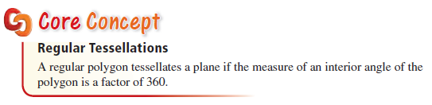
Tessellations

Slide 7
Tessellation Key Concepts
Tessellations have no gaps or overlaps
  Gap: angles add to less than 360
  Overlap: angles add to greater than 360
Only Regular figures that tessellate:
  Triangle 6 60° angles = 360
  Square 4 90° angles = 360
  Hexagon 3 120° angles = 360

Slide 8
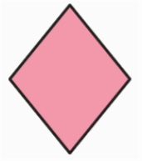

Example 1
Determine whether each shape tessellates
Answer: Rhombus – yes; crescent – no

Slide 9
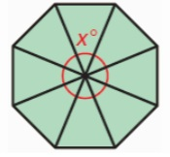
Example 2a
Find x in each tessellation
Answer:
X = 360/8 = 45° (Exterior angle of an octagon)

Slide 10
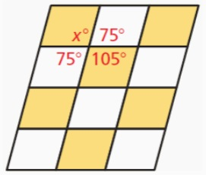
Example 2b
Find x in each tessellation
Answer:
x = 105°; (x = 360 – 75 – 105 – 75)
(also a vertical angle with 105)

Slide 11
Example 3
Determine whether each polygon tessellates
a) Equilateral triangle
b) Regular 13-sided polygon
c) Regular 14-sided polygon
Answer: yes
Answer: no
Answer: no

Slide 12
Summary & Homework
Summary:
  A tessellation is a repetitious pattern that covers a plane without overlaps or gaps
  Only 3 regular polygons tessellate the plane
    Triangle (Equilateral)
    Quadrilateral (Square)
    Hexagon
  Other nonregular polygons can tessellate: rectangles, right isosceles triangle for example
Homework:
  pg TBD

