Slide 1
Lesson 8-1
Similar Polygons

Slide 2
Khan Academy Videos for this lesson
Similar shapes and transformations
Introduction to triangle similarity

Slide 3
Objectives
Use similarity statements
Find corresponding lengths in similar polygons
Find perimeters and area of similar polygons
Decide whether polygons are similar

Slide 4
Vocabulary
Ratio: a comparison of two quantities (a:b)
Proportion: an equation stating that two ratios are equal
Corresponding parts – sides (in ratio equal to scaling factor) or angles (that are congruent) that line up in similar figures
Similar figures – a similarity transformation maps one of the figures onto the other
Similarity transformation – dilation or a composition of rigid motions and dilations

Slide 5
Solving Proportions
Solve proportions by cross-multiplication
a c
----- = -----
b d
ad = bc
Extremes
Means
x x + 2
----- = --------
5 7
7x = 5(x + 2)
7x = 5x + 10
2x = 10
x = 5

Slide 6
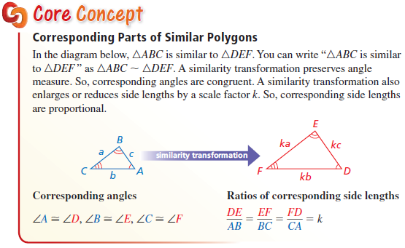
Corresponding Parts
Angles congruent
Sides proportional to scaling factor

Slide 7
Corresponding Parts
Angles congruent
Sides proportional to scaling factor

Slide 8
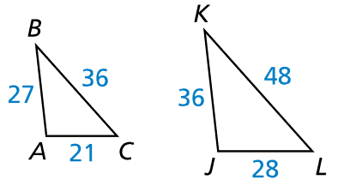
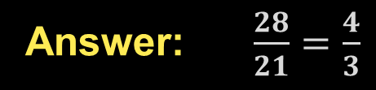

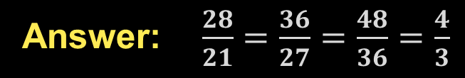
Example 1
In the diagram, $∆ABC\sim ∆JKL$.
a) Find the scale factor from $∆ABC$ to $∆JKL$.
b) List all pairs of congruent angles.
c) Write the ratios of the corresponding side lengths in a statement of proportionality.
Answer: $\frac{28}{21}=\frac{4}{3}$
Answer: Order rules $A∡≅∡J ∡B≅∡K ∡C≅∡L$
Answer: $\frac{28}{21}=\frac{36}{27}=\frac{48}{36}=\frac{4}{3}$

Slide 9
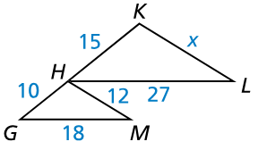
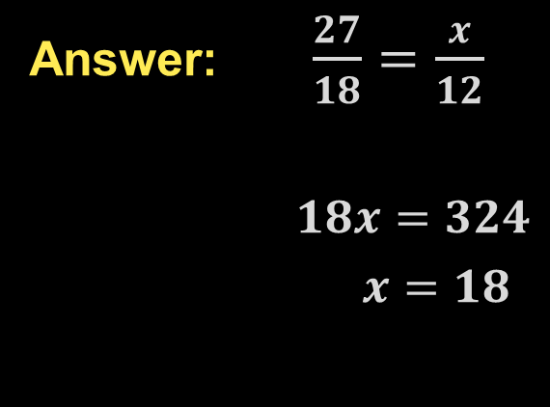

Example 2
In the diagram, $∆GHM\sim ∆HKL$.
Find the value of $x$.
Answer: $\frac{27}{18}=\frac{x}{12}$
$18x=324$
$x=18$

Slide 10
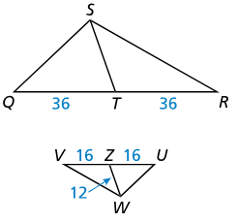
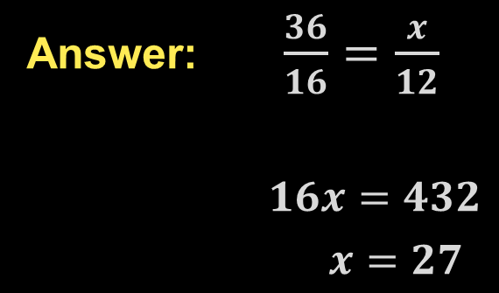

Example 3
In the diagram, $∆UVW\sim ∆QRS$.
Find the length of the median of $\overline{ST}$.
Answer: $\frac{36}{16}=\frac{x}{12}$
$16x=432$
$x=27$

Slide 11
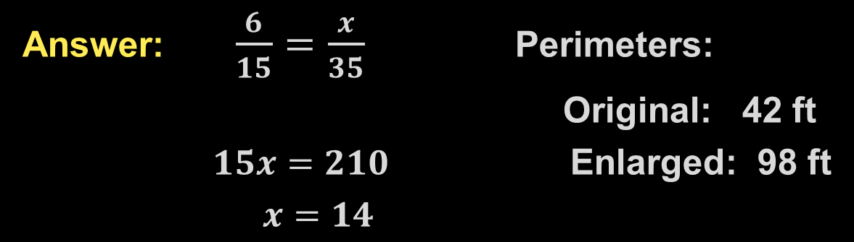

Example 4
Your neighbor has decided to enlarge his garden. The garden is rectangular with width $6$ feet and length $15$ feet. The new garden will be similar to the original one, but will have a length of $35$ feet. Find the perimeter of the original garden and the enlarged garden.
Answer: $\frac{6}{15}=\frac{x}{35}$ Perimeters:
Original: 42 ft
$15x=210$ Enlarged: 98 ft
$x=14$

Slide 12
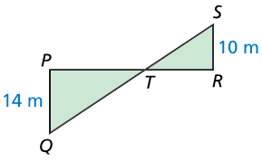

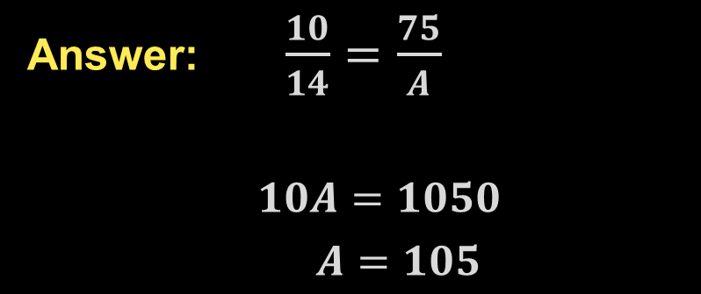
Example 5
In the diagram, $∆PQT\sim ∆RST$, and the area of $∆RST$ is $75$ square meters. Find the area of $∆PQT$.
Answer: $\frac{10}{14}=\frac{75}{A}$
$10A=1050$
$A=105$

Slide 13


Example 6
Decide whether $GNMH$ and $MLKH$ are similar. Explain your reasoning.
Answer: All angles between the two rectangles are 90° and equal to each other. The ratios of the lengths and widths of the two rectangles are k = 2.5

Slide 14
Summary & Homework
Summary:
  A ratio is a comparison of two quantities
  A proportion is an equation stating that two ratios are equal
  Recipes are “scaled up” or “scaled down” to fit the amount required (when multiplied by a scaling factor)
Homework:
  Proportions WS 1 and WS 2

