Slide 1
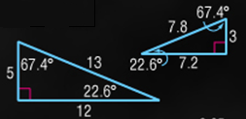
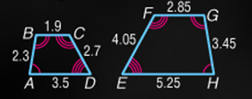
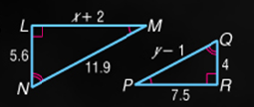
5-Minute Check on Lesson 7-2
Determine whether the triangles are similar.
Justify your answer.
The quadrilaterals are similar. Write a
similarity statement and find the scale
factor of the larger to the smaller
quadrilateral.
The triangles are similar. Find x and y.
4. Which one of the following statements is always true?
Yes: corresponding angles ≅
corresponding sides have same proportion
ABCD ~ HGFE
Scale factor = 2:3
x = 8.5, y = 9.5
Standardized Test Practice:
A
Two rectangles are similar
B
Two right triangles are similar
C
Two acute triangles are similar
D
Two isosceles right triangles are similar
D
Click the mouse button or press the
Space Bar to display the answers.

Slide 2
Lesson 8-2
Proving Triangle Similarity by AA

Slide 3
Objectives
Use the Angle-Angle Similarity Theorem
Solve real-life problems

Slide 4
Khan Academy Videos for this lesson
Triangle similarity postulates/criteria
Determining similar triangles

Slide 5
Vocabulary
None new

Slide 6
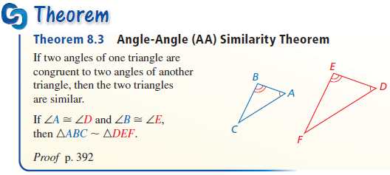
Theorems
Angle-Angle (AA) Similarity: If two angles of one triangle are congruent to two angles of another triangle, then the triangles are similar (corresponds to ASA and AAS in Δ ≅)

Slide 7
Theorems Cont
Theorem: Similarity in triangles is reflexive, symmetric, and transitive
  Reflexive:
  ∆ABC ~ ∆ABC
  Symmetric:
  If ∆ABC ~ ∆DEF, then ∆DEF ~ ∆ABC
  Transitive:
  If ∆ABC ~ ∆DEF and ∆DEF ~ ∆GHI,
  then ∆ABC ~ ∆GHI

Slide 8
AA Triangle Similarity
A
P
Third angle must be congruent as well
(∆ angle sum to 180°)
From Similar Triangles
Corresponding Side Scale Equal
AC AB BC
---- = ---- = ----
PQ PR RQ
Q
B
C
R
If Corresponding Angles Of Two Triangles Are Congruent,
Then The Triangles Are Similar
m∠A = m∠P
m∠B = m∠R

Slide 9
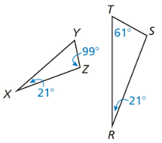
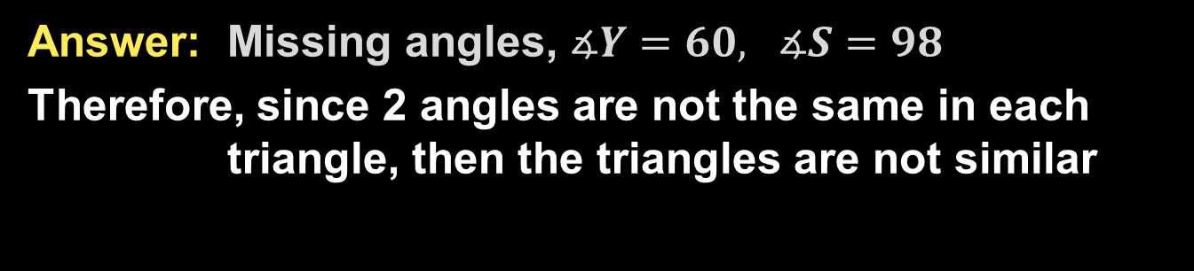
Example 1
Determine whether the triangles are similar. If they are, write a similarity statement. Explain your reasoning.
Answer: Missing angles, $∡Y=60, ∡S=98$
Therefore, since 2 angles are not the same in each triangle, then the triangles are not similar

Slide 10
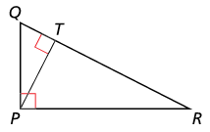
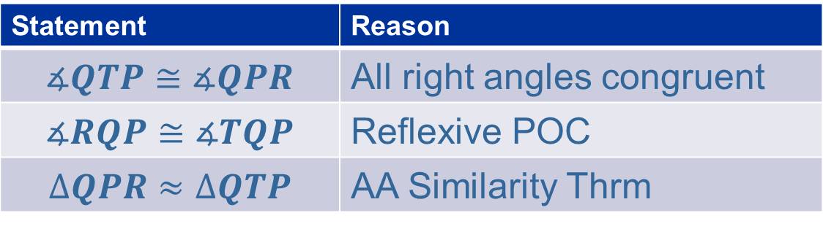
Example 2
Show that $∆QPR\sim ∆QTP$
Answer:
Statement | Reason
$$∡QTP≅∡QPR$$ | All right angles congruent
$$∡RQP≅∡TQP$$ | Reflexive POC
$$∆QPR≈∆QTP$$ | AA Similarity Thrm

Slide 11
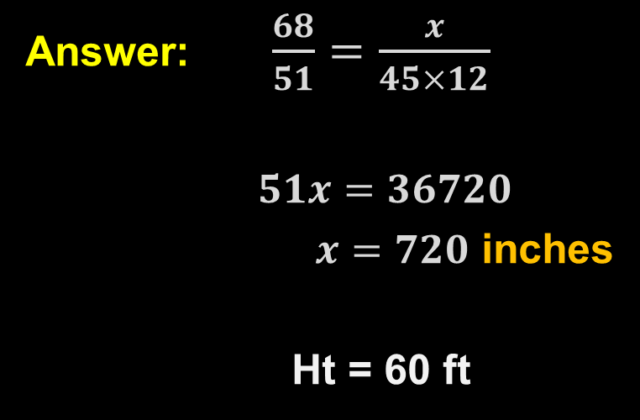

Example 3
A school flagpole casts a shadow that is $45$ feet long. At the same time, a boy who is five feet eight inches tall casts a shadow that is $51$ inches long. How tall is the flagpole to the nearest foot?
Answer: $\frac{68}{51}=\frac{x}{45×12}$
$51x=36720$
$x=720$ inches
Ht = 60 ft

Slide 12
Summary & Homework
Summary:
  AA, SSS and SAS Similarity can all be used to prove triangles similar
  Similarity of triangles is reflexive, symmetric, and transitive (just like congruence and equality was)
Homework:
  Similar Polygons WS

