Slide 1
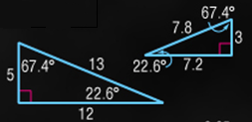
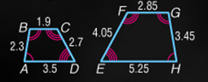
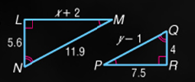
5-Minute Check on Lesson 7-2
Determine whether the triangles are similar.
Justify your answer.
The quadrilaterals are similar. Write a
similarity statement and find the scale
factor of the larger to the smaller
quadrilateral.
The triangles are similar. Find x and y.
4. Which one of the following statements is always true?
Yes: corresponding angles ≅
corresponding sides have same proportion
ABCD ~ HGFE
Scale factor = 2:3
x = 8.5, y = 9.5
Standardized Test Practice:
A
Two rectangles are similar
B
Two right triangles are similar
C
Two acute triangles are similar
D
Two isosceles right triangles are similar
D
Click the mouse button or press the
Space Bar to display the answers.

Slide 2
Lesson 8-3
Proving Triangle Similarity by SSS and SAS

Slide 3
Khan Academy Videos for this lesson
Solving similar triangles
Solving similar triangles: same side plays different roles

Slide 4
Objectives
Use the Side-Side-Side Similarity Theorem
Use the Side-Angle-Side Similarity Theorem
Prove slope criteria using similar triangles

Slide 5
Vocabulary
None new

Slide 6
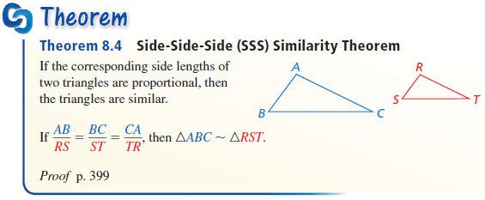
Theorems
Side-Side-Side (SSS) Similarity: If all the measures of the corresponding sides of two triangles are proportional, then the triangles are similar (corresponds to SSS Δ ≅)

Slide 7
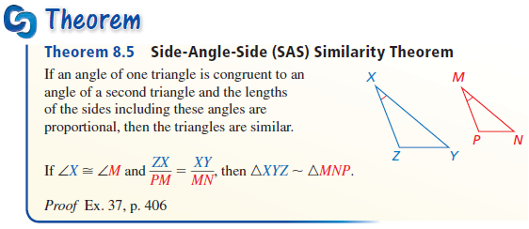
Theorems
Side-Angle-Side (SAS) Similarity: If the measures of two sides of a triangle are proportional to the measures of two corresponding sides of another triangle and the included angles are congruent, then the triangles are similar (corresponds to SAS Δ ≅)

Slide 8
AA Triangle Similarity
A
P
Third angle must be congruent as well
(∆ angle sum to 180°)
From Similar Triangles
Corresponding Side Scale Equal
AC AB BC
---- = ---- = ----
PQ PR RQ
Q
B
C
R
If Corresponding Angles Of Two Triangles Are Congruent,
Then The Triangles Are Similar
m∠A = m∠P
m∠B = m∠R

Slide 9
SSS Triangle Similarity
A
P
From Similar Triangles
Corresponding Angles Congruent
∠A ≅ ∠P
∠B ≅ ∠R
∠C ≅ ∠Q
Q
B
C
R
If All Three Corresponding Sides Of Two Triangles Have Equal Ratios,
Then The Triangles Are Similar
AC AB BC
---- = ---- = ----
PQ PR RQ

Slide 10
SAS Triangle Similarity
A
P
Q
B
C
R
If The Two Corresponding Sides Of Two Triangles Have Equal Ratios And The Included Angles Of The Two Triangles Are Congruent, Then The Triangles Are Similar
AC AB
---- = ---- and ∠A ≅ ∠P
PQ PR

Slide 11
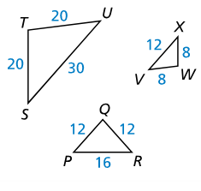
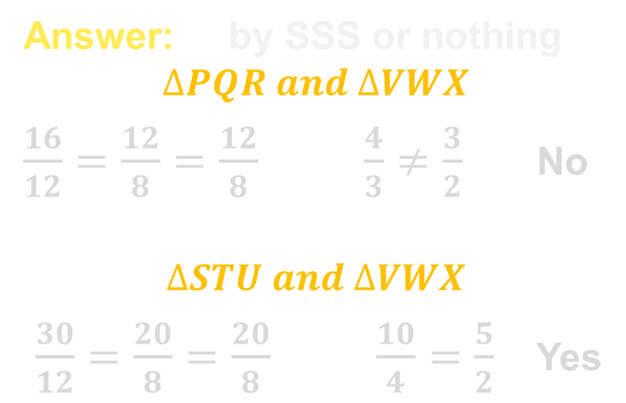

Example 1
Is either $∆PQR$ or $∆STU$ similar to $∆VWX$?
Answer: by SSS or nothing
$$∆PQR and ∆VWX$$
$\frac{16}{12}=\frac{12}{8}=\frac{12}{8} \frac{4}{3}≠\frac{3}{2}$ No
$$∆STU and ∆VWX$$
$\frac{30}{12}=\frac{20}{8}=\frac{20}{8} \frac{10}{4}=\frac{5}{2}$ Yes

Slide 12
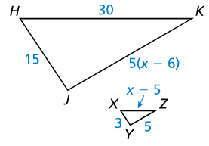
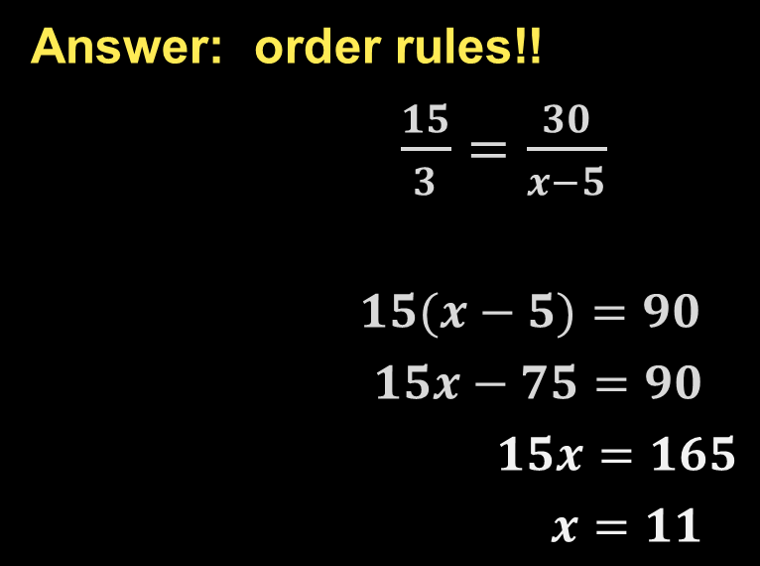

Example 2
Find the value of $x$ that makes $∆XYZ\sim ∆HJK$.
Answer: order rules!!
$\frac{15}{3}=\frac{30}{x−5}$
$15(x−5)=90$
$15x−75=90$
$15x=165$
$x=11$

Slide 13

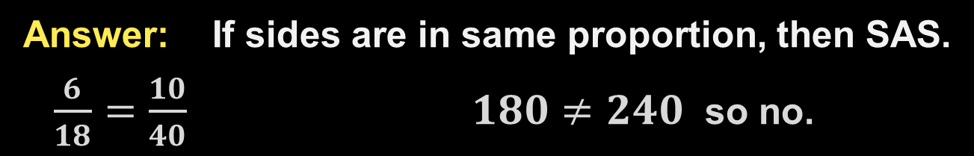

Example 3
The diagram is a scale drawing of a triangular roof truss. The lengths of the two upper sides of the actual truss are $18$ feet and $40$ feet. The actual truss and the scale drawing both have an included angle of $110°$. Is the scale drawing of the truss similar to the actual truss? Explain.
Answer: If sides are in same proportion, then SAS.
$\frac{6}{18}=\frac{10}{40} 180≠240$ so no.

Slide 14
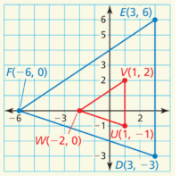
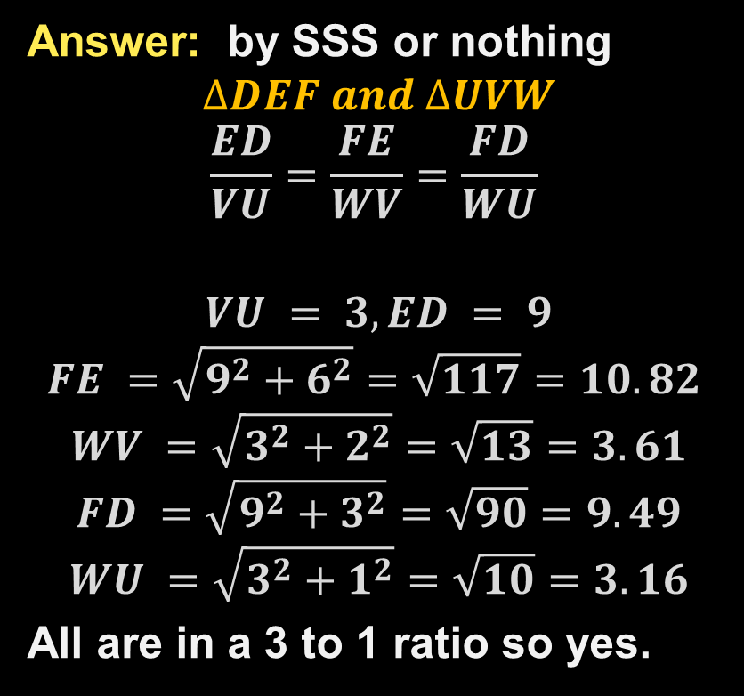

Example 4
Is $∆DEF$ similar to $∆UVW$?
Answer: by SSS or nothing
$$∆DEF and ∆UVW$$
$$\frac{ED}{VU}=\frac{FE}{WV}=\frac{FD}{WU}$$
$$VU = 3, ED = 9$$
$$FE =\sqrt{9^{2}+6^{2}}=\sqrt{117}=10.82$$
$$WV =\sqrt{3^{2}+2^{2}}=\sqrt{13}=3.61$$
$$FD =\sqrt{9^{2}+3^{2}}=\sqrt{90}=9.49$$
$$WU =\sqrt{3^{2}+1^{2}}=\sqrt{10}=3.16$$
All are in a 3 to 1 ratio so yes.

Slide 15
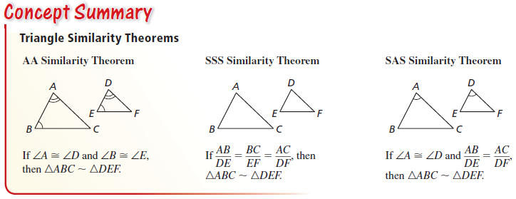
Summary & Homework
Summary:
  AA, SSS and SAS Similarity can all be used to prove triangles similar
  Similarity of triangles is reflexive, symmetric, and transitive
Homework: Similar Triangles WS 1

