Slide 1
5-Minute Check on Lesson 7-3
Determine if each pairs of triangles are similar. If so, write a similarity statement. Justify your statement.
2. 3.
4. In the figure below, if RS // VT, then find y.
9
H
J
6.75
K
D
E
4.8
7.6
3.5
5.7
3.6
C
4.5
G
I
9.0
L
A
B
12
∆BAC ~ ∆DEC
AA Similarity
No. Sides are not
proportional
∆GHI ~ ∆KLJ
SSS Similarity
Standardized Test Practice:
S
5 8 L
------ = -------- => -----
5+3 y + 12 B
= 5y + 60
4 = 5y
0.8 = y
R
T
3
V
8
y + 12
5
U
A
B
-0.8
B
0.8
C
1.2
D
4.8
Click the mouse button or press the
Space Bar to display the answers.

Slide 2
Lesson 8-4
Proportionality Theorems

Slide 3
Objectives
Introduction to angle bisector theorem
Using the angle bisector theorem
Using similar and congruent triangles

Slide 4
Objectives
Use the Triangle Proportionality Theorem and its converse
Use other proportionality theorems

Slide 5
Vocabulary
Midsegment: a segment whose endpoints are the midpoints of two sides of the triangle

Slide 6
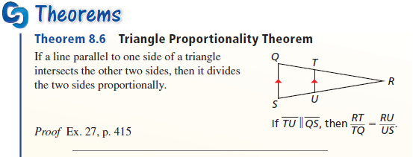
Triangle Proportionality Theorem
Parallel lines cut transversals into same proportions.

Slide 7
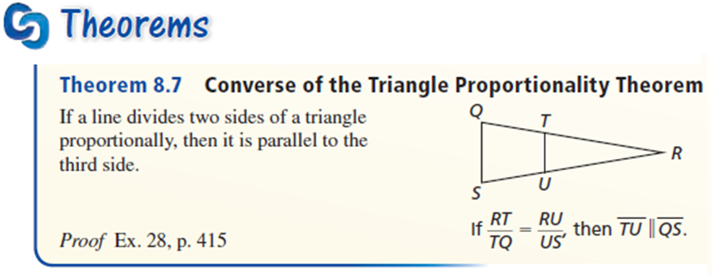
Converse of Triangle Proportionality
If the sides of a triangle, cut by a segment, are in the same proportion, then the segment is parallel.

Slide 8
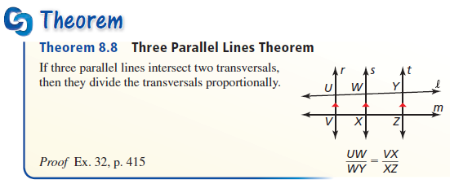
Three Parallel Lines Theorem
Parallel lines cut transversals into same proportions.

Slide 9
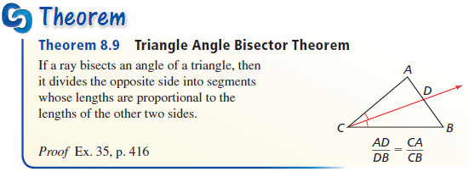
Triangle Proportionality Theorem
Angle bisector cuts the side opposite it into the same proportions as the angle’s two sides.

Slide 10
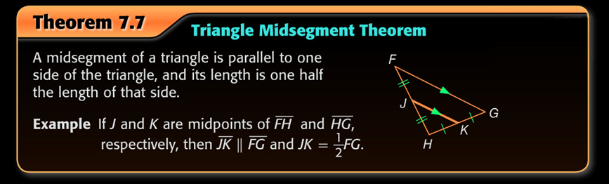
Triangle Midsegment Theorem
Midsegment makes the smaller triangle exactly one-half the larger triangle (scale factor of ½)

Slide 11
Example 0
A
In the diagram BD is a mid-segment, find x, y, z.
5
y
B
8
D
x
7
Answer: B and D are midpoints
So x = 5 and y = 7
Mid-segment Theorem says z = 2(8) = 16
C
E
z

Slide 12
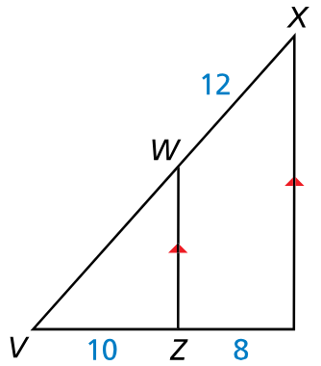


Example 1
In the diagram $\overline{WZ}∥\overline{XY}$, $WX=12$, $VZ=10$, and $ZY=8$. What is the length of $\overline{VW}$?
Answer:
$$\frac{10}{8}=\frac{t}{12}$$
$$8t=120$$
$$\overline{VW}=t= 15$$

Slide 13
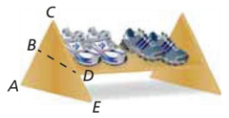

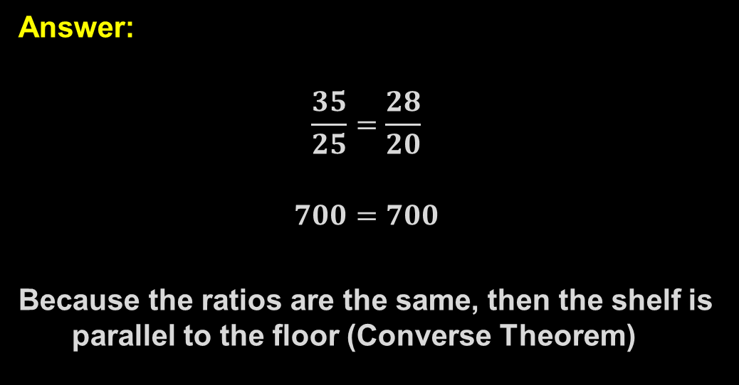
Example 2
$BA=35cm$, $CB=25cm$, $CD=20cm$, and $DE=28cm$. Explain why the shelf is parallel to the floor.
Answer:
$$\frac{35}{25}=\frac{28}{20}$$
$$700=700$$
Because the ratios are the same, then the shelf is parallel to the floor (Converse Theorem)

Slide 14
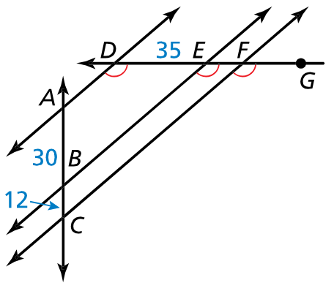

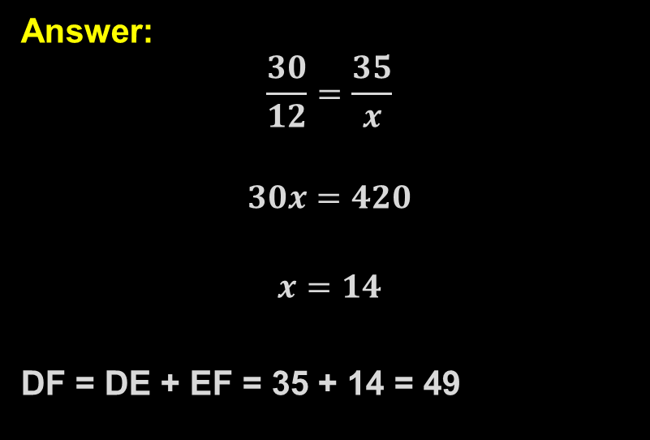
Example 3
In the diagram, $∠ADE$, $∠BED$, and $∠CFG$ are all congruent. $AB=30$, $BC=12$, and $DE=35$. Find $DF$.
Answer:
$$\frac{30}{12}=\frac{35}{x}$$
$$30x=420$$
$$x=14$$
DF = DE + EF = 35 + 14 = 49

Slide 15
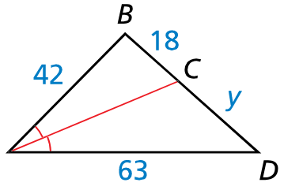

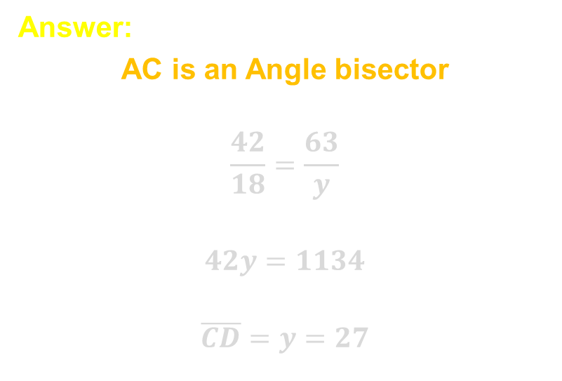
Example 4
In the diagram, $∠BAC≅∠CAD$. Use the given lengths to find the length of $\overline{CD}$.
Answer:
AC is an Angle bisector
$$\frac{42}{18}=\frac{63}{y}$$
$$42y=1134$$
$$\overline{CD}=y=27$$

Slide 16
Summary & Homework
Summary:
  A segment that intersects two sides of a triangle and is parallel to the third side divides the two intersected sides in proportion
  If two lines divide two segments in proportion, then the lines are parallel
  Angle bisector divides the side opposite into proportions of the other two sides
Homework:
  Similar Triangles in Parallel Lines Worksheet

