Slide 1
Lesson 9-1
The Pythagorean Theorem

Slide 2
Objectives
Use the Pythagorean Theorem
    If a right triangle, then c² = a² + b²
  Use the Converse of the Pythagorean Theorem
    If c² = a² + b², then a right triangle
Classify triangles
    If c² < a² + b², then an acute triangle
    If c² > a² + b², then an obtuse triangle

Slide 3
Vocabulary
Hypotenuse – side in a right triangle opposite the right angle; largest side
Legs of a right triangle – the sides of the right triangle; the two smaller sides in triangle
Pythagorean triple – a set of three whole numbers (no fractions of decimals) that satisfy the Pythagorean Theorem

Slide 4
Pythagorean Theorem
Pythagorean Theorem
a² + b² = c²
In a right triangle:
Sum of the squares of the legs is equal
to the square of the hypotenuse
c
a
b
Converse of the Pythagorean Theorem: If the sum of the squares of the measures of two sides of a triangle equals the square of the measure of the longest side, then the triangle is a right triangle

Slide 5
Pythagorean Triples
For three numbers to be a Pythagorean triple they must satisfy both of the following conditions:
  They must satisfy c² = a² + b²
  where c is the largest number
  All three must be whole numbers (integers)
Common Pythagorean Triples:
3, 4, 5 5, 12, 13 8, 15, 17
6, 8, 10
9, 12, 15 7, 24, 25
12, 16, 20 9, 40, 41
15, 20, 25 10, 24, 26 16, 30, 34

Slide 6
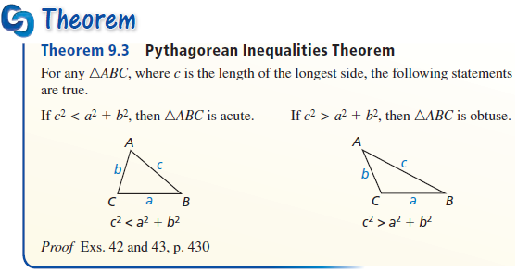
Pythagorean Theorem – Classifying Triangles
Remember:
In an acute triangle, c² < a² + b².
In an obtuse triangle, c² > a² + b².

Slide 7
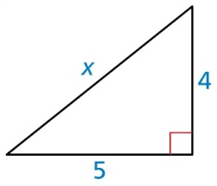
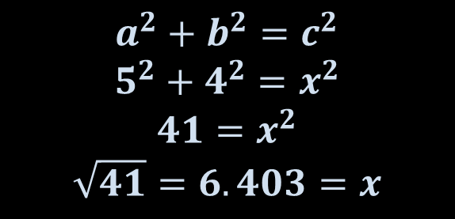
Example 1
Find the value of x. Then tell whether the side lengths from a Pythagorean triple.
$$a^{2}+b^{2}=c^{2}$$
$$5^{2}+4^{2}=x^{2}$$
$$41=x^{2}$$
$$\sqrt{41}=6.403=x$$
Answer: x = 6.403. Since all sides are not whole numbers, no Pythagorean triple.

Slide 8
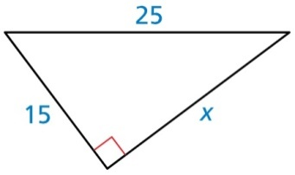
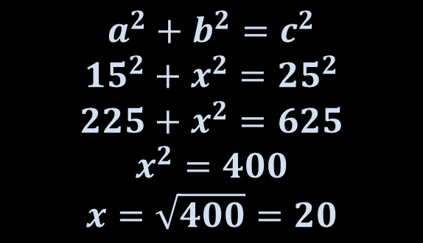
Example 2
Find the value of x. Then tell whether the side lengths from a Pythagorean triple.
$$a^{2}+b^{2}=c^{2}$$
$${15}^{2}+x^{2}={25}^{2}$$
$$225+x^{2}=625$$
$$x^{2}=400$$
$$x=\sqrt{400}=20$$
Answer: x = 20. Since all sides are whole numbers, then it is a Pythagorean triple.

Slide 9
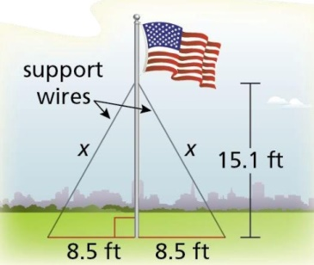
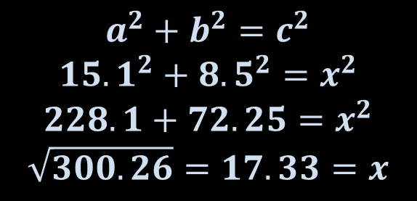
Example 3
The flagpole show is supported by two wires. Use the Pythagorean Theorem to approximate the length of each wire.
$$a^{2}+b^{2}=c^{2}$$
$${15.1}^{2}+{8.5}^{2}=x^{2}$$
$$228.1+72.25=x^{2}$$
$$\sqrt{300.26}=17.33=x$$
Answer: x = 17.33. Since all sides are not whole numbers, no Pythagorean triple.

Slide 10
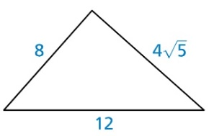
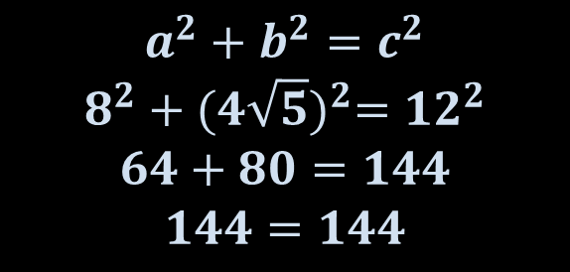
Example 4a
Tell whether each triangle is a right triangle.
$$a^{2}+b^{2}=c^{2}$$
$$8^{2}+{(4\sqrt{5})}^{2}={12}^{2}$$
$$64+80=144$$
$$144=144$$
Answer: Yes.

Slide 11
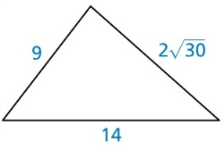
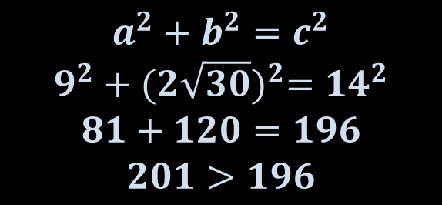
Example 4b
Tell whether each triangle is a right triangle.
$$a^{2}+b^{2}=c^{2}$$
$$9^{2}+{(2\sqrt{30})}^{2}={14}^{2}$$
$$81+120=196$$
$$201>196$$
Answer: No. (triangle is acute).

Slide 12
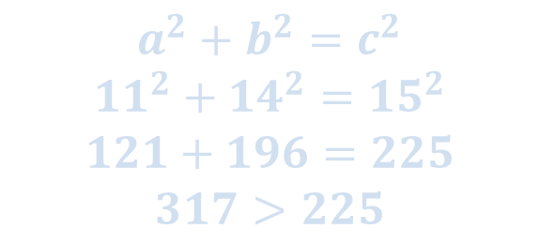
Example 5
Verify that segments with lengths of 14 meters, 15 meters and 11 meters form a triangle. Is the triangle acute, right or obtuse?
$$a^{2}+b^{2}=c^{2}$$
$${11}^{2}+{14}^{2}={15}^{2}$$
$$121+196=225$$
$$317>225$$
Answer: Since sum of smaller sides squares are bigger than larger side squared, then the triangle is acute

Slide 13
Summary & Homework
Summary:
  The Pythagorean Theorem can be used to find the measures of the sides of a right triangle
  If the square of the largest side equals the sum of the squares of the smaller sides, then it’s a right triangle
  Pythagorean Triples are all whole numbers
  Classify a triangle’s largest angle by relationship of its largest side to the smaller two sides
      If c² < a² + b², then an acute triangle
      If c² > a² + b², then an obtuse triangle
Homework:
  Pythagorean Worksheet

