Slide 1
Lesson 9-1
The Pythagorean Theorem

Slide 2
Objectives
Use the Pythagorean Theorem
    If a right triangle, then c² = a² + b²
  Use the Converse of the Pythagorean Theorem
    If c² = a² + b², then a right triangle
Classify triangles
    If c² < a² + b², then an acute triangle
    If c² > a² + b², then an obtuse triangle

Slide 3
Vocabulary
Hypotenuse – side in a right triangle opposite the right angle; largest side
Legs of a right triangle – the sides of the right triangle; the two smaller sides in triangle
Pythagorean triple – a set of three whole numbers (no fractions of decimals) that satisfy the Pythagorean Theorem

Slide 4
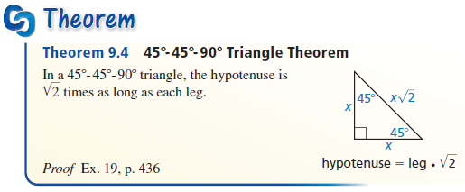

Special Case Right Triangles –
45°─ 45°─ 90°
Remember:
In a right isosceles triangle, either the legs have a $\sqrt{2}$ involved or the hypotenuse will have a $\sqrt{2}$ involved.

Slide 5
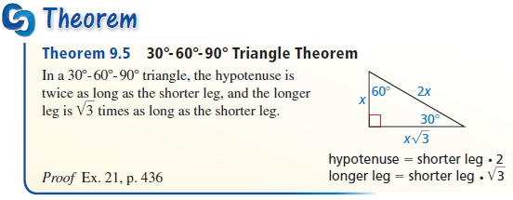

Special Case Right Triangles –
30°─ 60°─ 90°
Note: some people teach the short leg is $\frac{1}{2}hypotenuse$ and the long leg is $\frac{1}{2}hypotenuse\sqrt{3}$
30-60-90 is a right scalene triangle

Slide 6
Special Right Triangles
Remember
Pythagorean Theorem
a² + b² = c²
45°
x√2
60°
x
2y
y
45°
30°
x
y√3
Pythagorean Theorem
a² + b² = c²
x² + x² = (x√2)²
2x² = 2x²
Pythagorean Theorem
a² + b² = c²
y² + (y√3)² = (2y)²
y² + 3y² = 4y²

Slide 7
Special Right Triangles
45°
60°
½ hyp √2
½ hyp
45°
30°
½ hyp √2
½ hyp √3
Side opposite 30° is ½ the hypotenuse
Side opposite 45° is ½ the hypotenuse times √2
Side opposite 60° is ½ the hypotenuse times √3

Slide 8
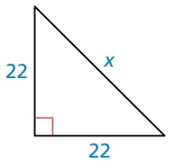
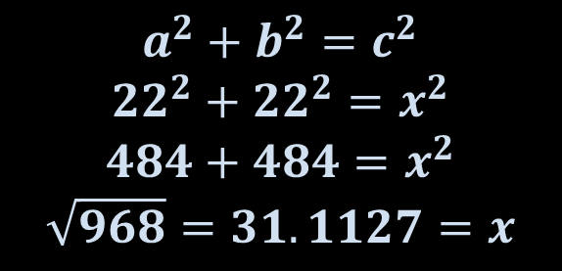
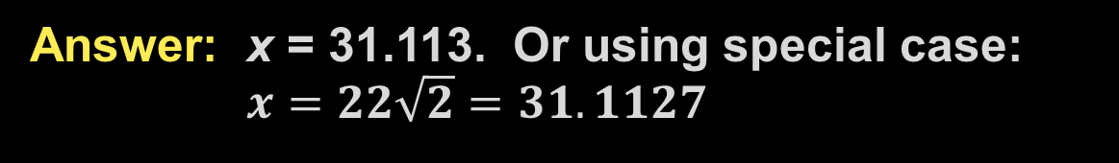
Example 1a
Find the value of x. Write your answer in simplest form.
$$a^{2}+b^{2}=c^{2}$$
$${22}^{2}+{22}^{2}=x^{2}$$
$$484+484=x^{2}$$
$$\sqrt{968}=31.1127=x$$
Answer: x = 31.113. Or using special case: $x=22\sqrt{2}=31.1127$

Slide 9
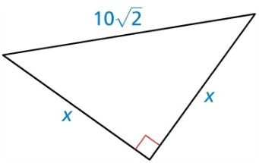
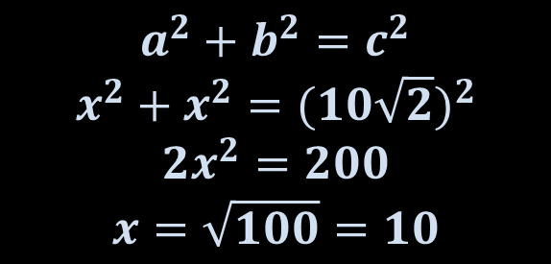
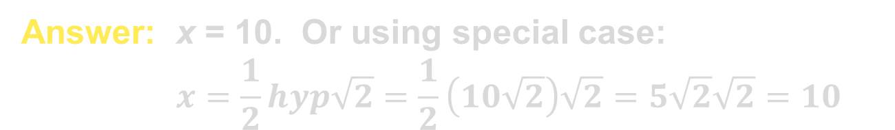
Example 1b
Find the value of x. Write your answer in simplest form.
$$a^{2}+b^{2}=c^{2}$$
$$x^{2}+x^{2}={(10\sqrt{2})}^{2}$$
$${2x}^{2}=200$$
$$x=\sqrt{100}=10$$
Answer: x = 10. Or using special case:
$$x=\frac{1}{2}hyp\sqrt{2}=\frac{1}{2}\left(10\sqrt{2}\right)\sqrt{2}=5\sqrt{2}\sqrt{2}=10$$

Slide 10
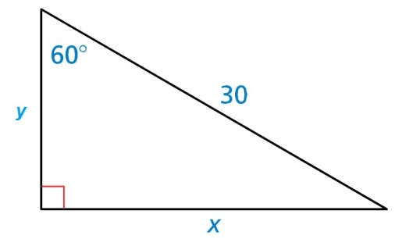
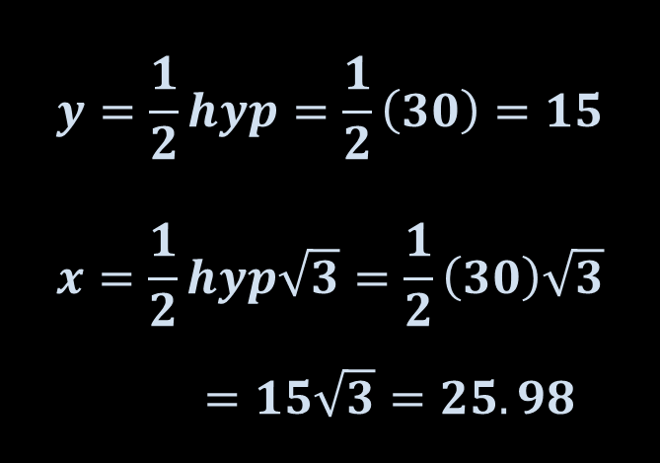
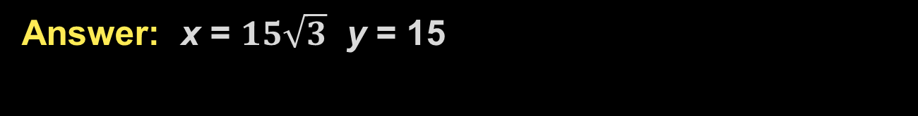
Example 2
Find the values of x and y. Write your answer in simplest form.
$$y=\frac{1}{2}hyp=\frac{1}{2}\left(30\right)=15$$
$$x=\frac{1}{2}hyp\sqrt{3}=\frac{1}{2}\left(30\right)\sqrt{3}=15\sqrt{3}=25.98$$
Answer: x = $15\sqrt{3}$ y = 15

Slide 11

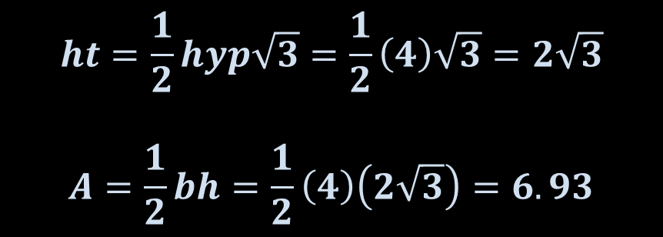
Example 3
A warning sticker is shaped like an equilateral triangle with side length of 4 inches. Estimate the area of the sticker by finding the area of the equilateral triangle to the nearest tenth of an inch
$$ht=\frac{1}{2}hyp\sqrt{3}=\frac{1}{2}\left(4\right)\sqrt{3}=2\sqrt{3}$$
$$A=\frac{1}{2}bh=\frac{1}{2}\left(4\right)\left(2\sqrt{3}\right)=6.93$$
Answer: A = 6.93

Slide 12
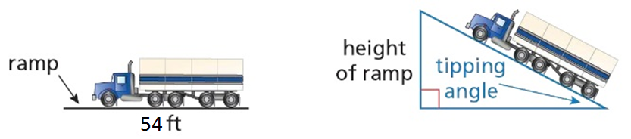
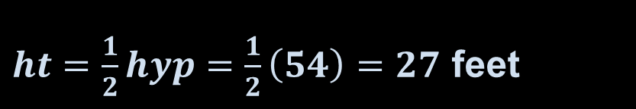
Example 4
How high is the end of a 54-foot ramp when the tipping angle is 30°?
$ht=\frac{1}{2}hyp=\frac{1}{2}\left(54\right)=27$ feet
Answer: Ht = 27 feet

Slide 13
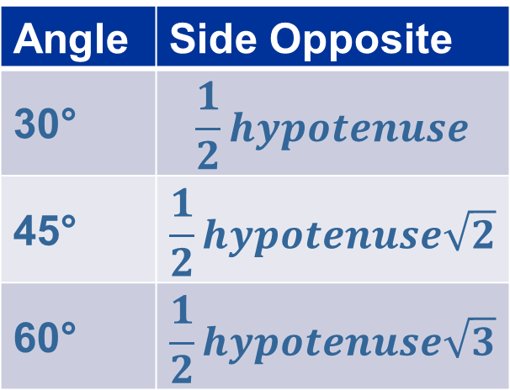
Summary & Homework
Summary:
  Sometimes special case right triangles can be solved using Pythagorean theorem
Homework:
  Special Case Triangles Worksheet
Angle | Side Opposite
30° | $$\frac{1}{2}hypotenuse$$
45° | $$\frac{1}{2}hypotenuse\sqrt{2}$$
60° | $$\frac{1}{2}hypotenuse\sqrt{3}$$

