Slide 1
Lesson 9-3
Similar Right Triangles -- Geometric and Arithmetic Means

Slide 2
Objectives
Identify similar triangles
Solve real-life problems involving similar triangles
Use geometric means

Slide 3

Vocabulary
Arithmetic Mean – between two numbers is their average (add the two numbers and divide by 2)
Geometric mean – a number, x, that satisfies $\frac{a}{x}=\frac{x}{b}$ or $x=\sqrt{ab}$
also the length of an altitude drawn to the hypotenuse of a right triangle

Slide 4
Means
Arithmetic Mean (AM): is the average of two numbers
example: 4 and 10 AM = (4 + 10)/2 = 14/2 = 7
Geometric Mean (GM): is the square root of their product
example: 4 and 10 GM = √(4•10) = √40 ≈ 6.32
Find the AM and GM of the following numbers
AM GM
a. 6 and 16
b. 4 and 8
c. 5 and 10
d. 2 and 14
(6+16)/2 = 11
√ (6•16) = √96 ≈ 9.8
(4+8)/2 = 6
√ (4•8) = √32 ≈ 5.66
(5+10)/2 = 7.5
√ (5•10) = √50 ≈ 7.07
(2+14)/2 = 8
√ (2•14) = √28 ≈ 5.29

Slide 5
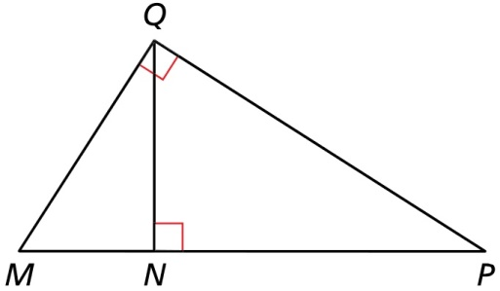

Example 1
Identify the similar triangles in the diagram.
Answer: Because of the shared angles and the right triangles, all three triangles are similar to each other: $∆QMP\sim ∆NQP\sim ∆NMQ$

Slide 6
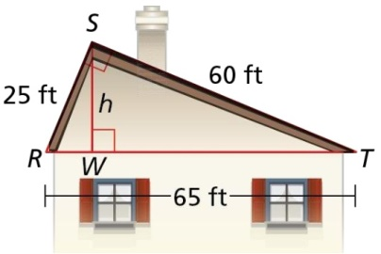
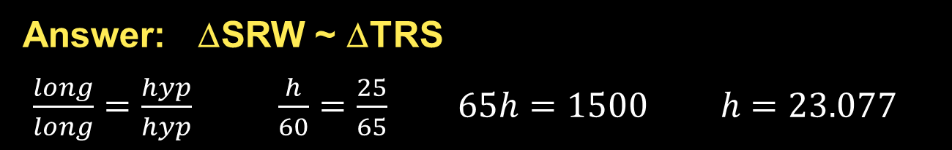
Example 2
A roof has a cross section that is a right triangle. The diagram shows the approximate dimensions of this cross section. Find the height h of the roof.
Answer: ΔSRW ~ ΔTRS
$\frac{long}{long}=\frac{hyp}{hyp} \frac{h}{60}=\frac{25}{65} 65h=1500 h=23.077$

Slide 7

Example 3
Find the geometric mean of 8 and 10
Answer: Geometric mean of two numbers is the square root of their product.
$$GM = \sqrt{8×10}=\sqrt{80}=8.94$$

Slide 8
Application of Geometric Mean
a
hypotenuse (length = a + b)
From similar triangles
a x
--- = ---
x b
altitude
b
x
Geometric mean of two numbers a, b is square root of their product, ab
The length of an altitude, x, from the 90° angle to the hypotenuse is
the geometric mean of the divided hypotenuse x = ab

Slide 9
Example of Geometric Mean
6
altitude
14
x
To find x, the altitude to the hypotenuse, we need to find the two pieces the hypotenuse has been divided into: a 6 piece and a 14 piece.
The length of the altitude, x, is the geometric mean of the divided hypotenuse.
x = √6 • 14
= √84
≈ 9.17

Slide 10
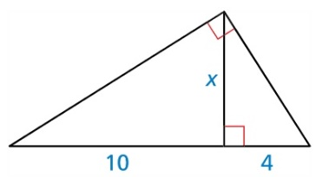

Example 4a
Find the value of each variable.
Answer: Altitude to hypotenuse is the geometric mean of the divided hypotenuse
$$GM: x = \sqrt{4×10}=\sqrt{40}=6.32$$

Slide 11
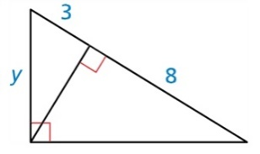

Example 4b
Find the value of each variable.
Answer: Altitude to hypotenuse is the geometric mean of the divided hypotenuse
$$GM: x = \sqrt{3×8}=\sqrt{24}=4.90$$
Then use Pythagorean Thrm:
$$3^{2}+{4.9}^{2}=y^{2}$$
$9+24=33=y^{2}$
$\sqrt{33}=5.74=y$

Slide 12
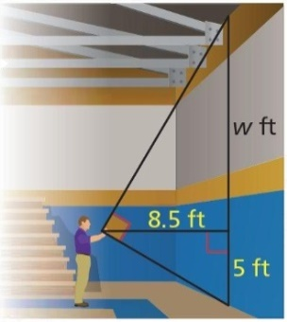
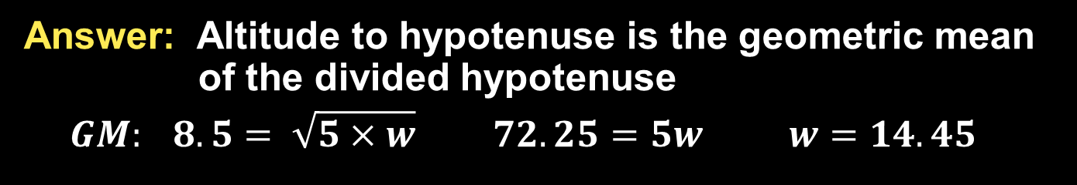
Example 5
The vertical distance from the ground to your eye is 5.4 feet and the distance from you to the gym wall is 8.1 feet. Approximate the height of the gym wall.
Answer: Altitude to hypotenuse is the geometric mean of the divided hypotenuse
$$GM: 8.5= \sqrt{5×w} 72.25=5w w=14.45$$

Slide 13
Summary & Homework
Summary:
  The arithmetic mean of two numbers is their average (add and divide by two)
  The geometric mean of two numbers is the square root of their product
  You can use the geometric mean to find the altitude of a right triangle
Homework:
  pg 535-37; 1-3, 5, 8, 9, 18, 36

