Slide 1
Lesson 9-4
The Tangent Ratio --
Trig Part I

Slide 2
Objectives
Use the tangent ratio
Solve real-life problems involving the tangent ratio

Slide 3

Vocabulary
Angle of elevation – angle that an upward line of sight makes with a horizontal line
Tangent – ratio for acute angles that involves the lengths of the legs of a right triangle
  $tan \left(angle\right)=\frac{opposite leg from angle}{adjacent leg to the angle}$
Trigonometric ratio – ratio of the lengths of two sides in a right triangle

Slide 4
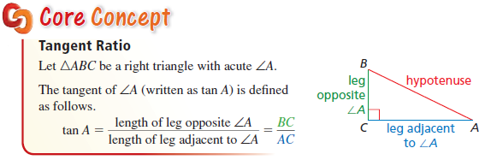
Core Concept
Tangents of angles over 45 are greater than 1
Tangents of angles under 45 are less than 1

Slide 5
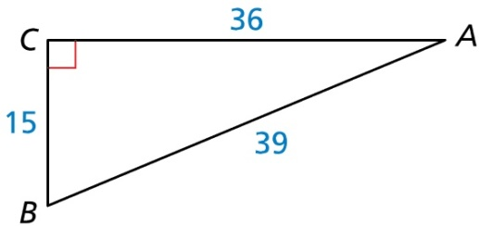

Example 1
Find tan A and tan B. Write each answer as a fraction and as a decimal rounded to four places.
Answer: $tan A= \frac{15}{36}=0.4167$ (so A is < 45°)
$tan B= \frac{36}{15}=2.4$ (so B is > 45°)

Slide 6
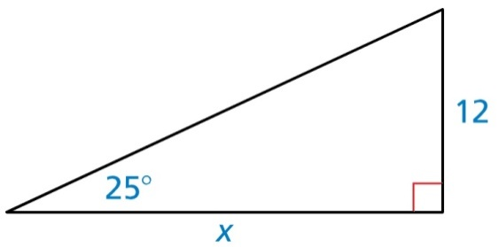

Example 2
Find the value of x. Round your answer to the nearest tenth.
Answer: $tan\left(25°\right)=\frac{12}{x}$ (variable – denominator)
$x=\frac{12}{tan⁡(25°)}=25.7$

Slide 7

Example 3
Use a special right triangle to find the tangent of a 60° angle.
Answer: Side opposite 60° angle is $\frac{1}{2}hyp\sqrt{3}$
Side adjacent (opposite 30°) angle is $\frac{1}{2}hyp$
$$tan 60°=\frac{1/2hyp\sqrt{3}}{1/2hyp}=\frac{\sqrt{3}}{1}=1.732$$

Slide 8

Example 4
You are measuring the height of a tree. You stand 40 feet from the base of the tree. The angle of elevation to the top of the tree is 65°. Find the height of the tree to the nearest foot.
Answer: $tan\left(65°\right)=\frac{x}{40}$ (variable – numerator)
$40tan\left(65°\right)=x=85.78$ feet

Slide 9
Summary & Homework
Summary:
  Tangent is used when we do not know the hypotenuse, but
    we know either both legs (looking for an angle)
    we know a leg and an angle (looking for the other leg)
  Used most often in finding the height of objects (knowing the distance from the object and the angle of elevation to the top of the object.
Homework:
  Trig WS 1

