Slide 1
Lesson 9-5
The Sine and Cosine Ratios --
Trig Part II

Slide 2
Objectives
Use the sine and cosine ratios
Find the sine and cosine of angle measures in special right triangles
Solve real-life problems involving sine and cosine ratios

Slide 3

Vocabulary
Angle of depression – angle that a downward line of sight makes with a horizontal line
Cosine – trigonometric ratio that involves a leg (adjacent to the angle) and the hypotenuse
  $cos\left(angle\right)=\frac{adjacent leg to the angle}{hypotenuse}$
Sine – trigonometric ratio that involves a leg (opposite of the angle) and the hypotenuse
  $sin\left(angle\right)=\frac{opposite leg to the angle}{hypotenuse}$

Slide 4
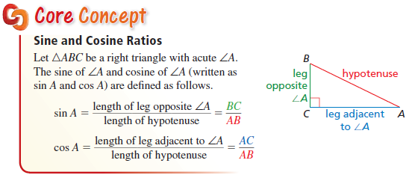
Core Concept
Sines and Cosines of angles are always between 0 and 1 (since hypotenuse is the largest side in a right triangle).

Slide 5
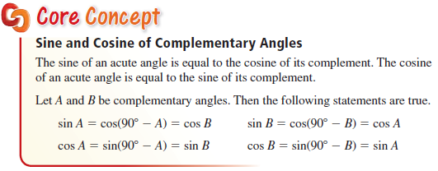
Core Concept
Note: Sin 45° = Cos 45° and from above concept Sin 30° = Cos 60° and Cos 30° = Sin 60°

Slide 6
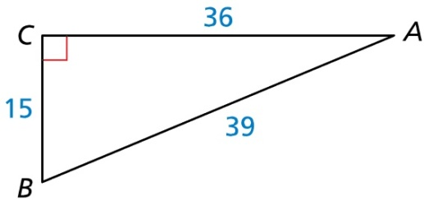
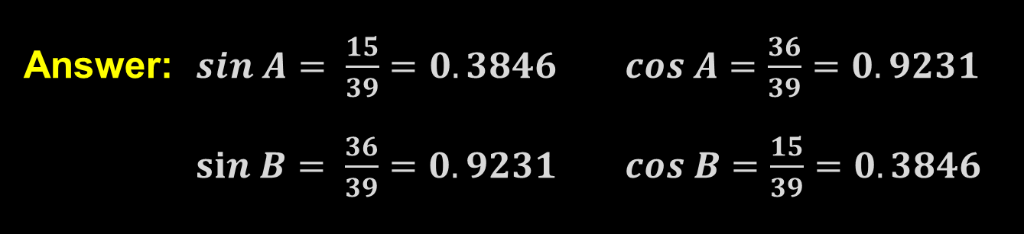
Example 1
Find sin A, sin B, cos A, cos B. Write each answer as a fraction and as a decimal rounded to four places.
Answer: $sin A= \frac{15}{39}=0.3846 cos A=\frac{36}{39}=0.9231$ $sin B= \frac{36}{39}=0.9231 cos B=\frac{15}{39}=0.3846$

Slide 7

Example 2
Write cos 69° in terms of sine.
Answer: $cos\left(69°\right)=sin\left(90−69\right)=sin(21°)$

Slide 8
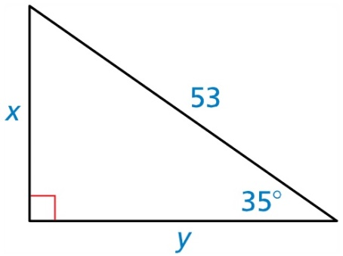
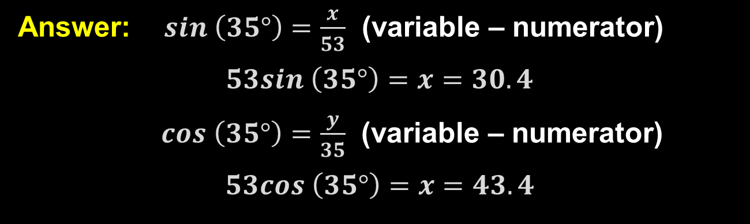
Example 3
Find the values of x and y using sine and cosine. Round your answers to the nearest tenth.
Answer: $sin \left(35°\right)=\frac{x}{53}$ (variable – numerator)
$$53sin \left(35°\right)=x=30.4$$
$cos \left(35°\right)=\frac{y}{35}$ (variable – numerator)
$$53cos \left(35°\right)=x=43.4$$

Slide 9
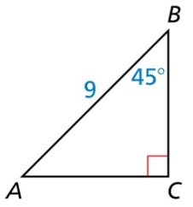
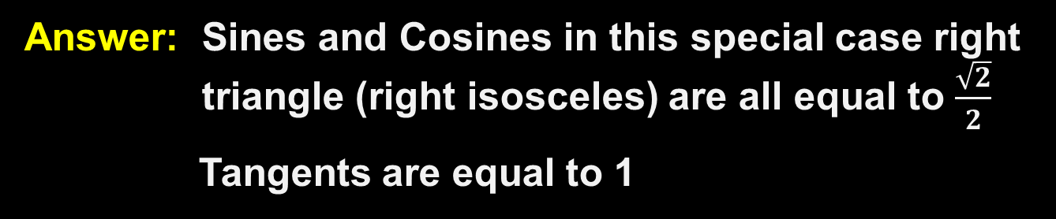

Example 4
Which ratios are equal to $\frac{\sqrt{2}}{2}$? Select all that apply
● Sin A ● Sin B
● Cos A ● Cos B
● Tan A ● Tan B
✓
✓
✓
✓
Answer: Sines and Cosines in this special case right triangle (right isosceles) are all equal to $\frac{\sqrt{2}}{2}$
Tangents are equal to 1

Slide 10
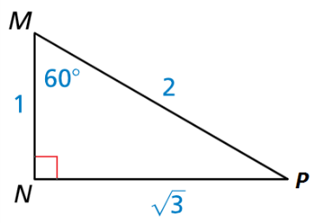


Example 5
Which ratios are equal to $\frac{\sqrt{3}}{2}$? Select all that apply
● Sin M ● Sin P
● Cos M ● Cos P
✓
✓
Answer: Sin M and Cos P in this special case right triangle (30-60-90) are all equal to $\frac{\sqrt{3}}{2}$

Slide 11
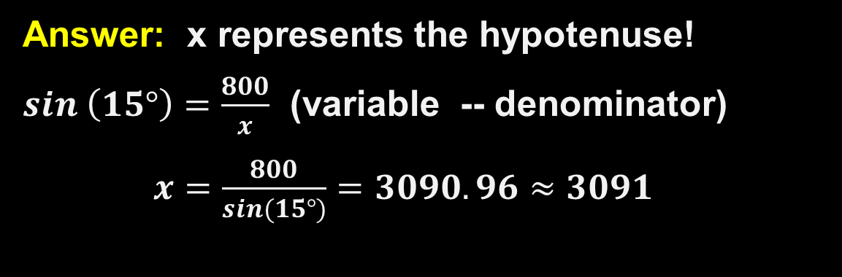
Example 6
You are skiing down a hill with an altitude of 800 feet. The angle of depression is 15°. Find the distance x you ski down the hill to the nearest foot.
Answer: x represents the hypotenuse!
$sin \left(15°\right)=\frac{800}{x}$ (variable -- denominator)
$x=\frac{800}{sin(15°)}=3090.96≈3091$
15°
800
15°

Slide 12
Summary & Homework
Summary:
  Sine and Cosine are the two only true trigonometric functions. All others are derived from these two (for example: Tan = Sin/Cos)
  You must have or be looking for the hypotenuse
  Due to the complementary nature of right triangles, Sin A = Cos B and Cos A = Sin B
    Sin A = opposite/hypotenuse
    Cos B = adjacent/hypotenuse
  Both Sin and Cos are between 0 and 1
Homework:
  Trig WS 2

