Slide 1
Lesson 9-6
Solving Right Triangles --
Trig Part III

Slide 2
Objectives
Use inverse trigonometric ratios (used to find angular measure)
Solve right triangles

Slide 3

Vocabulary
Inverse cosine – the measure of the angle whose cosine is the given ratio
Inverse sine – the measure of angle whose sine is the given ratio
Inverse tangent – the measure of angle whose tangent is the given ratio
  $angle=trig {fnc}^{−1}\left(\frac{side}{another side}\right)$

Slide 4
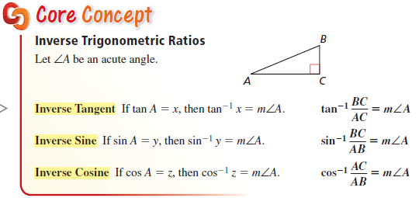
Core Concept
Angles are always acute and measured in degrees

Slide 5
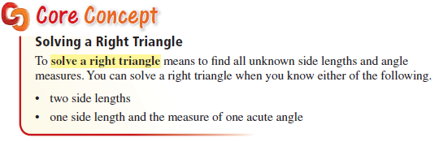
Core Concept
Pythagorean Theorem
Trig ratios

Slide 6
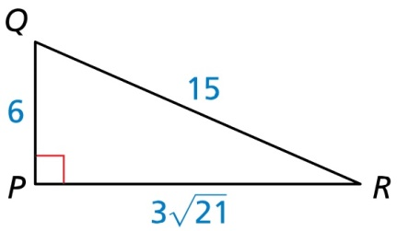
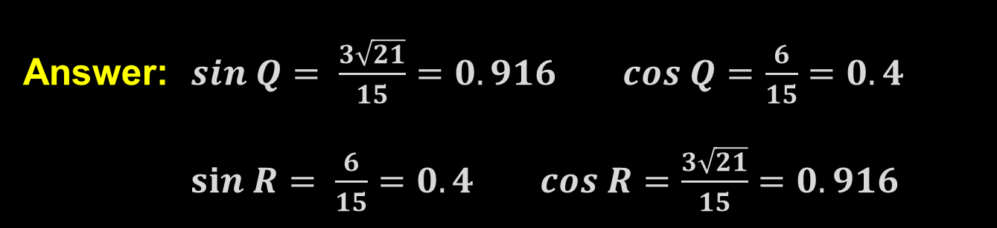
Example 1
Determine which of the two acute angles has a sine of 0.4
Answer: $sin Q= \frac{3\sqrt{21}}{15}=0.916 cos Q=\frac{6}{15}=0.4$ $sin R= \frac{6}{15}=0.4 cos R=\frac{3\sqrt{21}}{15}=0.916$

Slide 7
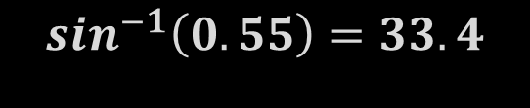

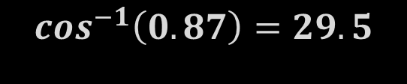
Example 2
Let ∠A, ∠B, and ∠C be acute angles. Use a calculator to approximate the measures of ∠A, ∠B, and ∠C to the nearest tenth of a degree.
a) Tan A = 3.29
b) Sin B = 0.55
c) Cos C = 0.87
$$\tan^{−1}\left(3.29\right)=73.1$$
$$\sin^{−1}\left(0.55\right)=33.4$$
$$\cos^{−1}\left(0.87\right)=29.5$$
Answer:

Slide 8
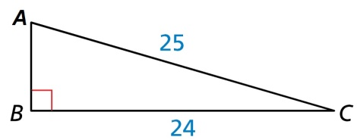
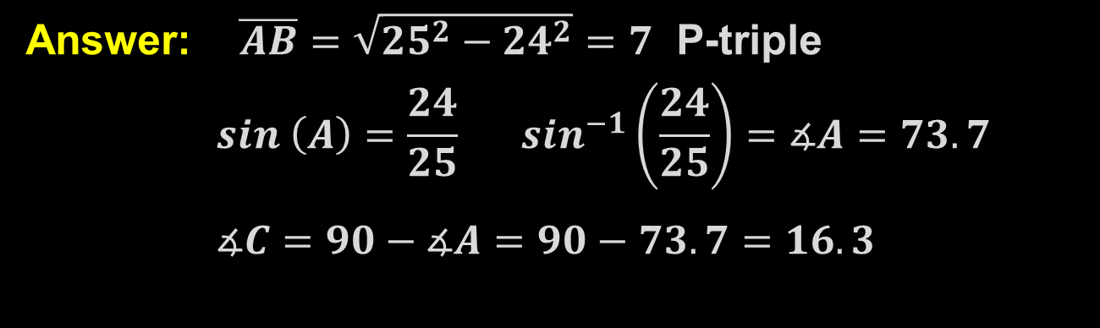
Example 3
Solve the right triangle (find the missing sides and angles). Round decimal answers to the nearest tenth.
Answer: $\overline{AB}=\sqrt{{25}^{2}−{24}^{2}}=7$ P-triple
$$sin \left(A\right)=\frac{24}{25} \sin^{−1}\left(\frac{24}{25}\right)=∡A=73.7$$
$$∡C=90−∡A=90−73.7=16.3$$

Slide 9
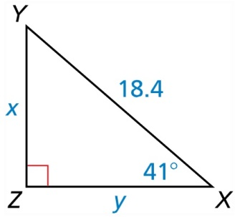
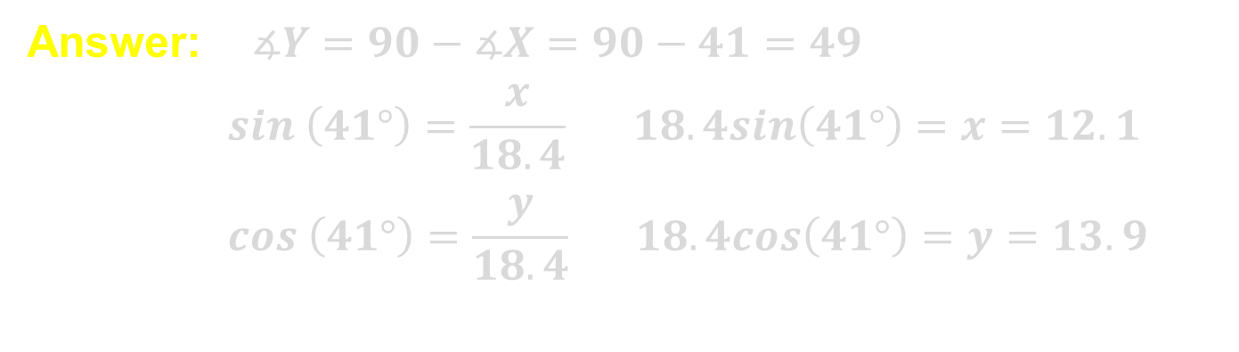
Example 4
Solve the right triangle (find the missing sides and angles). Round decimal answers to the nearest tenth.
Answer: $∡Y=90−∡X=90−41=49$
$$sin \left(41°\right)=\frac{x}{18.4} 18.4sin\left(41°\right)=x=12.1$$
$$cos \left(41°\right)=\frac{y}{18.4} 18.4cos\left(41°\right)=y=13.9$$

Slide 10
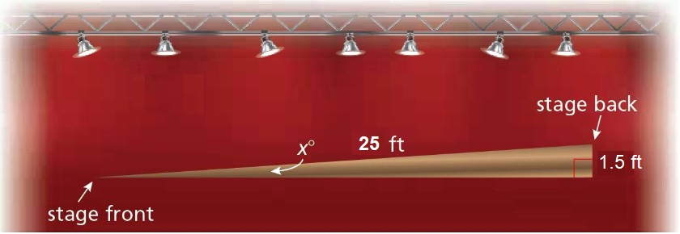
Example 5
Another raked stage is 25 feet long from front to back with a total rise of 1.5 feet. You want the rake to be 5° or less. Is this raked stage within your desired range? Explain.
Answer: $sin\left(x°\right)=\frac{1.5}{25} \sin^{−1}\left(\frac{1.5}{25}\right)=3.44<5$ OK

Slide 11

Summary & Homework
Summary:
  When you are looking for an angle, you use the inverse trig function
  Calculators will display them as $\sin^{−1}, \cos^{−1}, \tan^{−1}$
Homework:
  Trig WS 3/4

