Slide 1
Lesson 1 - 1
Analyzing Categorical Data

Slide 2

5-Minute Check on Lesson 1-0
Gender is an example of what type of variable?
Age is an example of what type of variable?
Your zip code is an example of what type of variable?
What was the percentage that was our boundary for something being unusual?
Categorical
Quantitative
Categorical
5% or 0.05 or 1/20
Click the mouse button or press the Space Bar to display the answers.

Slide 3
Objectives
Make and interpret bar graphs for categorical data
Identify what makes some graphs of categorical data misleading
Calculate marginal and joint relative frequencies from a two-way table
Calculate conditional relative frequencies from a two-way table
Use bar graphs to compare distributions of categorical data
Describe the nature of the association between two categorical

Slide 4
Vocabulary
Association – two variables are associated if knowing the value of one variable helps us predict the value of the other
Bar graph – shows each category as a bar. The heights of the bars show the category frequencies or relative frequencies
Conditional relative frequency – gives the percentage or proportion of individuals that have a specific value for one categorical variable among individuals who share the same value of another categorical variable (the condition)
Frequency table – the number of individuals having each value
Joint relative frequency – gives the percent of proportion of individuals that have a specific value for one categorical variable and a specific value for another categorical variable
Marginal relative frequency – the percent or proportion of individuals that have a specific value for one categorical variable
Pie chart – shows each category as a slice of the “pie.” The areas of the slices are proportional to the category frequencies or relative frequencies

Slide 5
Vocabulary (cont)
Relative frequency table – shows proportion or percent of individuals having each value
Segmented bar graph – displays distribution of a categorical variable as segments of a rectangle, with the area of each segment proportional to the percent of individuals in the corresponding category
Side-by-side bar graph – displays distribution of a categorical variable for each value of another categorical variable
Two-way table – a table of counts that summarizes data on the relationship between two categorical variables for some group of individuals

Slide 6
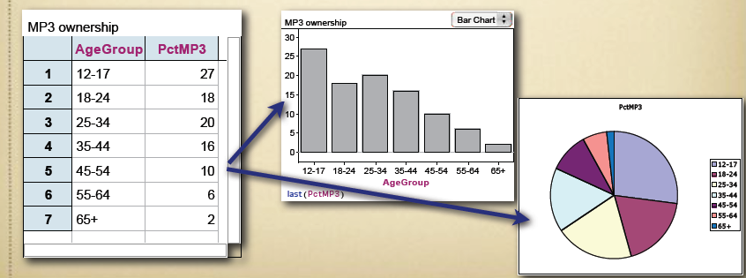
Categorical Data
Categorical Variable:
  Values are labels or categories
  Distributions list the categories and either the count or percent of individuals in each
Displays: BarGraphs and PieCharts

Slide 7
Categorical Data Example
Body Part | Frequency | Relative Frequency
Back | 12 | 0.4
Wrist | 2 | 0.0667
Elbow | 1 | 0.0333
Hip | 2 | 0.0667
Shoulder | 4 | 0.1333
Knee | 5 | 0.1667
Hand | 2 | 0.0667
Groin | 1 | 0.0333
Neck | 1 | 0.0333
Total | 30 | 1.0000
Physical Therapist’s Rehabilitation Sample

Slide 8
Categorical Data
Items are placed into one of several groups or categories (to be counted)
Typical graphs of categorical data:
  Pie Charts; emphasizes each category’s relation to the whole
  Bar Charts; emphasizes each category’s relation with other categories
Bar Chart
Pie Chart

Slide 9

Example 1
Construct a pie chart and a bar graph.
Radio Station Formats
Format | Nr of Stations | Percentage
Adult contemporary | 1,556 | 11.2
Adult standards | 1.196 | 8.6
Contemporary Hits | 569 | 4.1
Country | 2,066 | 14.9
News/Talk/Info | 2,179 | 15.7
Oldies | 1,060 | 7.7
Religious | 2,014 | 14.6
Rock | 869 | 6.3
Spanish Language | 750 | 5.4
Other formats | 1,579 | 11.4
Total | 13,838 | 99.9
Why not 100%?

Slide 10
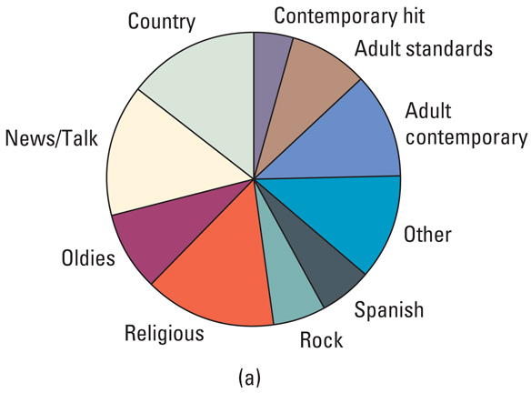
Example 1 Pie Chart

Slide 11
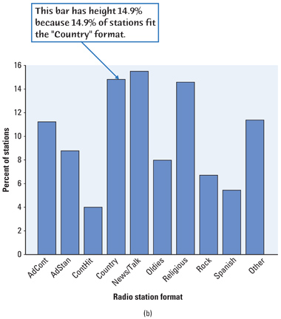
Example 1 Bar Graph

Slide 12
Categorical Data
Categorical Variables place individuals into one of several groups or categories
  The values are labels for the different categories
  The distribution lists the count or percent of individuals who fall into each category.
Frequency Table
Format | Count of Stations
Adult Contemporary | 1556
Adult Standards | 1196
Contemporary Hit | 569
Country | 2066
News/Talk | 2179
Oldies | 1060
Religious | 2014
Rock | 869
Spanish Language | 750
Other Formats | 1579
Total | 13838
Relative Frequency Table
Format | Percent of Stations
Adult Contemporary | 11.2
Adult Standards | 8.6
Contemporary Hit | 4.1
Country | 14.9
News/Talk | 15.7
Oldies | 7.7
Religious | 14.6
Rock | 6.3
Spanish Language | 5.4
Other Formats | 11.4
Total | 99.9
Variable
Values
Count
Percent

Slide 13
Displaying Categorical Data
Frequency tables can be difficult to read. Sometimes is is easier to analyze a distribution by displaying it with a bar graph or pie chart.
Frequency Table
Format | Count of Stations
Adult Contemporary | 1556
Adult Standards | 1196
Contemporary Hit | 569
Country | 2066
News/Talk | 2179
Oldies | 1060
Religious | 2014
Rock | 869
Spanish Language | 750
Other Formats | 1579
Total | 13838
Relative Frequency Table
Format | Percent of Stations
Adult Contemporary | 11.2
Adult Standards | 8.6
Contemporary Hit | 4.1
Country | 14.9
News/Talk | 15.7
Oldies | 7.7
Religious | 14.6
Rock | 6.3
Spanish Language | 5.4
Other Formats | 11.4
Total | 99.9

Slide 14
Summary – part 1
Summary
  Categorical data can be frequencies or relative frequencies (percentages)
  The distribution of a categorical variable lists the categories and gives the count or percent of individuals that fall into each category.
  Pie charts and bar graphs display the distribution of a categorical variable.

Slide 15
5-Minute Check on Lesson 1-1a
Name the two graphical displays we use for categorical data
When do we use a pie chart?
When do we use a bar graph?
Another name for categories is __________s.
Tables that use percentages are called _______________ tables.
pie charts and bar graphs
when your compare the part to the whole; relative frequencies
when your compare the part to other parts; either
group
relative frequency
Click the mouse button or press the Space Bar to display the answers.

Slide 16
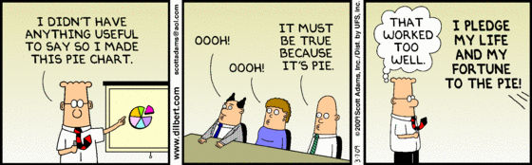
Graphs: Good and Bad
Bar graphs compare several quantities by comparing the heights of bars that represent those quantities.
Our eyes react to the area of the bars as well as height. Be sure to make your bars equally wide.
Avoid the temptation to replace the bars with pictures for greater appeal…this can be misleading!

Slide 17

Graphs: Good and Bad
This ad for DIRECTV has multiple problems. How many can you point out?
First, the heights of the bars are not accurate. According to the graph, the difference between 81 and 95 is much greater than the difference between 56 and 81. Also, the extra width for the DIRECTV bar is deceptive since our eyes respond to the area, not just the height.

Slide 18
Two-Way Tables
When a dataset involves two categorical variables, we begin by examining the counts or percents in various categories for one of the variables.
Definition:
Two-way Table – describes two categorical variables, organizing counts according to a row variable and a column variable.
Example, p. 12
Young adults by gender and chance of getting rich
 | Female | Male | Total
Almost no chance | 96 | 98 | 194
Some chance, but probably not | 426 | 286 | 712
A 50-50 chance | 696 | 720 | 1416
A good chance | 663 | 758 | 1421
Almost certain | 486 | 597 | 1083
Total | 2367 | 2459 | 4826
What are the variables described by this two-way table?
How many young adults were surveyed?

Slide 19
Alternate Example: Super Powers
A sample of 200 children from the United Kingdom ages 9-17 was selected from the CensusAtSchool website (www.censusatschool.com). The gender of each student was recorded along with which super power they would most like to have: invisibility, super strength, telepathy (ability to read minds), ability to fly, or ability to freeze time. Here are the results:
Superpower | % Females | % Males
Invisibility | 15 | 15
Super strength | 3 | 20
Telepathy | 34 | 6
Fly | 31 | 21
Freeze time | 17 | 38
Total | 100 | 100

Slide 20
Marginal Distributions
Definition:
The Marginal Distribution of one of the categorical variables in a two-way table of counts is the distribution of values of that variable among all individuals described by the table.
Note: Percents are often more informative than counts, especially when comparing groups of different sizes.
To examine a marginal distribution,
Use the data in the table to calculate the marginal distribution (in percents) of the row or column totals.
Make a graph to display the marginal distribution

Slide 21
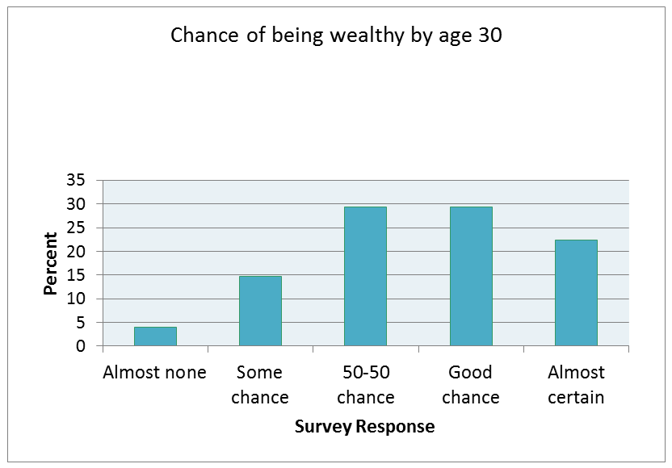
Tables & Marginal Distributions
Young adults by gender and chance of getting rich
 | Female | Male | Total
Almost no chance | 96 | 98 | 194
Some chance, but probably not | 426 | 286 | 712
A 50-50 chance | 696 | 720 | 1416
A good chance | 663 | 758 | 1421
Almost certain | 486 | 597 | 1083
Total | 2367 | 2459 | 4826
Examine the marginal distribution of chance of getting rich.
Example, p. 13
Response | Percent
Almost no chance | 194/4826 = 4.0%
Some chance | 712/4826 = 14.8%
A 50-50 chance | 1416/4826 = 29.3%
A good chance | 1421/4826 = 29.4%
Almost certain | 1083/4826 = 22.4%

Slide 22
Relationships Between Categorical Variables
Marginal distributions tell us nothing about the relationship between two variables.
Definition:
A Conditional Distribution of a variable describes the values of that variable among individuals who have a specific value of another variable.
To examine or compare conditional distributions,
Select the row(s) or column(s) of interest.
Use the data in the table to calculate the conditional distribution (in percents) of the row(s) or column(s).
Make a graph to display the conditional distribution.
  Use a side-by-side bar graph or segmented bar graph to compare distributions.

Slide 23
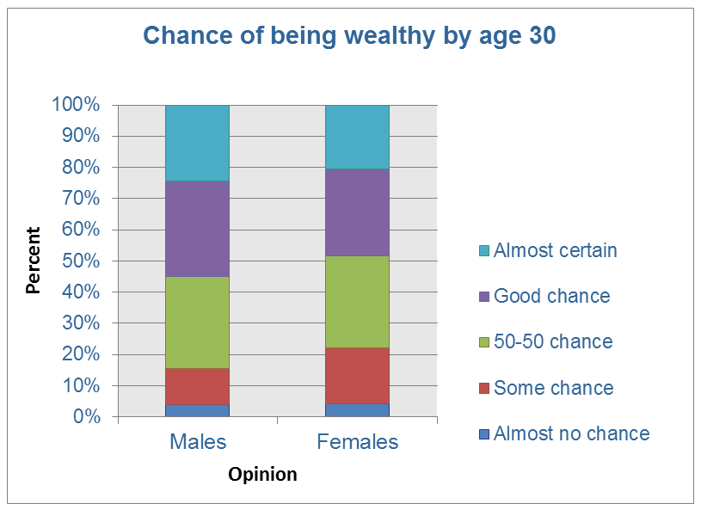
Tables & Conditional Distributions
Young adults by gender and chance of getting rich
 | Female | Male | Total
Almost no chance | 96 | 98 | 194
Some chance, but probably not | 426 | 286 | 712
A 50-50 chance | 696 | 720 | 1416
A good chance | 663 | 758 | 1421
Almost certain | 486 | 597 | 1083
Total | 2367 | 2459 | 4826
Calculate the conditional distribution of opinion among males.
Examine the relationship between gender and opinion
Example, p. 15
Response | Male
Almost no chance | 98/2459 = 4.0%
Some chance | 286/2459 = 11.6%
A 50-50 chance | 720/2459 = 29.3%
A good chance | 758/2459 = 30.8%
Almost certain | 597/2459 = 24.3%
Female
96/2367 = 4.1%
426/2367 = 18.0%
696/2367 = 29.4%
663/2367 = 28.0%
486/2367 = 20.5%

Slide 24
Association
  To describe the association between the row and column variables, compare an appropriate set of conditional distributions.
    Positive association, as we will learn more about later, means as one variable goes up or down, the other follows suit
    Negative association means as one variable goes up, the other variable goes down (or vice versa)
  Even a strong association between two categorical variables can be influenced by other variables lurking in the background.
    Lurking variables are a very statistical term that students are likely to misuse
    Extraneous variable is a better term to use

Slide 25
Charts for Both Data Types
Relative Frequency Chart
Pareto Chart
Cumulative Frequency Chart
Also known as an ogive chart

Slide 26
Organizing Statistical Problems
As you learn more about statistics, you will be asked to solve more complex problems.
Here is a four-step process you can follow.
How to Organize a Statistical Problem: A Four-Step Process
State: What’s the question that you’re trying to answer?
Plan: How will you go about answering the question? What statistical techniques does this problem call for?
Do: Make graphs and carry out needed calculations.
Conclude: Give your practical conclusion in the setting of the real-world problem.

Slide 27
Summary and Homework
Summary
  The distribution of a categorical variable lists the categories and gives the count or percent of individuals that fall into each category.
  Pie charts and bar graphs display the distribution of a categorical variable.
  A two-way table of counts organizes data about two categorical variables.
  The row-totals and column-totals in a two-way table give the marginal distributions of the two individual variables.
  There are two sets of conditional distributions for a two-way table.

Slide 28
Summary and Homework
Summary (cont)
  We can use a side-by-side bar graph or a segmented bar graph to display conditional distributions.
  To describe the association between the row and column variables, compare an appropriate set of conditional distributions.
  Even a strong association between two categorical variables can be influenced by other variables lurking in the background.
  You can organize many problems using the four steps state, plan, do, and conclude.
Homework
  pg 24-30; probs 11, 16, 20, 25, 30, 38

