Slide 1
Lesson 1 - 2
Displaying Quantitative Data with Graphs

Slide 2

5-Minute Check on Lesson 1-1B
To organize data on two categorical variables use a:
Row totals and column totals are called:
When we fix the value of one categorical variable and look at the distribution of the other variable it is called:
A variable not in the data that influences variables in the collected data is called:
The four-steps in statistical analysis are:
Two-way table
marginal distributions
conditional distribution
an extraneous variable
state, plan, do, and conclude.
Click the mouse button or press the Space Bar to display the answers.

Slide 3
Objectives
Make and interpret dotplots, stemplot, and histograms of quantitative data
Identify the shape of a distribution from a graph (roughly symmetric or skewed – right/left)
Describe the overall pattern (shape, center, and variability) of a distribution and identify any major departures from the pattern (outliers)
Compare distributions of quantitative data using dotplots, stemplot, and histograms

Slide 4
Vocabulary
Back-to-back stemplot – two distributions plotted with a common stem
Bimodal – a graph with two peaks (modes)
Dotplot – shows each data point as a dot above its location on a number line
Histogram – shows each interval of values as a bar. Heights of the bars show the frequencies or relative frequencies of values in each interval
Modes – major peaks in a distribution
Multimodal – a graph which has more than two peaks (modes)

Slide 5
Vocabulary (cont)
Outlier – an observation that falls outside the pattern
Skewed left – if the left side of the graph is longer than the right (forms a tail to the left)
Skewed right – if the right side of the graph is longer than the left (forms a tail to the right)
Stemplot – show each data value separated into two parts: a stem, which consists of all but the final digit and the leaf, the final digit
Symmetric – if right side of the graph is an approximate mirror images of the left side
Unimodal – a graph with a single peak (mode)

Slide 6
Quantitative Data
Quantitative Variable:
  Values are numeric - arithmetic computation makes sense (average, etc.)
  Distributions list the values and number of times the variable takes on that value
Displays:
  Dotplots
  Stemplots
  Histograms
  Boxplots

Slide 7
Comparing Distributions
Some of the most interesting statistics questions involve comparing two or more groups.
Always discuss shape, center, spread, and possible outliers whenever you compare distributions of a quantitative variable.
Compare the distributions of household size for these two countries. Don’t forget your SOCS!
Place
U.K South Africa

Slide 8
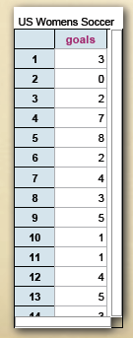
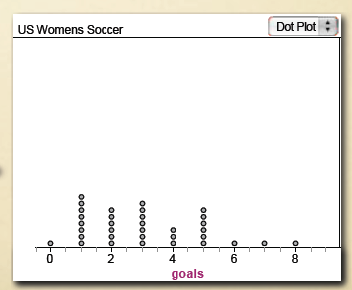
Dot Plot
Small datasets with a small range (max-min) can be easily displayed using a dotplot
  Draw and label a number line from min to max
  Place one dot per observation above its value
  Stack multiple observations evenly
Not, the first type of graph under STATPLOT
34 values
ranging from 0 to 8

Slide 9
Interesting Website
https://www.stapplet.com/
Does a lot of statistical analysis
Even advanced concepts
Specific web-pages tied to our book

Slide 10
Stem Plots
A stemplot gives a quick picture of the shape of a distribution while including the numerical values
  Separate each observation into a stem and a leaf
  eg. 14g -> 1|4 256 -> 25|6 32.9oz -> 32|9
  Write stems in a vertical column and draw a vertical line to the right of the column
  Write each leaf to the right of its stem
Note:
  Stemplots do not work well for large data sets
  Not available on calculator

Slide 11
Stem & Leaf Plots Review
Given the following values, draw a stem and leaf plot
20, 32, 45, 44, 26, 37, 51, 29, 34, 32, 25, 41, 56
Ages Occurrences
------------------------------------------------------------------
2 | 0, 6, 9, 5
|
3 | 2, 7, 4, 2
|
4 | 5, 4, 1
|
5 | 1, 6

Slide 12
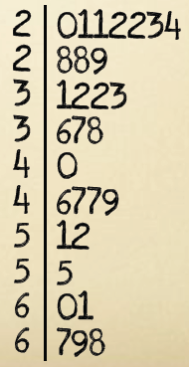
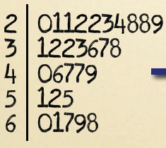
Splitting Stems
Double the number of stems, writing 0-4 after the first and 5-9 after second.

Slide 13
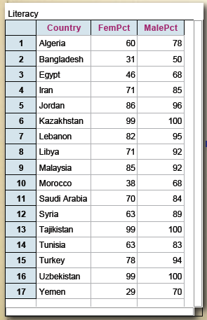
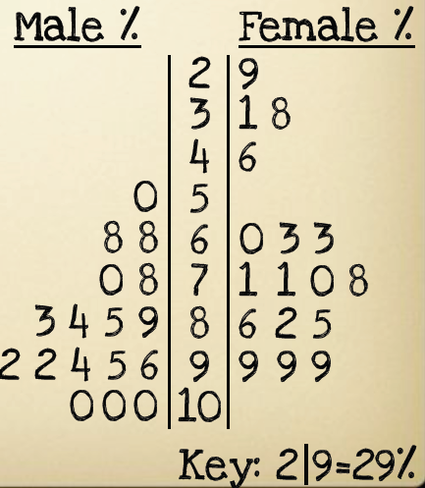
Back-to-Back Stemplots
Back-to-Back Stemplots: Compare datasets
Example1.4, pages 42-43
Literacy Rates in Islamic Nations

Slide 14
Example 1
The ages (measured by last birthday) of the employees of Dewey, Cheatum and Howe are listed below.
Construct a stem graph of the ages
Construct a back-to-back comparing the offices
Construct a histogram of the ages
22 | 31 | 21 | 49 | 26 | 42
42 | 30 | 28 | 31 | 39 | 39
20 | 37 | 32 | 36 | 35 | 33
45 | 47 | 49 | 38 | 28 | 48
Office A
Office B

Slide 15
Example 1a: Stem and Leaf
22 | 31 | 21 | 49 | 26 | 42
42 | 30 | 28 | 31 | 39 | 39
20 | 37 | 32 | 36 | 35 | 33
45 | 47 | 49 | 38 | 28 | 48
Ages of Personnel
2 0, 1, 2, 6, 8, 8,
3 0, 1, 1, 2, 3, 5, 6, 7, 8, 9, 9,
4 2, 2, 5, 7, 8, 9, 9,

Slide 16
Example 1b: Back-to-Back Stem
22 | 31 | 21 | 49 | 26 | 42
42 | 30 | 28 | 31 | 39 | 39
20 | 37 | 32 | 36 | 35 | 33
45 | 47 | 49 | 38 | 28 | 48
Office A: Ages of Personnel
Office B: Ages of Personnel
1, 2, 6, 8
0, 1, 1, 9, 9
2, 2, 9
2 0, 8
3 2, 3, 5, 6, 7, 8,
4 5, 7, 8, 9,

Slide 17
Example 2
Below are times obtained from a mail-order company's shipping records concerning time from receipt of order to delivery (in days) for items from their catalogue?
Construct a stem plot of the delivery times
Construct a split stem plot of the delivery times
3 | 7 | 10 | 5 | 14 | 12
6 | 2 | 9 | 22 | 25 | 11
5 | 7 | 12 | 10 | 22 | 23
14 | 8 | 5 | 4 | 7 | 13
27 | 31 | 13 | 21 | 6 | 8
3 | 10 | 19 | 12 | 11 | 8

Slide 18
Example 2: Stem and Leaf Part
3 | 7 | 10 | 5 | 14 | 12
6 | 2 | 9 | 22 | 25 | 11
5 | 7 | 12 | 10 | 22 | 23
14 | 8 | 5 | 4 | 7 | 13
27 | 31 | 13 | 21 | 6 | 8
3 | 10 | 19 | 12 | 11 | 8
Days to Deliver
0 2, 3, 3, 4, 5, 5, 5, 6, 6, 7, 7, 7, 8, 8, 8, 9
1 0, 0, 0, 1, 1, 2, 2, 2, 3, 3, 4, 4, 9
2 1, 2, 2, 3, 5, 7
3 1

Slide 19
Example 2b: Split Stem and Leaf
3 | 7 | 10 | 5 | 14 | 12
6 | 2 | 9 | 22 | 25 | 11
5 | 7 | 12 | 10 | 22 | 23
14 | 8 | 5 | 4 | 7 | 13
27 | 31 | 13 | 21 | 6 | 8
3 | 10 | 19 | 12 | 11 | 8
Days to Deliver
0 2, 3, 3, 4
0 5, 5, 5, 6, 6, 7, 7, 7, 8, 8, 8, 9
1 0, 0, 0, 1, 1, 2, 2, 2, 3, 3, 4, 4
1 9
2 1, 2, 2, 3
2 5, 7
3 1

Slide 20
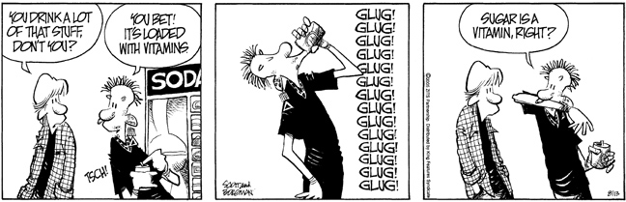
Vocabulary is Important
To speak the language, you got to know what the words really mean!

Slide 21
Summary
Summary
  When comparing distributions, be sure to discuss shape, center, spread, and possible outliers.
  Histograms are for quantitative data, bar graphs are for categorical data. Use relative frequency histograms when comparing data sets of different sizes.

Slide 22
5-Minute Check on Lesson 1-2A
Dot plots and stem-plots have what advantages:
Dot plots and stem-plots are impractical when:
What pieces of SOCS can be seen in dot and stem-plots?
Compare the following distributions:
maintains the original data
large sets of data
Shape, potential outliers, median and modes, range
Office A: Ages of Personnel
Office B: Ages of Personnel
1, 2, 6, 8
0, 1, 1, 9, 9
2, 2, 9
2 0, 8
3 2, 3, 5, 6, 7, 8,
4 5, 7, 8, 9,
Good: Office B has a greater range in ages, 29, than A (28).
Bad: Office B’s median is 36.5 and Office A’s is 31
Good: Both offices have a roughly symmetric shape of ages
Click the mouse button or press the Space Bar to display the answers.

Slide 23
Histograms
Histograms break the range of data values into classes and displays the count or % of observations that fall into that class
  Divide the range of data into equal-width classes
  Count the observations in each class: “frequency”
  Draw bars to represent classes: height = frequency
  Bars should touch (unlike bar graphs).

Slide 24
Histogram versus Bar Chart
Histogram Bar Chart
variables quantitative categorical
bar space no space spaces between

Slide 25
Determining Classes and Widths
The number of classes k to be constructed can be roughly approximated by
k = √number of observations
To determine the width of a class use
max - min
w = -----------------
k
and always round up to the same decimal units as the original data.

Slide 26
Example 1
The ages (measured by last birthday) of the employees of Dewey, Cheatum and Howe are listed below.
Construct a stem graph of the ages
Construct a back-to-back comparing the offices
Construct a histogram of the ages
22 | 31 | 21 | 49 | 26 | 42
42 | 30 | 28 | 31 | 39 | 39
20 | 37 | 32 | 36 | 35 | 33
45 | 47 | 49 | 38 | 28 | 48
Office A
Office B

Slide 27
Example 1 cont
n = 24
k = √24 ≈ 4.9 so pick k = 5
w = (49 – 20)/5
= 29/5 ≈ 5.8 → 6
K range Nr
1 20 – 25 3
2 26 – 31 6
3 32 – 37 5
4 38 – 43 5
5 44 – 50 5
8
6
4
Numbers of Personnel
2
20-25
32-37
44-50
26-31
38-43
Ages

Slide 28
Example 1 cont
n = 24
k = √24 ≈ 4.9 so pick k = 5
w = (49 – 20)/5
= 29/5 ≈ 5.8 → 6
K range Nr
1 20 – 25 3
2 26 – 31 6
3 32 – 37 5
4 38 – 43 5
5 44 – 50 5
8
6
4
Numbers of Personnel
2
20 26 32 38 44 50
Ages

Slide 29
Example 1: Histogram
n = 24
k = √24 ≈ 4.9 so pick k = 4
w = (49 – 20)/4
= 29/4 ≈ 7.3 → 8
K range Nr
1 20 – 27 4
2 28 – 35 8
3 36 – 43 7
4 44 – 51 5
8
6
4
Numbers of Personnel
2
20-27
36-43
27-35
44-51
Ages

Slide 30
Example 2
Below are times obtained from a mail-order company's shipping records concerning time from receipt of order to delivery (in days) for items from their catalogue?
Construct a stem plot of the delivery times
Construct a split stem plot of the delivery times
Construct a histogram of the delivery times
3 | 7 | 10 | 5 | 14 | 12
6 | 2 | 9 | 22 | 25 | 11
5 | 7 | 12 | 10 | 22 | 23
14 | 8 | 5 | 4 | 7 | 13
27 | 31 | 13 | 21 | 6 | 8
3 | 10 | 19 | 12 | 11 | 8

Slide 31
Example 2: Histogram
n = 36
k = √36 = 6
w = (31 – 2)/6
= 29/6 ≈ 4.8 → 5
K range1 Nr
1 2 – 6 9
2 7 – 11 12
3 12 – 16 7
4 17 – 21 2
5 22 – 26 4
6 27 – 31 2
12
10
8
6
Frequency
4
2
2 7 12 17 22 27 32
Days to Delivery

Slide 32
Describing Distributions
Overall patterns of a distribution should be described by anything unusual and:
  Shape of its graph
    symmetric, skewed,
    unimodal, bimodal, etc
  Center
    Quantitative: mean (symmetric data)
    median (skewed data)
    Categorical: mode
  Variability (Spread)
    Quantitative: range, standard deviation, IQR

Slide 33
Describing Shape
  When you describe a distribution’s shape, concentrate on the main features. Look for rough symmetry or clear skewness.
Definitions:
A distribution is roughly symmetric if the right and left sides of the graph are approximately mirror images of each other.
A distribution is skewed to the right (right-skewed) if the right side of the graph (containing the half of the observations with larger values) is much longer than the left side.
It is skewed to the left (left-skewed) if the left side of the graph is much longer than the right side.
Symmetric
Skewed-left
Skewed-right

Slide 34
Frequency Distributions
Uniform
Mound-like (Bell-Shaped)
Bi-Modal Skewed Right (-- tail)
Skewed Left (-- tail)

Slide 35
Exploratory Data Analysis Summary
The purpose of an EDA is to organize data and identify patterns/departures.
PLOT YOUR DATA
  Choose an appropriate graph
Look for overall pattern and departures from pattern
  Shape {mound, bimodal, skewed, uniform}
  Outliers {points clearly away from body of data}
  Center {What number “typifies” the data?}
  Spread {How “variable” are the data values?}

Slide 36
Time Series Plot
Time on the x-axis
Interested values on the y-axis
Look for seasonal (periodic) trends in data
  What seasonal trends do you expect in the following chart?

Slide 37
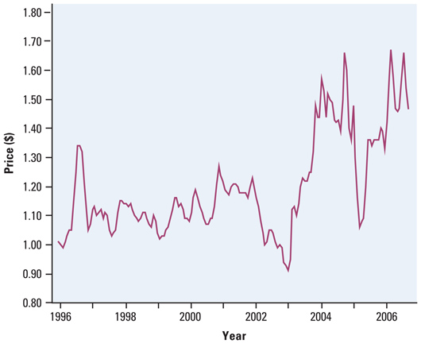
Ave Gas Prices Time Series Plot

Slide 38
Seasonal Trends
Gas prices go up during the summer
  Memorial Day to Labor Day
Sharp increases with Hurricane activity
  Hurricane season generally July – October
Major supply issues cause sharp increases
Positive general increase (due to inflation)

Slide 39
Cautions
Label all axeses and title all graphs
Histogram rectangles touch each other; rectangles in bar graphs do not touch.
Can’t have class widths that overlap
Raw data can be retrieved from the stem-and-leaf plot; but a frequency distribution of histogram of continuous data summarizes the raw data
Only quantitative data can be described as skewed left, skewed right or symmetric (uniform or bell-shaped)

Slide 40
Comparing Distributions
Some of the most interesting statistics questions involve comparing two or more groups.
Always discuss shape, center, spread, and possible outliers whenever you compare distributions of a quantitative variable.
Compare the distributions of household size for these two countries. Don’t forget your SOCS!
Place
U.K South Africa

Slide 41
Summary
Summary
  You can use a dotplot, stemplot, or histogram to show the distribution of a quantitative variable.
  When examining any graph, look for an overall pattern and for notable departures from that pattern. Describe the shape, center, spread, and any outliers. Don’t forget your SOCS!
  Some distributions have simple shapes, such as symmetric or skewed. The number of modes (major peaks) is another aspect of overall shape.

Slide 42
Summary and Homework
Summary cont
  When comparing distributions, be sure to discuss shape, center, spread, and possible outliers.
  Histograms are for quantitative data, bar graphs are for categorical data. Use relative frequency histograms when comparing data sets of different sizes.
Homework
  pg 47-54; prob 45, 51, 62, 66, 79

