Slide 1

5-Minute Check on Lesson 1-3b
When do we use each measure of spread?
Why do we divided by n – 1 in calculating the standard deviation?
Which measure of spread is resistant?
What is the formula for determining outliers?
A data set has a mean of 4 and a standard deviation of 3. A new data set is created by multiplying each data value by 2 and adding 5 to it. What are the new mean and standard deviation?
Use standard deviation with mean and IQR with median
Dividing by n creates a biased estimator of spread (too high)
IQR
LF = Q1 – 1.5×IQR UF = Q3 + 1.5×IQR
new mean = 4×2+5 = 13
new st_dev = 3×2 = 6
Click the mouse button or press the Space Bar to display the answers.

Slide 2
Lesson 1 - R
Summary to
Exploring Data

Slide 3
Objectives
Use a variety of graphical techniques to display a distribution. These should include bar graphs, pie charts, stemplots, histograms, ogives, time plots, and Boxplots
Interpret graphical displays in terms of the shape, center, and spread of the distribution, as well as gaps and outliers
Use a variety of numerical techniques to describe a distribution. These should include mean, median, quartiles, five-number summary, interquartile range, standard deviation, range, and variance

Slide 4
Objectives
Interpret numerical measures in the context of the situation in which they occur
Learn to identify outliers in a data set
Explore the effects of a linear transformation of a data set

Slide 5
Vocabulary
none new

Slide 6
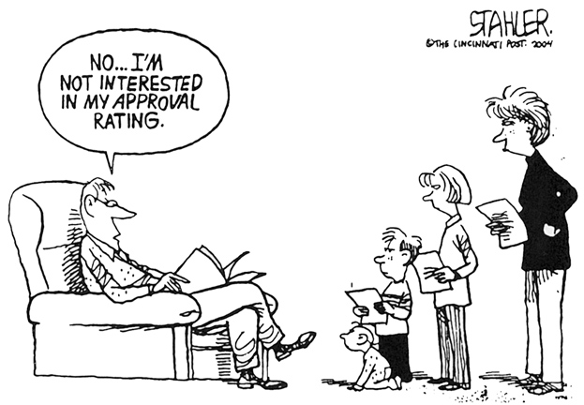
Do you know Chapter 1?
I am interested in your learning!

Slide 7
Statistical Plots
Stem-plot
  stem and leaf from Algebra
  remember back-to-back for comparisons
Box-plot (two on calculator)
  know how to use (will use it a lot in course)
Histogram (on calculator)
Dot-plot
Normality Plot (will learn later – on calculator)
Pie Chart
Bar Graph

Slide 8
Describing Distributions
Shape
  symmetric, skewed (left or right), multi-modal
Outliers
  do they exist, how many, and on which ends
Center
  appropriate measure (mean, median, or mode)
Spread
  appropriate measure (standard deviation or IQR)

Slide 9
Measures of Center and Spread
 | Measure | Resistant | When to Use | Outlier Effects
Center | Mean | No | symmetric | Pulls toward outlier
 | Median | Yes | skew | none
 | Mode | Yes | categorical | none
Spread | Standard Deviation | No | symmetric | Increases
 | IQR | Yes | Skew | none
 | Range | No | avoid | Increases
Plot your data
Dotplot, Stemplot, Histogram
Interpret what you see:
Shape, Outliers, Center, Spread
Choose numerical summary:
x and s, or
Five-Number Summary

Slide 10
Numerical Statistical Summaries
5 Number Summary from 1-VarStats
  Min
  Q1 (25th percentile of the dataset)
  Q2 (Median, 50th percentile of the dataset)
  Q3 (75th percentile of the dataset)
  Max
IQR = Q3 – Q1
Outliers → values
  less than Q1 - 1.5×IQR
  more than Q3 + 1.5×IQR
Mean and Standard Deviation from 1-VarStats

Slide 11
TI-83 Help
Use Lists to keep track of data for other work
1 Var Stats (mean, standard deviation, 5 number summary)
Stat Plot (Box plots, histogram, dot plot)
  ZoomStat
Comparative Plots (turn plot1 and plot2 on)

Slide 12

Data Analysis Toolbox
To answer a statistical question of interest:
Data: Organize and Examine (W⁵HW)
  Who are the individuals described?
  What are the variables?
  Why were the data gathered?
  When, Where, How, and By Whom were data gathered?
Graph: Construct an appropriate graphical display
  Comparative Graphs (boxplots, stemplots, histograms)
  Describe SOCS
Numerical Summary: Appropriate center & spread
  Calculate Mean and Standard Deviation
  Calculate 5 number summary
Interpretation: Answer question in context!

Slide 13
What You Learned
Displaying Distribution
  Make a stemplot of the distribution of a quantitative variable. Trim the numbers or split stems as needed to make an effective stemplot
  Make a histogram of the distribution of a quantitative variable
  Construct and interpret an ogive of a set of quantitative data

Slide 14
What You Learned
Inspecting Distributions (Quantitative)
  Look for the overall pattern and any major deviations from the pattern
  Assess from a dotplot, stemplot, or histogram whether the shape of a distribution is roughly symmetric, distinctly skewed, or neither. Assess whether the distribution has one or more major modes
  Describe the overall pattern by giving numerical measures of center and spread in addition to a verbal description of shape
  Decide which measures of center and spread are more appropriate: the mean and standard deviation (for symmetric distributions) or the five-number summary (for skewed distributions)
  Recognize outliers

Slide 15
What You Learned
Time Plots
  Make a time plot of data, with the time of each observation on the horizontal axis and the value of the observed variable on the vertical axis
  Recognize strong trends or other patterns in a time plot
Measuring Center
  Find the mean, x-bar, of a set of observations
  Find the median M of a set of observations
  Understand that the median is more resistant (less affected by extreme observations) than the mean. Recognize that skewness in a distribution moves the mean away from the median toward the long fall.

Slide 16
What You Learned
Measuring Spread
  Find the quartiles Q₁ and Q₃ for a set of data
  Give the five-number summary and draw a boxplot, assess center, spread, symmetry, and skewness from a boxplot. Determine outliers
  Using a calculator or software, find the standard deviation, s, for a set of observations
  Know the basic properties of s: s ≥ 0 always; s = 0 only when all observations are identical; s increases as the spread increases; s has the same units as the original measurements; s is increased by outliers or skewness

Slide 17
What You Learned
Comparing Distributions
  Use side-by-side bar graphs to compare distributions of categorical data
  Make back-to-back stemplots and side-by-side Boxplots to compare distributions of quantitative variables
  Write narrative comparisons of the shape, center, spread, and outliers for two or more quantitative distributions

Slide 18
Summary and Homework
Summary
  Data Analysis is the art of describing data in context using graphs and numerical summaries
  Graphs tell us a lot about the data
  Remember when describing datasets or distributions hit all 4 key areas (SOCS)
  Use comparative language (more, less, etc) when comparing two datasets or distributions
Homework
  pg 83-85; prob R1.3, 9, 10

Slide 19
Problem 1
The upper or third quartile for grades on the first calculus test was 85%. Your friend, who has not taken statistics, scored 90% on the test. Explain to your friend how her grade compares to others in her class.
Since the 3rd quartile (75% ranking) was 85%, her grade of 90% is better than at least 75% of the class.

Slide 20
Problem 2
Suppose you have test scores of 72%, 91%, 86%, and 95% in your chemistry class. What score do you need to make on the next test in order to have an 85% average?
5 × 85 = 425
72 + 91 + 86 + 95 = 344
425 – 344 = 81

Slide 21
Problem 3
In the computational formula for standard deviation, you sometimes use n and sometimes use (n – 1). Under what circumstances should you use n?
We use n-1 for sample standard deviation because we lose one degree of freedom for the estimate of the population mean with the sample mean.
If we have the entire population (a census), then our sample mean is the population mean and we can divide by n in calculating the standard deviation.

Slide 22
Problem 4
We studied two measures of central tendency, mean and median. Which of these is the more resistant measure? _________________ Explain why this measure is more resistant.
We studied three measures of spread: standard deviation, interquartile range, and range. Which of these is the most resistant measure? ________________
median
because they are least affected by outliers
IQR

Slide 23
Problem 5
In an experiment designed to determine the effect of a drug on reaction time, a subject is asked to press a button whenever a light flashes. The reaction times (in milliseconds) for ten trials are:
96 101 112 138 93 99 107 93 95 100
Make a stem and leaf plot to display this information. Be sure to include unit information (a legend).
What information about the distribution does the stem and leaf plot provide? Be thorough in your response.
Reaction Time
9 | 3 3 5 6 9
10 | 0 1 7
11 | 2
12 |
13 | 8
milliseconds
skewed right, median=99.5, IQR is 12, 138 is an outlier

Slide 24
Problem 6
Data were collected on a sample of Deerfield Academy students. Several of the variables are listed below. Next to each variable, put all of the following words that correctly describe the variable:
Categorical quantitative discrete continuous
(a) Advisor ______________________________
(b) Height _______________________________
(c) Number of courses student is taking this term ______________________________________
categorical
quantitative continuous
quantitative discrete

Slide 25
Problem 7
A teacher returned the first test to the five students in a small class. She reported that the median score was 85 and the mean score was 84. The student with the lowest score (62) realized that the teacher had incorrectly calculated her grade and that the correct grade was 72. Assuming that this is still be the lowest score for the seminar students, when the teacher recomputed the summary statistics, the median will equal _____________ and the mean will equal ________________ .
85
84 + 2 = 86
median doesn’t change because order is unaffected by rescoring
mean is recalculated by dividing 10 additional points by 5 = 2 and
adding 2 points to the mean

Slide 26
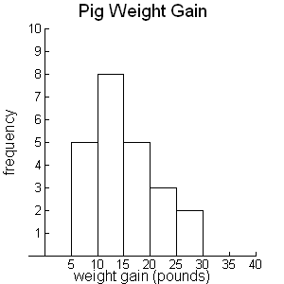
Problem 8
The histogram below displays weight increases (in pounds) for a sample of pigs fed a certain diet. Assume that bars include right endpoints.
How many pigs were in this sample? ___________
Estimate the median weight increase for the pigs in this sample. __________
What proportion of these pigs had a weight increase exceeding 20 pounds? _________________
Briefly (but completely) describe the shape of this distribution
5 + 8 + 5 + 3 + 2 = 23
12th ranked – 10-15 lb
5/23 = 21.74%
unimodal skewed right

Slide 27
Problem 9
As I drove through Connecticut several weeks ago, I obtained a sample of prices for a gallon of unleaded gasoline at service stations I passed. Four of these are provided here: $3.09, $3.15, $3.19, $3.29. Use the definition and show work below to find the mean and standard deviation of these prices. Round answers to the nearest cent.
Mean
Standard deviation
1/n ∑x_{i}
¼ × (3.09 + 3.15 + 3.19 + 3.29) = 3.18
Var = 1/(n-1)∑(x_{i} - mean)²
⅓ × [(3.09-3.18)² + (3.15-3.18)² + (3.19-3.18)² + (3.29-3.18)² ]
⅓ × [(-.09)² + (-.03)² + (.01)² + (.11)² ] = ⅓ × .0212 = 0.007067
Std dev = √Var = √0.007067 = 0.8406

Slide 28
Problem 10
The Los Angeles Times reported interest rates for savings accounts at a sample of California banks. Summary statistics are provided below:
Minimum = 3.15% Q1 = 3.25% Median = 3.31% Q3 = 3.33% Maximum = 4.35%
Determine whether the data set has any outliers (check for extremely low and high values). Show work and provide an explanation to support your answer.
IQR = Q3 – Q1 = 0.08%
LF = Q1 – 1.5×IQR
= 3.25 – 1.5 × 0.08
= 3.13%
UF = Q3 + 1.5×IQR
= 3.33 – 1.5 × 0.08
= 3.45%
Since the max is greater than UF, the data has at least one outlier.

