Slide 1
Lesson 10 - 1
Comparing Two Proportions

Slide 2

Objectives
Describe the shape, center, and variability of the sampling distribution of ${\hat{p}}_{1}−{\hat{p}}_{2}$
Determine whether the conditions are met for doing inference about a difference between two proportions
Construct and interpret a confidence interval for a difference between two proportions
Calculate the standardized test statistic and P-value for a test about a difference between two proportions
Perform a significance test about a difference between two proportions

Slide 3
Vocabulary
Standard error – also called the estimated standard deviation combines p-hat1 and p-hat2
Pooled (or combined) sample proportions – combines the separate values of p-hat1 and p-hat2 into a single value

Slide 4
Inference Toolbox Review
Step 1: Hypothesis
  Identify population of interest and parameter
  State H₀ and H_{a}
Step 2: Conditions
  Check appropriate conditions
Step 3: Calculations
  State test or test statistic
  Use calculator to calculate test statistic and p-value
Step 4: Interpretation
  Interpret the p-value (fail-to-reject or reject)
  Don’t forget 3 C’s: conclusion, connection and context

Slide 5
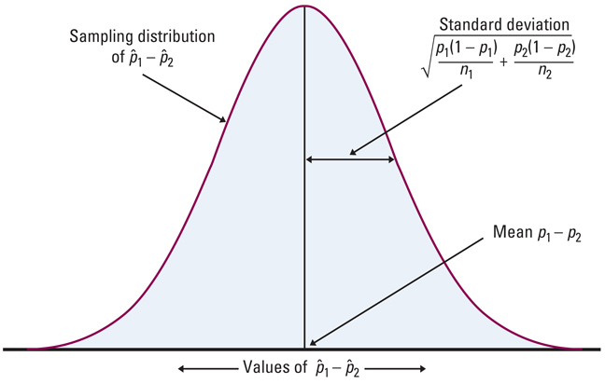
Difference in Two Proportions
Testing a claim regarding the difference of two proportions requires that they both are approximately Normal

Slide 6
Requirements
Testing a claim regarding the confidence interval of the difference of two proportions
SRS - Samples are independently obtained using SRS (simple random sampling)
Independence: groups are independent samples
n₁ ≤ 0.10N₁ and n₂ ≤ 0.10N₂;
Normality: n₁p₁ ≥ 10 and n₁(1-p₁) ≥ 10
n₂p₂ ≥ 10 and n₂(1-p₂) ≥ 10
(note: some books use 5 instead of 10)

Slide 7
Confidence Intervals
Two-Sample z Interval for a Difference Between Proportions
Independent: Both the samples or groups themselves and the individual observations in each sample or group are independent. When sampling without replacement, check that the two populations are a least 10 times as large as the corresponding samples (the 10% condition).

Slide 8
Confidence Interval – Difference in Two Proportions
Lower Bound:
Upper Bound:
p₁ and p₂ are the sample proportions of the two samples
Note: the same requirements hold as for the hypothesis testing
(p₁ – p₂) – z_{α/2} ·
p₁(1 – p₁) p₂(1 – p₂)
--------------- + --------------
n₁ n₂
(p₁ – p₂) + z_{α/2} ·
p₁(1 – p₁) p₂(1 – p₂)
--------------- + --------------
n₁ n₂

Slide 9
Using Your TI Calculator
Press STAT
  Tab over to TESTS
  Select 2-PropZInt and ENTER
    Entry x1,
    n1,
    x2,
    n2,
    C-level
    Highlight Calculate and ENTER
  Read interval information off

Slide 10
Teens and Adults on Social Networks
As part of the Pew Internet and American Life Project, researchers conducted two surveys in late 2009. The first survey asked a random sample of 800 U.S. teens about their use of social media and the Internet. A second survey posed similar questions to a random sample of 2253 U.S. adults. In these two studies, 73% of teens and 47% of adults said that they use social-networking sites.
Use these results to construct and interpret a 95% confidence interval for the difference between the proportion of all U.S. teens and adults who use social-networking sites.

Slide 11
Teens and Adults on Social Networks
State: Our parameters of interest are
p₁ = the proportion of all U.S. teens who use social networking sites and p₂ = the proportion of all U.S. adults who use social-networking sites.
We want to estimate the difference p₁ – p₂ at a 95% confidence level.
Plan: We should use a two-sample z interval for p₁ – p₂ if the conditions are satisfied.
Random: The data come from a random sample of 800 U.S. teens and a separate random sample of 2253 U.S. adults.
Independent: We clearly have two independent samples—one of teens and one of adults. Individual responses in the two samples also have to be independent. The researchers are sampling without replacement, so we check the 10% condition: there are at least 10(800) = 8000 U.S. teens and at least 10(2253) = 22,530 U.S. adults.
Normal: We check the counts of “successes” and “failures” and note the Normal condition is met since they are all at least 10:

Slide 12
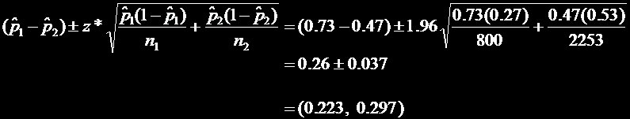
Teens and Adults on Social Networks
Do: Since the conditions are satisfied, we can construct a two-sample z interval for the difference p₁ – p₂.
Conclude: We are 95% confident that the interval from 0.223 to 0.297 captures the true difference in the proportion of all U.S. teens and adults who use social-networking sites. This interval suggests that more teens than adults in the United States engage in social networking by between 22.3 and 29.7 percentage points.

Slide 13
Example 1
A study of the effect of pre-school had on later use of social services revealed the following data.
Compute a 95% confidence interval on the difference between the control and Pre-school group proportions
Population | Description | Sample Size | Social Service | Proportion
1 | Control | 61 | 49 | 0.803
2 | Preschool | 62 | 38 | 0.613

Slide 14
Example 1 cont
Population | Description | Sample Size | Social Service | Proportion
1 | Control | 61 | 49 | 0.803
2 | Preschool | 62 | 38 | 0.613
Conditions: SRS Normality Independence
Calculations:
Conclusion:
Assumed
CAUTION!
n₁p₁ = 49 > 10 n₁(1-p₁) = 12 >10
n₂p₂ = 38 > 10 n₂(1-p₂) = 24 >10
Ni > 620
(kids that age)
(p₁ – p₂) ± z_{α/2} ·
p₁(1 – p₁) p₂(1 – p₂)
--------------- + --------------
n₁ n₂
2 proportion z-interval
Using our calculator we get: (0.03337 , 0.34738)
The method used to generate this interval, (0.0337 , 0.34738), will on average capture the true difference between population proportions 95% of the time. Since it does not include 0, then they are different.

Slide 15
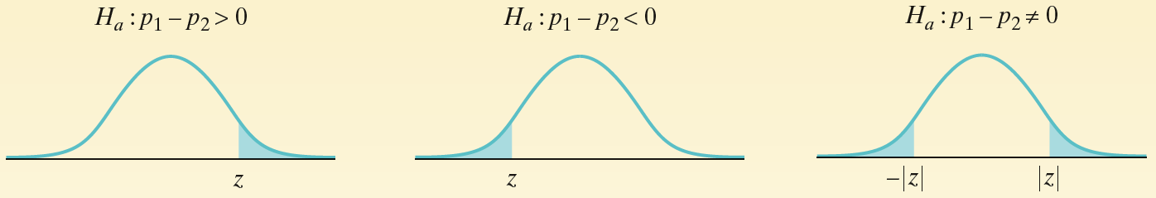
Inference Test on Two Proportions
Two-Sample z Test for the Difference Between Proportions

Slide 16
Classical and P-Value Approach – Two Proportions
P-Value is the
area highlighted
Remember to add the areas in the two-tailed!
z₀
-|z₀|
|z₀|
z₀
-z_{α}
-z_{α/2}
z_{α/2}
z_{α}
Critical Region
p₁ – p₂
z₀ = ---------------------------------
p (1- p)
where
x₁ + x₂
p = ------------
n₁ + n₂
Test Statistic:
1 1
--- + ---
n₁ n₂
Reject null hypothesis, if
P-value < α
Left-Tailed | Two-Tailed | Right-Tailed
z₀ < - z_{α} | z₀ < - z_{α/2} or z₀ > z_{α/2} | z₀ > z_{α}

Slide 17
Combined Sample Proportion Estimate
Combined sample proportion is used because all probabilities are being calculated under the null hypothesis that the independent proportions are equal!
x₁ + x₂
p = ------------
n₁ + n₂

Slide 18
Using Your Calculator
Press STAT
  Tab over to TESTS
  Select 2-PropZTest and ENTER
    Entry x1,
    n1,
    x2,
    n2
    Highlight test type (p1≠ p2, p1<p2, or p1>p2)
    Highlight Calculate and ENTER
  Read z-critical and p-value off screen
  other information is there to verify
Classical: compare Z₀ with Z_{c} (from table)
P-value: compare p-value with α

Slide 19
Hungry Children Example
Researchers designed a survey to compare the proportions of children who come to school without eating breakfast in two low-income elementary schools. An SRS of 80 students from School 1 found that 19 had not eaten breakfast. At School 2, an SRS of 150 students included 26 who had not had breakfast. More than 1500 students attend each school.
Do these data give convincing evidence of a difference in the population proportions? Carry out a significance test at the α = 0.05 level to support your answer.

Slide 20
Hungry Children Example
State: Our hypotheses are
H₀: p₁ - p₂ = 0
H_{a}: p₁ - p₂ ≠ 0
where
p₁ = the true proportion of students at School 1 who did not eat breakfast, and
p₂ = the true proportion of students at School 2 who did not eat breakfast.

Slide 21
Hungry Children Example
Plan: We should perform a two-sample z test for p₁ – p₂ if the conditions are satisfied.
Random: The data were produced using two simple random samples—of 80 students from School 1 and 150 students from School 2.
Independent: We clearly have two independent samples—one from each school. Individual responses in the two samples also have to be independent. The researchers are sampling without replacement, so we check the 10% condition: there are at least 10(80) = 800 students at School 1 and at least 10(150) = 1500 students at School 2.
Normal: We check the counts of “successes” and “failures” and note the Normal condition is met since they are all at least 10:

Slide 22

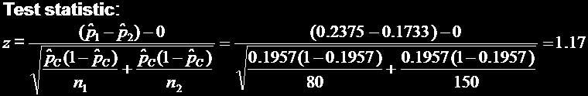
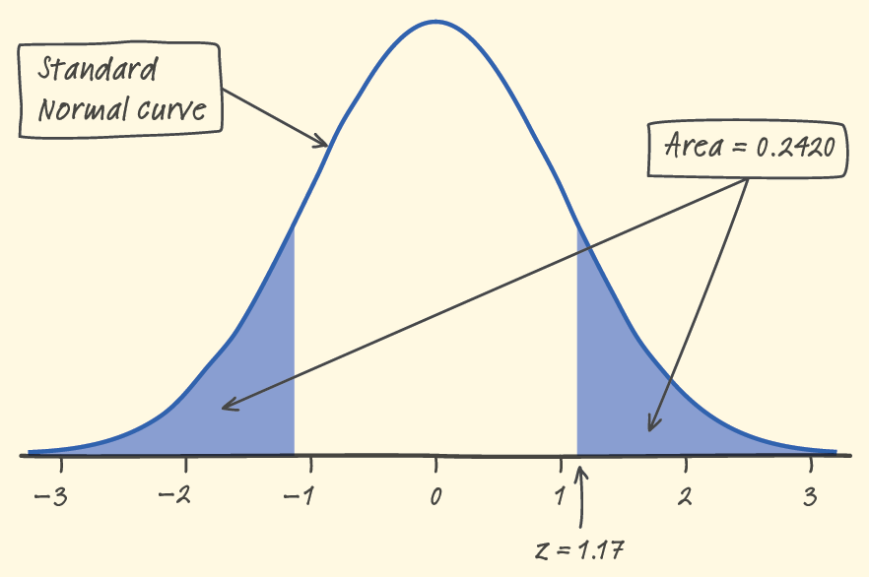
Hungry Children Example
Do: Since the conditions are satisfied, we can perform a two-sample z test for the difference p₁ – p₂.
P-value Using Table A or normalcdf, the desired P-value is
2P(z ≥ 1.17) = 2(1 - 0.8790) = 0.2420.
Conclude: Since our P-value, 0.2420, is greater than the chosen significance level of α = 0.05,we fail to reject H₀. There is not sufficient evidence to conclude that the proportions of students at the two schools who didn’t eat breakfast are different.

Slide 23
Example 2
We have two independent samples. 55 out of a random sample of 100 students at one university are commuters. 80 out of another random sample of 200 students at different university are commuters. We wish to know of these two proportions are equal. We use a level of significance α = .05

Slide 24
Example 2 cont
Parameter
Hypothesis
H₀:
H₁:
Requirements: SRS, Independence, Normality
p₁ and p₂ are the commuter rates (%) at the two universities
p₁ = p₂ (No difference in commuter rates)
p₁ ≠ p₂ (difference in commuter rates)
Random sample discussed above is assumed SRS ✓
n₁ = 100 n₁ < 0.05N₁ assume > 2000 total students ✓
n₂ = 200 n₂ < 0.05N₂ assume > 4000 total students ✓
p₁ = 0.55 n₁ p₁ and n₁ (1-p₁) (55, 45) > 10 ✓
p₂ = 0.40 n₂ p₂ and n₂(1-p₂) (80, 120) > 10 ✓

Slide 25
Example 2 cont
Pooled Est:
55 + 80
p = -------------- = 0.45
100 + 200
Test Statistic:
Critical Value:
Conclusion:
p₁ – p₂
z₀ = ---------------------------------
p (1- p)
= 2.462, p = 0.0138
1 1
--- + ---
n₁ n₂
z_{c}(0.05/2) = 1.96, α = 0.05
Since the p-value is less than α (.01 < .05) or z₀ > z_{c}, we have sufficient evidence to reject H₀. So there is a difference in the proportions of students who commute between the two universities

Slide 26
Sample Size for Estimating p₁ – p₂
The sample size required to obtain a (1 – α) * 100% confidence interval with a margin of error E is given by
2
z_{α/2}
n = n₁= n₂ = p₁(1 – p₁) + p₂(1 – p₂) ------
E
rounded up to the next integer. If a prior estimates of p_{i} are unavailable, the sample required is
2
z_{α/2}
n = n₁= n₂ = 0.5 ------
E
rounded up to the next integer, where p_{i} is a prior estimate of p_{i}. The margin of error should always be expressed as a decimal when using either of these formulas.

Slide 27
Example 3
A sports medicine researcher for a university wishes to estimate the difference between the proportion of male athletes and female athletes who consume the USDA’s recommended daily intake of calcium. What sample size should he use if he wants to estimate to be within 3% at a 95% confidence level?
if he uses a 1994 study as a prior estimate that found 51.1% of males and 75.2% of females consumed the recommended amount
if he does not use any prior estimates

Slide 28
Example 3a
Using the formula below with p₁=0.511, p₂=0.752, E=0.03 and Z_{0.975} = 1.96
n = [(0.511)(0.489)+(0.752)(0.248)] (1.96/0.03)²
= 1862.6
Round up to 1863 subjects in each group
2
z_{α/2}
n = n₁= n₂ = p₁(1 – p₁) + p₂(1 – p₂) ------
E

Slide 29
Example 3b
Using the formula below with, E=0.03 and
Z_{0.975} = 1.96
n = [(0.5)] (1.96/0.03)²
= 2134.2
Round up to 2135 subjects in each group
Prior estimates help make sizes required smaller
2
z_{α/2}
n = n₁= n₂ = 0.5 ------
E

Slide 30
Summary and Homework
Summary
  We can compare proportions from two independent samples
  We use a formula with the combined sample sizes and proportions for the standard error
  The overall process, other than the formula for the standard error, are the general hypothesis test and confidence intervals process
Homework
  Day One: 1, 3, 5;
  Day Two: 7, 9, 11, 13
  Day Three: 15, 17, 21, 23

