Slide 1
Lesson 10 - 2
Comparing Two Means

Slide 2

Objectives
Describe the shape, center, and variability of the sampling distribution of ${\overline{x}}_{1}−{\overline{x}}_{2}$
Determine whether the conditions are met for doing inference about a difference between two means
Construct and interpret a confidence interval for a difference between two means
Calculate the standardized test statistic and P-value for a test about a difference between two means
Perform a significance test about a difference between two means

Slide 3
Vocabulary
Pooled two-sample t statistic – assumes that the variances of the two sample are the same (we never use them in AP)

Slide 4
Two Sample Problems
The goal of inference is to compare the responses to two treatments or to compare the characteristics of two populations
We have a separate sample from each treatment or each population
The response of each group are independent of those in other group

Slide 5
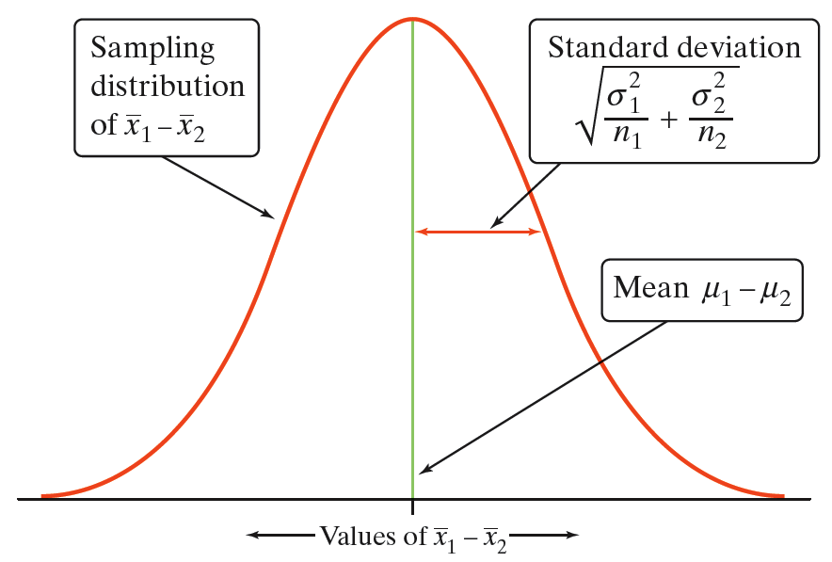
Two Sample Distributions
The Sampling Distribution of the Difference Between Sample Means
Choose an SRS of size n₁ from Population 1 with mean µ₁ and standard deviation σ₁ and an independent SRS of size n₂ from Population 2 with mean µ₂ and standard deviation σ₂.

Slide 6
Confidence Intervals
Two-Sample t Interval for a Difference Between Means

Slide 7
Conditions for Comparing 2 Means
SRS
  Two SRS’s from two distinct populations
  Measure same variable from both populations
Independence
  Samples are independent of each other
  (not the test for match pair designs)
  N_{i} ≥ 10n_{i}
Normality
  Both populations are Normally distributed
  In practice, (large sample sizes for CLT to apply) similar shapes with no strong outliers

Slide 8
2-Sample z Statistic
Facts about sampling distribution of x₁ – x₂
Mean of x₁ – x₂ is μ₁ - μ₂ (since sample means are an unbiased estimator)
Variance of the difference of x₁ – x₂ is
(note variances add because samples are independent. Standard deviations do not)
If the two population distributions are Normal, then so is the distribution of x₁ – x₂
² ²
σ₁ σ₂
--- + ---
n₁ n₂

Slide 9
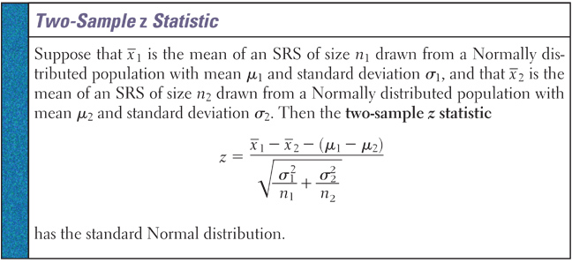
2-Sample z Statistic
Since we almost never know the population standard deviation (or for sure that the populations are normal), we very rarely use this in practice.

Slide 10
t-Test Statistic
Since H₀ assumes that the two population means are the same, our test statistic is reduce to:
Similar in form to all of our other test statistics
(x₁ – x₂)
t₀ = -------------------------------
s₁² s₂²
----- + -----
n₁ n₂
Test Statistic:

Slide 11
2-Sample t Statistic
Since we don’t know the standard deviations we use the t-distribution for our test statistic. But we have a problem with calculating the degrees of freedom! We have two options:
Let our calculator handle the complex calculations and tell us what the degrees of freedom are
Use the smaller of n₁ – 1 and n₂ – 1 as a conservative estimate of the degrees of freedom

Slide 12
Confidence Intervals
Lower Bound:
Upper Bound:
t_{α/2} is determined using the smaller of n₁ -1 or n₂ -1 degrees of freedom
x₁ and x₂ are the means of the two samples
s₁ and s₂ are the standard deviations of the two samples
Note: The two populations need to be normally distributed or the sample sizes large
(x₁ – x₂) – t_{α/2} ·
s₁² s₂²
----- + -----
n₁ n₂
PE ± MOE
(x₁ – x₂) + t_{α/2} ·
s₁² s₂²
----- + -----
n₁ n₂

Slide 13
Two-sample, independent, T-Test on TI
If you have raw data:
  enter data in L1 and L2
Press STAT, TESTS, select 2-SampT-Test
  raw data: List1 set to L1, List2 set to L2 and freq to 1
  summary data: enter as before
  Set Pooled to NO
  copy off t* value and the degrees of freedom
Confidence Intervals
  follow hypothesis test steps, except select 2-SampTInt and input confidence level

Slide 14
Trees Example
The Wade Tract Preserve in Georgia is an old-growth forest of longleaf pines that has survived in a relatively undisturbed state for hundreds of years. One question of interest to foresters who study the area is “How do the sizes of longleaf pine trees in the northern and southern halves of the forest compare?” To find out, researchers took random samples of 30 trees from each half and measured the diameter at breast height (DBH) in centimeters. Construct and interpret a 90% confidence interval for the difference in the mean DBH for longleaf pines in the northern and southern halves of the Wade Tract Preserve.

Slide 15
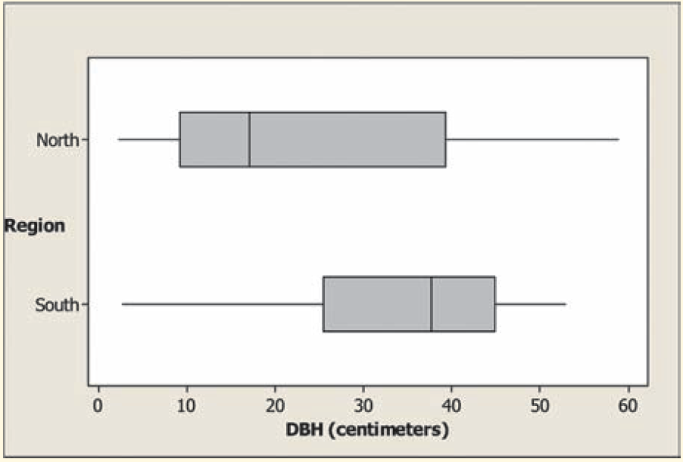
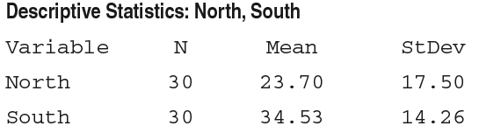
Trees Example Cont
Comparative boxplots of the data and summary statistics from Minitab are shown below.
State: Our parameters of interest are
µ₁ = the true mean DBH of all trees in the southern half of the forest and
µ₂ = the true mean DBH of all trees in the northern half of the forest.
We want to estimate the difference µ₁ - µ₂ at a 90% confidence level.

Slide 16
Trees Example Cont
Plan: We should use a two-sample t interval for µ₁ – µ₂ if the conditions are satisfied.
SRS: The data come from a random samples of 30 trees each from the northern and southern halves of the forest.
Independent: Researchers took independent samples from the northern and southern halves of the forest. Because sampling without replacement was used, there have to be at least 10(30) = 300 trees in each half of the forest. This is pretty safe to assume.
Normal: The boxplots give us reason to believe that the population distributions of DBH measurements may not be Normal. However, since both sample sizes are at least 30, we are safe using t procedures.

Slide 17
Trees Example Cont
Do: Since the conditions are satisfied, we can construct a two-sample t interval for the difference µ₁ – µ₂. We’ll use the conservative df = 30-1 = 29.
From our calculator we get: [3.83, 17.83] for a 90% CI
Conclude: We are 90% confident that the interval from 3.83 to 17.83 centimeters captures the difference in the actual mean DBH of the southern trees and the actual mean DBH of the northern trees.
This interval suggests that the mean diameter of the southern trees is between 3.83 and 17.83 cm larger than the mean diameter of the northern trees.

Slide 18
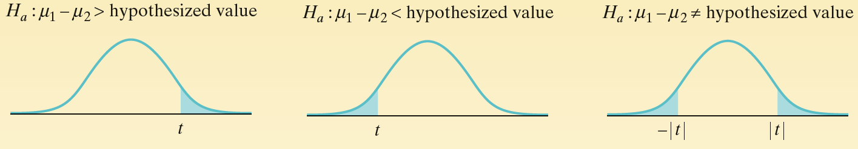
Two sample t-Test
Two-Sample t Test for the Difference Between Two Means

Slide 19
Classical and P-Value Approach – Two Means
P-Value is the area highlighted
Remember to add the areas in the two-tailed!
t₀
-|t₀|
|t₀|
t₀
-t_{α}
-t_{α/2}
t_{α/2}
t_{α}
Critical Region
(x₁ – x₂) – (μ₁ – μ₂ )
t₀ = -------------------------------
s₁² s₂²
----- + -----
n₁ n₂
Test Statistic:
Reject null hypothesis, if
P-value < α
Left-Tailed | Two-Tailed | Right-Tailed
t₀ < - t_{α} | t₀ < - t_{α/2} or t₀ > t_{α/2} | t₀ > t_{α}

Slide 20
Inference Toolbox Review
Step 1: Hypothesis
  Identify population of interest and parameter
  State H₀ and H_{a}
Step 2: Conditions
  Check appropriate conditions
Step 3: Calculations
  State test or test statistic
  Use calculator to calculate test statistic and p-value
Step 4: Interpretation
  Interpret the p-value (fail-to-reject or reject)
  Don’t forget 3 C’s: conclusion, connection and context

Slide 21
Example 1
Does increasing the amount of calcium in our diet reduce blood pressure? Subjects in the experiment were 21 healthy black men. A randomly chosen group of 10 received a calcium supplement for 12 weeks. The control group of 11 men received a placebo pill that looked identical. The response variable is the decrease in systolic (top #) blood pressure for a subject after 12 weeks, in millimeters of mercury. An increase appears as a negative response. Data summarized below
Calculate the summary statistics.
Test the claim
Subjects | 1 | 2 | 3 | 4 | 5 | 6 | 7 | 8 | 9 | 10 | 11
Calcium | 7 | -4 | 18 | 17 | -3 | -5 | 1 | 10 | 11 | -2 | ----
Control | -1 | 12 | -1 | -3 | 3 | -5 | 5 | 2 | -11 | -1 | -3

Slide 22
Example 1a
Calculate the summary statistics.
Subjects | 1 | 2 | 3 | 4 | 5 | 6 | 7 | 8 | 9 | 10 | 11
Calcium | 7 | -4 | 18 | 17 | -3 | -5 | 1 | 10 | 11 | -2 | ----
Control | -1 | 12 | -1 | -3 | 3 | -5 | 5 | 2 | -11 | -1 | -3
Group | Treatment | N | x-bar | s
1 | Calcium | 10 | 5.000 | 8.743
2 | Control | 11 | -0.273 | 5.901
Looks like there might be a difference!

Slide 23
Example 1b
Test the claim
Hypotheses:
Group | Treatment | N | x-bar | s
1 | Calcium | 10 | 5.000 | 8.743
2 | Control | 11 | -0.273 | 5.901
μ₁ = mean decreases in black men taking calcium
μ₂ = mean decreases in black men taking placebo
H_{O}: μ₁ = μ₂
H_{a}: μ₁ > μ₂
or
equivalently
H_{O}: μ₁ - μ₂ = 0
H_{a}: μ₁ - μ₂ > 0

Slide 24
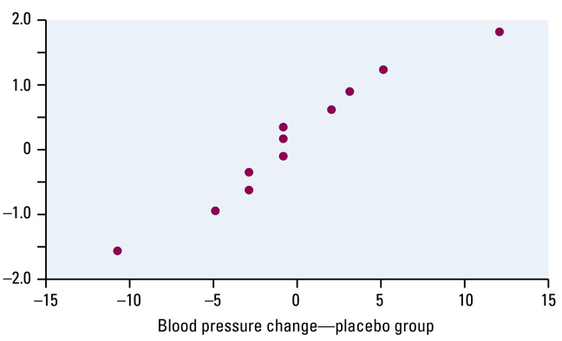
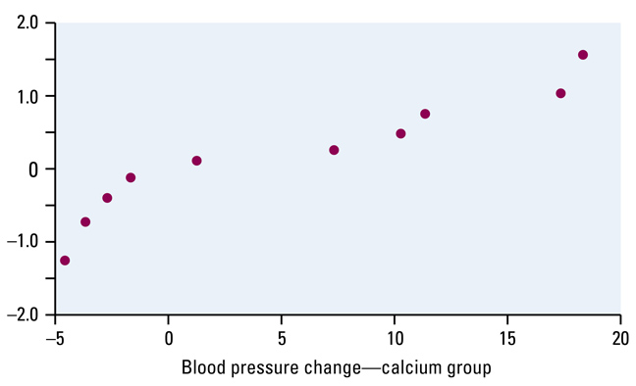
Example 1b cont
Conditions:
SRS
Independence
Normality
The 21 subjects were not a random selection from all healthy black men. Hard to generalize to that population any findings. Random assignment of subjects to treatments should ensure differences due to treatments only.
Because of the randomization, the groups can be treated as two independent samples; more than 110 black men in population
Sample size too small for CLT to apply; Plots Ok.

Slide 25
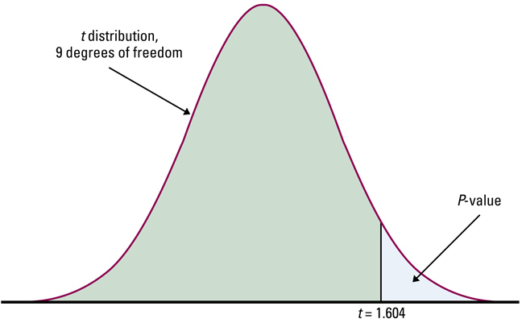
Example 1b cont
Calculations:
Conclusions:
df = min(11-1,10-1) = 9
(x₁ – x₂) 5.273
t₀ = ------------------------------- = ------------ = 1.604
s₁² s₂² 3.2878
----- + -----
n₁ n₂
from calculator: t=1.6038
p-value = 0.0644 df = 15.59
Since p-value is above an α = 0.05 level, we conclude that the difference in sample mean systolic blood pressures is not sufficient evidence to reject H₀. Not enough evidence to support Calcium supplements lowering blood pressure.

Slide 26
Who’s taller?
Based on information from the U.S. National Health and Nutrition Examination Survey (NHANES), the heights (in inches) of ten-year-old girls follow a Normal distribution N(56.4, 2.7). The heights (in inches) of ten-year-old boys follow a Normal distribution N(55.7, 3.8).
A researcher takes independent SRSs of 12 girls and 8 boys of this age and measures their heights. After analyzing the data, the researcher reports that the sample mean height of the boys is larger than the sample mean height of the girls.

Slide 27
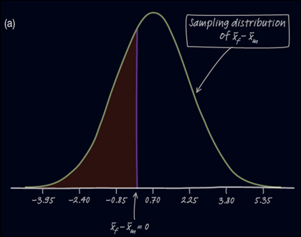

Who’s taller?
a) Describe the center, shape, and spread of the sampling distribution of x-bar_{f} – x-bar_{m}

Slide 28

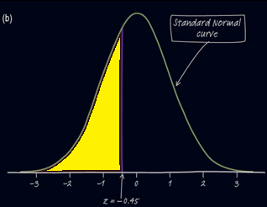
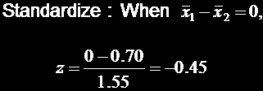
Who’s taller?
b) Find the probability of getting a difference in sample means, , that is less than zero.
Use Table A: the area to the left of x = -0.45 under the standard Normal curve is 0.3264

Slide 29
Who’s taller?
(c) Does the result in part (b) give us reason to doubt the researchers’ stated results?
If the mean height of the boys is greater than the mean height of the girls, x-bar_{m} > x-bar_{f}; that is x-bar_{m} - x-bar_{f} < 0.
Part (b) shows that there’s about a 33% chance of getting a difference in sample means that’s negative just due to sampling variability.
This gives us little reason to doubt the researcher’s claim.

Slide 30
Example 2
Given the following data collected from two independently done simple random samples on average cell phone costs:
Test the claim that μ₁ > μ₂ at the α = 0.05 level of significance
Construct a 95% confidence interval about μ₁ - μ₂
Data | Provider 1 | Provider 2
n | 23 | 13
x-bar | 43.1 | 41.0
s | 4.5 | 5.1

Slide 31
Example 2a Cont
Parameters
Hypothesis
H₀:
H₁:
Requirements:
SRS:
Independence:
Normality:
u_{i} is average cell phone cost for provider i
μ₁ = μ₂ (No difference in average costs)
μ₁ > μ₂ (Provider 1 costs more than Provider 2)
Stated in the problem
Stated in the problem; More than 230 cell phone users
Have to assume to work the problem. Sample size to small for CLT to apply

Slide 32
Example 2a Cont
Calculation:
Critical Value:
Conclusion:
x₁ – x₂ - 0
t₀ = ------------------------
√(s²₁/n₁) + (s²₂/n₂)
= 1.237, p-value = 0.1144
t_{c}(13-1,0.05) = 1.782, α = 0.05
Since the p-value > α (or that t_{c} > t₀), we would not have evidence to reject H₀. The cell phone providers average costs seem to be the same.

Slide 33
Example 2b
Confidence Interval: PE ± MOE
(x₁ – x₂) ± t_{α/2} ·
s₁² s₂²
----- + -----
n₁ n₂
t_{c}(13-1,0.025) = 2.179
2.1 ± 2.179 √ (20.25/23) + (26.01/13)
2.1 ± 2.179 (1.6974) = 2.1 ± 3.6986
[ -1.5986, 5.7986] by hand
[ -1.4166, 5.6156] by calculator
It uses a different way to calculate the degrees of freedom (as shown on pg 792)

Slide 34
Using Two-Sample t Procedures Wisely
The two-sample t procedures are more robust against non-Normality than the one-sample t methods. When the sizes of the two samples are equal and the two populations being compared have distributions with similar shapes, probability values from the t table are quite accurate for a broad range of distributions when the sample sizes are as small as n₁ = n₂ = 5.
Using the Two-Sample t Procedures: The Normal Condition
Sample size less than 15: Use two-sample t procedures if the data in both
samples/groups appear close to Normal (roughly symmetric, single peak,
no outliers). If the data are clearly skewed or if outliers are present, do not
use t.
• Sample size at least 15: Two-sample t procedures can be used except in the presence of outliers or strong skewness.
• Large samples: The two-sample t procedures can be used even for clearly
skewed distributions when both samples/groups are large, roughly n ≥ 30.

Slide 35
Different View
Sample Size | Allowed Skewness | Outliers ? | Normality
≥ 30 | Any | None | From CLT: distribution of x-bar is apx normal
15 ≤ n < 30 | Slight skewness only | None | From boxplot or normality plot
n < 15 | none | None | From boxplot or normality plot

Slide 36
Using Two-Sample t Procedures Wisely
Here are several cautions and considerations to make when using two-sample t procedures.
In planning a two-sample study, choose equal sample sizes if you can.
Do not use “pooled” two-sample t procedures!
We are safe using two-sample t procedures for comparing two means in a randomized experiment.
Do not use two-sample t procedures on paired data!
Beware of making inferences in the absence of randomization. The results may not be generalized to the larger population of interest.

Slide 37
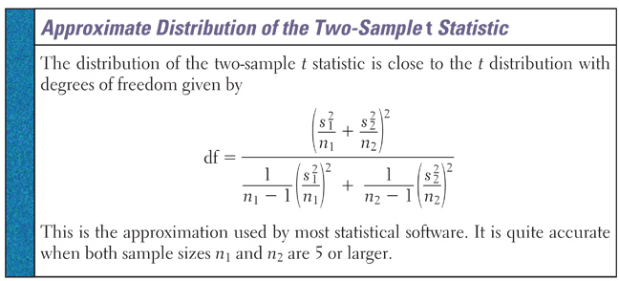
DF - Welch and Satterthwaite Apx
Using this approximation results in narrower confidence intervals and smaller p-values than the conservative approach mentioned before

Slide 38
Pooling Standard Deviations??
DON’T
Pooling assumes that the standard deviations of the two populations are equal – very hard to justify this
This could be tested using the F-statistic (a non robust procedure beyond AP Stats)
Beware: formula on AP Stat equation set under Descriptive Statistics

Slide 39
Summary and Homework
Summary
  Two sets of data are independent when observations in one have no affect on observations in the other
  Differences of the two means usually use a Student’s t-test of mean differences
  The overall process, other than the formula for the standard error, are the general hypothesis test and confidence intervals process
Homework
  Day One: 29-32, 35, 37, 57;
  Day Two: 39, 41, 43, 45;
  Day Three: 51, 53, 59, 65, 67-70

