Slide 1
Lesson 10 - 3
Comparing Two Means
Match Pair Designs

Slide 2
Objectives
Analyze the distribution of differences in a paired data set using graphs and summary statistics
Construct and interpret a confidence interval for a mean difference
Perform a significance test about a mean difference
Determine when it is appropriate to use paired t procedures versus two-sample t procedures

Slide 3
Vocabulary
Pooled two-sample t statistic – assumes that the variances of the two sample are the same (we never use them in AP)
Paired data – result from recording two values of the same quantitative variable for each individual or for each pair of similar individuals

Slide 4
Inference Toolbox Review
Step 1: Hypothesis
  Identify population of interest and parameter
  State H₀ and H_{a}
Step 2: Conditions
  Check appropriate conditions
Step 3: Calculations
  State test or test statistic
  Use calculator to calculate test statistic and p-value
Step 4: Interpretation
  Interpret the p-value (fail-to-reject or reject)
  Don’t forget 3 C’s: conclusion, connection and context

Slide 5
Two Sample Problems
The goal of inference is to compare the responses to two treatments or to compare the characteristics of two populations
We have a separate sample from each treatment or each population
The response of each group are independent of those in other group

Slide 6
Conditions for Comparing Match Pairs
SRS
  Two SRS’s from two distinct populations
  Measure same variable from both populations
Independence
  Samples are independent of each other
  (not the test for match pair designs)
  N_{i} ≥ 10n_{i}
Normality
  Both populations are Normally distributed
  In practice, (large sample sizes for CLT to apply) similar shapes with no strong outliers

Slide 7
Two-sample, dependent, T-Test on TI
If you have raw data:
  enter the difference data in L1
Press STAT, TESTS, select T-Test
  raw data: List1 set to L1 and freq to 1
  summary data: enter as before
  Set Pooled to NO
  copy off t* value and the degrees of freedom
Confidence Intervals
  follow hypothesis test steps, except select TInterval and input confidence level

Slide 8
Analyzing Paired Data
A researcher studied a random sample of identical twins who had been separated and adopted at birth. In each case, one twin (Twin A) was adopted by a high-income family and the other (Twin B) by a low-income family. Both twins were given an IQ test as adults.

Slide 9
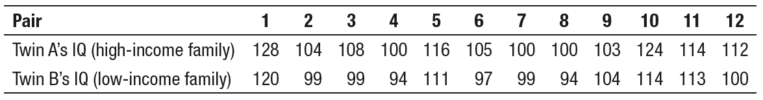
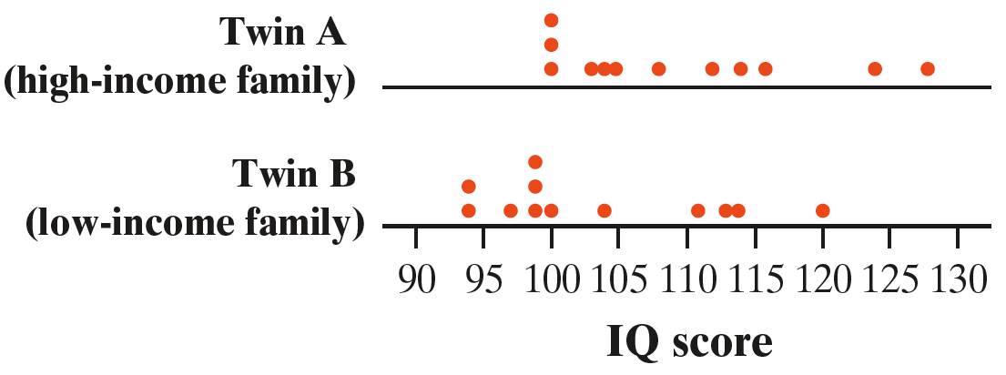
Analyzing Paired Data
A researcher studied a random sample of identical twins who had been separated and adopted at birth. In each case, one twin (Twin A) was adopted by a high-income family and the other (Twin B) by a low-income family. Both twins were given an IQ test as adults.

Slide 10


Analyzing Paired Data
Twins raised in high income households had a higher mean IQ ${\overline{x}}_{A}$=109.5 versus ${\overline{x}}_{B}$=103.667.
There is a similar amount of variability in IQ scores for these two groups of twins:
$s_{A}=$9.47 and $s_{B}=$8.66
But with so much overlap between the groups, the difference in means does not seem statistically significant.

Slide 11
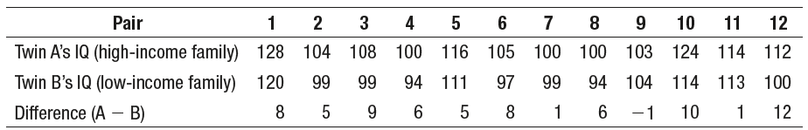
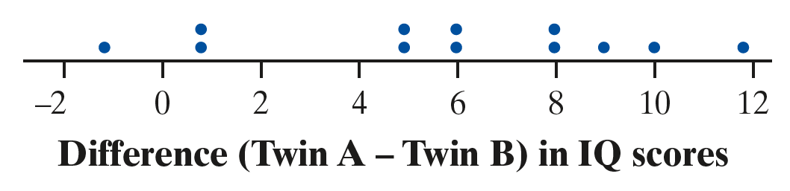


Analyzing Paired Data
The previous analysis ignores the fact that these are paired data.
Paired data result from recording two values of the same quantitative variable for each individual or for each pair of similar individuals.
The mean difference is ${\overline{x}}_{diff}$ = 5.833 points
$s_{diff}$ = 3.93 points

Slide 12


Analyzing Paired Data
CAUTION:
Remember: The proper method of analysis depends on how
the data are produced.
Analyzing Paired Data
To analyze paired data, start by computing the difference for each pair.
Then make a graph of the differences. Use the mean difference ${\overline{x}}_{diff}$ and the standard deviation of the differences s_{diff} as summary statistics.

Slide 13
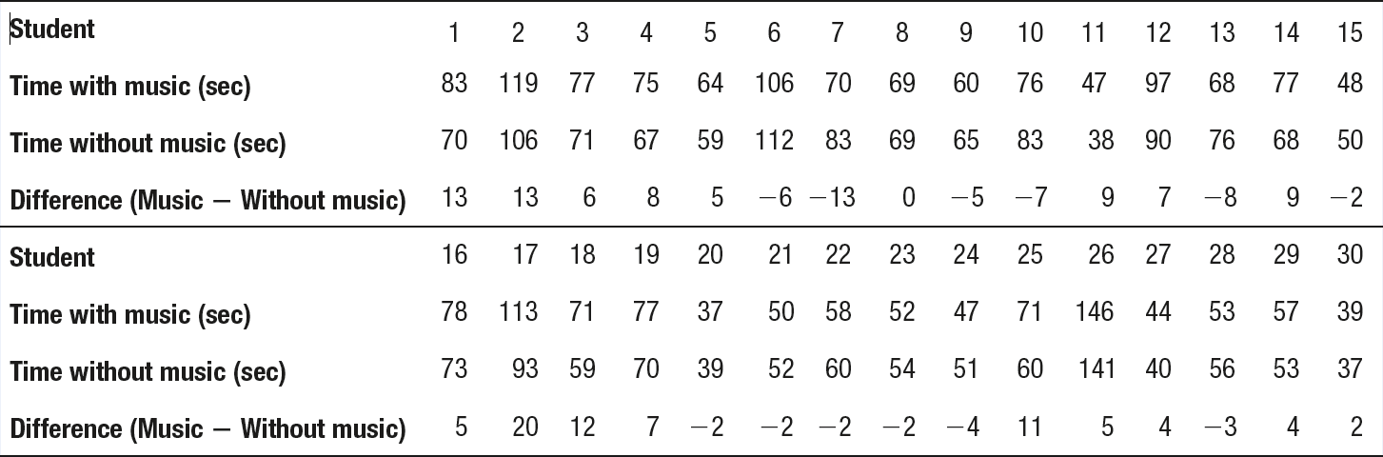
Example 1
Problem: Does music help or hinder performance
in math? Student researchers Abigail, Carolyn,
and Leah designed an experiment using 30
student volunteers to find out. Each subject
completed a 50-question single-digit arithmetic
test with and without music playing. For each
subject, the order of the music and no music treatments was randomly assigned, and the time to complete the test in seconds in seconds was recorded for each treatment. Here are the data, along with the difference in time for each subject:
gawrav/Getty Images

Slide 14
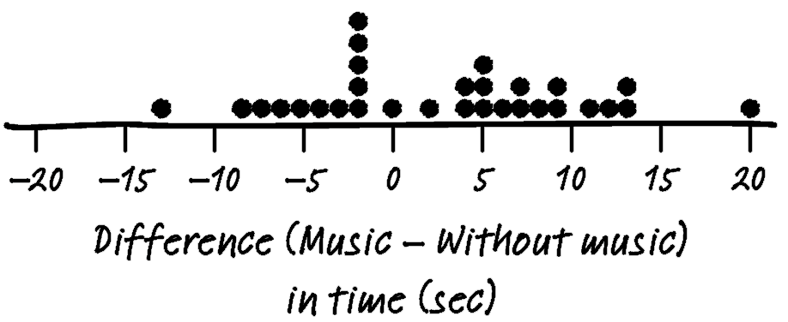
Example 1a
Problem:
(a) Make a dotplot of the difference
(Music – Without music) in time for each
subject to complete the test.
(b) Describe what the graph reveals about whether
music helps or hinders math performance.
(c) Calculate the mean difference and the standard deviation of the differences. Interpret the mean difference.
gawrav/Getty Images
(a)

Slide 15
Example 1b
Problem:
(a) Make a dotplot of the difference
(Music – Without music) in time for each
subject to complete the test.
(b) Describe what the graph reveals about whether
music helps or hinders math performance.
(c) Calculate the mean difference and the standard deviation of the differences. Interpret the mean difference.
gawrav/Getty Images
(b) There is some evidence that music hinders performance on the math test. 17 of the 30 subjects took longer to complete the test when listening to music.

Slide 16
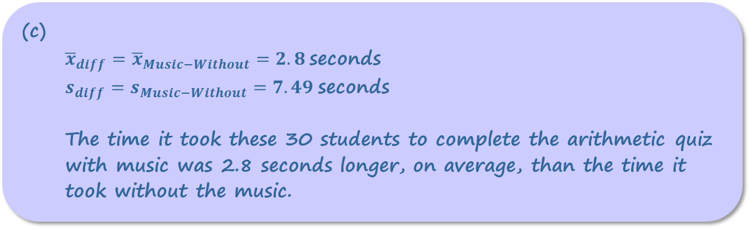
Example 1c
Problem:
(a) Make a dotplot of the difference
(Music – Without music) in time for each
subject to complete the test.
(b) Describe what the graph reveals about whether
music helps or hinders math performance.
(c) Calculate the mean difference and the standard deviation of the differences. Interpret the mean difference.
gawrav/Getty Images
(c)
  ${\overline{x}}_{diff}={\overline{x}}_{Music−Without}=2.8$seconds
  $s_{diff}=s_{Music−Without}=7.49$seconds
  The time it took these 30 students to complete the arithmetic quiz with music was 2.8 seconds longer, on average, than the time it took without the music.

Slide 17
Analyzing Paired Data
There are two ways that a statistical study involving a single quantitative variable can yield paired data:
Researchers can record two values of the variable for each individual. (experiment investigating whether music helps or hinders learning)
The researcher can form pairs of similar individuals and record the value of the variable once for each individual.
(observational study of identical twins’ IQ scores)
It is also possible to carry out a matched pairs experiment using Method 2 if the researcher forms pairs of similar subjects and randomly assigns each treatment to exactly one member of every pair.

Slide 18
Confidence Intervals for µ_{diff}
Conditions for Constructing a Confidence Interval
About a Mean Difference
• Random: Paired data come from a random sample from the population of interest or from a randomized experiment.
◦ 10%: When sampling without replacement, n_{diff} < 0.10N_{diff}.
• Normal/Large Sample: The population distribution of differences (or the true distribution of differences in response to the treatments) is Normal or the number of differences in the sample is large (n_{diff} ≥ 30). If the population (true) distribution of differences has unknown shape and the number of differences in the sample is less than 30, a graph of the sample differences shows no strong skewness or outliers.

Slide 19

Confidence Intervals for µ_{diff}
One-Sample t Interval for a Mean Difference
(Paired t Interval for a Mean Difference)
When the conditions are met, a C% confidence interval for µ_{diff} is
$${\overline{x}}_{diff}±t^{∗}\frac{s_{diff}}{\sqrt{n_{diff}}}$$
where t* is the critical value with C% of the area between –t* and t* for the t distribution with n_{diff} – 1 degrees of freedom.

Slide 20
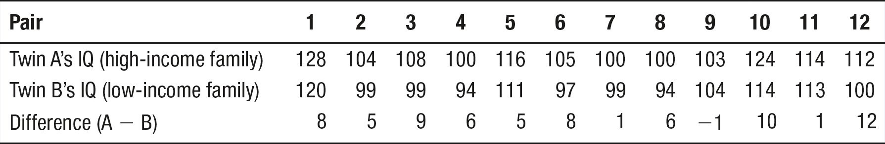
Example 2
Problem: The data from the random sample of identical
twins are shown again in the following table. Construct and
interpret a 95% confidence interval for the true mean
difference in IQ scores among twins raised in high-income
and low-income households.
Jodi Cobb/Getty Images

Slide 21
Example 2
Problem: The data from the random sample of identical
twins are shown again in the following table. Construct and
interpret a 95% confidence interval for the true mean
difference in IQ scores among twins raised in high-income
and low-income households.
Jodi Cobb/Getty Images
PARAMETER:
95% CI for µ_{diff} where
µ_{diff} = the true mean difference (High income – Low income) in IQ scores for pairs of identical twins raised in separate households.

Slide 22
Example 2
Problem: The data from the random sample of identical
twins are shown again in the following table. Construct and
interpret a 95% confidence interval for the true mean
difference in IQ scores among twins raised in high-income
and low-income households.
Jodi Cobb/Getty Images
CONDITIONS:
One-sample t interval for µ_{diff}
• Random: Random sample of 12 pairs of identical twins, one raised in a high-income household and the other in a low-income household. ✓
10%: Assume 12 < 10% of all pairs of identical twins raised in separate households.

Slide 23
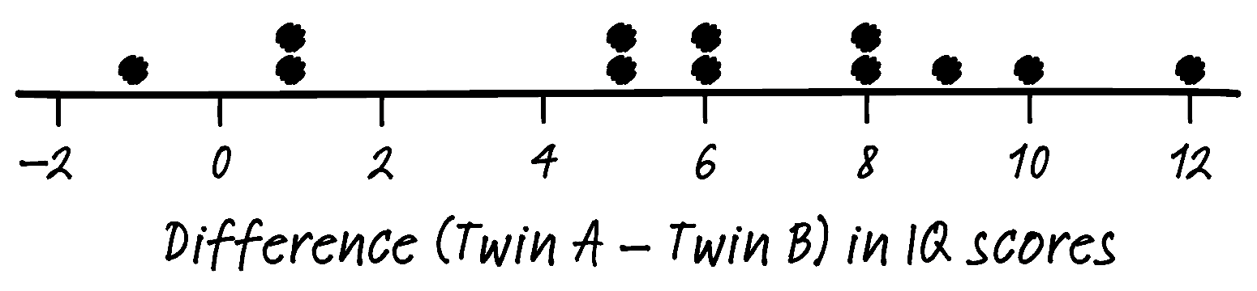
Example 2
Problem: The data from the random sample of identical
twins are shown again in the following table. Construct and
interpret a 95% confidence interval for the true mean
difference in IQ scores among twins raised in high-income
and low-income households.
Jodi Cobb/Getty Images
CONDITIONS:
• Normal/Large Sample?
The number of differences
is small, but the dotplot
doesn’t show any strong
skewness or outliers.✓

Slide 24
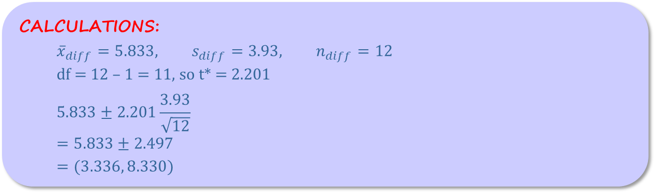
Example 2
Problem: The data from the random sample of identical
twins are shown again in the following table. Construct and
interpret a 95% confidence interval for the true mean
difference in IQ scores among twins raised in high-income
and low-income households.
Jodi Cobb/Getty Images
CALCULATIONS:
$${\overline{x}}_{diff}=5.833, s_{diff}=3.93, n_{diff}=12$$
df = 12 – 1 = 11, so t* = 2.201
$$5.833±2.201\frac{3.93}{\sqrt{12}}$$
$$=5.833±2.497$$
$$=(3.336, 8.330)$$

Slide 25
Example 2
Problem: The data from the random sample of identical
twins are shown again in the following table. Construct and
interpret a 95% confidence interval for the true mean
difference in IQ scores among twins raised in high-income
and low-income households.
Jodi Cobb/Getty Images
INTERPRETATION:
We are 95% confident that the interval from 3.336 to 8.330 captures the true mean difference (High income – Low income) in IQ scores among pairs of identical twins raised in separate households.

Slide 26
Significance Tests for µ_{diff}
H₀: µ_{diff} = hypothesized value
H₀: µ_{diff} = 0
Conditions for Performing a Significance Test
About a Mean Difference
• Random: Random: Paired data come from a random sample from the population of interest or from a randomized experiment.
◦ 10%: When sampling without replacement, n_{diff} < 0.10N_{diff}.
• Normal/Large Sample: The population distribution of differences (or the true distribution of differences in response to the treatments) is Normal or the number of differences in the sample is large (n_{diff} ≥ 30). If the population (true) distribution of differences has unknown shape and the number of differences in the sample is less than 30, a graph of the sample differences shows no strong skewness or outliers.

Slide 27

Significance Tests for µdiff
One-Sample t Test for a Mean Difference
(Paired t Test for a Mean Difference)
Suppose the conditions are met. To test the hypothesis H₀: µ_{diff} = 0,
compute the standardized test statistic,
$$t=\frac{{\overline{x}}_{diff}−0}{\frac{s_{diff}}{\sqrt{n_{diff}}}}$$
Find the P-value by calculating the probability of getting a t statistic this large or larger in the direction specified by the alternative hypothesis H_{a}. Use the t distribution with n_{diff} – 1 degrees of freedom.

Slide 28

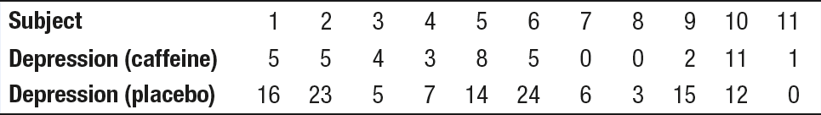
Example 3
Problem: Researchers designed an experiment to study the
effects of caffeine withdrawal. They recruited 11 volunteers
who were diagnosed as being caffeine dependent to serve
as subjects. Each subject was barred from coffee, colas, and
other substances with caffeine for the duration of the
experiment. During one 2-day period, subjects took capsules
containing their normal caffeine intake. During another 2-day period,
they took placebo capsules. The order in which subjects took caffeine and the placebo was randomized. At the end of each 2-day period, a test for depression was given to all 11 subjects. Researchers wanted to know whether being deprived of caffeine would lead to an increase in depression. he table displays data on the subjects’ depression test scores. Higher scores show more symptoms of depression.
MrPants/Getty Images

Slide 29
Example 3
Problem: Do the data provide convincing evidence at the
α = 0.05 significance level that caffeine withdrawal increases
depression score, on average, for subjects like the ones in
this experiment?
MrPants/Getty Images
HYPOTHESES:
H₀: µ_{diff} = 0
H_{a}: µ_{diff} > 0
µ_{diff} = the true mean difference (Placebo – Caffeine) in depression test score for subjects like these.
Because no significance level is given, we’ll use α = 0.05.

Slide 30
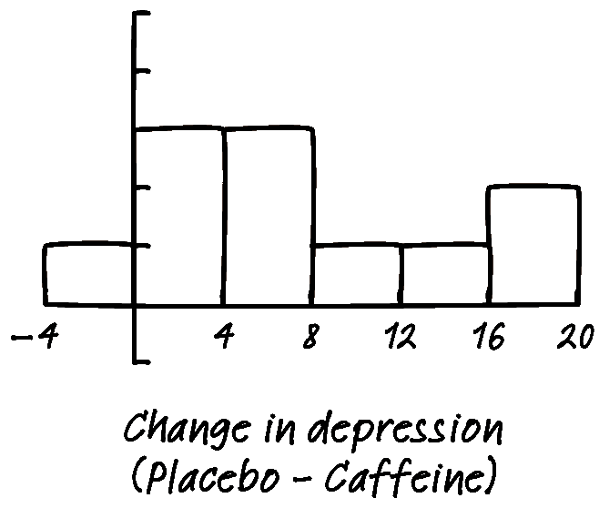
Example 3
Problem: Do the data provide convincing evidence at the
α = 0.05 significance level that caffeine withdrawal increases
depression score, on average, for subjects like the ones in
this experiment?
MrPants/Getty Images
CONDITIONS: Paired t test for µ_{diff}
• Random: Researchers randomly assigned the
treatments— placebo then caffeine, caffeine
then placebo—to the subjects.✓
• Normal/Large Sample:
The sample size is small, but the
histogram of differences doesn’t
show any outliers or strong skewness. ✓

Slide 31
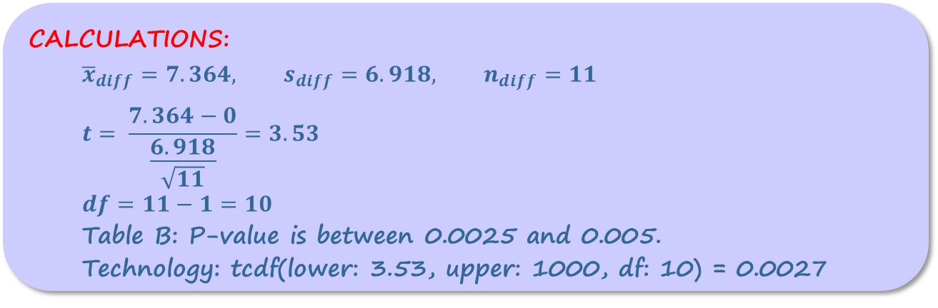
Example 3
Problem: Do the data provide convincing evidence at the
α = 0.05 significance level that caffeine withdrawal increases
depression score, on average, for subjects like the ones in
this experiment?
MrPants/Getty Images
CALCULATIONS:
$${\overline{x}}_{diff}=7.364, s_{diff}=6.918, n_{diff}=11$$
$$t= \frac{7.364−0}{\frac{6.918}{\sqrt{11}}}=3.53$$
$$df=11−1=10$$
Table B: P-value is between 0.0025 and 0.005.
Technology: tcdf(lower: 3.53, upper: 1000, df: 10) = 0.0027

Slide 32
Example 3
Problem: Do the data provide convincing evidence at the
α = 0.05 significance level that caffeine withdrawal increases
depression score, on average, for subjects like the ones in
this experiment?
MrPants/Getty Images
INTERPRETATION:
Because the P-value of 0.0027 < α = 0.05, we reject H₀. We have convincing evidence that caffeine withdrawal increases depression test score, on average, for subjects like the ones in this experiment.

Slide 33
Paired Data or Two Samples?
Two-sample t procedures require data that come from independent random samples from the two populations of interest or from two groups in a randomized experiment.
µ₁ – µ₂
µ_{diff}
Paired t procedures require paired data that come from a random sample from the population of interest or from a randomized experiment.
CAUTION:
The proper inference method depends on how the data were produced.

Slide 34
Example 4a
Problem: In each of the following settings, decide whether you should use two-sample t procedures to perform inference about a difference in means or paired t procedures to perform inference about a mean difference. Explain your choice.
(a) Before exiting the water, scuba divers remove their fins. A maker of scuba equipment advertises a new style of fins that is supposed to be faster to remove. A consumer advocacy group suspects that the time to remove the new fins may be no different than the time required to remove old fins, on average. Twenty experienced scuba divers are recruited to test the new fins. Each diver flips a coin to determine if they wear the new fin on the left foot and the old fin on the right foot, or vice versa. The time to remove each type of fin is recorded for every diver.
Paired t procedures. The data come from two measurements of the same variable (time to remove fin) for each diver.

Slide 35
Example 4b
Problem: In each of the following settings, decide whether you should use two-sample t procedures to perform inference about a difference in means or paired t procedures to perform inference about a mean difference. Explain your choice.
(b) To study the health of aquatic life, scientists gathered a random sample of 60 White Piranha fish from a tributary of the Amazon River during one year. The average length of these fish was compared to a random sample of 82 White Piranha from the same tributary a decade ago.
Two-sample t procedures. The data come from independent
random samples of White Piranha in two different years.

Slide 36
Example 4c
Problem: In each of the following settings, decide whether you should use two-sample t procedures to perform inference about a difference in means or paired t procedures to perform inference about a mean difference. Explain your choice.
(c) Can a wetsuit deter shark attacks? A researcher has designed a new wetsuit with color variations that are suspected to deter shark attacks. To test this idea, she fills two identical drums with bait and covers one in the standard black neoprene wetsuit and the other in the new suit. Over a period of one week, she selects 16 two-hour time periods and randomly assigns 8 of them to the drum in the black wetsuit. The other 8 are assigned to the drum with the new suit. During each time period, the appropriate drum is submerged in waters that sharks frequent and the number of times a shark bites the drum is recorded.
Two-sample t procedures. The data come from two groups in a randomized experiment, with each group consisting of 8 time periods in which a drum with a specific wetsuit (standard or new) was randomly
assigned to be submerged.

Slide 37
Summary and Homework
Summary
  Two sets of data are dependent when observations in one are paired with ones from another set of observations
  The differences of the two means are used as a single data set and usually use a Student’s t-test
  The overall process, other than the formula for the standard error, are the general hypothesis test and confidence intervals process
Homework

