Slide 1
Lesson 11 - 1
Test for Goodness of Fit
One-Way Tables

Slide 2
Objectives
State appropriate hypotheses and compute the expected counts and chi-square test statistic for a chi-square test for goodness of fit
State and check the Random, 10%, and Large Counts conditions for performing a chi-square test for goodness of fit
Calculate the degrees of freedom and P-value for a chi-square for goodness of fit
Perform a chi-square test for goodness of fit
Conduct a follow-up analysis when the results of a chi-square test are statistically significantly

Slide 3
Vocabulary
Chi-square test statistic – a measure of how far the observed counts are from the expected counts.
Chi-square distribution – defined by a density curve that takes only nonnegative values and is skewed to the right. A particular chi-square distribution is specified by its degrees of freedom
Goodness-of-fit test – an inferential procedure used to determine whether a categorical frequency distribution follows a claimed distribution.
Expected counts – probability of an outcome times the sample size for k mutually exclusive outcomes
One-way table – a table of k mutually exclusive observed values
Cells – one item in the one-way table

Slide 4
Introduction
In the previous chapter, we discussed inference procedures for comparing the proportion of successes for two populations or treatments. Sometimes we want to examine the distribution of a single categorical variable in a population. The chi-square goodness-of-fit test allows us to determine whether a hypothesized distribution seems valid.

Slide 5
Introduction - cont
We can decide whether the distribution of a categorical variable differs for two or more populations or treatments using a chi-square test for homogeneity. In doing so, we will often organize our data in a two-way table.
It is also possible to use the information in a two-way table to study the relationship between two categorical variables. The chi-square test for association/independence allows us to determine if there is convincing evidence of an association between the variables in the population at large.

Slide 6
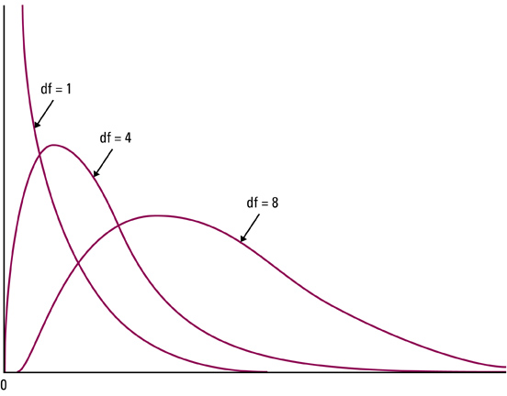
Chi-Square Distributions

Slide 7
Chi-Square Distribution
Total area under a chi-square curve is equal to 1
It is not symmetric, it is skewed right
The shape of the chi-square distribution depends on the degrees of freedom (just like t-distribution)
As the number of degrees of freedom increases, the chi-square distribution becomes more nearly symmetric
The values of χ² are nonnegative; that is, values of χ² are always greater than or equal to zero (0); they increase to a peak and then asymptotically approach 0
Table D in the back of the book gives critical values

Slide 8
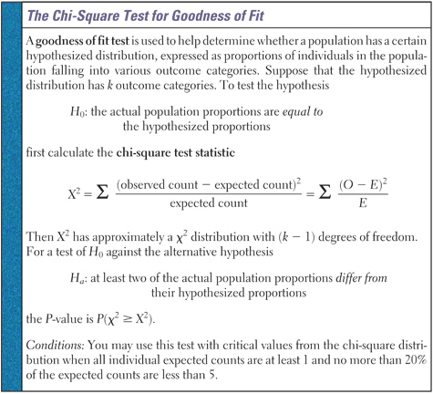
Chi-Square Test for Goodness of Fit

Slide 9
Conditions
Goodness-of-fit test:
Independent SRSs
All expected counts are greater than or equal to 1 (all E_{i} ≥ 1)
No more than 20% of expected counts are less than 5
Remember it is the expected counts, not the observed that are critical conditions

Slide 10
Goodness-of-Fit Test
P-Value is the
area highlighted
P-value = P(χ² ₀)
χ²_{α}
Critical Region
where
O_{i} is observed count
for ith category and
E_{i} is the expected count
for the ith category
Σ
(O_{i} – E_{i})²
Test Statistic: χ²₀ = -------------
E_{i}
Reject null hypothesis, if
P-value < α
χ²₀ > χ²_{α, k-1}
(Right-Tailed)

Slide 11
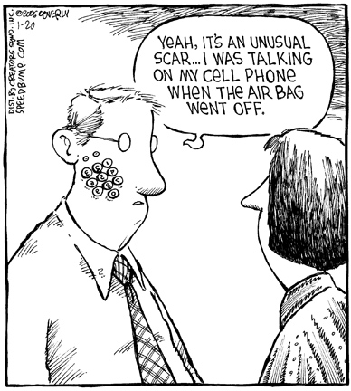

Things to Avoid

Slide 12
Example 1
Are you more likely to have a motor vehicle collision when using a cell phone? A study of 699 drivers who were using a cell-phone when they were involved in a collision examined this question. These drivers made 26,798 cell phone calls during a 14 month study period. Each of the 699 collisions was classified in various ways.
Are accidents equally likely to occur on any day of the week?
Sun | Mon | Tue | Wed | Thu | Fri | Sat
20 | 133 | 126 | 159 | 136 | 113 | 12

Slide 13
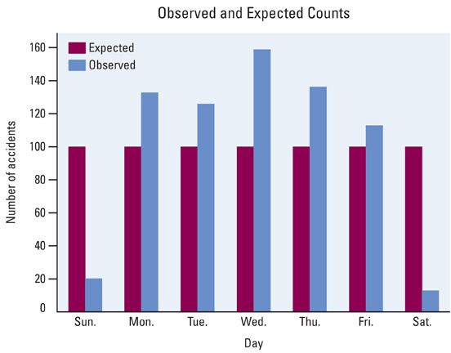
Example 1 – Graphical Analysis
Are accidents equally likely to occur on any day of the week?
Sun | Mon | Tue | Wed | Thu | Fri | Sat
20 | 133 | 126 | 159 | 136 | 113 | 12

Slide 14
Example 1 – Chi-Square Analysis
Are accidents equally likely to occur on any day of the week?
Hypotheses:
Conditions:
H₀: Motor vehicle accidents involving cell phones are equally likely to occur everyday of the week
H_{a}: Motor vehicle accidents involving cell phones will vary everyday of the week (not all the same)
SRS – must be assumed
Expected counts (everyday) = 699/7 = 99.857
All expected counts > 0
All expected counts > 5

Slide 15
Example 1 – Chi-Square Analysis
Are accidents equally likely to occur on any day of the week?
Calculations:
Interpretation:
(Obs – Exp)²
χ² = ∑ -----------------
Exp
P-value=2.486e-42
Item | Sun | Mon | Tue | Wed | Thu | Fri | Sat
Observed | 20 | 133 | 126 | 159 | 136 | 113 | 12
Expected | 99.86 | 99.86 | 99.86 | 99.86 | 99.86 | 99.86 | 99.86
χ² | 63.86 | 11.00 | 6.84 | 35.03 | 13.08 | 1.73 | 77.30
χ² = ∑ (63.86 + 11 + 6.84 + 35.03 + 13.08 + 1.73 + 77.3)
= 208.84
χ² (n-1,p-value) = χ² (6, 0.0005) = 24.1
Since our χ² value is much greater than the critical value (208 > 24.1), we would reject H₀ and conclude that the accidents are not equally likely each day of the week.

Slide 16

Example 2
 | Yellow | Orange |  | Red | Green | Brown | Blue | Totals
Sample 1 | 66 | 88 |  | 38 | 59 | 53 | 96 | 400
Sample 2 | 10 | 9 |  | 4 | 16 | 9 | 7 | 55
Peanut | 0.15 | 0.23 |  | 0.12 | 0.15 | 0.12 | 0.23 | 1
Plain | 0.14 | 0.2 |  | 0.13 | 0.16 | 0.13 | 0.24 | 1
 | K = 6 classes (different colors)
 |  | CS(5,.1) | CS(5,.05) |  | CS(5,.025) | CS(5,.01)
 |  | 9.236 | 11.071 |  | 12.833 | 15.086

Slide 17
Example 2:
Conditions
 | Yellow | Orange | Red | Green | Brown | Blue | Totals
Sample 1 | 66 | 88 | 38 | 59 | 53 | 96 | 400
Sample 2 | 10 | 9 | 4 | 16 | 9 | 7 | 55
Peanut | 8.25 | 12.65 | 6.6 | 8.25 | 6.6 | 12.65 | 55
Plain | 7.7 | 11 | 7.15 | 8.8 | 7.15 | 13.2 | 55
 | Expected Counts for snack bag will be the smallest
 |  | Assume each bag is an SRS
 |  | All expected counts > 5

Slide 18
Example 2 (sample 1)
H₀:
H_{a}:
Test Statistic
Critical Value:
Conclusion:
The big bag came from Peanut M&Ms
The big bag did not come from Peanut M&Ms
Σ
(O_{i} – E_{i})²
Test Statistic: χ²₀ = -------------
E_{i}
 | Yellow | Orange | Red | Green | Brown | Blue | Totals
L1-Observed | 66 | 88 | 38 | 59 | 53 | 96 | 400
L2-Expected | 60 | 92 | 48 | 60 | 48 | 92 | 400
CNTRB-Chi-value | 0.6 | 0.174 | 2.632 | 0.017 | 0.521 | 0.174 | 4.118
All critical values are bigger than 9.236
FTR H₀, not sufficient evidence to conclude
bag is not peanut M&M’s

Slide 19
Example 2 (sample 2)
H₀:
H_{a}:
Test Statistic
Critical Value:
Conclusion:
The snack bag came from Peanut M&Ms
The snack bag did not come from Peanut M&Ms
Σ
(O_{i} – E_{i})²
Test Statistic: χ²₀ = -------------
E_{i}
 | Yellow | Orange | Red | Green | Brown | Blue | Totals
L1-Observed | 10 | 9 | 4 | 16 | 9 | 7 | 55
L2-Expected | 8.25 | 12.65 | 6.6 | 8.25 | 6.6 | 12.65 | 55
CNTRB-Chi-value | 0.371 | 1.053 | 1.024 | 7.280 | 0.873 | 2.524 | 13.125
All critical values are less than 13, except for
α = 0.01.
Rej H₀, sufficient evidence to conclude
bag is not peanut M&M’s

Slide 20
TI-Calculator Help
Enter observed data into L1
Enter expected data into L2
(can let the calculator do the “math”)
Select GOF-Test
Remember: Must write two terms of the Chi-Square statistic down before writing down test statistic and p-value from calculator in the calculations section

Slide 21
AP Tip
Writing out an entire χ² summation will be very time consuming (something you don’t have much of on the test)
To demonstrate to the AP reader that you have an understanding of χ² statistic do:
write out statistic, definition, first and last terms and what’s its sum is
(O – E)² (# - #)² (# - #)²
χ² = ∑ ----------- = --------- + . . . + --------- = ###.##
E # #

Slide 22
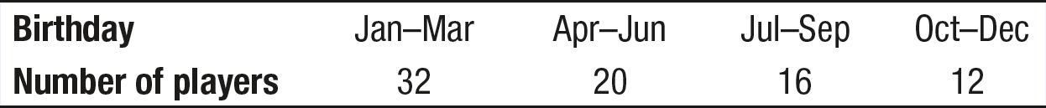
Example 3
A random sample of 80 NHL players from a recent season was selected and their birthdays were recorded. The one-way table summarizes the data on birthdays for these 80 players.
Do these data provide convincing evidence that the birthdays of NHL players are not uniformly distributed across the four quarters of the year?

Slide 23
Example 3
Hypothesis:
H₀: The birthdays of all NHL players are uniformly distributed across the four quarters of the year.
H_{a}: The birthdays of all NHL players are not uniformly distributed across the four quarters of the year.
We’ll use α = 0.05.
Conditions: Chi-square test for goodness of fit
• Random: The data came from a random sample of NHL players ✓
◦ 10%: We must assume that 80 is less than 10% of all NHL players ✓
• Large Counts: All expected counts = 80(1/4) = 20 ≥ 5 ✓

Slide 24
Example 3
Calculations:
df = 4 – 1 = 3
Using Table C: The P-value is between 0.01 and 0.02
Using technology: χ² cdf(lower:11.2, upper:10000, df:3) = 0.011
$$χ^{2}=\frac{{(32−20)}^{2}}{20}+\frac{{(20−20)}^{2}}{20}+\frac{{(16−20)}^{2}}{20}+\frac{{(12−20)}^{2}}{20}=7.2+0+0.8+3.2=11.2$$
Interpretation:
Because the P-value of 0.011 < α = 0.05, we reject H₀. We have convincing evidence that the birthdays of NHL players are not uniformly distributed across the four quarters of the year.

Slide 25
Summary and Homework
Summary
  Goodness-of-fit tests apply to situations where there are a series of independent trials, and each trial has 3 or more possible outcomes
  The test statistic to be used combines all of the outcomes and all of the expected counts
  The test statistic has approximately a chi-square distribution
  Calculator is a tool for one-way tables not a crutch!
Homework

