Slide 1
Lesson 11 - 2
Inference for Two-Way Tables

Slide 2
Objectives
State appropriate hypothesis and compute the expected counts and chi-square statistic for a chi-square test based on data in a two-way table
State and check the Random, 10%, and Large Count conditions for a chi-square test based on data in a two-way table
Calculate the degrees of freedom and P-value for a chi-square test based on data in a two-way table
Perform a chi-square test for homogeneity
Perform a chi-square test for independence
Choose the appropriate chi-square test in a given setting

Slide 3
Vocabulary
Statistical Inference – provides methods for drawing conclusions about a population parameter from sample data
Chi-Squared Test for Independence – used to determine if there is an association between a row variable and a column variable in a contingency table constructed from single sample data
Expected Frequencies – row total * column total / table total
Chi-Squared Test for Homogeneity of Proportions – used to test if different populations (different samples or treatments) have the same proportions of individuals with a particular characteristic

Slide 4
Expanding Chapter 11 Material
Two-sample z procedures allowed us to compare the proportions of successes in two groups (either two populations or two treatment groups in an experiment).
What do we do if we have more than two groups that we would like to compare?
Remember back to conditional probability, in chapter 6, we had tables of observed values that we used for conditional probabilities. We us something similar now called a two-way table.

Slide 5
Example 1
Market researchers know that background music can influence the mood and purchasing behavior of customers. One study in supermarket in Northern Ireland compared three treatments: no music, French accordion music, and Italian string music. Under each condition, the researchers recorded the numbers of bottles of French, Italian, and other wine purchased. Here is a table that summarizes the data:
Music
Wine | None | French | Italian | Total
French | 30 | 39 | 30 | 99
Italian | 11 | 1 | 19 | 31
Other | 43 | 35 | 35 | 113
Total | 84 | 75 | 84 | 243

Slide 6
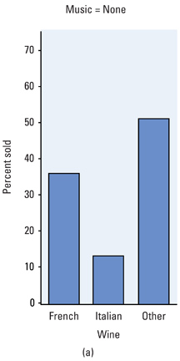
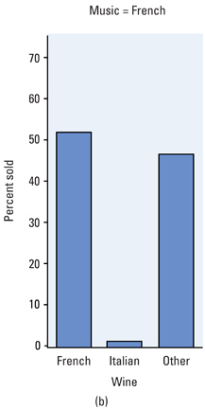
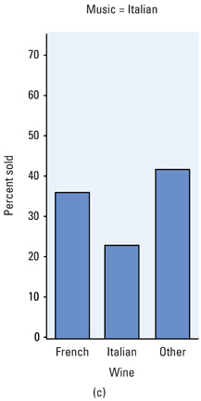
Example 1 cont
There appears to be an association between the music played and the type of wine customers buy by Column %’s.

Slide 7
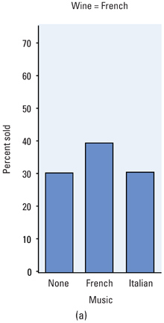
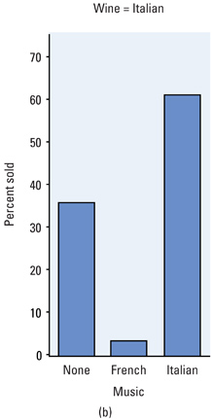
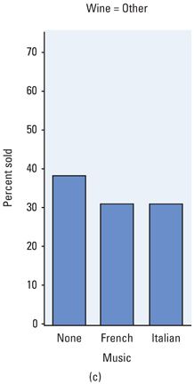
Example 1 cont
The negative effect of French music on Italian wine is even more evident looking at the Row %’s

Slide 8
Comparing 3 Population Distributions
We might use chi-square goodness of fit procedures 3 times:
Test H₀: the distribution of wine types for no music is the same as the distribution of wine types for French music
Test H₀: the distribution of wine types for no music is the same as the distribution of wine types for Italian music
Test H₀: the distribution of wine types for French music is the same as the distribution of wine types for Italian music
The problem is that we get 3 results and we can’t expand it to take all 3 into consideration at the same time

Slide 9
Problem of Multiple Comparisons
Statistical methods for dealing with multiple comparisons usually have two parts
An overall test to see if there is good evidence of any differences among the parameters that we want to compare
A detailed follow-up analysis to decide which of the parameters differ and to estimate how large the differences are
Caution:
  Many students incorrectly state H_{a} as “all the proportions are different.”
  Think about it this way: the opposite of “all the proportions are equal” is “some of the proportions are not equal.”

Slide 10
Problem of Multiple Comparisons
The problem of how to do many comparisons at once without increasing the overall probability of a Type I error is common in statistics. Statistical methods for dealing with multiple comparisons usually have two steps:
  Perform an overall test to see if there is convincing evidence of any differences among the parameters that we want to compare.
  When the overall test shows there is convincing evidence of a difference, perform a detailed follow-up analysis to decide which of the parameters differ and to estimate how large the differences are.

Slide 11
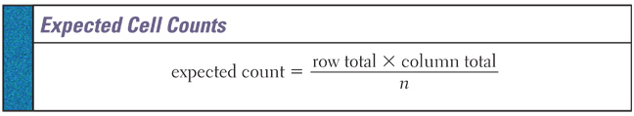
Expected Cell Counts
Figuring out expected cell counts in two-way tables is a little more difficult, but still follows an understandable mathematical formula:
n is the table total (sum of either all rows or all columns)
Note that although the observed counts will be whole numbers, an expected count need not be

Slide 12
Example 1 revisited
Here is a table that summarizes the observed data:
Music
Wine | None | French | Italian | Total
French | 30 | 39 | 30 | 99
Italian | 11 | 1 | 19 | 31
Other | 43 | 35 | 35 | 113
Total | 84 | 75 | 84 | 243
Here is a table that summarizes the expected data:
Music
Wine | None | French | Italian | Total
French | 34.22 | 30.56 | 34.22 | 99
Italian | 10.72 | 9.57 | 10.72 | 31
Other | 39.06 | 34.88 | 39.06 | 113
Total | 84 | 75 | 84 | 243

Slide 13
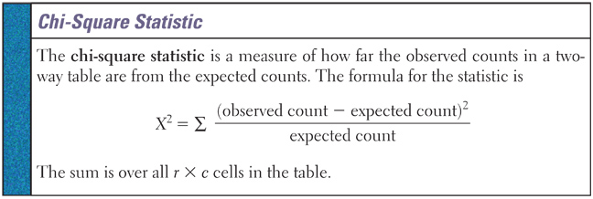
Chi-Square Test for Homogeneity
Large values of χ² are evidence against H₀ because they say the observed counts are far from what we would expect if H₀ were true.
Chi-Square tests are one-side (even though Ha is many-sided)

Slide 14
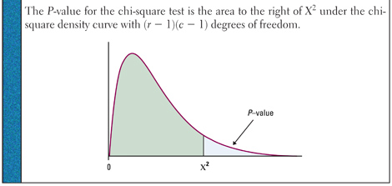
Chi-Square Test for Homogeneity
H₀: distribution of response variable is the same for all c populations
H_{a}: distributions are not all the same
Conditions:
Independent SRS from each of c populations (the same)
No more than 20% of the expected counts are less than 5 and all individual counts are 1 or greater

Slide 15
Example 1 revisited
Here is a table that summarizes the observed data:
Music
Wine | None | French | Italian | Total
French | 30 | 39 | 30 | 99
Italian | 11 | 1 | 19 | 31
Other | 43 | 35 | 35 | 113
Total | 84 | 75 | 84 | 243
Here is a table that summarizes the expected data:
Music
Wine | None | French | Italian | Total
French | 34.22 | 30.56 | 34.22 | 99
Italian | 10.72 | 9.57 | 10.72 | 31
Other | 39.06 | 34.88 | 39.06 | 113
Total | 84 | 75 | 84 | 243

Slide 16
Example 1 Completed
Hypotheses:
Conditions:
Calculations:
Interpretation:
Distributions of wine
H₀: Distributions of wine selected are the same for all 3 music types
H_{a}: Distributions of wine selected are not all the same
Independent SRSs from the populations of interest is assumed
Smallest expected count is 9.57; so expected counts conditions met
(O – E)² (30 - 34.22)² (35 - 39.06)²
χ² = ∑ ---------- = ---------------- + … + --------------- = 18.28
E 34.22 39.06
calculator: χ² = 18.279 p-value = 0.00109
There is strong evidence to reject H₀ (χ² = 18.28, df = 4, p-value < 0.0025) and conclude that the type of music being played has a significant effect on wine sales.

Slide 17
AP Tip
Writing out an entire χ² summation will be very time consuming (something you don’t have much of on the test)
To demonstrate to the AP reader that you have an understanding of χ² statistic do:
write out statistic, definition, first and last terms and what’s its sum is
(O – E)² (# - #)² (# - #)²
χ² = ∑ ----------- = --------- + . . . + --------- = ###.##
E # #

Slide 18
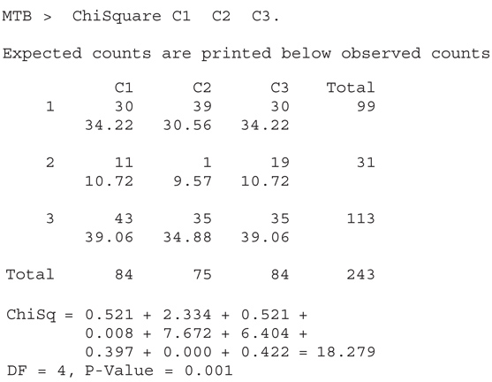
MiniTab Output for Example 1

Slide 19
GOF and Homogeneity Differences
Once χ² has been calculated, the difference between a goodness-of-fit test and a test for homogeneity of populations lies in the degrees of freedom used to compute the P-value
where n is the number of categories and where r is the number of rows and c the number of columns in the two-way table
 | Goodness-of-Fit | Homogeneity
Degrees of Freedom | n - 1 | (r – 1)(c – 1)

Slide 20
Chi-Square Test on TI
Press 2nd X⁻¹ (access MATRIX menu)
  Arrow to EDIT and select 1: [A]
Enter the number of rows and columns of the matrix
Enter the cell entries for the observed data and press 2nd QUIT
Press STAT, highlight TESTS and select C: χ²-Test
Matrix [A] (and Matrix [B] for expected) are defaults
Highlight Calculate and press ENTER
Highlight Draw and the χ² curve will be drawn, the critical area in the tail shaded and the p-value displayed
If you need the expect counts display Matrix B from the matrix menu

Slide 21
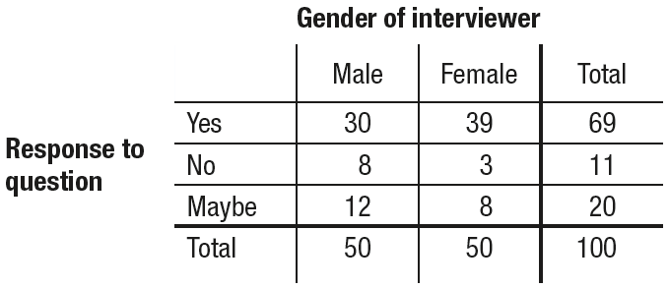
Example 2
For a class project, Abby and Mia wanted to know if the gender of an interviewer could affect the responses to a survey question. The subjects in their experiment were 100 males from their school. Half of the males were randomly assigned to be asked, “Would you vote for a female president?” by a female interviewer. The other half of the males were asked the same question by a male interviewer. The table shows the results.

Slide 22
Example 2 Questions
State the appropriate null and alternative hypotheses.
Show the calculation for the expected count in the Male/Yes cell. Then provide a complete table of expected counts.
Calculate the value of the chi-square test statistic.
Calculate the p-value and give your interpretation

Slide 23
Example 2
State the appropriate null and alternative hypotheses.
H₀: There is no difference in the true distributions of response to this question when asked by a male interviewer and when asked by a female interviewer for subjects like these.
H_{a}: There is a difference in the true distributions of response to this question when asked by a male interviewer and when asked by a female interviewer for subjects like these.

Slide 24
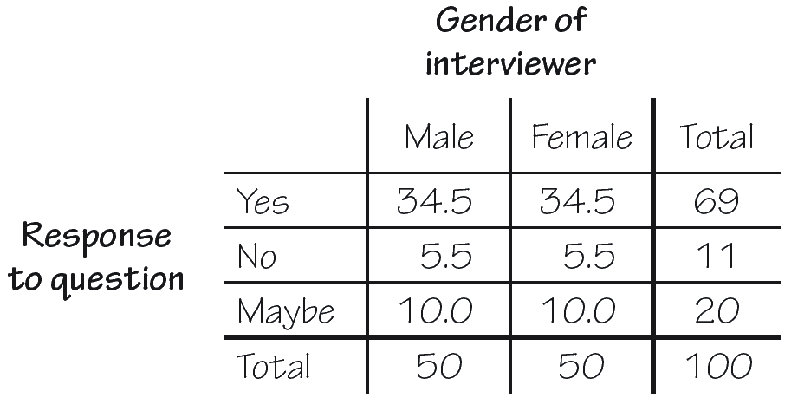
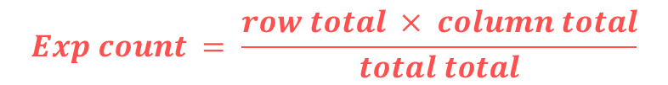
Example 2
Show the calculation for the expected count in the Male/Yes cell. Then provide a complete table of expected counts.
$$Exp count = \frac{row total × column total}{total total}$$
The expected count
for the Male/Yes cell
is (69 · 50)/100 = 34.5.
The rest of the expected
counts are shown in the table.

Slide 25
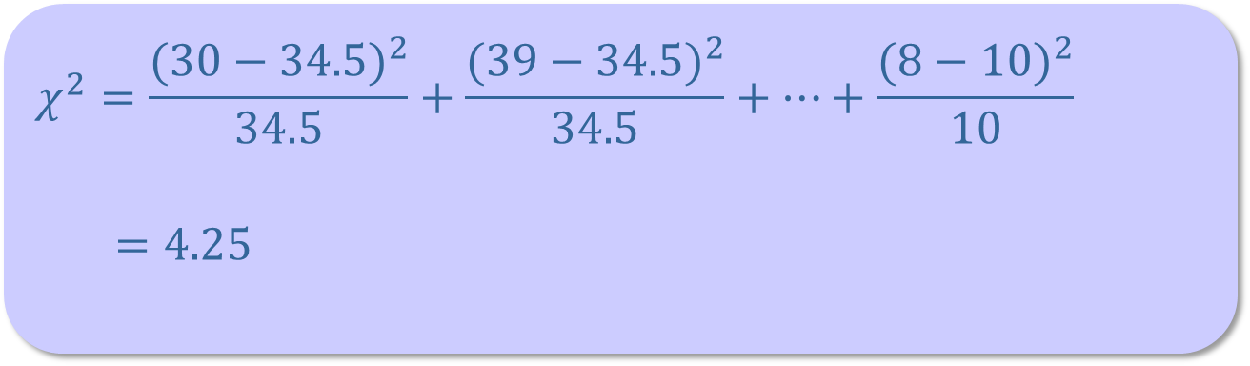
Example 2
Calculate the value of the chi-square test statistic.
$$χ^{2}=\frac{{(30−34.5)}^{2}}{34.5}+\frac{{(39−34.5)}^{2}}{34.5}+⋯+\frac{{(8−10)}^{2}}{10}$$
$=4.25$

Slide 26
Example 2
Calculate the p-value and give your interpretation
Assuming that the gender of the interviewer doesn’t affect responses to this question, there is a 0.119 probability of observing differences in the distributions of responses as large as or larger than those in this study by chance alone.
Because the P-value of 0.119 > α = 0.05, we fail to reject H₀. There is not convincing evidence of a difference in the true distributions of response to this question when asked by a male interviewer and when asked by a female interviewer for subjects like these.

Slide 27
Warnings
If we reject H₀ and conclude that the distributions are not the same – we don’t know which one (or more) are different. More analysis is required. The Tukey test, beyond AP Stats course, would be able to tell us which ones were different.
The test confirms only that there is some relationship. The chi-square test does not in itself tell us what population our conclusion describes. Researchers may invoke their understanding of the problem to argue that their findings apply more generally, but that is beyond the scope of the statistical analysis

Slide 28
z-Test versus χ² Test
We use the χ² test to compare any number of proportions
The results from the χ² test for 2 proportions will be the same as a z-test for 2 proportions
z-Test is recommended to compare two proportions because it gives you a choice of a one-side test and is related to the confidence interval for p₁ – p₂.

Slide 29
Summary
Summary
  Often, in contingency tables, we wish to test specific relationships, or lack of, between the two variables
  The test for homogeneity analyzes whether the observed proportions are the same across the different populations or treatments

Slide 30
Expanding Chi-Square Tests
In looking at the types of χ² problems we have dealt with so far, we have measured a single categorical variable effects across multiple (two or more) populations.
Now we look at χ² problems where two categorical variables are measured across a single population.
We draw a single independent SRS and break it down into categories

Slide 31
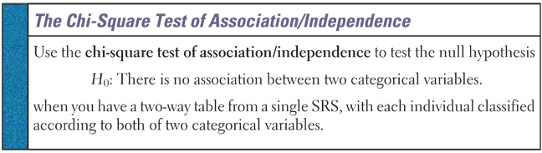
χ² Test of Association/Independence
This test assesses whether this observed association is statistically significant. That is, is the relationship in the sample sufficiently strong for us to conclude that it is due to a relationship between the two variables and not merely to chance.

Slide 32
Other Acceptable Hypotheses
H₀: no association between two categorical variables
H_{a}: an association between two categorical variables
H₀: the two categorical variables are independent
H_{a}: the two categorical variables are not independent
H₀: the two categorical variables are not related
H_{a}: the two categorical variables are related
Remember to specify the specific variables in place of the yellow text. Do not leave it in general terms – that will lack problem context and be docked.

Slide 33
GOF and Independence Differences
Once χ² has been calculated, the difference between a goodness-of-fit test and a test for Independence of populations lies in the degrees of freedom used to compute the P-value
where n is the number of categories and where r is the number of rows and c the number of columns in the two-way table
 | Goodness-of-Fit | Independence
Degrees of Freedom | n - 1 | (r – 1)(c – 1)

Slide 34
Example 3
Many popular businesses, like McDonald’s, are franchises. Some contracts with franchises include a right to exclusive territory (another McDonald’s can’t open in that area). How does the presence of an exclusive territory clause in the contract relate to the survival of the business? A study designed to address this question collected data from a sample of 170 new franchise firms. Here are the observed count data:
Exclusive Territory
Success | Yes | No | Total
Yes | 108 | 15 | 123
No | 34 | 13 | 47
Total | 142 | 28 | 170

Slide 35
Example 3
Exclusive Territory - Observed
Success | Yes | No | Total
Yes | 108 | 15 | 123
No | 34 | 13 | 47
Total | 142 | 28 | 170
Exclusive Territory - Percentages
Success | Yes | No
Yes | 76% | 54%
No | 24% | 46%
Total | 100% | 100%
There definitely appears to be a relationship, but is it statistically significant?

Slide 36
Example 3
Exclusive Territory - Observed
Success | Yes | No | Total
Yes | 108 | 15 | 123
No | 34 | 13 | 47
Total | 142 | 28 | 170
To figure out the expected counts we use the same formula as in other χ² tests
row total × column total
expected count = -------------------------------------
table total
Exclusive Territory - Expected
Success | Yes | No | Total
Yes | 102.74 | 20.26 | 123
No | 39.26 | 7.74 | 47
Total | 142 | 28 | 170

Slide 37
Example 2 Completed
Parameter and Hypotheses
Conditions:
Calculations:
Interpretation:
Success vs Exclusive Territory
H₀: Success and exclusive territory are independent
H_{a}: Success and exclusive territory are dependent
Independent SRS from the population of franchises is assumed
Smallest expected count is 7.74; so expected counts conditions met
(O – E)² (108 – 102.74)² (13 – 7.74)²
χ² = ∑ ---------- = -------------------- + … + --------------- = 5.9112
E 102.74 7.74
calculator: χ² = 5.91112 p-value = 0.015
There is sufficient evidence to reject H₀ (χ² = 5.91, df = 1, p-value < 0.02) and conclude that there is an association between franchise success and exclusive territory

Slide 38
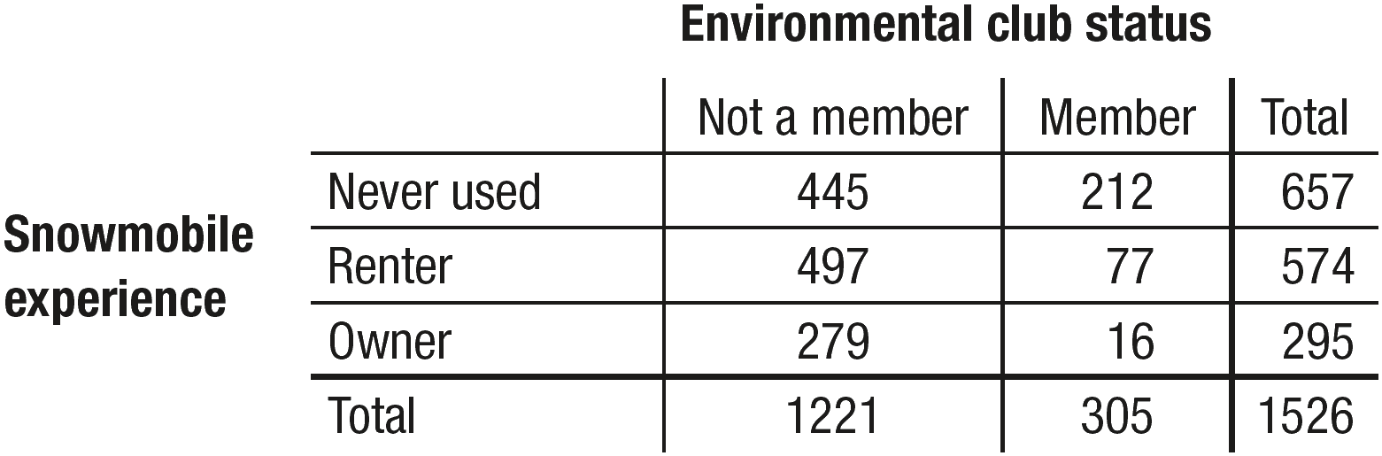
Example 4
A random sample of 1526 visitors winter visitors to Yellowstone National Park was asked two questions:
  1. Do you belong to an environmental club (like the Sierra Club)?
  2. What is your experience with a snowmobile: own, rent, or never used?
The two-way table summarizes the results.
Do these data provide convincing evidence of an association between environmental club status and type of snowmobile use in the population of winter visitors to Yellowstone National Park?

Slide 39
Example 4 – Hypothesis Conditions
Hypothesis:
H₀: There is no association between environmental club status and type of snowmobile use in the population of winter visitors to YNP.
H_{a}: There is an association between environmental club status and type of snowmobile use in the population of winter visitors to YNP.
We’ll use α = 0.05.
Conditions: Chi-square test for independence
• Random: Random sample of 1526 winter visitors to Yellowstone. ✓
º 10%: It is reasonable to assume that 1526 * 10% of all winter visitors to Yellowstone. ✓
• Large Counts: All expected counts are at least 5 (see table below).✓

Slide 40

Example 4 – Calculations Interpretation
Calculation:
df = (3 – 1)(2 – 1) = 2
Using Table C: P-value < 0.0005
Using technology: calculator χ² –Test gives P-value = 4.82 × 10⁻²⁶
$$χ^{2}=\frac{{(445−525.7)}^{2}}{525.7}+\frac{{(212−131.3)}^{2}}{131.3}+ ⋯=116.6$$
Interpretation:
Because the P-value of approximately 0 < α = 0.05, we reject H₀. We have convincing evidence of an association between environmental club status and type of snowmobile use in the population of winter visitors to Yellowstone National Park.

Slide 41
Using Chi-Square Tests Wisely
Both the chi-square test for homogeneity and the chi-square test for association/independence start with a two-way table of observed counts. They even calculate the test statistic, degrees of freedom, and P-value in the same way. The questions that these two tests answer are different, however.
A chi-square test for homogeneity tests whether the distribution of a categorical variable is the same for each of several populations or treatments.
The chi-square test for association/independence tests whether two categorical variables are associated in same population of interest.

Slide 42
Using Chi-Square Tests Wisely
Instead of focusing on the question asked, it’s much easier to look at how the data were produced.
If the data come from two or more independent random samples or treatment groups in a randomized experiment, then do a chi-square test for homogeneity.
If the data come from a single random sample, with the individuals classified according to two categorical variables, use a chi-square test for association/independence.

Slide 43
Summary and Homework
Summary
  Often, in contingency tables, we wish to test specific relationships, or lack of, between the two variables
  The test for independence analyzes whether the row and column variables are independent
  It differs from the test for homogeneity
    Homogeneity: one categorical variable across several populations (one independent SRSs for each population)
    Independence: two categorical variables across one population (one independent SRS)
Homework
  Problems 29, 31, 35, 43, 49

