Slide 1
Lesson 11 - R
Chapter 11 Review:
Inference for Distribution of Categorical Variables:
Chi-Square Procedures

Slide 2
Objectives
Explain what is meant by a chi-square goodness of fit test
Conduct a chi-square goodness of fit test
Given a two-way table, compute conditional distributions
Conduct a chi-square test for homogeneity of populations
Conduct a chi-square test for association / independence
Use technology to conduct a chi-square significance test

Slide 3
Vocabulary
none new

Slide 4
Chi-Square Distribution
Total area under a chi-square curve is equal to 1
It is not symmetric, it is skewed right
The shape of the chi-square distribution depends on the degrees of freedom (just like t-distribution)
As the number of degrees of freedom increases, the chi-square distribution becomes more nearly symmetric
The values of χ² are nonnegative; that is, values of χ² are always greater than or equal to zero (0); they increase to a peak and then asymptotically approach 0
Table D in the back of the book gives critical values

Slide 5
Conditions
All Chi-Square tests (GOF, Homogeneity, Independence):
Independent SRS(s)
All expected counts are greater than or equal to 1 (all E_{i} ≥ 1)
No more than 20% of expected counts are less than 5
Remember it is the expected counts, not the observed that are critical conditions

Slide 6
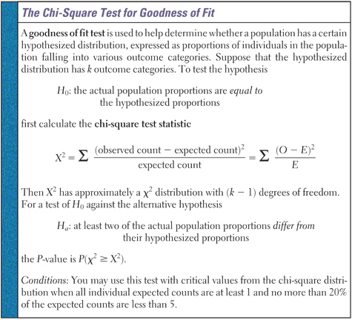
Chi-Square Test for Goodness of Fit

Slide 7
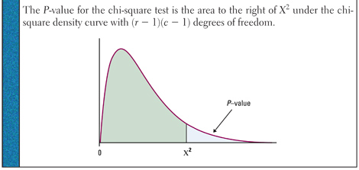
Chi-Square Test for Homogeneity
H₀: distribution of response variable is the same for all c populations
H_{a}: distributions are not the same

Slide 8
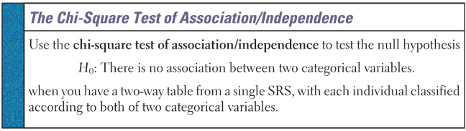
χ² Test of Association/Independence
This test assesses whether this observed association is statistically significant. That is, is the relationship in the sample sufficiently strong for us to conclude that it is due to a relationship between the two variables and not merely to chance.

Slide 9
Homogeneity vs Independence
Homogeneity – two or more random samples from two or more distinct populations.
Independence – a single sample from a single population, where two categorical variables are measured

Slide 10
z-Test versus χ² Test
We use the χ² test to compare any number of proportions
The results from the χ² test for 2 proportions will be the same as a z-test for 2 proportions
  z and χ² p-value will be the same
  χ² test statistic with df = 1 will be z test statistic squared
z-Test is recommended to compare two proportions because it gives you a choice of a one-side test and is related to the confidence interval for p₁ – p₂.

Slide 11
Summary and Homework
Summary
  Goodness-of-fit tests apply to situations where there are a series of independent trials, and each trial has 3 or more possible outcomes
  The test for homogeneity analyzes whether the observed proportions are the same across the different samples of the populations
  The test for independence analyzes whether the row and column variables are independent in the same sample
Homework
  Quiz

Slide 12
Problem 1
The makers of the movie Titanic imply that lower-class passengers were treated unfairly when the lifeboats were being filled. We want to determine whether that portrayal is accurate. The following table contains the survival data by passenger class for the 1316 passengers.
Following the outline on the next page, you will use a chi-square test to determine whether there is a relationship between survival and passenger class.
Class | Survived | Lost
First | 203 | 122
Second | 118 | 167
Third | 178 | 528

Slide 13
Problem 1 cont
(a) If this table is considered an r x c table,
r = ______ and c = _______.
(b) State the null and alternative hypotheses that would be appropriate for this test:
(c) Show how to determine the expected number of second class survivors.
3
2
H₀: proportions of survivors is the same across classes
H_{a}: at least one proportion is different
Exp = rt × ct / tt = 499 × 285 ÷ 1316 = 108.07

Slide 14
Problem 1 cont
(d) In order to validly use the chi-square test, how many expected values could be less than 5? _______ How many expected values could be less than 1? ________
(e) How many degrees of freedom would be associated with this test? _________ Show how you determined the degrees of freedom:
1
0
2
(r-1)(c-1) = (3-1)(2-1) = 2(1) = 2

Slide 15
Problem 1 cont
(f) Use your calculator to perform this chi-square test.
Examine the matrix of expected values and write the expected values for each cell next to their observed frequencies in the table. (Round to tenths.)
In what classes are there more survivors than would be expected under the assumption of the null hypothesis?
What is the value of the chi-square statistic? ______
Class | Survived | Lost
First | 203 | 122
Second | 118 | 167
Third | 178 | 528
123.23 201.77
108.07 176.93
267.7 438.3
about 80 more in 1st class and 10 more in 2nd class
133.05

Slide 16
Problem 1 cont
(iv) What is the P-value associated with the chi-square statistic? __________
(v) State your conclusion regarding the hypotheses of this test:
(vi) Examine the matrix of chi-square components that is created by your calculator. Which entry has the greatest contribution to your test statistic? What is the value of this component?
1.2 × 10⁻²⁹
Since the p-value is so small we have strong evidence to reject H₀ and conclude that survivor rates were different between classes.
51.94 from first class survivors

Slide 17
Problem 2
Class | Survived | Lost
First | 203 | 122
Second | 118 | 167
Third | 178 | 528
(a) What proportion of all 1316 passengers were third class passengers?
(b) What proportion of survivors were third class passengers?
(c) What proportion of first class passengers survived?
706 / 1316 = 53.65%
178 / 499 = 35.67%
203 / 325 = 62.46%

Slide 18
Problem 3
It is sometimes said that older people are over-represented on juries. The table below gives the percentage distribution of all people over 21 years of age in Alameda County, CA by age group. The table also shows the age group classification for a sample of 66 people who served on grand juries in this county.
Age | Countywide Percentage | Number of jurors
21 to 40 | 42 | 5
41 to 50 | 23 | 9
51 to 60 | 16 | 19
61 or older | 19 | 33
Total | 100 | 66

Slide 19
Problem 3 cont
We would like to perform a chi-square test to determine whether the age distribution of jurors is significantly different from the age distribution of county residents. That is, we want to test the following hypotheses:
H₀: 42% of jurors are 21 to 40 years old, 23% of jurors are 41 to 50 years old, 16% of jurors are 51 to 60 years old, and 19% of jurors are 61 or older.
H_{a}: The age distribution of jurors is different from the one above.

Slide 20
Problem 3 cont
Working under the assumption that the H₀ is true, write how many of the 66 jurors would you expect next to the observed values in the table below:
Write a few sentences to describe how the counts you expect if the null hypothesis is true compared to the counts observed in this sample.
Age | Countywide Percentage | Number of jurors
21 to 40 | 42 | 5
41 to 50 | 23 | 9
51 to 60 | 16 | 19
61 or older | 19 | 33
Total | 100 | 66
27.72
15.18
10.56
12.54
the expected counts will be close to the observed values if the null hypothesis is true.

Slide 21
Problem 3 cont
Use a chi-square test to determine whether the age distribution of jurors differs significantly from the age distribution of the general population. Show the computations needed to compute the chi-square statistic, and state the degrees of freedom, the P-value, and the conclusion. You do not need to state or check conditions.
(O – E)²
χ² = ------------
E
= 17.02 + 2.52 + 6.75 + 33.38
= 59.66 df = 3
p-value < 0.0005
Age | Countywide Percentage | Number of jurors
21 to 40 | 42 | 5
41 to 50 | 23 | 9
51 to 60 | 16 | 19
61 or older | 19 | 33
Total | 100 | 66
With such a low p-value we have strong evidence to reject H0 and conclude that the percentages of jurors by age does not follow the county’s percentages by age.

