Slide 1
Lesson 12 - 1
Inference for Regression

Slide 2

Objectives
Check the conditions for performing inference about the slope $β_{1}$of the population (true) regression line
Interpret the values of $b_{0}$, $b_{1}$, s and ${SE}_{b1}$ in context, and determine these values from computer output
Construct and interpret a confidence interval for the slope $β_{1}$ of the population (true) regression line
Perform a significance test about the slope $β_{1}$ of the population (true) regression line

Slide 3
Vocabulary
Statistical Inference – tests to see if the relationship is statistically significant

Slide 4
Introduction
When a scatterplot shows a linear relationship between a quantitative explanatory variable x and a quantitative response variable y, we can use the least-squares line fitted to the data to predict y for a given value of x. If the data are a random sample from a larger population, we need statistical inference to answer questions like these:
• Is there really a linear relationship between x and y in the population, or could the pattern we see in the scatterplot plausibly happen just by chance?
• In the population, how much will the predicted value of y change for each increase of 1 unit in x? What’s the margin of error for this estimate?

Slide 5
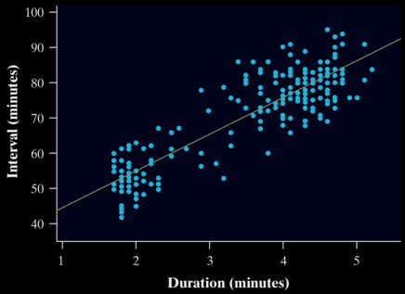
Inference for Linear Regression
In Chapter 3, we examined data on eruptions of the Old Faithful geyser. Below is a scatterplot of the duration and interval of time until the next eruption for all 222 recorded eruptions in a single month. The least-squares regression line for this population of data has been added to the graph.
It has slope 10.36 and y-intercept 33.97. We call this the population regression line (or true regression line) because it uses all the observations that month

Slide 6
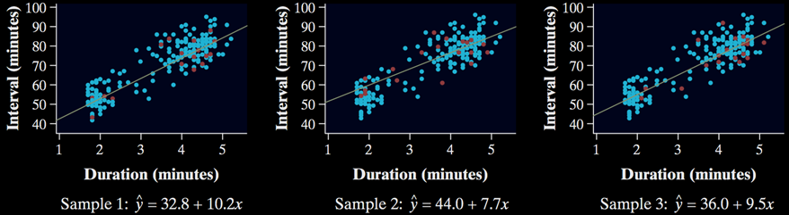
Sampling Distribution of b
The figures below show the results of taking three different SRSs of 20 Old Faithful eruptions in this month. Each graph displays the selected points and the LSRL for that sample.
Notice that the slopes of the sample regression lines – 10.2, 7.7, and 9.5 – vary quite a bit from the slope of the population regression line, 10.36.
The pattern of variation in the slope b is described by its sampling distribution.

Slide 7
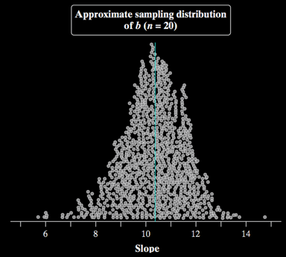
Sampling Distribution of b
Confidence intervals and significance tests about the slope of the population regression line are based on the sampling distribution of b, the slope of the sample regression line.
Fathom software was used to simulate choosing 1000 SRSs of n = 20 from the Old Faithful data, each time calculating the equation of the LSRL for the sample. The values of the slope b for the 1000 sample regression lines are plotted.
Describe this approximate sampling distribution of b.

Slide 8
Sampling Distribution of b
Shape
Center
Spread
We can see that the distribution of b-values is roughly symmetric and unimodal. A Normal probability plot of these sample regression line slopes suggests that the approximate sampling distribution of b is close to Normal.
The mean of the 1000 b-values is 10.32. This value is quite close to the slope of the population (true) regression line, 10.36.
The standard deviation of the 1000 b-values is 1.31. Later, we will see that the standard deviation of the sampling distribution of b is actually 1.30.

Slide 9
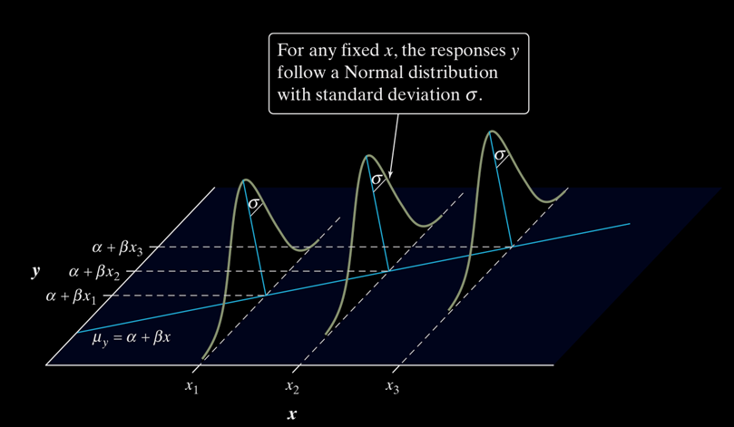
Sampling Distribution Concepts
The figure below shows the regression model when the conditions are met. The line in the figure is the population regression line µ_{y}= α + βx.
The Normal curves show how y will vary when x is held fixed at different values. All the curves have the same standard deviation σ, so the variability of y is the same for all values of x.
For each possible value of the explanatory variable x, the mean of the responses µ(y | x) moves along this line.
The value of σ determines whether the points fall close to the population regression line (small σ) or are widely scattered (large σ).

Slide 10
Conditions for Regression Inference
The slope b and intercept a of the least-squares line are statistics. That is, we calculate them from the sample data. These statistics would take somewhat different values if we repeated the data production process. To do inference, think of a and b as estimates of unknown parameters α and β that describe the population of interest.

Slide 11
Conditions for Regression Inference
The mean response, μ_{y}, has a straight-line relationship with x:
μ_{y} = α + βx
where the slope β and intercept α are unknown parameters
Repeated responses y are independent of each other
For any fixed value of x, the response variable y varies according to a Normal distribution
The standard deviation of y (call it σ) is the same for all values of x. The value of σ is unknown.
Simple Random Sample

Slide 12
Conditions for Regression Inference
Suppose we have n observations on an explanatory variable x and a response variable y. Our goal is to study or predict the behavior of y for given values of x.
• Linear The (true) relationship between x and y is linear. For any fixed value of x, the mean response µ_{y} falls on the population (true) regression line µ_{y}= α + βx. The slope b and intercept a are usually unknown parameters.
• Independent Individual observations are independent of each other.
• Normal For any fixed value of x, the response y varies according to a Normal distribution.
• Equal variance The standard deviation of y (call it σ) is the same for all values of x. The common standard deviation σ is usually an unknown parameter.
• Random The data come from a well-designed random sample or randomized experiment.
Note the acronym: LINER or Line Regression

Slide 13
Checking Regression Conditions
You should always check the conditions before doing inference about the regression model. Although the conditions for regression inference are a bit complicated, it is not hard to check for major violations.
Start by making a histogram or Normal probability plot of the residuals and also a residual plot. Here’s a summary of how to check the conditions one by one.
• Linear Examine the scatterplot to check that the overall pattern is roughly linear. Look for curved patterns in the residual plot. Check to see that the residuals center on the “residual = 0” line at each x-value in the residual plot.
• Independent Look at how the data were produced. Random sampling and random assignment help ensure the independence of individual observations. If sampling is done without replacement, remember to check that the population is at least 10 times as large as the sample (10% condition).
• Normal Make a stemplot, histogram, or Normal probability plot of the residuals and check for clear skewness or other major departures from Normality.
• Equal variance Look at the scatter of the residuals above and below the “residual = 0” line in the residual plot. The amount of scatter should be roughly the same from the smallest to the largest x-value.
• Random See if the data were produced by random sampling or a randomized experiment.
L
I
N
E
R

Slide 14
Example: Helicopter Experiment
Mrs. Barrett’s class did a variation of the helicopter experiment on page 738. Students randomly assigned 14 helicopters to each of five drop heights: 152 centimeters (cm), 203 cm, 254 cm, 307 cm, and 442 cm. Teams of students released the 70 helicopters in a predetermined random order and measured the flight times in seconds.

Slide 15
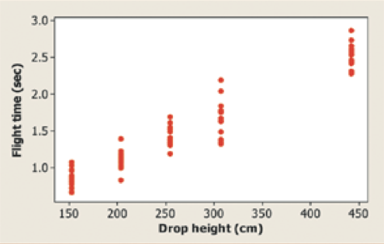
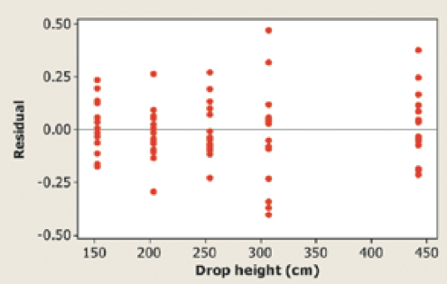
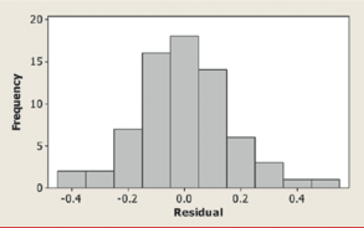
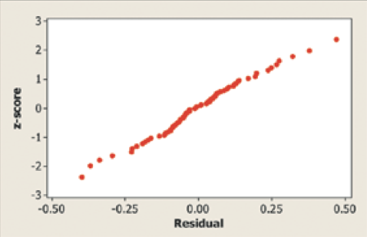
Example: Helicopter Experiment
The class used Minitab to carry out a least-squares regression analysis for these data. A scatterplot, residual plot, histogram, and Normal probability plot of the residuals are shown below.

Slide 16
Conditions Check
Linear The scatterplot shows a clear linear form. For each drop height used in the experiment, the residuals are centered on the horizontal line at 0. The residual plot shows a random scatter about the horizontal line.
Normal The histogram of the residuals is single-peaked, unimodal, and somewhat bell-shaped. In addition, the Normal probability plot is very close to linear.
Independent Because the helicopters were released in a random order and no helicopter was used twice, knowing the result of one observation should give no additional information about another observation.
Equal variance The residual plot shows a similar amount of scatter about the residual = 0 line for the 152, 203, 254, and 442 cm drop heights. Flight times (and the corresponding residuals) seem to vary more for the helicopters that were dropped from a height of 307 cm.
Random The helicopters were randomly assigned to the five possible drop heights.
Except for a slight concern about the equal-variance condition, we should be safe performing inference about the regression model in this setting.

Slide 17
Estimating the Parameters
When the conditions are met, we can do inference about the regression model µ_{y} = α+ βx. The first step is to estimate the unknown parameters.
  If we calculate the least-squares regression line, the slope b is an unbiased estimator of the population slope β, and the y-intercept a is an unbiased estimator of the population y-intercept α.
  The remaining parameter is the standard deviation σ, which describes the variability of the response y about the population regression line.

Slide 18
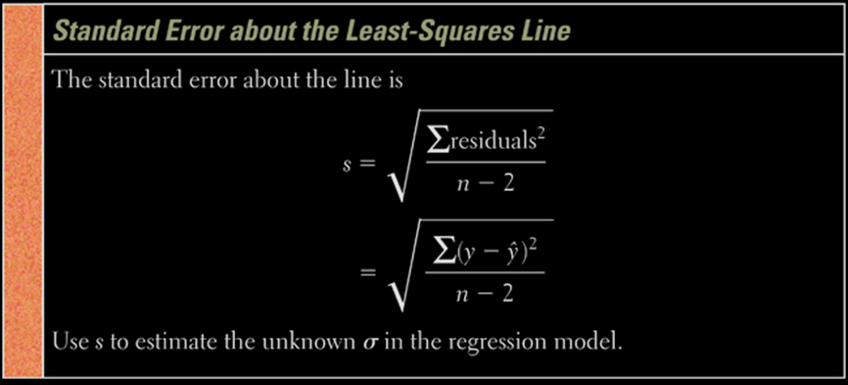
Estimating the Parameters
We need to estimate parameters for μ_{y} = α + βx and σ
From the least square regression line: y-hat = a + bx
we get unbiased estimators a (for α) and b (for β)
We use n – 2 because we used a and b as estimators

Slide 19
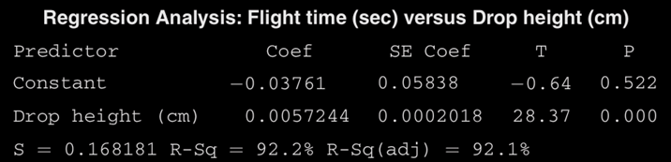

Example: Helicopter Experiment
Computer output from the least-squares regression analysis on the helicopter data for Mrs. Barrett’s class is shown below.
The slope β of the true regression line says how much the average flight time of the paper helicopters increases when the drop height increases by 1 centimeter.
Because b = 0.0057244 estimates the unknown β, we estimate that, on average, flight time increases by about 0.0057244 seconds for each additional centimeter of drop height.
We need the intercept a = -0.03761 to draw the line and make predictions, but it has no statistical meaning in this example. No helicopter was dropped from less than 150 cm, so we have no data near x = 0.
We might expect the actual y-intercept α of the true regression line to be 0 because it should take no time for a helicopter to fall no distance.
The y-intercept of the sample regression line is -0.03761, which is pretty close to 0.
Our estimate for the standard deviation σ of flight times about the true regression line at each x-value is s = 0.168 seconds.
This is also the size of a typical prediction error if we use the least-squares regression line to predict the flight time of a helicopter from its drop height.

Slide 20
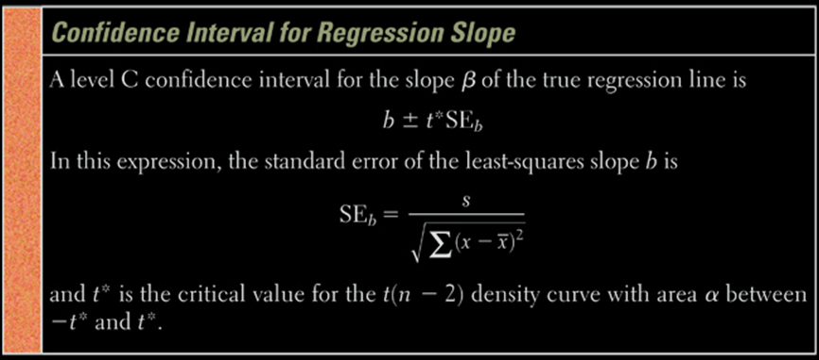
Confidence Interval on β
Remember our form: Point Estimate ± Margin of Error
Since β is the true slope, then b is the point estimate
The Margin of Error takes the form of t* × SE_{b}

Slide 21
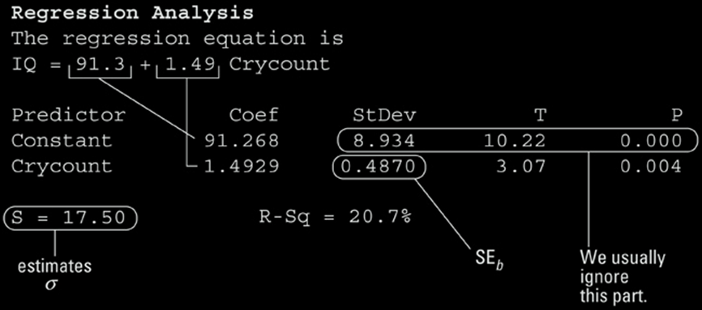
Confidence Intervals in Practice
We use rarely have to calculate this by hand
Output from Minitab:
Parameters: b (1.4929), a (91.3), s (17.50)
t* = 2.042 from n – 2, 95% CL
CI = PE ± MOE = 1.4929 ± (2.042)(0.4870)
= 1.4929 ± 0.9944
[0.4985, 2.4873]
Since 0 is not in the interval, then we might conclude that β ≠ 0

Slide 22
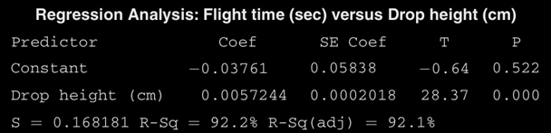
Example: Helicopter Experiment
Earlier, we used Minitab to perform a least-squares regression analysis on the helicopter data for Mrs. Barrett’s class. Recall that the data came from dropping 70 paper helicopters from various heights and measuring the flight times. We checked conditions for performing inference earlier. Construct and interpret a 95% confidence interval for the slope of the population regression line.
SE_{b} = 0.0002018, from the “SE Coef ” column in the computer output.
Because the conditions are met, we can calculate a t interval for the slope β based on a t distribution with df = n - 2 = 70 - 2 = 68. Using the more conservative df = 60 from Table B gives t* = 2.000.
The 95% confidence interval is
b ± t* SE_{b} = 0.0057244 ± 2.000(0.0002018)
= 0.0057244 ± 0.0004036
= (0.0053208, 0.0061280)
We are 95% confident that the interval from 0.0053208 to 0.0061280 seconds per cm captures the slope of the true regression line relating the flight time y and drop height x of paper helicopters.

Slide 23
Inference Tests on β
Since the null hypothesis can not be proved, our hypotheses for tests on the regression slope will be:
H₀: β = 0 (no correlation between x and y)
H_{a}: β ≠ 0 (some linear correlation)
Testing correlation makes sense only if the observations are a random sample.
  This is often not the case in regression settings, where researchers often fix in advance the values of x being tested
  Random assignment of the values of x to the order in which they are tested is usually the best we can hope for

Slide 24
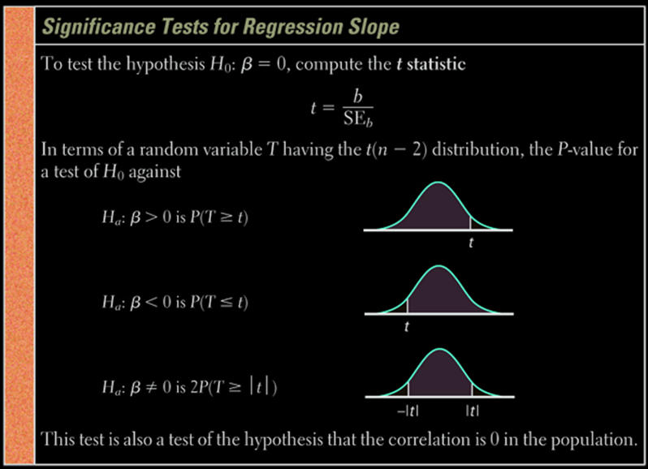
Test Statistic

Slide 25
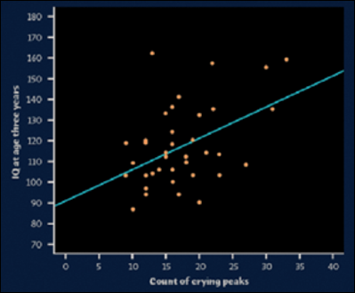
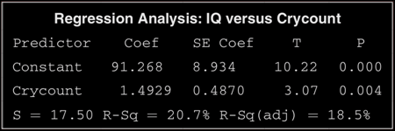
Example: Crying and IQ
Infants who cry easily may be more easily stimulated than others. This may be a sign of higher IQ. Child development researchers explored the relationship between the crying of infants 4 to 10 days old and their later IQ test scores. A snap of a rubber band on the sole of the foot caused the infants to cry. The researchers recorded the crying and measured its intensity by the number of peaks in the most active 20 seconds. They later measured the children’s IQ at age three years using the Stanford-Binet IQ test. A scatterplot and Minitab output for the data from a random sample of 38 infants is below.
Do these data provide convincing evidence that there is a positive linear relationship between crying counts and IQ in the population of infants?

Slide 26
Example: Crying and IQ Test
We want to perform a test of
H₀ : β = 0
H_{a} : β > 0
where β is the true slope of the population regression line relating crying count to IQ score. No significance level was given, so we’ll use α = 0.05.

Slide 27
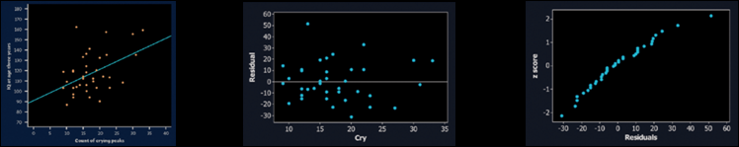
Example: Crying and IQ Conditions
Plan: If the conditions are met, we will perform a t test for the slope β.
• Linear : The scatterplot suggests a moderately weak positive linear relationship between crying peaks and IQ. The residual plot shows a random scatter of points about the residual = 0 line.
• Independent: Later IQ scores of individual infants should be independent. Due to sampling without replacement, there have to be at least 10(38) = 380 infants in the population from which these children were selected.

Slide 28
Example: Crying and IQ Conditions
Plan: If the conditions are met, we will perform a t test for the slope β.
• Normal: The Normal probability plot of the residuals shows a slight curvature, which suggests that the responses may not be Normally distributed about the line at each x-value. With such a large sample size (n = 38), however, the t procedures are robust against departures from Normality.
• Equal variance: The residual plot shows a fairly equal amount of scatter around the horizontal line at 0 for all x-values.
• Random: We are told that these 38 infants were randomly selected.

Slide 29
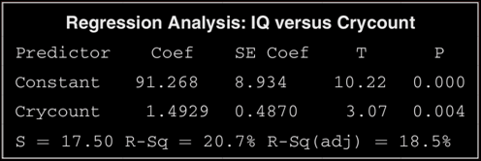
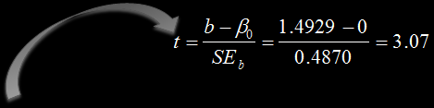
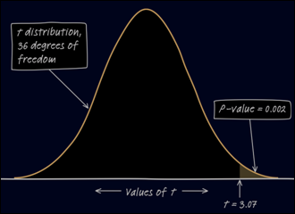
Example: Crying and IQ t-Test
With no obvious violations of the conditions, we proceed to inference. The test statistic and P-value can be found in the Minitab output.
The Minitab output gives P = 0.004 as the P-value for a two-sided test. The P-value for the one-sided test is half of this, P = 0.002.
Conclude: The P-value, 0.002, is less than our α = 0.05 significance level, so we have enough evidence to reject H₀ and conclude that there is a positive linear relationship between intensity of crying and IQ score in the population of infants.

Slide 30
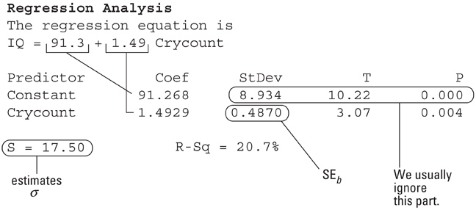
TI Output from Cry-count
y = a + bx
β ≠ 0 and ρ ≠ 0
t = 3.06548
p = .004105
df = 36
a = 91.26829
b = 1.492896
s = 17.49872
r² = .206999
r = .4549725
Minitab Output

Slide 31
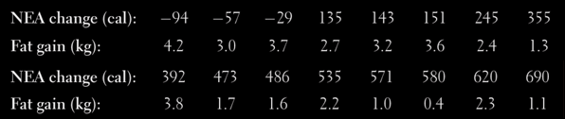
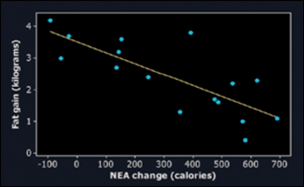
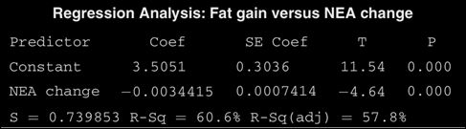
Example: Fidgeting
In Chapter 3, we examined data from a study that investigated why some people don’t gain weight even when they overeat. Perhaps fidgeting and other “nonexercise activity” (NEA) explains why. Researchers deliberately overfed a random sample of 16 healthy young adults for 8 weeks. They measured fat gain (in kilograms) and change in energy use (in calories) from activity other than deliberate exercise for each subject. Here are the data:

Slide 32
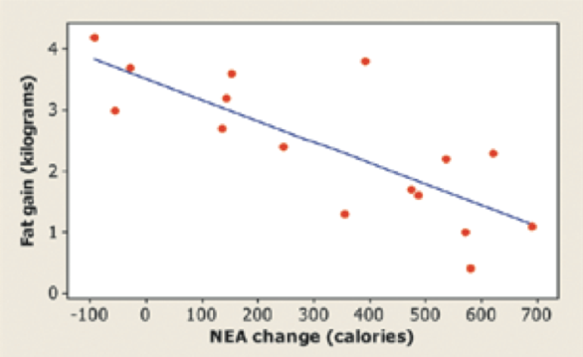
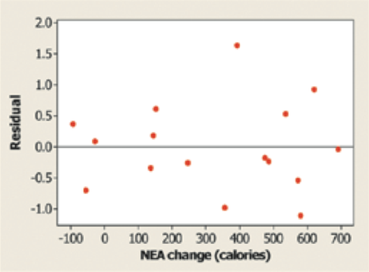
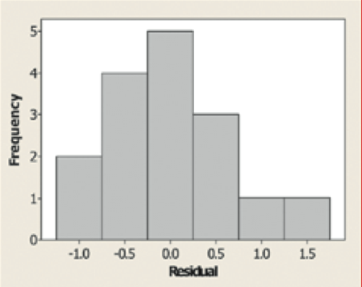
Example: Fidgeting Conditions
Construct and interpret a 90% confidence interval for the slope of the population regression line
Plan: If the conditions are met, we will use a t interval for the slope to estimate β.
• Linear The scatterplot shows a clear linear pattern. Also, the residual plot shows a random scatter of points about the “residual = 0” line.
• Independent Individual observations of fat gain should be independent if the study is carried out properly. Because researchers sampled without replacement, there have to be at least 10(16) = 160 healthy young adults in the population of interest.
• Normal The histogram of the residuals is roughly symmetric and single-peaked, so there are no obvious departures from normality.
• Equal variance It is hard to tell from so few points whether the scatter of points around the residual = 0 line is about the same at all x-values.
• Random The subjects in this study were randomly selected to participate.

Slide 33
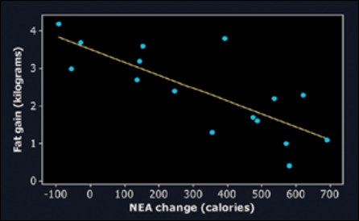
Example: Fidgeting Finished
Construct and interpret a 90% confidence interval for the slope of the population regression line
Calculations: We use the t distribution with 16 - 2 = 14 degrees of freedom to find the critical value. For a 90% confidence level, the critical value is t* = 1.761. So the 90% confidence interval for β is
b ± t* SE_{b} = −0.0034415 ± 1.761(0.0007414)
= −0.0034415 ± 0.0013056
= (−0.004747,−0.002136)
Interpretation: We are 90% confident that the interval from -0.004747 to -0.002136 kg captures the actual slope of the population regression line relating NEA change to fat gain for healthy young adults.

Slide 34
Beer vs BAC Example
16 student volunteers at Ohio State drank a randomly assigned number of cans of beer. Thirty minutes later, a police officer measured their BAC. Here are the data:
Enter the data into your calculator.
Draw a scatter plot of the data and the regression line
Conduct an inference test on the effect of beers on BAC
Student | 1 | 2 | 3 | 4 | 5 | 6 | 7 | 8
Beers | 5 | 2 | 9 | 8 | 3 | 7 | 3 | 5
BAC | 0.10 | 0.03 | 0.19 | 0.12 | 0.04 | 0.095 | 0.07 | 0.06
Student | 9 | 10 | 11 | 12 | 13 | 14 | 15 | 16
Beers | 3 | 5 | 4 | 6 | 5 | 7 | 1 | 4
BAC | 0.02 | 0.05 | 0.07 | 0.10 | 0.085 | 0.09 | 0.01 | 0.05
LinReg(a + bx) L1, L2, Y1

Slide 35
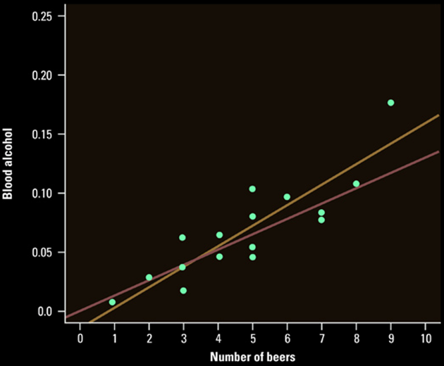
Scatter plot and Regression Line
D
F
S
O
C
Interpret the scatter plot

Slide 36
Using the TI for Inference Test on β
Enter explanatory data into L1
Enter response data into L2
Stat → Tests → E:LinRegTTest
Xlist: L1
Ylist: L2
(Test type) β & ρ: ≠ 0 <0 >0
RegEq: (leave blank)
Test will take two screens to output the data
Inference: t-statistic, degrees of freedom and p-value
Regression: a, b, s, r², and r

Slide 37
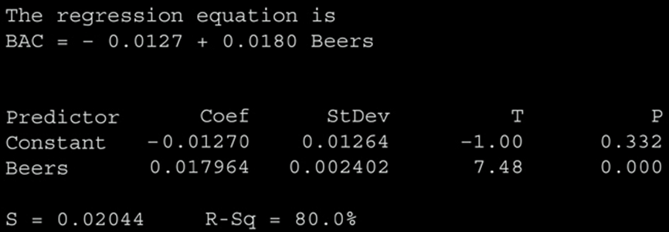
Output from Minitab
Could we have used this instead of output from our calculator?

Slide 38
Interpreting Computer Output
In the following examples of computer output from commonly used statistical packages:
Find the a and b values for the regression eqn
Find r and r²
Find SE_{b}, t-value and p-value (if available)
We can use these outputs to finish an inference test on the association of our explanatory and response variables.

Slide 39
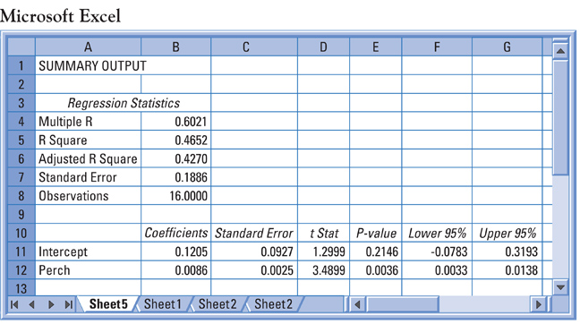
Sample from Excel prob 15.10

Slide 40
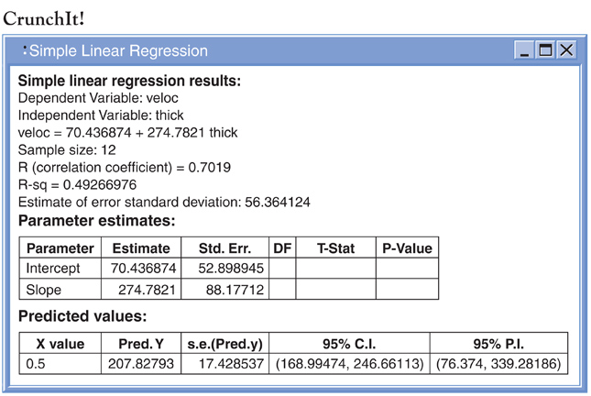
Sample from CrunchIt prob 15.20

Slide 41
Summary and Homework
Summary
  Inference Conditions Needed (LINER):
  1) Linear Model appropriate
  2) Independent Observations
  3) Normally distributed response values about a given x
  4) Equal standard deviation (or spread); σ is constant
  5) Randomly selected values
  Confidence Intervals on β can be done
  Computer output needs to be understood
  Inference testing on β use the t statistic = b/SE_{b}
Homework
  Problems 1, 5, 7, 11, 15

