Slide 1
Lesson 12 - 2
Transformations to Convert Nonlinear Data to Linear Model

Slide 2
Objectives
USE transformations involving powers and roots to achieve linearity for a relationship between two variables
MAKE predictions from a least-squares regression line involving transformed data
USE transformations involving logarithms to achieve linearity for a relationship between two variables
DETERMINE which of several transformations does a better job of producing a linear relationship

Slide 3
Vocabulary
Transformation – changing a variable into a more linear model

Slide 4
Introduction
In Chapter 3, we learned how to analyze relationships between two quantitative variables that showed a linear pattern. When two-variable data show a curved relationship, we must develop new techniques for finding an appropriate model. This section describes several simple transformations of data that can straighten a nonlinear pattern
Once the data have been transformed to achieve linearity, we can use least-squares regression to generate a useful model for making predictions.
And if the conditions for regression inference are met, we can estimate or test a claim about the slope of the population (true) regression line using the transformed data.

Slide 5
Introduction (cont)
Applying a function such as the logarithm or square root to a quantitative variable is called transforming the data. We will see in this section that understanding how simple functions work helps us choose and use transformations to straighten nonlinear patterns.

Slide 6


Transforming with Powers and Roots
When you visit a pizza parlor, you order a pizza by its diameter—say, 10 inches, 12 inches, or 14 inches. But the amount you get to eat depends on the area of the pizza. The area of a circle is π times the square of its radius r. So the area of a round pizza with diameter x is
Although a power model of the form y = ax^{p} describes the relationship between x and y in this setting, there is a linear relationship between x^{p} and y.
If we transform the values of the explanatory variable x by raising them to the p power, and graph the points (x^{p}, y), the scatterplot should have a linear form.

Slide 7
Example 1: Go Fish!
Imagine that you have been put in charge of organizing a fishing tournament in which prizes will be given for the heaviest Atlantic Ocean rockfish caught. You know that many of the fish caught during the tournament will be measured and released. You are also aware that using delicate scales to try to weigh a fish that is flopping around in a moving boat will probably not yield very accurate results. It would be much easier to measure the length of the fish while on the boat. What you need is a way to convert the length of the fish to its weight.

Slide 8
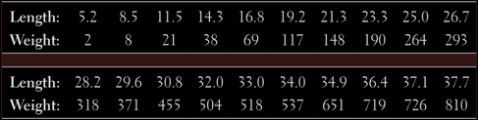
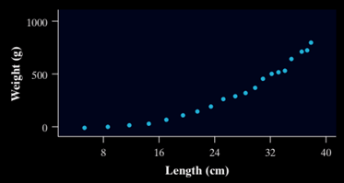
Example 1: Go Fish!
What you need is a way to convert the length of the fish to its weight.

Slide 9
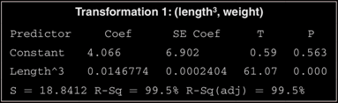
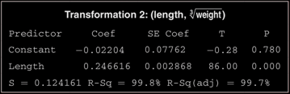
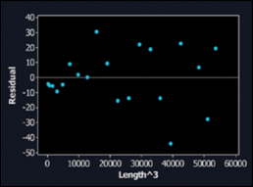
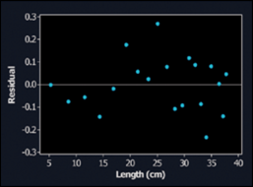
Example 1: Go Fish!
Here is Minitab output from separate regression analyses of the two sets of transformed Atlantic Ocean rockfish data.

Slide 10
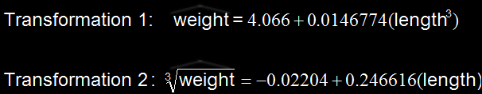
Example 1: Go Fish!
(a) Give the equation of the least-squares regression line. Define any variables you use.

Slide 11
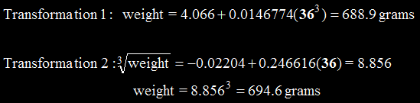
Example 1: Go Fish!
(b) Suppose a contestant in the fishing tournament catches an Atlantic ocean rockfish that’s 36 centimeters long. Use the model from part (a) to predict the fish’s weight. Show your work.

Slide 12
Example 1: Go Fish!
(c) Interpret the value of s in context.
For transformation 1, the standard deviation of the residuals is s = 18.841 grams. Predictions of fish weight using this model will be off by an average of about 19 grams. For transformation 2, s = 0.12. that is, predictions of the cube root of fish weight using this model will be off by an average of about 0.12.

Slide 13


Transforming with Powers and Roots
When experience or theory suggests that the relationship between two variables is described by a power model of the form y = ax^{p}, you now have two strategies for transforming the data to achieve linearity.
Raise the values of the explanatory variable x to the p power and plot the points
Take the p^{th} root of the values of the response variable y and plot the points

Slide 14
Transforming with Powers and Roots
What if you have no idea what power to choose? You could guess and test until you find a transformation that works. Some technology comes with built-in sliders that allow you to dynamically adjust the power and watch the scatterplot change shape as you do.
It turns out that there is a much more efficient method for linearizing a curved pattern in a scatterplot. Instead of transforming with powers and roots, we use logarithms. This more general method works when the data follow an unknown power model or any of several other common mathematical models.

Slide 15
Transforming with Powers and Roots
Using natural logs instead of guess and check:
Take the natural log of both sides
y = cx^{n} ln y = ln(cx^{n}) = ln c + n ln x
Compare ln y vs ln x plot for linearity
If conditions warrant, run the regression
Use following format (see algebraic reductions found on page 780 in the text) to model data
ln y = a + b ln x (a and b from linear regression)
y = eª × x^{b} = (eª)x^{b}

Slide 16
Transforming with Logarithms
Not all curved relationships are described by power models. Some relationships can be described by a logarithmic model of the form: y = a + b log x.
Sometimes the relationship between y and x is based on repeated multiplication by a constant factor. That is, each time x increases by 1 unit, the value of y is multiplied by b. An exponential model of the form
y = ab^{x} describes such multiplicative growth.

Slide 17
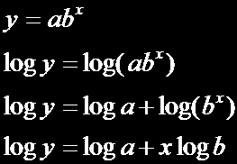
Transforming with Logarithms
If an exponential model of the form y = ab^{x} describes the relationship between x and y, we can use logarithms to transform the data to produce a linear relationship.
exponential model
taking the logarithm of both sides
using the property log(mn) = log m + log n
using the property log m^{p} = p log m

Slide 18
Transforming with Logarithms
We can rearrange the final equation as
log y = log a + (log b)x.
Notice that log a and log b are constants because a and b are constants.
So the equation gives a linear model relating the explanatory variable x to the transformed variable log y.
Thus, if the relationship between two variables follows an exponential model, and we plot the logarithm (base 10 or base e) of y against x, we should observe a straight-line pattern in the transformed data.

Slide 19

Transforming with Logarithms
If we fit a least-squares regression line to the transformed data, we can find the predicted value of the logarithm of y for any value of the explanatory variable x by substituting our x-value into the equation of the line.
To obtain the corresponding prediction for the response variable y, we have to “undo” the logarithm transformation to return to the original units of measurement. One way of doing this is to use the definition of a logarithm as an exponent:

Slide 20
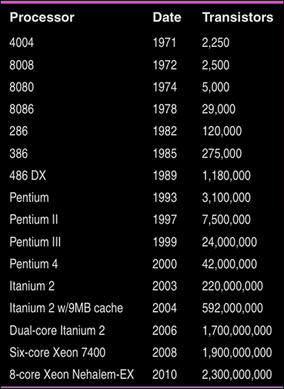
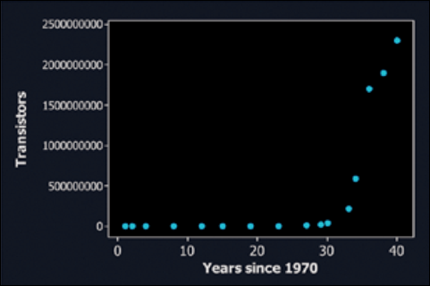
Example 2: Moore’s Law
Gordon Moore, one of the founders of Intel Corporation, predicted in 1965 that the number of transistors on an integrated circuit chip would double every 18 months. This is Moore’s law, one way to measure the revolution in computing. Here are data on the dates and number of transistors for Intel microprocessors:

Slide 21
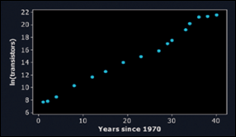
Example 2: Moore’s Law
a) A scatterplot of the natural logarithm (log base e or ln) of the number of transistors on a computer chip versus years since 1970 is shown. Based on this graph, explain why it would be reasonable to use an exponential model to describe the relationship between number of transistors and years since 1970.
If an exponential model describes the relationship between two variables x and y, then we expect a scatterplot of (x, ln y) to be roughly linear. the scatterplot of ln(transistors) versus years since 1970 has a fairly linear pattern, especially through the year 2000. So an exponential model seems reasonable here.

Slide 22
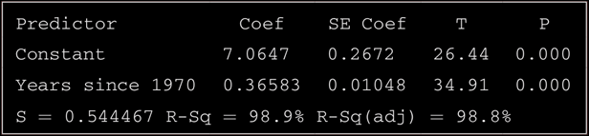
Example 2: Moore’s Law
(b) Minitab output from a linear regression analysis on the transformed data is shown below.
Give the equation of the least-squares regression line.
Be sure to define any variables you use
ln y = 7.0647 + 0.36583x where x = years since 1970
and y = ln(transistors in processors)

Slide 23

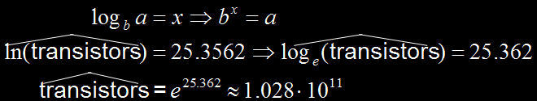
Example 2: Moore’s Law
(c) Use your model from part (b) to predict the number of transistors on an Intel computer chip in 2020. Show your work.

Slide 24
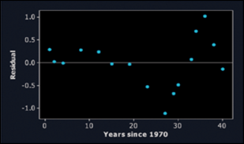
Example 2: Moore’s Law
(d) A residual plot for the linear regression in part (b) is shown below. Discuss what this graph tells you about the appropriateness of the model.
The residual plot shows a distinct pattern, with the residuals going from positive to negative to positive as we move from left to right. But the residuals are small in size relative to the transformed y-values. Also, the scatterplot of the transformed data is much more linear than the original scatterplot. We feel reasonably comfortable using this model to make predictions about the number of transistors on a computer chip.

Slide 25
Power versus Exponential
Power: if we use Ln(y) = a + bLn(x) to linearize the data, then a power function model is appropriate
  Y = (eª)x^{b}
  (taking logs of both sides)
Exponential: if we use just Ln(y) = a + bx to linearize the data, then an exponential function model is appropriate
  Y = ab^{x}
  (taking log of y, response variable, only

Slide 26
Putting It All Together: Which Transformation Should We Choose?
Suppose that a scatterplot shows a curved relationship between two quantitative variables x and y.
How can we decide whether a power model or an exponential model better describes the relationship?
The following example shows the strategy we should use.

Slide 27
Example 3: Eris
On July 31, 2005, a team of astronomers announced that they had discovered what appeared to be a new planet in our solar system. They had first observed this object almost two years earlier using a telescope at Caltech’s Palomar Observatory in California.
Originally named UB313, the potential planet is bigger than Pluto and has an average distance of about 6.3 billion miles from the sun. (For reference, Earth is about 93 million miles from the sun.)
Could this new astronomical body, now called Eris, be a new planet?

Slide 28
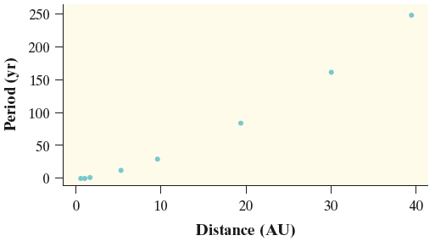
Example 3: Eris
At the time of the discovery, there were nine known planets in our solar system. Here is a scatterplot on the distance from the sun and period of revolution of those planets. Note that distance is measured in astronomical units (AU), the number of Earth distances the object is from the sun. There appears to be a strong curved relationship between distance from the sun and period of revolution.

Slide 29
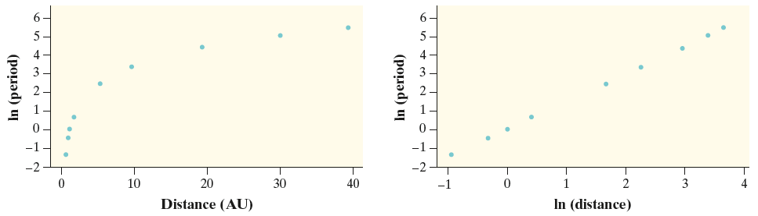
Example 3: Eris
The following graphs show the results of two different
transformations of the data.
The graph on the left plots the natural logarithm of period against distance from the sun for all nine planets.
The graph on the right plots the natural logarithm of period against the natural logarithm of distance from the sun for the nine planets.

Slide 30
Example 3: Eris
Based on the scatterplots, would an exponential model or a power model provide a better description of the relationship between distance and period? Justify your answer.
The graph of ln(period) versus ln(distance) is much more linear than the graph of ln(period) versus distance, so a power model would be more appropriate.

Slide 31
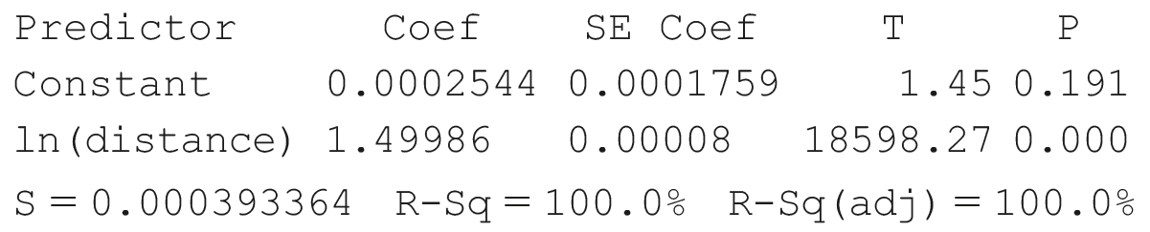
Example 3: Eris
Here is computer output from a linear regression analysis of the transformed data in the graph previous slide. Give the equation of the least-squares regression line. Be sure to define any variables you use.
$\hat{ln⁡(period)}=0.0002544+1.49986∙ln\left(distance\right)$

Slide 32
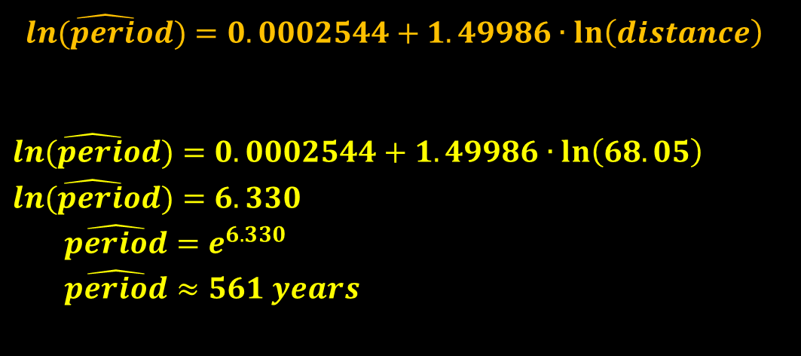
Example 3: Eris
Use your model from part (b) to predict the period of
revolution for Eris, which is about 68.05 AU from the sun
$\hat{ln⁡(period)}=0.0002544+1.49986∙ln\left(distance\right)$
$\hat{ln⁡(period)}=0.0002544+1.49986∙ln\left(68.05\right)$
$\hat{ln⁡(period)}=6.330$
$\hat{period}=e^{6.330}$
$\hat{period}≈561 years$

Slide 33
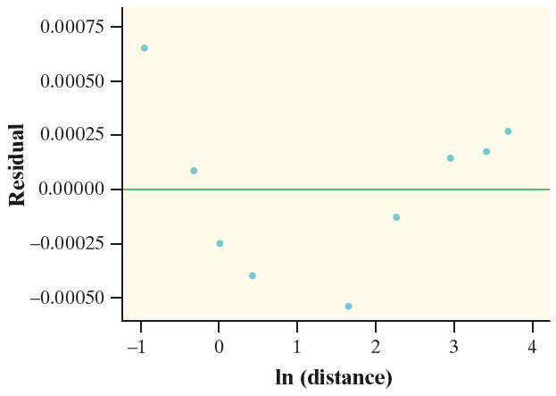
Example 3: Eris
Here is a residual plot for
the linear regression in
part (b). Do you expect
your prediction in part (c)
to be too large, too small,
or about right? Justify your
answer.
Eris’s value for ln(distance) is ln(68.05) = 4.22, which would fall at the far right of the residual plot, where all the residuals are positive. Because it is likely that residual = actual y − predicted y > 0, we would expect our prediction to be too small.

Slide 34
Example 3: Eris
Based on the residual graph to the right. Is the power model a good model?
Since there is a curved pattern to the residual graph, then no it is not a good model.

Slide 35
Power versus Exponential
Power: if we use Ln(y) = a + bLn(x) to linearize the data, then a power function model is appropriate
  Y = (eª)x^{b}
Exponential: if we use just Ln(y) = a + bx to linearize the data, then an exponential function model is appropriate
  Y = ab^{x}

Slide 36
Summary and Homework
Summary
Nonlinear relationships between two quantitative variables can sometimes be changed into linear relationships by transforming one or both of the variables. Transformation is particularly effective when there is reason to think that the data are governed by some nonlinear mathematical model.
When theory or experience suggests that the relationship between two variables follows a power model of the form y = ax^{p}, there are two transformations involving powers and roots that can linearize a curved pattern in a scatterplot.
    Option 1: Raise the values of the explanatory variable x to the power p, then look at a graph of (x^{p}, y).
    Option 2: Take the p^{th} root of the values of the response variable y, then look at a graph of (x, p^{th} root of y).
Homework
  Problems 33, 35, 37, 43, 47

