Slide 1
Lesson 12 - R
Chapter 12 Review
Inference for Regression

Slide 2
Objectives
Identify the conditions necessary to do inference for regression
Explain what is meant by the standard error about the least-squares line
Given a set of data, check that the conditions for doing inference for regression are present
Compute a confidence interval for the slope of the regression line
Conduct a test of the hypothesis that the slope of the regression line is 0 (or that the correlation is 0) in the population

Slide 3
Vocabulary
none new

Slide 4
Conditions for Regression Inference
Repeated responses y are independent of each other
The mean response, μ_{y}, has a straight-line relationship with x:
μ_{y} = α + βx
where the slope β and intercept α are unknown parameters
The standard deviation of y (call it σ) is the same for all values of x. The value of σ is unknown.
For any fixed value of x, the response variable y varies according to a Normal distribution

Slide 5
Checking Regression Conditions
Observations are independent
  No repeated observations on the same individual
The true relationship is linear
  Scatter plot the data to check this
  Remember the transformations to make non-linear data linear
Response standard deviation is the same everywhere
  Check the scatter plot to see if this is violated
Response varies Normally about the true regression line
  To check this, we look at the residuals (since they must be Normally distributed as well) either with a box plot or normality plot
  These procedures are robust, so slight departures from Normality will not affect the inference

Slide 6
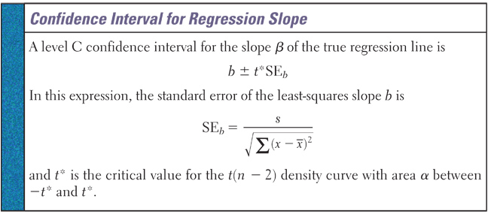
Confidence Interval on β
Remember our form: Point Estimate ± Margin of Error
Since β is the true slope, then b is the point estimate
The Margin of Error takes the form of t* × SE_{b}

Slide 7
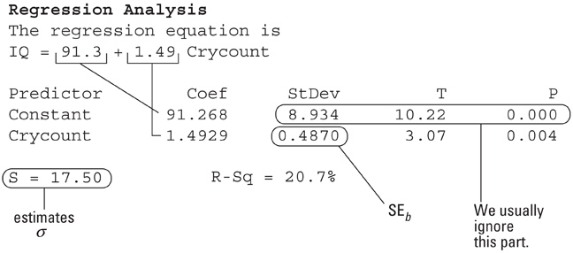
Confidence Intervals in Practice
We use rarely have to calculate this by hand
Output from Minitab:
Parameters: b (1.4929), a (91.3), s (17.50)
t* = 2.042 from n – 2, 95% CL
CI = PE ± MOE = 1.4929 ± (2.042)(0.4870)
= 1.4929 ± 0.9944
[0.4985, 2.4873]
Since 0 is not in the interval, then we might conclude that β ≠ 0

Slide 8
Inference Tests on β
Since the null hypothesis can not be proved, our hypotheses for tests on the regression slope will be:
H₀: β = 0 (no correlation between x and y)
H_{a}: β ≠ 0 (some linear correlation)
Testing correlation makes sense only if the observations are a random sample.
  This is often not the case in regression settings, where researchers often fix in advance the values of x being tested

Slide 9
Using the TI for Inference Test on β
Enter explanatory data into L1
Enter response data into L2
Stat → Tests → E:LinRegTTest
Xlist: L1
Ylist: L2
(Test type) β & ρ: ≠ 0 <0 >0
RegEq: (leave blank)
Test will take two screens to output the data
Inference: t-statistic, degrees of freedom and p-value
Regression: a, b, s, r², and r

Slide 10
Transforming with Powers and Roots
Using natural logs instead of guess and check:
Take the natural log of both sides
y = cx^{n} ln y = ln(cx^{n}) = ln c + n ln x
Compare ln y vs ln x plot for linearity
If conditions warrant, run the regression
Use following format (see algebraic reductions found on page 780 in the text) to model data
ln y = a + b ln x (a and b from linear regression)
y = eª × x^{b} = (eª)x^{b}

Slide 11
Transforming with Logarithms
Not all curved relationships are described by power models. Some relationships can be described by a logarithmic model of the form: y = a + b log x.
Sometimes the relationship between y and x is based on repeated multiplication by a constant factor. That is, each time x increases by 1 unit, the value of y is multiplied by b. An exponential model of the form
y = ab^{x} describes such multiplicative growth.

Slide 12
Power versus Exponential
Power: if we use Ln(y) = a + bLn(x) to linearize the data, then a power function model is appropriate
  Y = (eª)x^{b}
Exponential: if we use just Ln(y) = a + bx to linearize the data, then an exponential function model is appropriate
  Y = ab^{x}

Slide 13
Summary and Homework
Summary
  Inference Conditions Needed:
  1) Observations independent
  2) True relationship is linear
  3) σ is constant
  4) Responses Normally distributed about the line
  Inference Test: H₀: b₁ = 0 vs H_{a}: b₁ < ≠ > 0
  CI form: PE ± MOE
  Confidence level gives the probability that the method will have the true parameter in the interval
Homework
  study for quiz
b₁ ± t*SE_{b1}

