Slide 1

5-Minute Check on Chapter 1
Given the following two UNICEF African school enrollment data sets:
Northern Africa: 34, 98, 88, 83, 77, 48, 95, 97, 54, 91, 94, 86, 96
Central Africa: 69, 65, 38, 98, 85, 79, 58, 43, 63, 61, 53, 61, 63
Describe each dataset
Compare the two datasets
NA: Shape: skewed left
Outliers: none
Center: M=88
Spread: IQR=30
CA: Shape: ~symmetric
Outliers: none
Center: μ = 64.3
Spread: σ = 16.18
Shape: CA is apx symmetric and its IQR is smaller (data bunched more together); while NA is skewed left with a long tail
Outliers: neither data set has outliers; however, Q2 of CA lies below Q1 of NA.
Center: NA’s Median is much larger than CA (88 to 63)
Spread: NA’s spread is much larger than CA (by range, IQR or σ)
Click the mouse button or press the Space Bar to display the answers.

Slide 2
Lesson 2-1
Describing Location in a Distribution

Slide 3
Objectives
Find and interpret the percentile of an individual value in a distribution of data
Estimate percentiles and individual values using a cumulative relative frequency graph
Find and interpret the standardized score (z-score) of an individual value in a distribution of data
Describe the effect of adding, subtracting, multiplying by, or dividing by a constant on the shape, center, and variability of a distribution of data

Slide 4
Vocabulary
Cumulative relative frequency graph – plots a point corresponding to the cumulative relative frequency in each interval at the smallest value of the next interval; also known as ogives
Density Curve – the curve that represents the proportions of the observations; and describes the overall pattern
Mean of a Density Curve – is the “balance point” and denoted by μ (Greek letter mu)

Slide 5
Vocabulary cont
Normal Curve – a special symmetric, mound shaped density curve with special characteristics
Percentile – the percent of values in a distribution that are less than the individual’s data value
Standardized Value – a z score
Standardize score – how many standard deviations from the mean the individual value is
Z-score – a standardized value indicating the number of standard deviations about or below the mean

Slide 6
Example 1
Consider the following test scores for a small class:
79 | 81 | 80 | 77 | 73 | 83 | 74 | 93 | 78 | 80 | 75 | 67 | 73
77 | 83 | 86 | 90 | 79 | 85 | 83 | 89 | 84 | 82 | 77 | 72
Jenny’s score is noted in red. How did she perform on this test relative to her peers?

Slide 7
Percentiles
Another measure of relative standing is a percentile rank
  One way to describe the location of a value in a distribution is to tell what percent of observations are less than it.
  median = 50th percentile
  {mean=50th %ile if symmetric}
  Q1 = 25th percentile
  Q3 = 75th percentile
Definition:
The p^{th} percentile of a distribution is the value with p percent of the observations less than it.

Slide 8
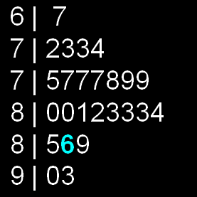
Measuring Position: Percentiles
Jenny earned a score of 86 on her test. How did she perform relative to the rest of the class?
Her score was greater than 21 of the 25 observations. Since 21 of the 25, or 84%, of the scores are below hers, Jenny is at the 84th percentile in the class’s test score distribution.

Slide 9
Describing Location in a Distribution
Cumulative Relative Frequency Graphs
A cumulative relative frequency graph (or ogive) displays the cumulative relative frequency of each class of a frequency distribution.
Age of First 44 Presidents When They Were Inaugurated
Age | Frequency | Relative frequency | Cumulative frequency | Cumulative relative frequency
40-44 | 2 | 2/44 = 4.5% | 2 | 2/44 = 4.5%
45-49 | 7 | 7/44 = 15.9% | 9 | 9/44 = 20.5%
50-54 | 13 | 13/44 = 29.5% | 22 | 22/44 = 50.0%
55-59 | 12 | 12/44 = 34% | 34 | 34/44 = 77.3%
60-64 | 7 | 7/44 = 15.9% | 41 | 41/44 = 93.2%
65-69 | 3 | 3/44 = 6.8% | 44 | 44/44 = 100%

Slide 10
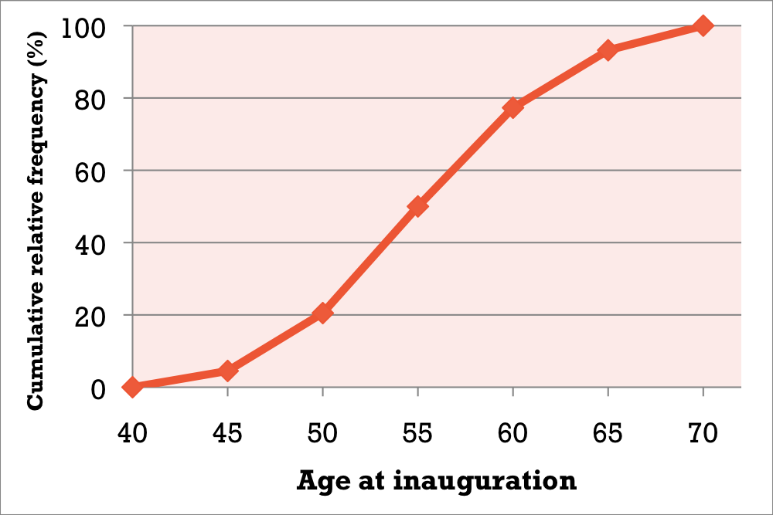
Describing Location in a Distribution
Interpreting Cumulative Relative Frequency Graphs
Use the graph from page 88 to answer the following questions.
Was Barack
Obama, who
was inaugurated
at age 47,
unusually young?
Estimate and interpret the 65th percentile of the distribution
65
11
47
58

Slide 11
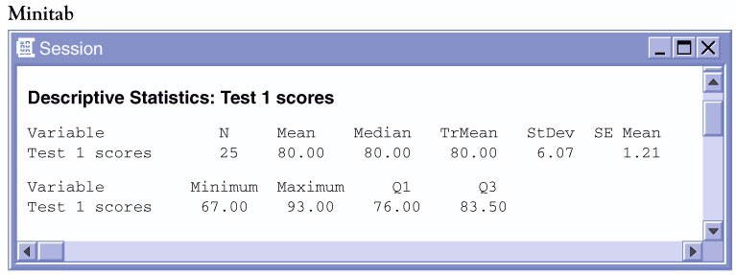
Measuring Position: vs Average
Consider the following test scores for a small class:
79 | 81 | 80 | 77 | 73 | 83 | 74 | 93 | 78 | 80 | 75 | 67 | 73
77 | 83 | 86 | 90 | 79 | 85 | 83 | 89 | 84 | 82 | 77 | 72
Jenny’s score is noted in red. How did she perform on this test relative to her peers?
Her score is “above average”...
but how far above average is it?

Slide 12
Standardized Value
One way to describe relative position in a data set is to tell how many standard deviations above or below the mean the observation is.
Standardized Value: “z-score”
If the mean and standard deviation of a distribution are known, the “z-score” of a particular observation, x, is:

Slide 13

Calculating z-scores
Consider the test data and Julia’s score.
79 | 81 | 80 | 77 | 73 | 83 | 74 | 93 | 78 | 80 | 75 | 67 | 73
77 | 83 | 86 | 90 | 79 | 85 | 83 | 89 | 84 | 82 | 77 | 72
According to Minitab, the mean test score was 80 while the standard deviation was 6.07 points.
Jenny’s score was above average. Her standardized z-score is:
Julia’s score was almost one full standard deviation above the mean. What about some of the others?

Slide 14
Example 1: Calculating z-scores
79 | 81 | 80 | 77 | 73 | 83 | 74 | 93 | 78 | 80 | 75 | 67 | 73
77 | 83 | 86 | 90 | 79 | 85 | 83 | 89 | 84 | 82 | 77 | 72
Jenny: z=(86-80)/6.07
z= 0.99 {above average = +z}
Kevin: z=(72-80)/6.07
z= -1.32 {below average = -z}
Katie: z=(80-80)/6.07
z= 0 {average z = 0}

Slide 15


Example 2: Comparing Scores
Standardized values can be used to compare scores from two different distributions
  Statistics Test: mean = 80, std dev = 6.07
  Chemistry Test: mean = 76, std dev = 4
  Jenny got an 86 in Statistics and 82 in Chemistry.
  On which test did she perform better?
Statistics
Chemistry
Although she had a lower score, she performed relatively better in Chemistry.

Slide 16
Example 3
What is Jenny’s percentile?
Her score was 22 out of 25 or 88%.

Slide 17
Chebyshev’s Inequality
The % of observations at or below a particular z-score depends on the shape of the distribution.
  An interesting (non-AP topic) observation regarding the % of observations around the mean in ANY distribution is Chebyshev’s Inequality.
Chebyshev’s Inequality:
In any distribution, the % of observations within k standard deviations of the mean is at least
Note: Chebyshev only works for k > 1

Slide 18
Summary
Summary
  An individual observation’s relative standing can be described using a z-score or percentile rank
  Z-score is a standardized measure
  Chebyshev’s Inequality works for all distributions

Slide 19
5-Minute Check on Section 2-1a
What does a z-score represent?
According to Chebyshev’s Inequality, how much of the data must lie within two standard deviations of any distribution?
Given the following z-scores on the test: Charlie, 1.23; Tommy, -1.62; and Amy, 0.87
Who had the better test score?
Who was farthest away from the mean?
What does the IQR represent?
What percentile is the person who is ranked 12th in a class of 98?
number of standard deviations away from the mean
1 – 1/2² = 1 – 0.25 = 0.75 so 75% of the data
Charlie; his was the highest z-score
Tommy ; his was the highest |z-score|
The width of the middle 50% of the data; a single number
1 – 12/98 = 1 – 0.1224 = 0.8776 or 88%-tile
Click the mouse button or press the Space Bar to display the answers.

Slide 20
Transforming Data
Transforming converts the original observations from the original units of measurements to another scale. Transformations can affect the shape, center, and spread of a distribution.

Slide 21
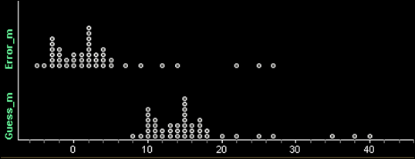
Transforming Data
Effect of Adding (or Subtracting) a Constant
Adding the same number a (either positive, zero, or negative) to each observation:
  adds a to measures of center and location (mean, median, quartiles, percentiles), but
  Does not change the shape of the distribution or measures of spread (range, IQR, standard deviation).
 | n | Mean | s_{x} | Min | Q₁ | M | Q₃ | Max | IQR | Range
Guess(m) | 44 | 16.02 | 7.14 | 8 | 11 | 15 | 17 | 40 | 6 | 32
Error (m) | 44 | 3.02 | 7.14 | -5 | -2 | 2 | 4 | 27 | 6 | 32

Slide 22
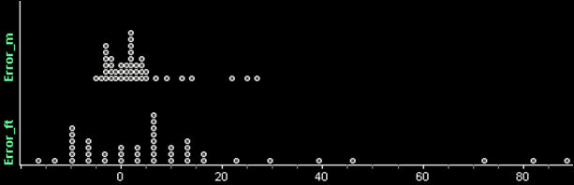
Transforming Data
Effect of Multiplying (or Dividing) by a Constant
Multiplying (or dividing) each observation by the same number b (positive, negative, or zero):
  multiplies (divides) measures of center and location by b
  multiplies (divides) measures of spread by |b|, but
  does not change the shape of the distribution
 | n | Mean | s_{x} | Min | Q₁ | M | Q₃ | Max | IQR | Range
Error(ft) | 44 | 9.91 | 23.43 | -16.4 | -6.56 | 6.56 | 13.12 | 88.56 | 19.68 | 104.96
Error (m) | 44 | 3.02 | 7.14 | -5 | -2 | 2 | 4 | 27 | 6 | 32

Slide 23
Example 1
If the mean of a distribution is 14 and its standard deviation is 6, what happens to these values if each observation has 3 added to it?
Given the same distribution (from above), what happens if each observation has been multiplied by -4?
μ_{new} = 14 + 3 = 17
σ_{new} = 6 (no change)
μ_{new} = 14 × -4 = -56
σ_{new} = 6 × |-4| = 24

Slide 24
Density Curve
In Chapter 1, we developed a kit of graphical and numerical tools for describing distributions. Now, we’ll add one more step to the strategy.
Exploring Quantitative Data
Always plot your data: make a graph.
Look for the overall pattern (shape, center, and spread) and for striking departures such as outliers.
Calculate a numerical summary to briefly describe center and spread.
4. Sometimes the overall pattern of a large number of observations is so regular that we can describe it by a smooth curve.

Slide 25
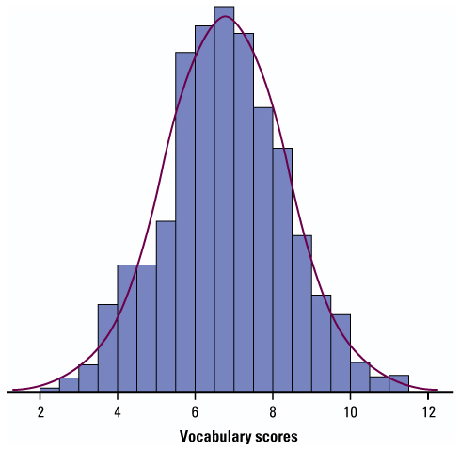
Density Curve
In Chapter 1, you learned how to plot a dataset to describe its shape, center, spread, etc
Sometimes, the overall pattern of a large number of observations is so regular that we can describe it using a smooth curve
Density Curve:
An idealized description of the overall pattern of a distribution.
Area underneath = 1, representing 100% of observations.

Slide 26
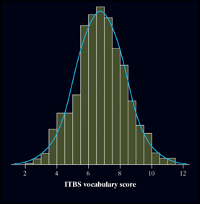
Density Curve
Definition:
A density curve is a curve that
  is always on or above the horizontal axis, and
  has area exactly 1 underneath it.
A density curve describes the overall pattern of a distribution. The area under the curve and above any interval of values on the horizontal axis is the proportion of all observations that fall in that interval.
The overall pattern of this histogram of the scores of all 947 seventh-grade students in Gary, Indiana, on the vocabulary part of the Iowa Test of Basic Skills (ITBS) can be described by a smooth curve drawn through the tops of the bars.

Slide 27
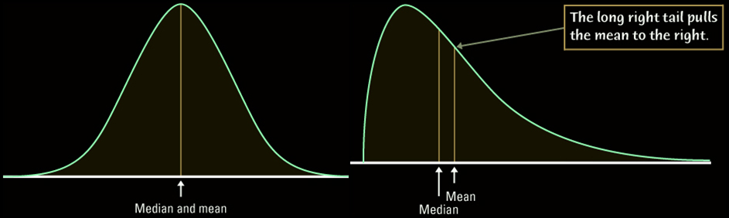
Density Curves
Density Curves come in many different shapes; symmetric, skewed, uniform, etc
The area of a region of a density curve represents the % of observations that fall in that region
The median of a density curve cuts the area in half
The mean of a density curve is its “balance point”

Slide 28
Describing a Density Curve
To describe a density curve focus on:
Shape
  Skewed (right or left – direction toward the tail)
  Symmetric (mound-shaped or uniform)
Unusual Characteristics
  Bi-modal, outliers
Center
  Mean (symmetric) or median (skewed)
Spread
  Standard deviation, IQR, or range

Slide 29
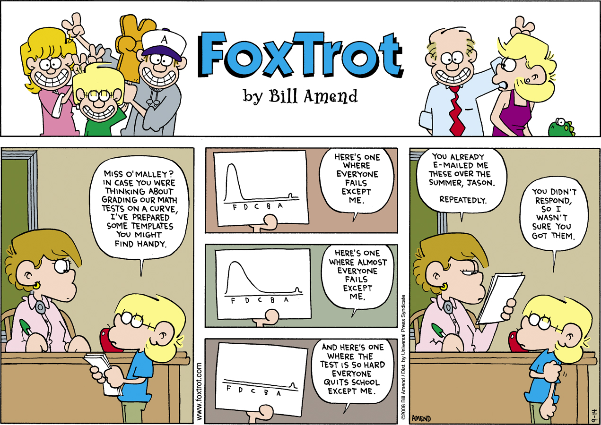
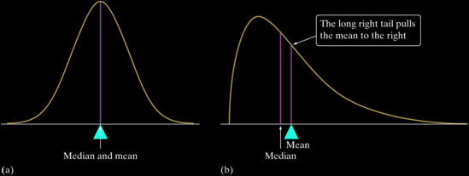
Describing Density Curves
Distinguishing the Median and Mean of a Density Curve
The median of a density curve is the equal-areas point, the point that divides the area under the curve in half.
The mean of a density curve is the balance point, at which the curve would balance if made of solid material.
The median and the mean are the same for a symmetric density curve. They both lie at the center of the curve. The mean of a skewed curve is pulled away from the median in the direction of the long tail.

Slide 30
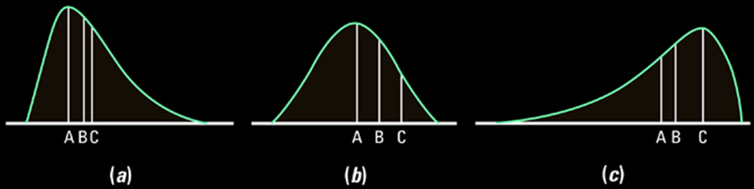
Mean, Median, Mode
In the following graphs which letter represents the mean, the median and the mode?
Describe the distributions
(a) A: mode, B: median, C: mean
Distribution is slightly skewed right
(b) A: mean, median and mode (B and C – nothing)
Distribution is symmetric (mound shaped)
(c) A: mean, B: median, C: mode
Distribution is very skewed left

Slide 31
Uniform PDF
Sometimes we want to model a random variable that is equally likely between two limits
When “every number” is equally likely in an interval, this is a uniform probability distribution
  Any specific number has a zero probability of occurring
  The mathematically correct way to phrase this is that any two intervals of equal length have the same probability
Examples
  Choose a random time … the number of seconds past the minute is random number in the interval from 0 to 60
  Observe a tire rolling at a high rate of speed … choose a random time … the angle of the tire valve to the vertical is a random number in the interval from 0 to 360

Slide 32
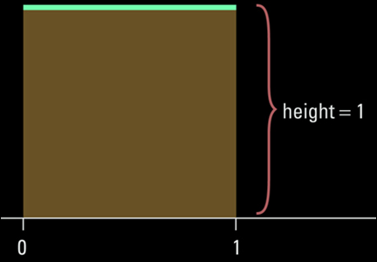
Uniform Distribution
All values have an equal likelihood of occurring
Common examples: 6-sided die or a coin
This is an example of random numbers between 0 and 1
This is a function on your calculator
Note that the area under the curve is still 1

Slide 33
Uniform PDF
P(x=0) = 0.25
P(x=1) = 0.25
P(x=2) = 0.25
P(x=3) = 0.25
Discrete Uniform PDF
P(x=1) = 0
P(x ≤ 1) = 0.33
P(x ≤ 2) = 0.66
P(x ≤ 3) = 1.00
Continuous Uniform PDF

Slide 34
Example 2
A random number generator on calculators randomly generates a number between 0 and 1. The random variable X, the number generated, follows a uniform distribution
Draw a graph of this distribution
What is the percentage (0<X<0.2)?
What is the percentage (0.25<X<0.6)?
What is the percentage > 0.95?
Use calculator to generate 200 random numbers
1
0.20
1
0.35
0.05
Math ➔ prb ➔ rand(200) STO L3 then 1varStat L3

Slide 35
Statistics and Parameters
Parameters are of Populations
  Population mean is μ
  Population standard deviation is σ
  Population percentage is ρ
Statistics are of Samples
  Sample mean is called x-bar or x
  Sample standard deviation is s
  Sample percentage is p
∧

Slide 36
Summary and Homework
Summary
  Transformations
  -- add/sub: moves mean; does not change shape
  -- multiply: moves mean and changes shape
  The area under any density curve = 1. This represents 100% of observations
  Areas on a density curve represent % of observations over certain regions
  Median divides area under curve in half
  Mean is the “balance point” of the curve
  Skewness draws the mean toward the tail
Homework
  1, 9, 13, 21, 25, 29

