Slide 1

5-Minute Check on Lesson 2-1b
Statistics are from ______ and parameters are from ________
In a uniform distribution everything is ______ likely.
If a distribution is skewed right, which is greater, the mean or the median and why?
The area under a density function is equal to ____
Name a common uniform probability example
Uniform probability distributions are of what types of quantitative variables?
samples populations
equally
mean. It is pulled toward the tail
(right and larger numbers)
1
a six-sided dice, coin (heads or tails)
discrete and continuous!
Click the mouse button or press the Space Bar to display the answers.

Slide 2
Lesson 2 - 2
Normal Distributions

Slide 3
Objectives
Use a density curve to model distributions of quantitative data
Identify the relative locations of the mean and median of a distribution from a density curve
Use the 68-95-99.7 (or Empirical) rule to estimate
  The proportion of values in a specified interval
  The value that corresponds to a given percentile in a Normal distribution
Find the proportion of values in a specified interval in a Normal distribution using Table A or technology
Find the value that corresponds to a given percentile in a Normal distribution using Table A or technology
Determine whether a distribution of data is approximately Normal from graphical and numerical evidence

Slide 4
Vocabulary
68-95-99.7 Rule (or Empirical Rule) – given a density curve is normal (or population is normal), then the following is true:
  within plus or minus one standard deviation is 68% of data
  within plus or minus two standard deviation is 95% of data
  within plus or minus three standard deviation is 99.7% of data
Density Curve – a curve that represents the proportions of the observations; and describes the overall pattern
  Is always on or above the horizontal axis
  Has area (underneath it) exactly equal to 1

Slide 5
Vocabulary (cont)
Inverse Normal – calculator function that allows you to find a data value given the area under the curve (percentage)
Mean of a density curve – its balance point (if it were made of solid material)
Median of a density curve – the equal-areas point; the point that divides the area under the curve in half

Slide 6
Vocabulary (cont)
Normal curve – special family of bell-shaped, symmetric density curves that follow a complex formula
Normality probability plot – a scatterplot of the ordered pair (data value, expected z-score) for each of the individuals in a quantitative data set; datasets that are approximately normal look linear in this type of plot
Standard Normal Distribution – a normal distribution with a mean of 0 and a standard deviation of 1

Slide 7
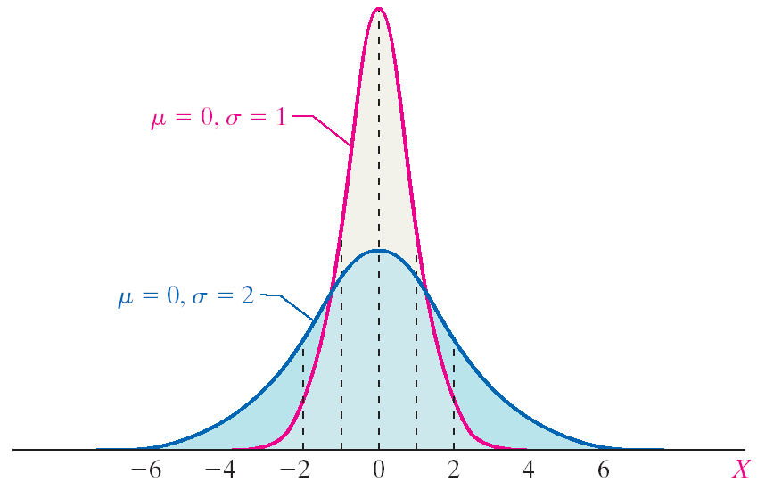
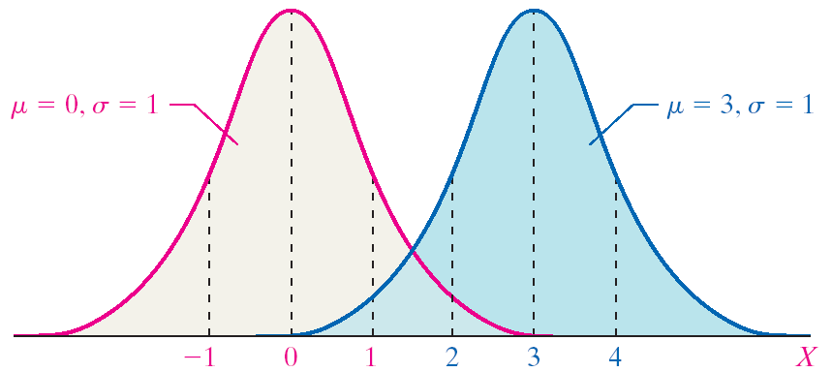
Normal Curves
Two normal curves with different means (but the same standard deviation) [on left]
  The curves are shifted left and right
Two normal curves with different standard deviations (but the same mean) [on right]
  The curves are shifted up and down

Slide 8
Normal Density Curve Properties
It is symmetric about its mean, μ
Because mean = median = mode, the highest point occurs at x = μ
It has inflection points at μ – σ and μ + σ
Area under the curve = 1
Area under the curve to the right of μ equals the area under the curve to the left of μ, which equals ½
As x increases or decreases without bound (gets farther away from μ), the graph approaches, but never reaches the horizontal axis (like approaching an asymptote)
The Empirical Rule (68-95-99.7) applies

Slide 9
Empirical Rule
μ ± 3σ
μ ± 2σ
μ ± σ
99.7%
95%
68%
2.35%
2.35%
34%
34%
0.15%
13.5%
13.5%
0.15%
μ - 2σ
μ
μ + 2σ
μ - 3σ
μ - σ
μ + σ
μ + 3σ
Normal Probability Density Function
1
y = -------- e
√2π
-(x – μ)²
2σ²
where μ is the mean and σ is the standard deviation of the random variable x

Slide 10
Area under a Normal Curve
The area under the normal curve for any interval of values of the random variable X represents either
The proportion of the population with the characteristic described by the interval of values or
The probability that a randomly selected individual from the population will have the characteristic described by the interval of values
[the area under the curve is either a proportion or the probability]

Slide 11
Standardizing a Normal Random Variable
X - μ
Z statistic: Z = -----------
σ
where μ is the mean and σ is the standard deviation of the random variable X
Z is normally distributed with mean of 0 and standard deviation of 1
Note: we are going to use tables (for Z statistics) not the normal PDF!!
Or our calculator (see next chart)

Slide 12
Example 1
A random variable x is normally distributed with μ=10 and σ=3.
Compute Z for x₁ = 8 and x₂ = 12
If the area under the curve between x₁ and x₂ is 0.495, what is the area between z₁ and z₂?
8 – 10 -2
Z = ---------- = ----- = -0.67
3 3
12 – 10 2
Z = ----------- = ----- = 0.67
3 3
0.495

Slide 13
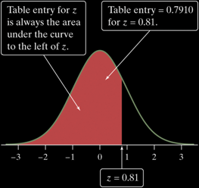
The Standard Normal Table
Because all Normal distributions are the same when we standardize, we can find areas under any Normal curve from a single table.
Definition: The Standard Normal Table
Table A is a table of areas under the standard Normal curve. The table entry for each value z is the area under the curve to the left of z.
Suppose we want to find the proportion of observations from the standard Normal distribution that are less than 0.81.
We can use Table A:
P(z < 0.81) =
.7910
Z | .00 | .01 | .02
0.7 | .7580 | .7611 | .7642
0.8 | .7881 | .7910 | .7939
0.9 | .8159 | .8186 | .8212

Slide 14
Normal Distributions on TI-83
normalpdf pdf = Probability Density Function
This function returns the probability of a single value of the random variable x. Use this to graph a normal curve. Using this function returns the y-coordinates of the normal curve.
Syntax: normalpdf (x, mean, standard deviation)
taken from http://mathbits.com/MathBits/TISection/Statistics2/normaldistribution.htm
Remember the cataloghelp app on your calculator
  Hit the + key instead of enter when the item is highlighted

Slide 15
Normal Distributions on TI-83
normalcdf cdf = Cumulative Distribution Function
This function returns the cumulative probability from zero up to some input value of the random variable x. Technically, it returns the percentage of area under a continuous distribution curve from negative infinity to the x. You can, however, set the lower bound.
Syntax: normalcdf (lower bound, upper bound, mean, standard deviation)
(note: lower bound is optional and we can use -E99 for negative infinity and E99 for positive infinity)

Slide 16
Normal Distributions on TI-83
invNorm inv = Inverse Normal PDF
This function returns the x-value given the probability region to the left of the x-value. (0 < area < 1 must be true.) The inverse normal probability distribution function will find the precise value at a given percent based upon the mean and standard deviation.
Syntax: invNorm (probability, mean, standard deviation)

Slide 17
Properties of the Standard Normal Curve
It is symmetric about its mean, μ = 0, and has a standard deviation of σ = 1
Because mean = median = mode, the highest point occurs at μ = 0
It has inflection points at μ – σ = -1 and μ + σ = 1
Area under the curve = 1
Area under the curve to the right of μ = 0 equals the area under the curve to the left of μ, which equals ½
As Z increases the graph approaches, but never reaches 0 (like approaching an asymptote). As Z decreases the graph approaches, but never reaches, 0.
The Empirical Rule (68-95-99.7) applies

Slide 18
Calculate the Area Under the Standard Normal Curve
Three different area calculations
  Find the area to the left of a value
  Find the area to the right of a value
  Find the area between two values
There are several ways to calculate the area under the standard normal curve
  What does not work – some kind of a simple formula
  We can use a table (such as Table IV on the inside back cover)
  We can use technology (a calculator or software)
Using technology is preferred

Slide 19
Normal Distribution Calculations
How to Solve Problems Involving Normal Distributions
State: Express the problem in terms of the observed variable x.
Plan: Draw a picture of the distribution and shade the area of interest under the curve.
Do: Perform calculations.
  Standardize x to restate the problem in terms of a standard Normal variable z.
  Use Table A and the fact that the total area under the curve is 1 to find the required area under the standard Normal curve.
Conclude: Write your conclusion in the context of the problem.

Slide 20
Obtaining Area under Standard Normal Curve
Approach | Graphically | Solution
Find the area to the left of z_{a} P(Z < a) | Shade the area to the left of z_{a} | Use Table IV to find the row and column that correspond to z_{a}. The area is the value where the row and column intersect. Normcdf(-E99,a,0,1)
Find the area to the right of z_{a} P(Z > a) or 1 – P(Z < a) | Shade the area to the right of z_{a} | Use Table IV to find the area to the left of z_{a}. The area to the right of z_{a} is 1 – area to the left of z_{a}. Normcdf(a,E99,0,1) or 1 – Normcdf(-E99,a,0,1)
Find the area between z_{a} and z_{b} P(a < Z < b) | Shade the area between z_{a} and z_{b} | Use Table IV to find the area to the left of z_{a} and to the left of z_{a}. The area between is area_{zb} – area_{za}. Normcdf(a,b,0,1)
a
a
a
b

Slide 21
Example 2
Determine the area under the standard
normal curve that lies to the left of
Z = -3.49
Z = -1.99
Z = 0.92
Z = 2.90
a
Normalcdf(-E99,-3.49) = 0.000242
Normalcdf(-E99,-1.99) = 0.023295
Normalcdf(-E99,0.92) = 0.821214
Normalcdf(-E99,2.90) = 0.998134

Slide 22
Example 3
Determine the area under the standard
normal curve that lies to the right of
Z = -3.49
Z = -0.55
Z = 2.23
Z = 3.45
a
Normalcdf(-3.49,E99) = 0.999758
Normalcdf(-0.55,E99) = 0.70884
Normalcdf(2.23,E99) = 0.012874
Normalcdf(3.45,E99) = 0.00028

Slide 23
Example 4
Find the indicated probability of the
standard normal random variable Z
P(-2.55 < Z < 2.55)
P(-0.55 < Z < 0)
P(-1.04 < Z < 2.76)
a
b
Normalcdf(-2.55,2.55) = 0.98923
Normalcdf(-0.55,0) = 0.20884
Normalcdf(-1.04,2.76) = 0.84794

Slide 24
Example 5
Find the Z-score such that the area under the standard normal curve to the left is 0.1.
Find the Z-score such that the area under the standard normal curve to the right is 0.35.
invNorm(0.1) = -1.282 = a
a
invNorm(1-0.35) = 0.385
a

Slide 25
Summary
Summary
  All normal distributions follow empirical rule
  Standard normal has mean = 0 and StDev = 1
  Table A gives you proportions that are less than z

Slide 26
5-Minute Check on Lesson 2-2a
What is the mean and standard deviation of Z?
Given the following distributions: A~N(4,1), B~N(10,4) C~N(6,8)
Which is the tallest?
Which is the widest?
The Empirical Rule is also known as the __ , __ , ___ rule.
Given P(z < a) = 0.251, find P(z > a)
In distribution B, what is the area to the left of 10?
mean, μ = 0 and standard deviation, σ = 1
distribution A (it has smallest σ)
distribution C (it has largest σ)
68 95 99.7
P( z > a) = 1 – P(z < a)
= 1 – 0.251
= 0.749
0.5 (half area is to left of mean)
Click the mouse button or press the Space Bar to display the answers.

Slide 27
Finding the Area under any Normal Curve
Draw a normal curve and shade the desired area
Convert the values of X to Z-scores
using Z = (X – μ) / σ
Draw a standard normal curve and shade the area desired
Find the area under the standard normal curve. This area is equal to the area under the normal curve drawn in Step 1
Using your calculator, normcdf(-E99,x,μ,σ)

Slide 28
Given Probability Find the Associated Random Variable Value
Procedure for Finding the Value of a Normal Random Variable Corresponding to a Specified Proportion, Probability or Percentile
Draw a normal curve and shade the area corresponding to the proportion, probability or percentile
Use Table IV to find the Z-score that corresponds to the shaded area
Obtain the normal value from the fact that X = μ + Zσ
Using your calculator, invnorm(p(x),μ,σ)

Slide 29
Example 1
For a general random variable X with
  μ = 3
  σ = 2
a. Calculate Z
b. Calculate P(X < 6)
Z = (6-3)/2 = 1.5
so P(X < 6) = P(Z < 1.5) = 0.9332
Normcdf(-E99,6,3,2) or Normcdf(-E99,1.5)

Slide 30
Example 2
For a general random variable X with
  μ = -2
  σ = 4
Calculate Z
Calculate P(X > -3)
Z = [-3 – (-2) ]/ 4 = -0.25
P(X > -3) = P(Z > -0.25) = 0.5987
Normcdf(-3,E99,-2,4)

Slide 31
Example 3
For a general random variable X with
  μ = 6
  σ = 4
calculate P(4 < X < 11)
P(4 < X < 11) = P(– 0.5 < Z < 1.25) = 0.5858
Converting to z is a waste of time for these
Normcdf(4,11,6,4)

Slide 32
Example 4
For a general random variable X with
  μ = 3
  σ = 2
find the value x such that P(X < x) = 0.3
x = μ + Zσ Using the tables:
0.3 = P(Z < z) so z = -0.525
x = 3 + 2(-0.525) so x = 1.95
invNorm(0.3,3,2) = 1.9512

Slide 33
Example 5
For a general random variable X with
  μ = –2
  σ = 4
find the value x such that P(X > x) = 0.2
x = μ + Zσ Using the tables:
P(Z>z) = 0.2 so P(Z<z) = 0.8 z = 0.842
x = -2 + 4(0.842) so x = 1.368
invNorm(1-0.2,-2,4) = 1.3665

Slide 34
Example 6
For random variable X with
  μ = 6
  σ = 4
Find the values that contain 90% of the data around μ
a
b
x = μ + Zσ Using the tables: we know that z_{.05} = 1.645
x = 6 + 4(1.645) so x = 12.58
x = 6 + 4(-1.645) so x = -0.58
P(–0.58 < X < 12.58) = 0.90
invNorm(0.05,6,4) = -0.5794 invNorm(0.95,6,4) = 12.5794

Slide 35
Summary and Homework
Summary
  Using a calculator we can avoid converting to z-values before calculating the area under the normal curves
  Calculator gives you proportions between any two values (-e99 and e99 represent -∞ and ∞)

Slide 36
5-Minute Check on Lesson 2-2b
Given a normal distribution with μ = 4 and σ = 2, Find
P(x < 2)
P(x > 5)
P(1< x < 5)
x, if P(x) = 0.95
x, if P(x) = 0.05
via TI: normalcdf(-e99,2,4,2) = 0.1587
via TI: normalcdf(5,e99,4,2) = 0.3085
via TI: normalcdf(1,5,4,2) = 0.6247
via TI: invNorm(0.95,4,2) = 7.290
via TI: invNorm(0.05,4,2) = 0.710
Click the mouse button or press the Space Bar to display the answers.

Slide 37
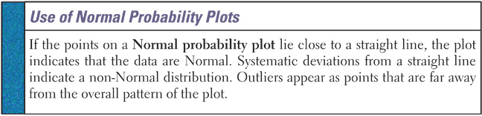
Is Data Normally Distributed?
For small samples we can readily test it on our calculators with Normal probability plots
Large samples are better down using computer software doing similar things

Slide 38
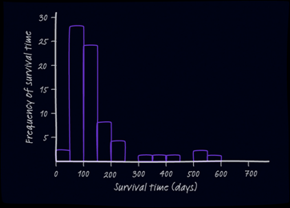
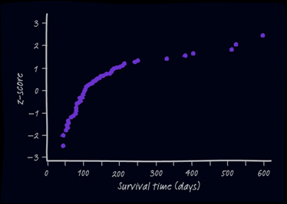
Normality Plots
Most software packages can construct Normal probability plots. These plots are constructed by plotting each observation in a data set against its corresponding percentile’s z-score.
Interpreting Normal Probability Plots
If the points on a Normal probability plot lie close to a straight line, the plot indicates that the data are Normal. Systematic deviations from a straight line indicate a non-Normal distribution. Outliers appear as points that are far away from the overall pattern of the plot.

Slide 39
TI-83 Normality Plots
Enter raw data into L1
Press 2nd ‘Y=‘ to access STAT PLOTS
Select 1: Plot1
Turn Plot1 ON by highlighting ON and pressing ENTER
Highlight the last Type: graph (normality) and hit ENTER. Data list should be L1 and the data axis should be x-axis
Press ZOOM and select 9: ZoomStat
Does it look pretty linear? (hold a piece of paper up to it)

Slide 40
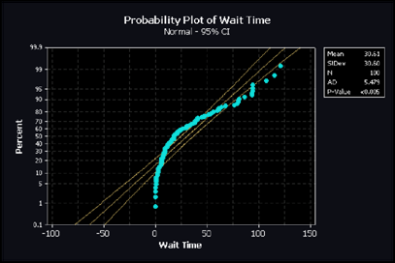
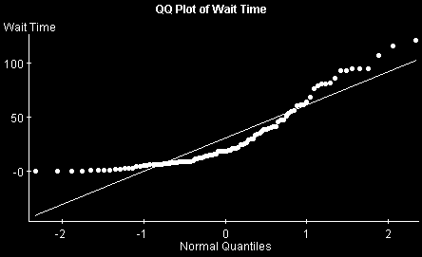
Non-Normal Plots
Both of these show that this particular data set is far from having a normal distribution
  It is actually considerably skewed right

Slide 41
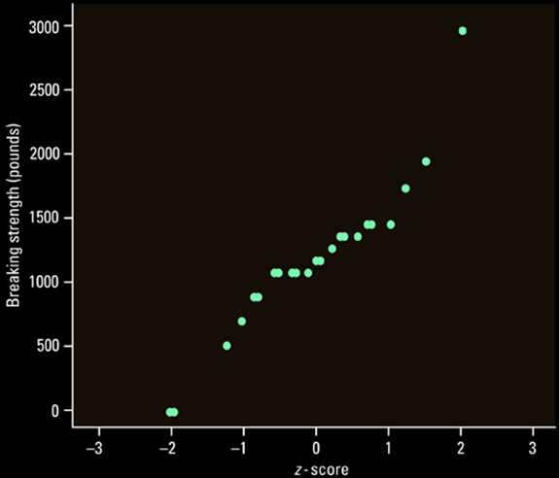
Example 1: Normal or Not?
Roughly Normal (linear in mid-range) with two possible outliers on extremes

Slide 42
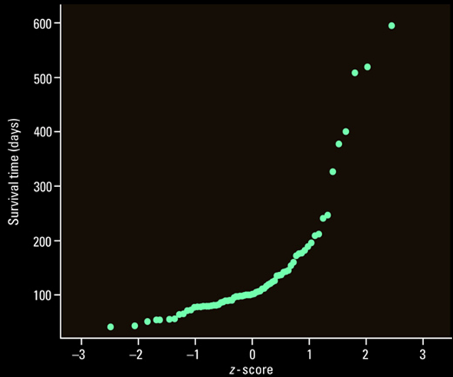
Example 2: Normal or Not?
Not Normal (skewed right); three possible outliers on upper end

Slide 43
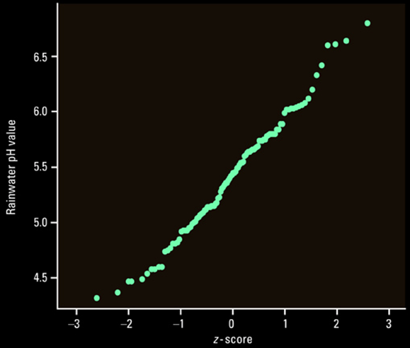
Example 3: Normal or Not?
Roughly Normal (very linear in mid-range)

Slide 44
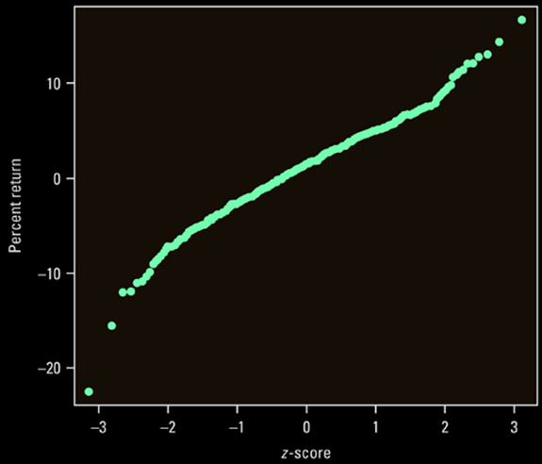
Example 4: Normal or Not?
Roughly Normal (linear in mid-range) with deviations on each extreme

Slide 45
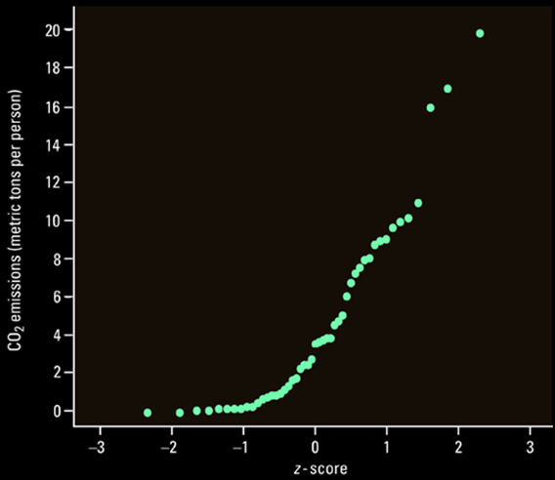
Example 5: Normal or Not?
Not Normal (skewed right) with 3 possible outliers

Slide 46
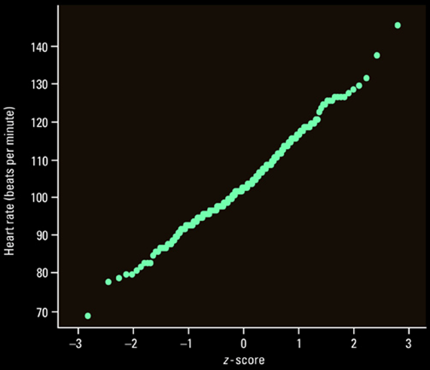
Example 6: Normal or Not?
Roughly Normal (very linear in midrange) with 2 possible outliers

Slide 47
Summary and Homework
Summary
  Calculator gives you proportions between any two values (-e99 and e99 represent -∞ and ∞)
  Assess distribution’s potential normality by
    comparing with empirical rule
    normality probability plot (using calculator)
Homework
  Pg 138-43, probs 41, 45, 47, 51, 53, 57, 63, 75, 79

