Slide 1

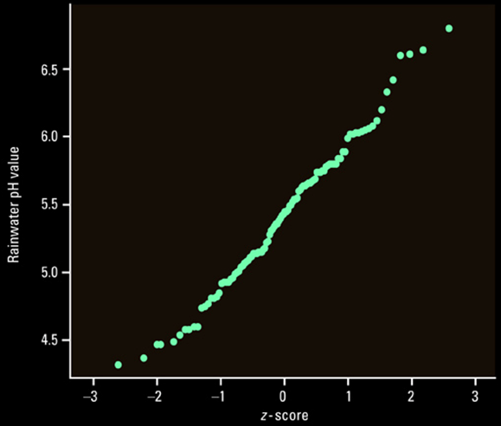
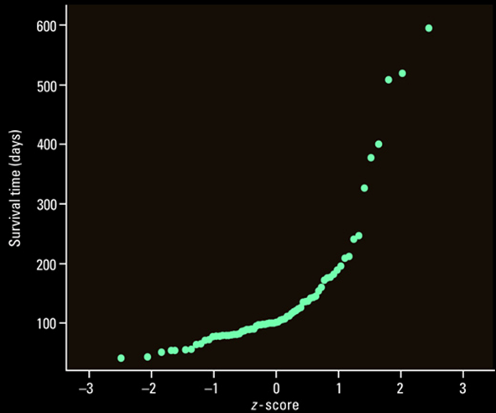
5-Minute Check on Lesson 2-2c
What is the shape of a normality plot if the distribution is approximately normal?
Do these normality plots indicate a normal distribution?
linear → a line
approximately normal
not normal;
possible outliers
Click the mouse button or press the Space Bar to display the answers.

Slide 2
Lesson 2 - R
Review of Chapter 2
Describing Location in a Distribution

Slide 3
Objectives
Be able to compute measures of relative standing for individual values in a distribution. This includes standardized values z-scores and percentile ranks.
Use Chebyshev’s Inequality to describe the percentage of values in a distribution within an interval centered at the mean
Demonstrate an understanding of a density curve, including its mean and median

Slide 4
Objectives
Demonstrate an understanding of the Normal distribution and the 68-95-99.7 Rule (Empirical Rule)
Use tables and technology to find
  (a) the proportion of values on an interval of the Normal distribution and
  (b) a value with a given proportion of observations above or below it
Use a variety of techniques, including construction of a normal probability plot, to assess the Normality of a distribution

Slide 5
Vocabulary
none new

Slide 6
Measures of Relative Standing
x – μ
Z = ---------- Z ~ N(0, 1) Normal(μ, σ)
σ
Z-score:
measures the number of standard deviations away from the mean an x value is
Invnorm(percentile[,μ,σ]) gives us the z-value associated with a given percentile
Empirical Rule vs Chebyshev’s Inequality
Standard Deviations | Empirical Rule | Chebyshev’s Inequality
Within 1 | 68% | Not applicable
Within 2 | 95% | 75%
Within 3 | 99.7% | 89%
Distribution | Normal | Any

Slide 7
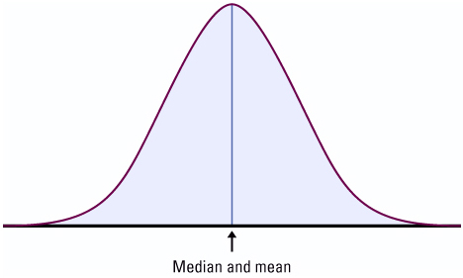
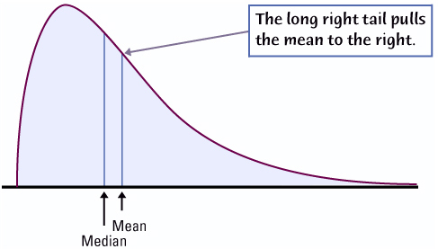
Density Curves
The area underneath a density curve between two points is the proportion of all observations
Sum of the area underneath density curve is equal to 1
The median is the equal area point
The mean is the “balance” point
The mean is pulled more toward any skewness

Slide 8
Normal Distribution
Symmetric, mound shaped, distribution
mean is μ and standard deviation is σ X ~ N (μ, σ)
Empirical Rule (68-95-99.7) applies
Mean is highest point; ± one standard deviation is at the two inflection points
(where the curve goes bowl down to bowl up)
μ ± 3σ
μ ± 2σ
μ ± σ
99.7%
95%
68%
2.35%
34%
34%
2.35%
0.15%
13.5%
13.5%
0.15%
μ - 3σ
μ - 2σ
μ - σ
μ
μ + σ
μ + 2σ
μ + 3σ

Slide 9
Obtaining Area under Standard Normal Curve
Approach | Graphically | Solution
Find the area to the left of z_{a} P(Z < a) | Shade the area to the left of z_{a} | Use Table IV to find the row and column that correspond to z_{a}. The area is the value where the row and column intersect. Normcdf(-E99,a)
Find the area to the right of z_{a} P(Z > a) or 1 – P(Z < a) | Shade the area to the right of z_{a} | Use Table IV to find the area to the left of z_{a}. The area to the right of z_{a} is 1 – area to the left of z_{a}. Normcdf(a,E99) or 1 – Normcdf(-E99,a)
Find the area between z_{a} and z_{b} P(a < Z < b) | Shade the area between z_{a} and z_{b} | Use Table IV to find the area to the left of z_{a} and to the left of z_{a}. The area between is area_{zb} – area_{za}. Normcdf(a,b)
a
a
a
b

Slide 10
Obtaining Area under Any Normal Curve
Approach | Graphically | Solution
Find the area to the left of a P(X < a) | Shade the area to the left of a | Use Table IV to find the row and column that correspond to z_{a}. The area is the value where the row and column intersect. Normalcdf(-E99,a,μ,σ)
Find the area to the right of a P(X > a) or 1 – P(X < a) | Shade the area to the right of a | Use Table IV to find the area to the left of z_{a}. The area to the right of z_{a} is 1 – area to the left of z_{a}. Normalcdf(a,E99,μ,σ) or 1 – Normalcdf(-E99,a,μ,σ)
Find the area between a and b P(a < X < b) | Shade the area between a and b | Use Table IV to find the area to the left of z_{a} and to the left of z_{a}. The area between is area_{zb} – area_{za}. Normalcdf(a,b,μ,σ)
a
a
a
b

Slide 11
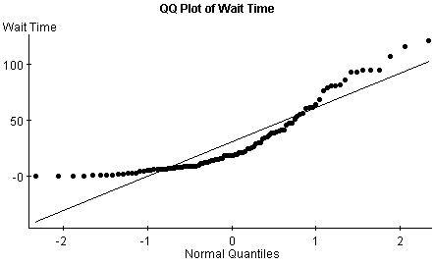
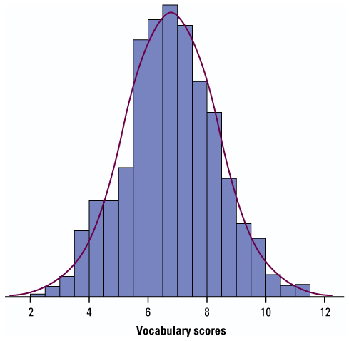
Assessing Normality
Use calculator to view
  Normal probability plots to access the linearity of the graph (linear plot indicates normal distribution)
  Histogram and/or boxplot to access the symmetry and mound shape of the distribution
Use Empirical Rule (68-95-99.7) to evaluate how “normal-like” the distribution is

Slide 12
TI-83 Help
normalpdf pdf = Probability Density Function
This function returns the probability of a single value of the random variable x. Use this to graph a normal curve. Not used very often. Syntax: normalpdf (x, mean, standard deviation)
normalcdf cdf = Cumulative Distribution Function
Technically, it returns the percentage of area under a continuous distribution curve from negative infinity to the x.
Syntax: normalcdf (lower bound, upper bound, mean, std dev)
(note: lower bound is optional and we can use -E99 for negative infinity and E99 for positive infinity)
invNorm inv = Inverse Normal PDF
The inverse normal probability distribution function will find the precise value at a given percent based upon the mean and standard deviation. Syntax: invNorm (probability, mean, std dev)

Slide 13
Uniform Distribution
Rectangular-shaped distribution with all outcomes equally likely; area sums to 1
Discrete example: one dice
1/6 probability of each number
Continuous example: a fire drill equally likely at any time during a period
length = 50 (minutes) and height = (1/50)
P(x=1) = 0
P(x ≤ 1) = 0.33
P(x ≤ 2) = 0.66
P(x ≤ 3) = 1.00
P(x=0) = 0.25
P(x=1) = 0.25
P(x=2) = 0.25
P(x=3) = 0.25

Slide 14
What You Learned
Measures of Relative Standing
  Find the standardized value (z-score) of an observation. Interpret z-scores in context
  Use percentiles to locate individual values within distributions of data
  Apply Chebyshev’s inequality to a given distribution of data

Slide 15
What You Learned
Density Curves
  Know that areas under a density curve represent proportions of all observations and that the total area under a density curve is 1
  Approximately locate the median (equal-areas point) and the mean (balance point) on a density curve
  Know that the mean and median both lie at the center of a symmetric density curve and that the mean moves farther toward the long tail of a skewed curve

Slide 16
What You Learned
Normal Distribution
  Recognize the shape of Normal curves and be able to estimate both the mean and standard deviation from such a curve
  Use the 68-95-99.7 rule (Empirical Rule) and symmetry to state what percent of the observations from a Normal distribution fall between two points when the points lie at the mean or one, two, or three standard deviations on either side of the mean

Slide 17
What You Learned
Normal Distribution (continued)
  Use the standard Normal distribution to calculate the proportion of values in a specified range and to determine a z-score from a percentile
  Given a variable with a Normal distribution with mean μ and standard deviation σ, use Table A and your calculator to
    determine the proportion of values in a specified range
    calculate the point having a stated proportion of all values to the left or to the right of it

Slide 18
What You Learned
Assessing Normality
  Plot a histogram, stemplot, and/or boxplot to determine if a distribution is bell-shaped
  Determine the proportion of observations within one, two, and three standard deviations of the mean and compare with the 68-95-99.7 rule (Empirical rule) for Normal distributions
  Construct and interpret Normal probability plots

Slide 19
Summary and Homework
Summary
  Remember SOCS
  Z-score (standard deviations from the mean)
  Chebyshev’s inequality vs 68-95-99.7 Rule
  Determine proportions of given parameters
  Assessing Normality
    Empirical Rule
    Normality plots
  Normal & Standard Normal Curves’ Properties
Homework
  R2-1, 3, 5, 7, 12

Slide 20
Problem 1
Scores on a test have mean 75 and standard deviation 6. The teacher is considering curving these grades.
(a) If the teacher adds 5 points to all individual grades, the class mean will be ___________ and the standard deviation will be _____________.
(b) If the teacher increases all grades by 10%, the class mean will be ________________ and the standard deviation will be _________________.
75 + 5 = 80
6 (unchanged)
75 + 7.5 = 82.5
6(1.1) = 6.6

Slide 21
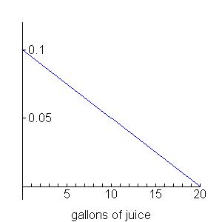
Problem 2
Suppose that the juice dispensers in a school dining hall are filled each morning with 20 gallons of juice. Records show that a probability density function describing the daily juice consumption j is:
f(j) = 0.1 – 0.005j if 0 ≤ j ≤ 20
A sketch of this density curve is provided
in the space to the right.
(a) Verify that f is a valid density function.
Area under the curve must be 1!
Area of triangle = ½ b h = ½ (20) (0.1) = ½ (2) = 1
Yes it is a valid density function

Slide 22
Problem 3
Scores on an intelligence test are normally distributed with mean 100 and standard deviation 15.
(a) What proportion of the population scores between 90 and 125?____________
(b) According to this test, how high must a person score to be in the top 25% of the population in intelligence? _____________
≈ 70%
Use calculator: normalcdf(90,125,100,15) = 0.6997
≈ 111
Use calculator: invNorm(.75,100,15) = 110.117

Slide 23
Problem 4
The lifetime of a brand of television picture tubes is normally distributed with μ = 8.4 years and σ = 1.5 years. The manufacturer guarantees to replace tubes that burn out prior to the time they specify in the guarantee.
(a) How long will the middle 95% of all tubes last?
(b) If the manufacturer guarantees the tubes for 5 years, what proportion of tubes will have to be replaced? _______
Use calculator: invNorm(.025,8.4,1.5) = 5.46 (LL)
Use calculator: invNorm(.975,8.4,1.5) = 11.34 (UL)
So between 5.46 and 11.34 years
1.17%
Use calculator: Normalcdf(0,5,8.4,1.5) = 0.0117
Use calculator: Normalcdf(-e99,5,8.4,1.5) = 0.0117

Slide 24
Problem 4 cont
The lifetime of a brand of television picture tubes is normally distributed with μ = 8.4 years and σ = 1.5 years. The manufacturer guarantees to replace tubes that burn out prior to the time they specify in the guarantee.
(c) If the firm is willing to replace the picture tubes in a maximum of 5% of the television sets sold, what is the maximum guarantee period they should they offer? ________________________________
So 11 years (10 year sounds better)
Use calculator: invNorm(.975,8.4,1.5) = 11.34 (UL)

Slide 25
Problem 5
Packaging machines used to fill sugar bags can deliver any target weight with standard deviation of 2 ounces. If you want to fill 5 pound bags so that only 2% are underweight, what target setting would you use for the machine?_____________
Include an illustrative drawing and clearly organized work in the space below. Note: 5 pounds = 80 ounces..
Use calculator: invNorm(.02) = -2.05375
0.02
-2.05375 = (80 – x-bar) / 2
-4.10750 = (80 – x-bar)
x-bar ≈ 84.11
80

Slide 26
Problem 6
A study team was commissioned to compare the performance of two local hospitals. One of the factors they considered was the survival record for surgical patients at each hospital. When the team first looked at the data, they clumped all patients together as shown below:
It appears from the table above that Hospital B has the lower fatality rate.
All Patients | Survived | Died | % Died
Hospital A | 2037 | 63 | 3.0%
Hospital B | 784 | 16 | 2.0%

Slide 27
Problem 6 cont
It appears from the table above that Hospital B has the lower fatality rate. The administrators of Hospital A were concerned. They had been keeping similar records, but they had divided the patients into groups according to their condition when they entered surgery. These data, shown in the tables below, indicate that Hospital A has lower fatality rates.
The members of the study team are confused. Write a few sentences to help them understand what is going on.
All Patients | Survived | Died | % Died
Hospital A | 2037 | 63 | 3.0%
Hospital B | 784 | 16 | 2.0%
Good | Survived | Died | % Died
Hospital A | 594 | 6 | 1.0%
Hospital B | 592 | 8 | 1.33%
Poor | Survived | Died | % Died
Hospital A | 1443 | 57 | 3.8%
Hospital B | 192 | 8 | 4.0%

Slide 28
Problem 6 cont 2
The members of the study team are confused. Write a few sentences to help them understand what is going on.
All Patients | Survived | Died | % Died
Hospital A | 2037 | 63 | 3.0%
Hospital B | 784 | 16 | 2.0%
Good | Survived | Died | % Died
Hospital A | 594 | 6 | 1.0%
Hospital B | 592 | 8 | 1.33%
Poor | Survived | Died | % Died
Hospital A | 1443 | 57 | 3.8%
Hospital B | 192 | 8 | 4.0%
Hospital A had about the same number of patients arriving in good condition as Hospital B, but Hospital A had 7 times the number of patient arriving in poor condition as Hospital B. Since the survival rate of the people arriving in poor condition is less, it makes Hospital A seem to have worse rates than B overall.

Slide 29
Problem 7
After the Challenger disaster, investigators examined data to determine what caused the problems that occurred on that fateful day. Following are the temperatures (at time of launch) associated with shuttle launches in which there were O-ring failures (prior to the Challenger launch):
54 54 54 57 58 63 70 75 75
Following are the temperatures (at time of launch) associated with shuttle launches in which there were not O-ring failures (prior to the Challenger launch:
66 67 67 67 68 69 70 70 72 73 76 78 79 80 81

Slide 30
Problem 7 cont
O-ring failures (prior to the Challenger launch):
54 54 54 57 58 63 70 75 75
not O-ring failures (prior to the Challenger launch:
66 67 67 67 68 69 70 70 72 73 76 78 79 80 81
(a) Complete the table below:
 | Temperature
 | 54 - 62 | 63 - 71 | 72 - 81
Failure
No Failure
5
2
2
0
8
7

Slide 31
Problem 7 cont 2
 | Temperature
 | 54 - 62 | 63 - 71 | 72 - 81
Failure | 5 | 2 | 2
No Failure | 0 | 8 | 7
b) How many launches had occurred at the time these data were recorded? ________
(c) What percent of the launches had O-ring failures? ___________
(d) What percent of the O-ring failures occurred when launch temperatures were between 54 and 62 degrees? ________
(e) What percent of the launches that were made when temperatures were between 54 and 62 degrees resulted in O-ring failures? _________
24
9/24 = 37.5%
7/9 = 77.8%
5/5 = 100%

Slide 32
Problem 8
A company needs to buy several cars for its motor pool. Managers have specified that the new cars should get at least 30 miles per gallon (MPG) on the highway. Two models are being considered, and the gas mileage for both is normally distributed. For one model the mean gasoline consumption is 35 mpg with a standard deviation of 3 mpg. The other model averages 34 mpg with a standard deviation of 1.5 mpg. Which model should the managers choose? Support your answer with an explanation based on what you have learned about normal distributions.

Slide 33
Problem 8 cont
At least 30 miles per gallon (MPG) on the highway. The gas mileage for both is normally distributed. For one model μ₁ = 35 mpg with σ₁ = 3 mpg. The other model
μ₂ = 34 mpg with σ₂ = 1.5 mpg. Which model should the managers choose? Support your answer with an explanation based on what you have learned about normal distributions.
Use calculator: For model 1 normalcdf(0,30,35,3) = 0.0478
For model 2 normalcdf(0,30,34,1.5) = 0.0038
So model 2 averages less mpg, but has far less chance of getting under 30 mpg than model 1 (because of the smaller σ value). So if at least 30 mpg is a “live or die” point, model 2 is a better choice.

