Slide 1
Lesson 3 - 1
Scatterplots and Correlation

Slide 2
Objectives
Distinguish between explanatory and response variables for quantitative data
Make a scatterplot to display the relationship between two quantitative variables
Describe the direction, form, and strength of a relationship displayed in a scatterplot and identify unusual features
Interpret the correlation
Understand the basic properties of correlation, including how the correlation is influenced by outliers
Distinguish correlation from causation

Slide 3
Vocabulary
Bivariate data – data that has two variables involved with each point
Categorical Variables – variables to which arithmetic operations make no sense
Correlation (r) – the amount of linear association between two variables
Cluster – a group of points distinct from other points in the scatterplot
Explanatory variable – a variable that helps explain or influence changes in a response variable
Negatively Associated – decreasing left to right
Outlier – an individual value that falls outside the overall pattern of the relationship

Slide 4
Vocabulary
Positively Associated – increasing left to right
Response variable – a variable that is measured and determines the outcome of a study
Scatterplot – shows the relationship between two quantitative variables measured on the same individuals
Scatterplot Direction – positive (increasing left to right) or negative (decreasing left to right) association
Scatterplot Form – drawing a single line to represent the data (linear, curved, exponential, etc)
Scatterplot Strength – how closely the points follow a clear form (weak, moderately weak, moderately strong, strong)

Slide 5
A Tale of Two Variables
“It was the best of times, it was the worst of times, …”
Response Variables are the variables we use to draw conclusions from a study. They are what we measure as outcome.
Explanatory Variables are what we hope explain the changes in the response variable. They are the independent variable; one we have control over in a study.

Slide 6
Example 1
Identify the explanatory and response variable in each setting:
A) In a study, adult volunteers drank different numbers of cans of beer. Thirty minutes later, a police officer measured their blood alcohol levels.
B) The National Student Loan Survey provides data on the amount of debt for recent college graduates, their current income, and how stressed the feel about college debt. A sociologist looks at the data with the goal of using amount of debt and income to explain the stress caused by college debt.
R: blood alcohol levels E: number of beers drunk
R: Levels of stress E: debt and income

Slide 7
Scatter Plots
Shows relationship between two quantitative variables measured on the same individual.
Each individual in the data set is represented by a point in the scatter diagram.
Explanatory variable plotted on horizontal axis and the response variable plotted on vertical axis.
Do not connect the points when drawing a scatter diagram.

Slide 8
Drawing Scatter Plots by Hand
Plot the explanatory variable on the x-axis. If there is no explanatory-response distinction, either variable can go on the horizontal axis.
Label both axes
Scale both axes (but not necessarily the same scale on both axes). Intervals must be uniform.
Make your plot large enough so that the details can be seen easily.
If you have a grid, adopt a scale so that you plot uses the entire grid

Slide 9
TI-83 Instructions for Scatter Plots
Enter explanatory variable in L1
Enter response variable in L2
Press 2nd y= for StatPlot, select 1: Plot1
Turn plot1 on by highlighting ON and enter
Highlight the scatter plot icon and enter
Press ZOOM and select 9: ZoomStat

Slide 10
Interpreting Scatterplots
Just like distributions had certain important characteristics (Shape, Outliers, Center, Spread)
Scatter plots should be described by
  Direction
  positive association (positive slope left to right)
  negative association (negative slope left to right)
  Form
  linear – straight line,
  curved – quadratic, cubic, etc, exponential, etc
  Strength of the form (r will give us a number to use)
  weak
  moderate (either weak or strong)
  strong
  Outliers (any points not conforming to the form)
  Clusters (any sub-groups not conforming to the form)

Slide 11
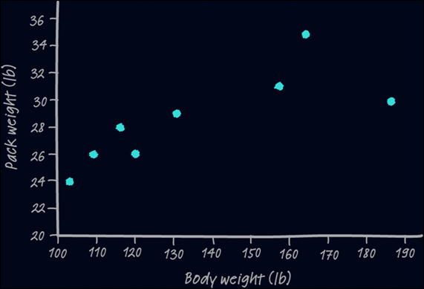
Interpreting Scatterplots
Outlier
There is one possible outlier, the hiker with the body weight of 187 pounds seems to be carrying relatively less weight than are the other group members.
Strength
Direction
Form
There is a moderately strong, positive, linear relationship between body weight and pack weight.
It appears that lighter students are carrying lighter backpacks.
moderately strong
positive
linear

Slide 12
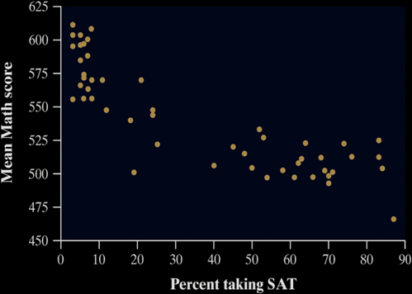
Interpreting Scatterplots
Definition:
Two variables have a positive association when above-average values of one tend to accompany above-average values of the other, and when below-average values also tend to occur together.
Two variables have a negative association when above-average values of one tend to accompany below-average values of the other.
Strength
Consider the SAT example from page 144. Interpret the scatterplot.
Direction
Form
There is a moderately strong, negative, curved relationship between the percent of students in a state who take the SAT and the mean SAT math score. Further, there are two distinct clusters of states and two possible outliers that fall outside the overall pattern.

Slide 13
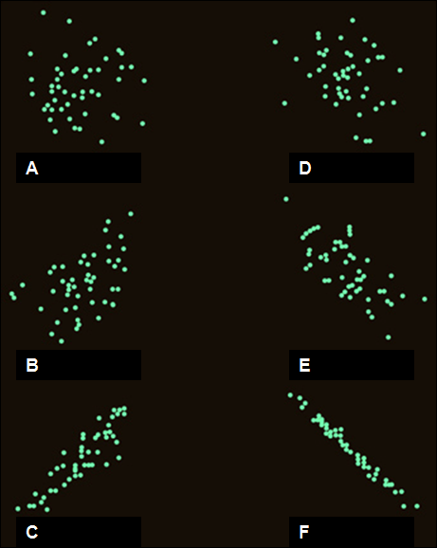
Example 2
Describe each of these scatterplots:
A) random, none, none,
none, none
D) negative, linear, strong,
some, some
B) positive, linear, weak,
none, some
E) negative, linear, moderate,
maybe, none
C) positive, linear, strong,
maybe, none
F) negative, linear, very strong,
none, none

Slide 14
Example 3
Strong Negative Linear Association
Response
Response
Response
Explanatory
Explanatory
Explanatory
Strong Positive Linear Association
No Relation
Response
Response
Explanatory
Explanatory
Strong Negative Quadratic Association
Weak Negative Linear Association

Slide 15
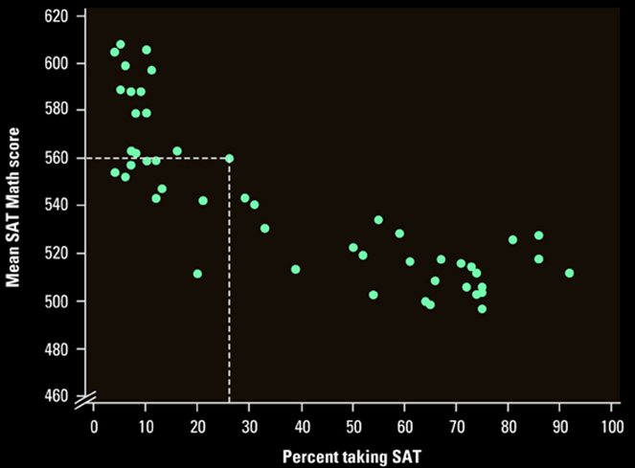
Example 4
Describe the scatterplot below
Mild
Negative
Exponential
Association
One obvious
outlier
Two clusters
> 50%
< 50%
Colorado

Slide 16
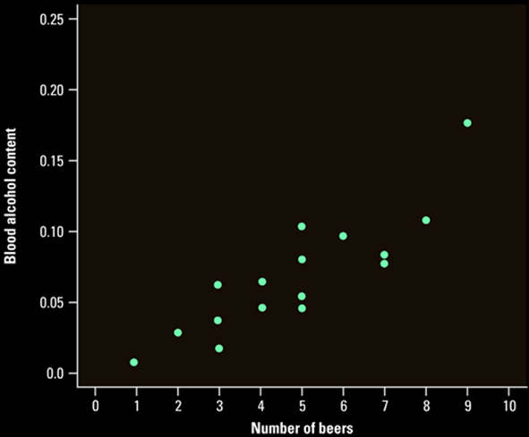
Example 5
Describe the scatterplot below
Mild
Positive
Linear
Association
One mild
outlier

Slide 17
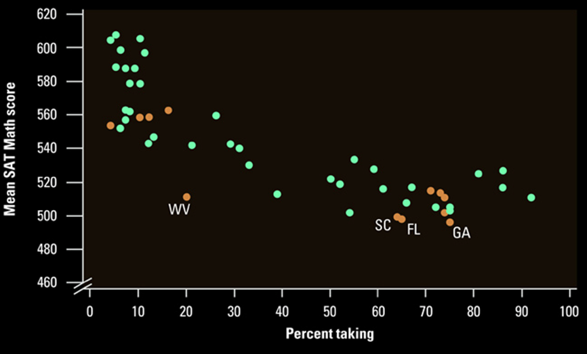
Adding Categorical Variables
Use a different plotting color or symbol for each category

Slide 18
Summary and Homework
Summary
  Scatter plots can show associations between variables and are described using
    direction,
    form,
    strength
    outliers
    and clusters
Homework
  Problems 1, 5, 7, 11, 13

Slide 19

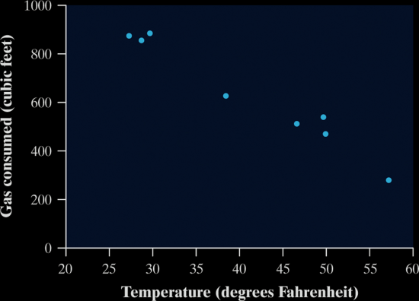
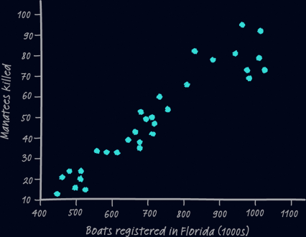
5-Minute Check on Section 1 Part 1
Describe each scatterplot
Identify the explanatory and response variables
A study observes a large group of people over a 10-year period. The goal is to see if overweight and obese people are more likely to die during the study than people who weigh less. Such studies can be misleading because obese people are more likely to be inactive and poor.
Could we conclude that increase weight causes greater risk of dying if the study reveals a strong positive correlation?
Negative
Linear
Strong
none
Positive
Linear
Strong
maybe cluster
RV: death rate EV: weight, activity, wealth
Observational study – cannot determine causation (DOE)
What about activity and wealth??
Click the mouse button or press the Space Bar to display the answers.

Slide 20
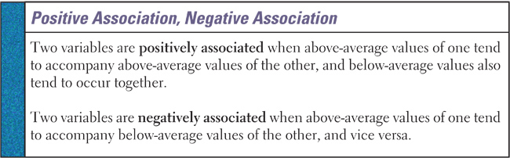
Associations
Remember the emphasis in the definitions on above and below average values in examining the definition for linear correlation coefficient, r

Slide 21
Linear Correlation Coefficient, r
1
r = ------
n – 1
Σ
(x_{i} – x)
----------
s_{x}
(y_{i} – y)
----------
s_{y}
Where
x is the sample mean of the explanatory variable
s_{x} is the sample standard deviation for x
y is the sample mean of the response variable
s_{y} is the sample standard deviation for y
n is the number of individuals in the sample

Slide 22
Equivalent Form for r
Σ
Σ
Σ
x_{i} y_{i}
x_{i}y_{i} – -----------
n
s_{xy}
r =
=
√
(Σ )²
(Σ )²
√s_{xx} √s_{yy}
Σ
x_{i}
x_{i}² – --------
n
Σ
y_{i}
y_{i}² – --------
n
Easy for computers (and calculators)

Slide 23
Important Properties of r
  Correlation makes no distinction between explanatory and response variables
  r does not change when we change the units of measurement of x, y or both
  Positive r indicates positive association between the variables and negative r indicates negative association
  The correlation r is always a number between -1 and 1
  The linear correlation coefficient is a unitless measure of association

Slide 24
Linear Correlation Coefficient Properties
  The linear correlation coefficient is always between -1 and 1
  If r = 1, then the variables have a perfect positive linear relation
  If r = -1, then the variables have a perfect negative linear relation
  The closer r is to 1, then the stronger the evidence for a positive linear relation
  The closer r is to -1, then the stronger the evidence for a negative linear relation
  If r is close to zero, then there is little evidence of a linear relation between the two variables. R close to zero does not mean that there is no relation between the two variables

Slide 25
Facts about Correlation
  How correlation behaves is more important than the details of the formula. Here are some important facts about r.
Correlation makes no distinction between explanatory and response variables.
r does not change when we change the units of measurement of x, y, or both.
The correlation r itself has no unit of measurement.
Cautions:
Correlation requires that both variables be quantitative.
Correlation does not describe curved relationships between variables, no matter how strong the relationship is.
Correlation is not resistant. r is strongly affected by a few outlying observations.
Correlation is not a complete summary of two-variable data.

Slide 26
TI-83 Instructions for
Correlation Coefficient
With explanatory variable in L1 and response variable in L2
Turn diagnostics on by
  Go to catalog (2nd 0)
  Scroll down and when diagnosticOn is highlighted, hit enter twice
Press STAT, highlight CALC and select
4: LinReg (ax + b) and hit enter twice
Read r value (last line)

Slide 27
Example 4
 | 1 | 2 | 3 | 4 | 5 | 6 | 7 | 8 | 9 | 10 | 11 | 12
x | 3 | 2 | 2 | 4 | 5 | 15 | 22 | 13 | 6 | 5 | 4 | 1
y | 0 | 1 | 2 | 1 | 2 | 9 | 16 | 5 | 3 | 3 | 1 | 0
Draw a scatter plot of the above data
Compute the correlation coefficient
y
x
r = 0.9613

Slide 28
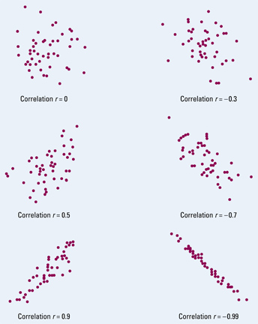
Example 5
Match the r values to the Scatterplots to the left
r = -0.99
r = -0.7
r = -0.3
r = 0
r = 0.5
r = 0.87
F
A
D
E
D
A
B
B
E
C
C
F

Slide 29
Cautions to Heed
Correlation requires that both variables be quantitative, so that it makes sense to do the arithmetic indicated by the formula for r
Correlation does not describe curved relationships between variables, not matter how strong they are
Like the mean and the standard deviation, the correlation is not resistant: r is strongly affected by a few outlying observations
Correlation is not a complete summary of two-variable data

Slide 30
Observational Data Reminder
If bivariate (two variable) data are observational, then we cannot conclude that any relation between the explanatory and response variable are due to cause and effect
Remember Observational versus Experimental Data (for cause-and-effect)

Slide 31
Summary and Homework
Summary
  A scatterplot displays the relationship between two quantitative variables.
  An explanatory variable may help explain, predict, or cause changes in a response variable.
  When examining a scatterplot, look for an overall pattern showing the direction, form, and strength of the relationship and then look for outliers or other departures from the pattern.
  The correlation r measures the strength and direction of the linear relationship between two quantitative variables.
Homework
  Problems 1, 3, 5, 19, 23

