Slide 1
Lesson 3 - 2
Least-Squares Regression

Slide 2

5-Minute Check on Section 1 Part 2
Are correlations are resistant to outliers?
When we change units of measure for one of the variables in a correlation, we have to recalculate the correlation, r.
Perfect negative correlation is _______.
An extremely strong correlation proves a variable caused a reaction in another variable.
How do we get the linear regression line to display on the scatter plot?
No; outliers mess up correlations.
No; r is a unitless measure and does not depend on the variable’s units of measure.
-1
Correlation does not prove causation
LineReg (ax+b) L1, L2, Y1
Click the mouse button or press the Space Bar to display the answers.

Slide 3
Objectives
Make predictions using regression lines, keeping in mind the dangers of extrapolation
Calculate and interpret a residual
Interpret the slope and y-intercept of a regression line
Determine the equation of a least-squares regression line using technology or computer output
Construct and interpret residual plots to assess whether a regression model is appropriate

Slide 4
Objectives (cont)
Interpret the standard deviation of the residuals and r² and use these values to assess how well a least-squares regression line models the relationship between two variables
Describe how the least-squares regression line, standard deviation of the residuals, and r² are influenced by outliers
Find the slope and y-intercept of the least-squares regression line from the means and standard deviations of x and y and their correlation

Slide 5
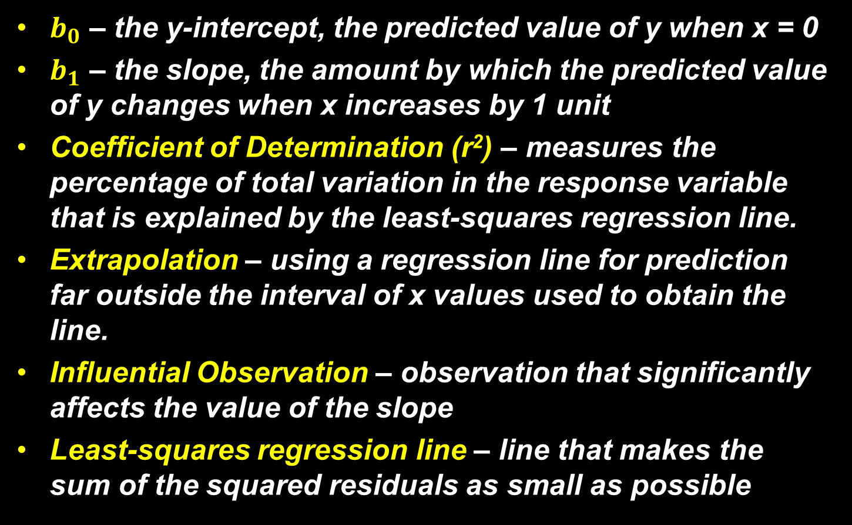
Vocabulary
$b_{0}$ – the y-intercept, the predicted value of y when x = 0
$b_{1}$ – the slope, the amount by which the predicted value of y changes when x increases by 1 unit
Coefficient of Determination (r²) – measures the percentage of total variation in the response variable that is explained by the least-squares regression line.
Extrapolation – using a regression line for prediction far outside the interval of x values used to obtain the line.
Influential Observation – observation that significantly affects the value of the slope
Least-squares regression line – line that makes the sum of the squared residuals as small as possible

Slide 6

Vocabulary (cont)
Regression Line – a line that describes how a response variable y changes as an explanatory variable x changes; expressed in the form $\hat{y}=b_{0}+b_{1}x$ , where y-hat is the predicted value for y, given a value of x
Residual – difference between the actual value of y and the value of y predicted by the regression line;
$residual=actual y−predicted y=y−\hat{y}$
Residual plot – a scatterplot that displays the residuals on the vertical axis and the explanatory variable on the horizontal axis
Standard deviation of the residuals, s – measures the size of a typical residual; the typical distance between the actual y values and the predicted y values

Slide 7
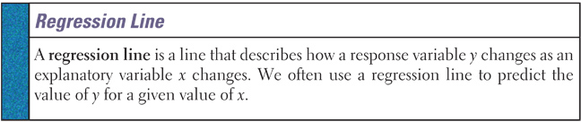
Linear Regression
Back in Algebra I students used “lines of best fit” to model the relationship between and explanatory variable and a response variable. We are going to build upon those skills and get into more detail.
∧
We will use the model with y as the predicted value of the response variable and x as the explanatory variable.
y = a + bx
with a as the y-intercept and b is the slope
∧

Slide 8
AP Test Keys
Slope of the regression line is interpreted as the “predicted or average change in the response variable given a unit of change in the explanatory variable.”
It is not correct, statistically, to say “the slope is the change in y for a unit change in x.” The regression line is not an algebraic relationship, but a statistical relationship with probabilistic chance involved.
Y-intercept, a, is useful only if it has any meaning in context of the problem. Remember: no one has a zero circumference head size!

Slide 9
Example 1
Obesity is a growing problem around the world. Some people don’t gain weight even when they overeat. Perhaps fidgeting and other “nonexercise activity” (NEA) explains why – some people may spontaneously increase NEA when fed more. Researchers deliberately overfed 16 healthy young adults for 8 weeks. They measured fat gain (in kg) and change in NEA – fidgeting, daily living, and the like.
NEA change | -94 | -57 | -29 | 135 | 143 | 151 | 245 | 355
Fat gain | 4.2 | 3.0 | 3.7 | 2.7 | 3.2 | 3.6 | 2.4 | 1.3
NEA change | 392 | 473 | 486 | 535 | 571 | 580 | 620 | 690
Fat gain | 3.8 | 1.7 | 1.6 | 2.2 | 1.0 | 0.4 | 2.3 | 1.1

Slide 10
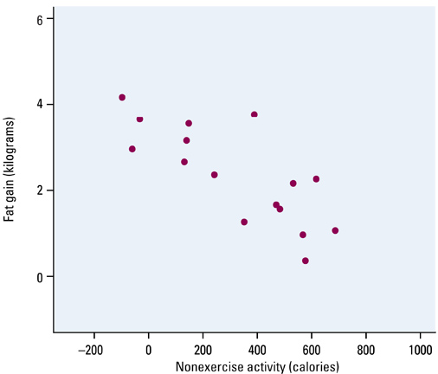
Example 1
Describe the scatterplot
Guess at the line of best fit
The plot shows a moderately strong, negative, linear association between NEA change and fat gain with no outliers
Note that the vertical axis is not at x = 0

Slide 11
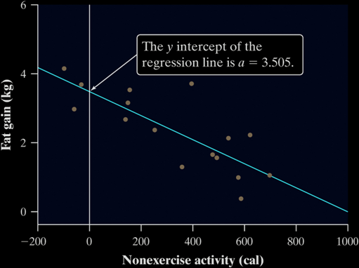
Interpreting a Regression Line
Consider the regression line from the example “Does Fidgeting Keep You Slim?” Identify the slope and y-intercept and interpret each value in context
The slope b = -0.00344 tells us that the amount of fat gained is predicted to go down by 0.00344 kg for each added calorie of NEA.
The y-intercept a = 3.505 kg is the fat gain estimated by this model if NEA does not change when a person overeats.

Slide 12
Prediction and Extrapolation
Regression lines can be used to predict a response value (y) for a specific explanatory value (x)
Extrapolation, prediction beyond the range of x values in the model, can be very inaccurate and should be done only with noted caution
Extrapolation near the extreme x values generally will be less inaccurate than those done with values farther away from the extreme x values
Note: you can’t say how important a relationship is by looking at the size of the regression slope

Slide 13
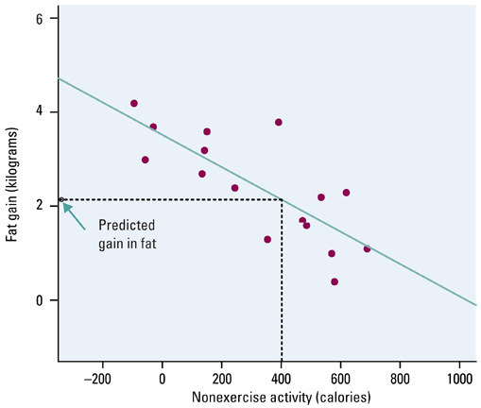
Using the Model to Predict
Extrapolation
Prediction
How close did your best-fit line come?
From the model at 400 cal it predicts slightly over 2 lbs gain
Where is the Prediction vs Extrapolation range?

Slide 14
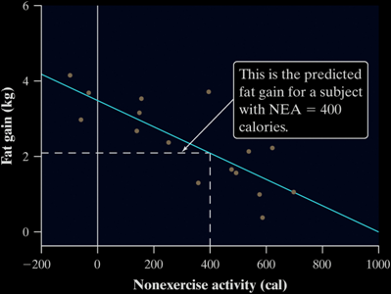


Prediction
We can use a regression line to predict the response ŷ for a specific value of the explanatory variable x.
Use the NEA and fat gain regression line to predict the fat gain for a person whose NEA increases by 400 cal when she overeats.
We predict a fat gain of 2.13 kg when a person with NEA = 400 calories.

Slide 15
Regression Lines
A good regression line makes the vertical distances of the points from the line (also known as residuals) as small as possible
Residual = Observed - Predicted
The least squares regression line of y on x is the line that makes the sum of the squared residuals as small as possible

Slide 16
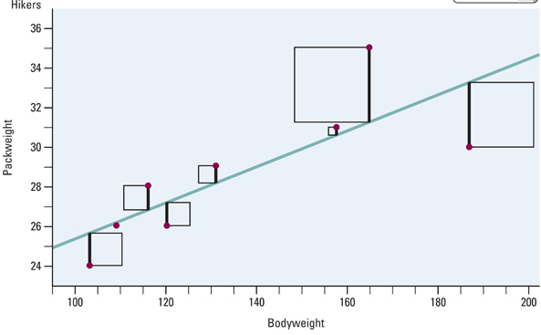
Least Squares Regression Line
The blue line minimizes the sum of the squares of the residuals (dark vertical lines)

Slide 17
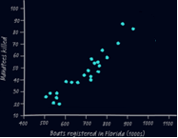
5-Minute Check on Section 2 Part 1
Label the following graph with interpolation and extrapolation areas
A regression line is a mathematical or statistical relationship?
Write the definition of residuals:
What does the Least square regression line minimize?
Model ranges from about 500 to 900. Anything inside that range is an interpolation; outside is an extrapolation.
Statistical !!!
Residual = Observed – Predicted
The squares of the residuals
Click the mouse button or press the Space Bar to display the answers.

Slide 18
Least Squares Regression Line
residual
residual
The blue line minimizes the sum of the squares of the residuals (dark vertical lines)

Slide 19
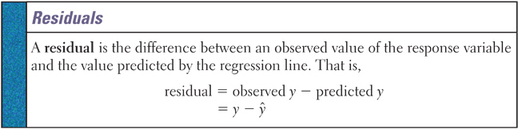
Residuals Part One
Positive residuals mean that the observed (actual value, y) lies above the line (predicted value, y-hat)
Negative residuals mean that the observed (actual value, y) lies below the line (predicted value, y-hat)
Order is not optional!

Slide 20
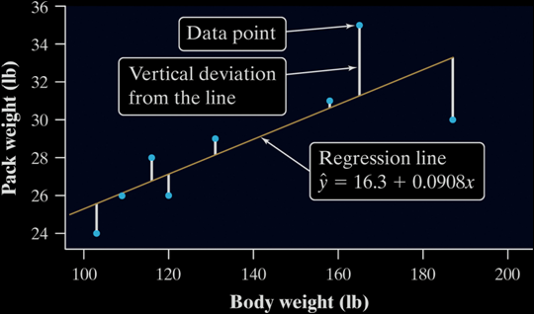
Residuals
In most cases, no line will pass exactly through all the points in a scatterplot. A good regression line makes the vertical distances of the points from the line as small as possible
Definition:
A residual is the difference between an observed value of the response variable and the value predicted by the regression line. That is,
residual = observed y – predicted y = y - ŷ
Positive residuals
(above line)
residual
Negative residuals
(below line)

Slide 21
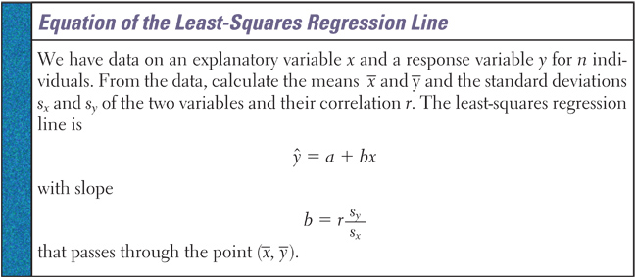
Least-Squares Line Equation
If calculations are done by hand, you need to carry extra decimal places in preliminary calculations to get accurate values

Slide 22
Example 1 cont
c) Using your calculator do the scatterplot for this data, checking it against the plot in your notes
d) Again using your calculator (1-VarStats) calculate the LS regression line using the formula (r = -0.7786)
x-bar = 324.8 s_{x} = 257.66
y-bar = 2.388 s_{y} = 1.11389
s_{y} 1.11389
b = r ----- = (-0.7786) ------------- = -0.00344 kg per calorie
s_{x} 257.66
y-bar = a + b x-bar
2.388 = a + (-0.00344)(324.8)
2.388 = a – 1.117
3.505 kg = a
^
y = 3.505 – 0.00344x

Slide 23
Using the TI-83
2nd 0 (Catalog); scroll down to DiagnosticON and press Enter twice (like Catalog help → do once)
Enter “X” data into L1 and “Y” data into L2
Define a scatterplot using L1 and L2
Use ZoomStat to see the data properly
Press STAT, choose CALC, scroll to LinReg(a+bx)
Enter LinReg(a+bx)L1,L2,Y1
Y1 is found under VARS / Y-VARS / 1: function

Slide 24
Example 1 cont
e) Now use you calculator to calculate the LS regression line, r and r²
LinReg
y=a+bx
a = 3.505122916
b = -.003441487
r² = .6061492049
r = -.7785558457

Slide 25
Residuals Part Two
The sum of the least-squares residuals is always zero
Residual plots helps assess how well the line describes the data
A good fit has
  no discernable pattern to the residuals
  and the residuals should be relatively small in size
A poor fit violates one of the above
  Discernable patterns:
  Curved residual plot
  Increasing / decreasing spread in residual plot

Slide 26
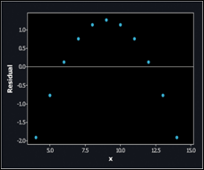
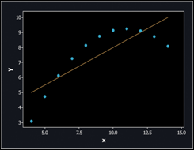
Interpreting Residual Plots
A residual plot magnifies the deviations of the points from the line, making it easier to see unusual observations and patterns.
      The residual plot should show no obvious patterns
      The residuals should be relatively small in size.
Pattern in residuals
Linear model not appropriate
Definition:
If we use a least-squares regression line to predict the values of a response variable y from an explanatory variable x, the standard deviation of the residuals (s) is given by

Slide 27
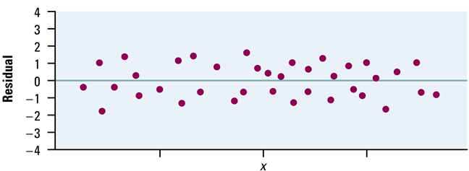
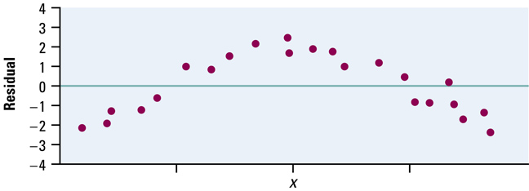
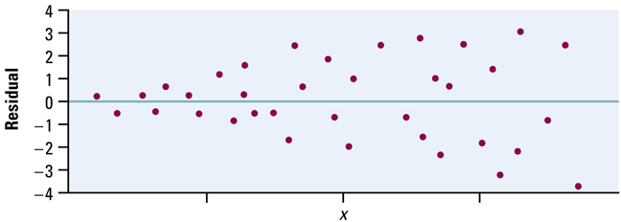
Residuals Part Two Cont
Unstructured scatter of residuals indicates that linear model is a good fit
A)
Curved pattern of residuals indicates that linear model may not be good fit
B)
Increasing (or decreasing) spread of the residuals indicates that linear model is not a good fit (accuracy!)
C)

Slide 28
Residuals Using the TI-83
After getting the scatterplot (plot1) and the LS regression line as before
Define L3 = Y1(L1) [remember how we got Y1!!]
Define L4 = L2 – L3 [actual – predicted]
Turn off Plot1 and deselect the regression eqn (Y=)
With Plot2, plot L1 as x and L4 as y
Use 1-VarStat L4 to find sum of residuals squared
Residuals are a calculated list in your list data set after you have run a regression model.

Slide 29
Coefficient of Determination, r²
r and r² are related mathematically, but they have different meanings in terms of regression modeling
r is a measure of the strength of the linear relationship;
r² tells us how much better our linear model is at predicting y-values than just using y-bar
SST – SSE SSE
r² = ---------------- = 1 – --------
SST SST
^
where SSE = ∑ residual² = ∑(y – y)² and
SST = ∑(y – y)² = (n-1)s_{y}²
_

Slide 30
The Role of r² in Regression
  The standard deviation of the residuals gives us a numerical estimate of the average size of our prediction errors. There is another numerical quantity that tells us how well the least-squares regression line predicts values of the response y.
Definition:
The coefficient of determination r² is the fraction of the variation in the values of y that is accounted for by the least-squares regression line of y on x. We can calculate r² using the following formula:
where
and

Slide 31
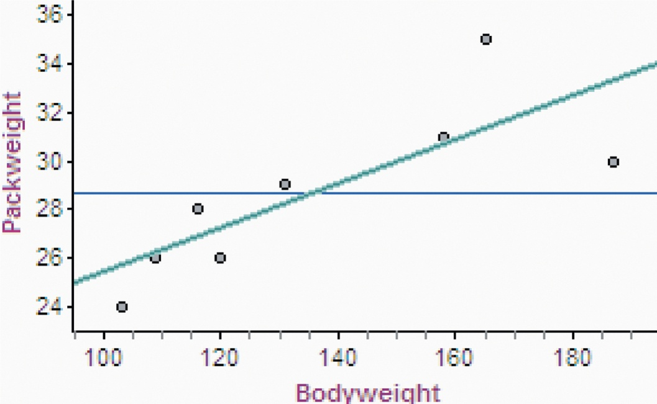
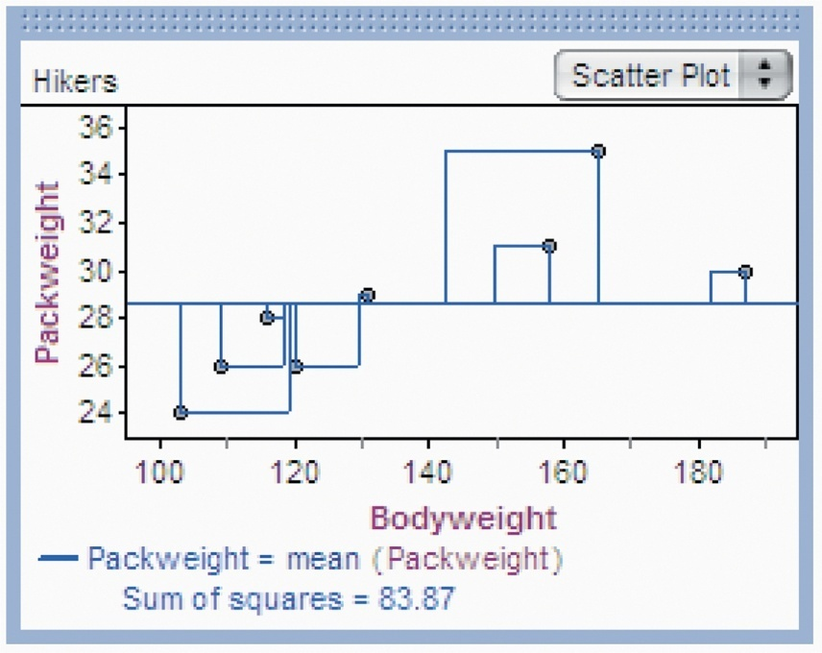
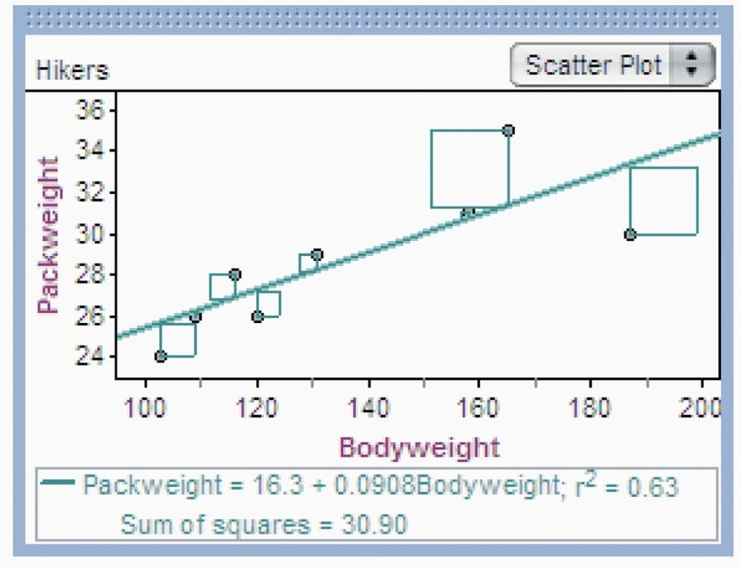
The Role of r² in Regression
r ² tells us how much better the LSRL does at predicting values of y than simply guessing the mean y for each value in the dataset. Consider the example on page 179. If we needed to predict a backpack weight for a new hiker, but didn’t know each hikers weight, we could use the average backpack weight as our prediction.
SSE/SST = 30.97/83.87
SSE/SST = 0.368
Therefore, 36.8% of the variation in pack weight is unaccounted for by the least-squares regression line.
1 – SSE/SST = 1 – 30.97/83.87
r² = 0.632
63.2 % of the variation in backpack weight is accounted for by the linear model relating pack weight to body weight.
If we use the mean backpack weight as our prediction, the sum of the squared residuals is 83.87.
SST = 83.87
If we use the LSRL to make our predictions, the sum of the squared residuals is 30.90.
SSE = 30.90

Slide 32
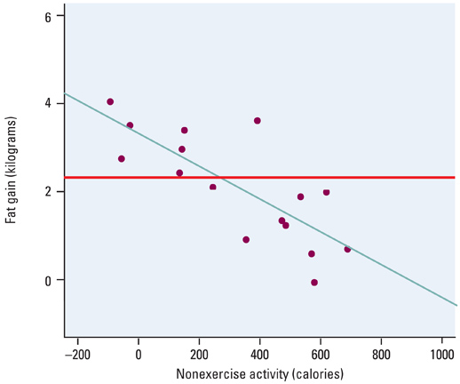
Example 1 and r²
_
SST = ∑(y – y)²
Total Deviation
^
SSE = ∑(y – y)²
Residual (Error)
SSR = SST – SSE
or
SST = SSE + SSR

Slide 33
Example 1 and r² cont
Calculate r² using the formulas
Using our previous calculations:
SST = ∑(y – y)² = (n-1)s_{y}² = 15(1.1389)² = 19.4565
SSE = ∑ residual² = ∑(y – y)² = 7.6634
SSE 7.6634
r² = 1 – --------- = 1 – ---------- = 0.6061
SST 19.4565
so 60.6% of the variation in fat gain is explained by the least squares regression line relating fat gain and nonexercise activity
_
^

Slide 34
Facts about LS Regression
The distinction between explanatory and response variable is essential in regression
There is a close connection between correlation and the slope of the LS line
The LS line always passes through the point (x-bar, y-bar)
The square of the correlation, r², is the fraction of variation in the values of y that is explained by the LS regression of y on x

Slide 35
5-Minute Check on Section 2 Part 2
Describe each residual plot
What does a positive residual mean? A negative residual?
Define what r² is.
A.
B.
C.
D.
Residual
Residual
Residual
Residual
Explanatory
Explanatory
Explanatory
Explanatory
Outlier Pattern Horn-effect Good Fit
Possible Bad model Bad model
problem
Positive – the actual value is higher than the predicted value
Negative – the actual value is lower than the predicted value
R² is the percentage of variation that is explained by the model
Click the mouse button or press the Space Bar to display the answers.

Slide 36
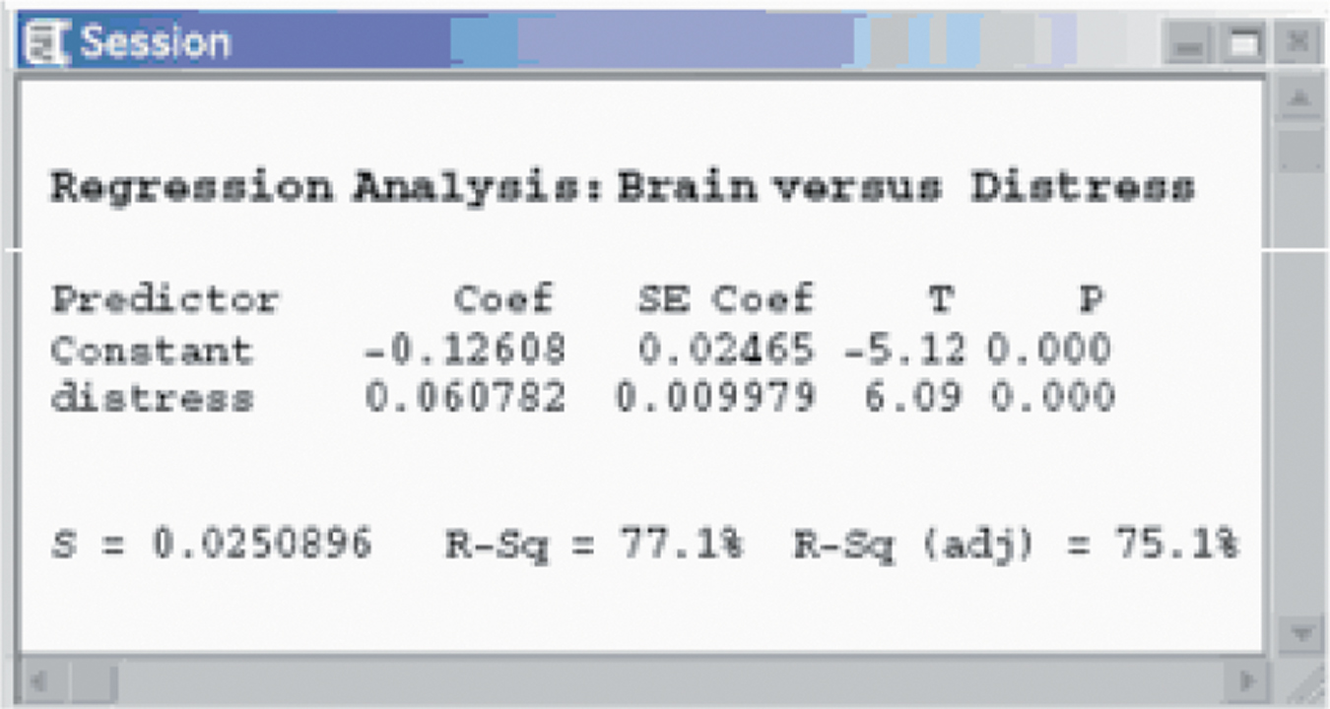
Computer Output Example 1

Slide 37
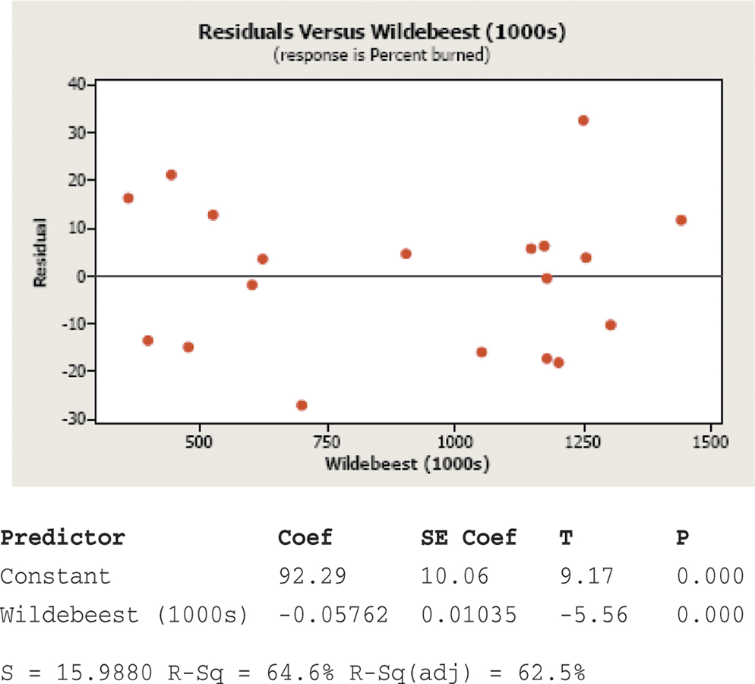
Computer Output Example 2

Slide 38
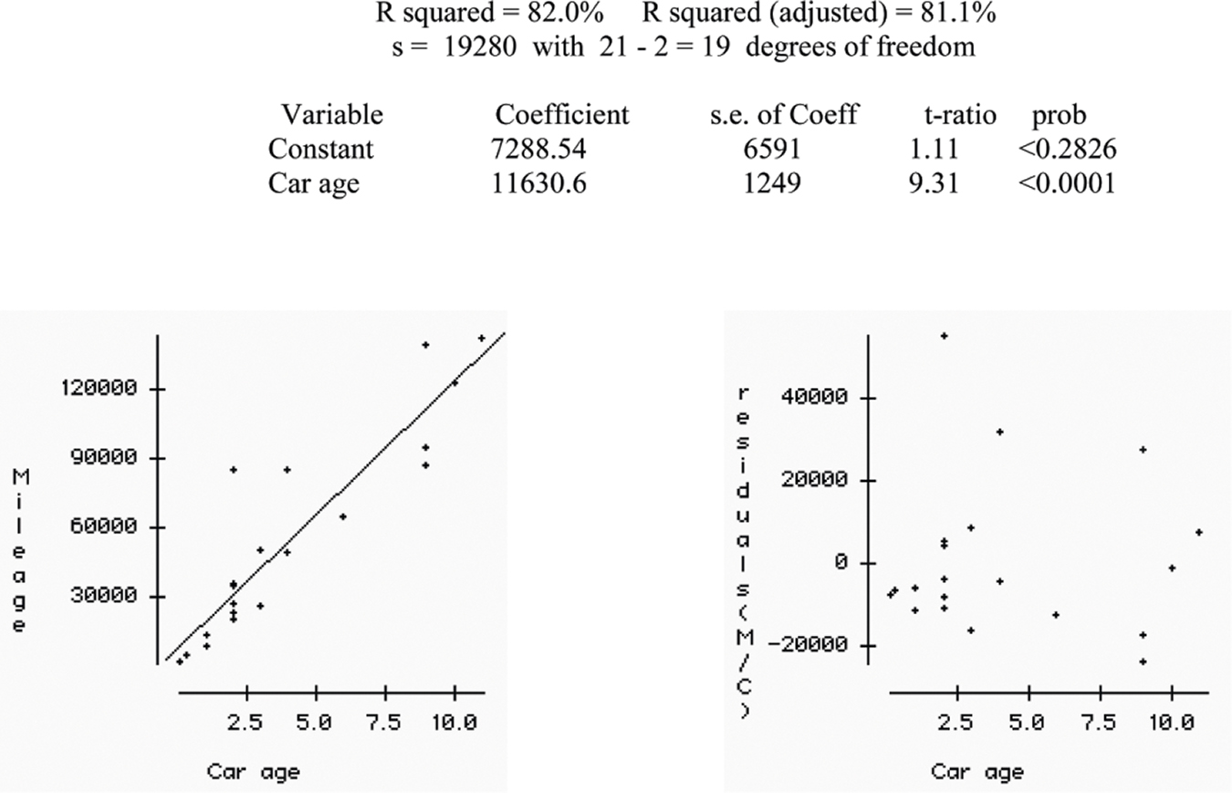
Computer Output Example 3

Slide 39
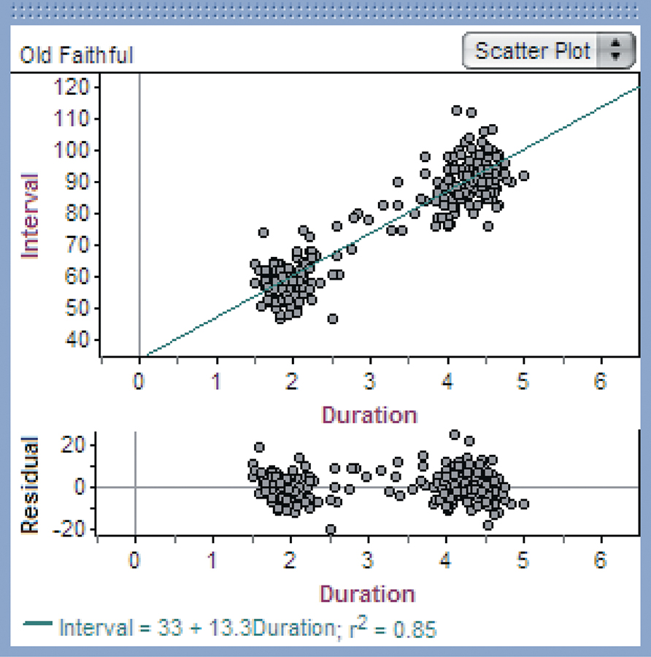
Computer Output Example 4

Slide 40
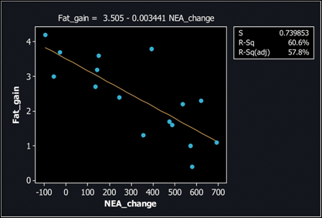
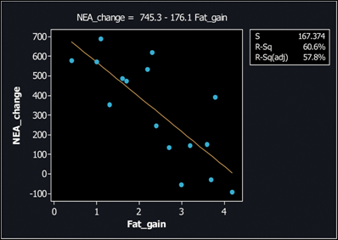
Limitations
Correlation and regression are powerful tools for describing the relationship between two variables. When you use these tools, be aware of their limitations
The distinction between explanatory and response variables is important in regression.

Slide 41
Limitations
Correlation and regression describe only linear relationships
Extrapolation (using model outside range of the data) often produces unreliable predications
Correlation and least-squares regression lines are not resistant.

Slide 42
Outliers vs Influential Observation
Outlier is an observation that lies outside the overall pattern of the other observations
  Outliers in the Y direction will have large residuals. but may not influence the slope of the regression line
  Outliers in the X direction are often influential observations
Influential observation is one that if by removing it, it would markedly change the result of the regression calculation

Slide 43
Example 1
Does the age at which a child begins to talk predict later score on a test of metal ability? A study of the development of 21 children recorded the age in months at which they spoke their first word and their later Gesell Adaptive Score (GAS).
Child | Age | GAS | Child | Age | GAS | Child | Age | GAS
1 | 15 | 95 | 8 | 11 | 100 | 15 | 11 | 102
2 | 26 | 71 | 9 | 8 | 104 | 16 | 10 | 100
3 | 10 | 83 | 10 | 20 | 94 | 17 | 12 | 105
4 | 9 | 91 | 11 | 7 | 113 | 18 | 42 | 57
5 | 15 | 102 | 12 | 9 | 96 | 19 | 17 | 121
6 | 20 | 87 | 13 | 10 | 83 | 20 | 11 | 86
7 | 18 | 93 | 14 | 11 | 84 | 21 | 10 | 100

Slide 44
Example 1 cont
What is the equation of the LS regression line used to model this data?
What is the interpretation of this data?
y-hat = 109.8738 – 1.127x r = -0.64
The scatter plot and the slope of the regression line indicates a negative association. Children who begin to speak later tend to have lower test scores than early talkers. The slope suggests that for every month older a child is when they begin to speak, their score on the Gesell test will decrease by about 1.13 points. The y-intercept has no real meaning in this case.

Slide 45
Example 1 cont
Are there any outliers?
Are there any influential observations?
Child #19 is an outlier in the Y-direction and child #18 is an outlier in the X-direction.
Child #18 is an outlier in the X-direction and also an influential observation because it has a strong influence on the positioning of the regression line.

Slide 46
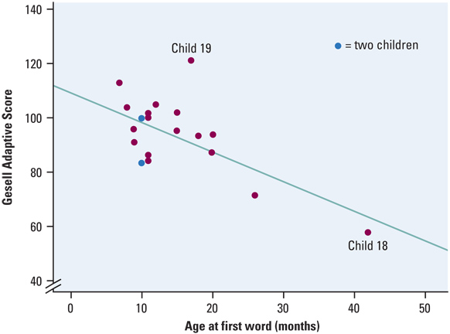
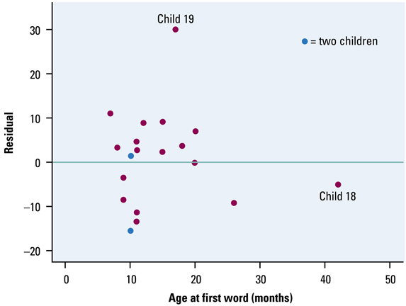
Example 1 cont
Scatterplot w/ Regression Line
Residual Plot

Slide 47
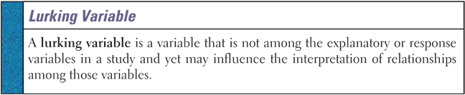
Lurking or Extraneous Variable
The relationship between two variables can often be misunderstood unless you take other variables into account
Association does not imply causation!
Instances of Rocky Mt spotted fever and drownings reported per month are highly correlated, but completely without causation

Slide 48
Summary and Homework
Summary
  Regression line is a prediction on y-hat based on an explanatory variable x
  Slope is the predicted change in y as x changes
  b is the change in y-hat when x increase by 1
  y-intercept, a, makes no statistical sense unless x=0 is a valid input
  Prediction between xmin and xmax, but avoid extrapolation for values outside x domain
  Residuals assess validity of linear model
  r² is the fraction of the variance of y explained by the least-squares regression on the x variable
Homework
  Prob 37, 41, 55, 59, 67

