Slide 1
Lesson 3 - R
Review of Chapter 3
Examining Relationships

Slide 2

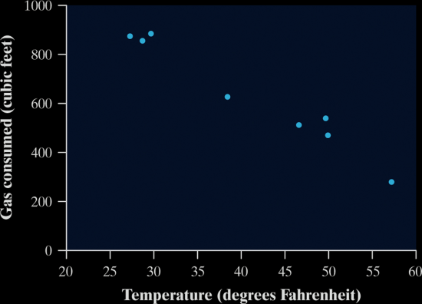
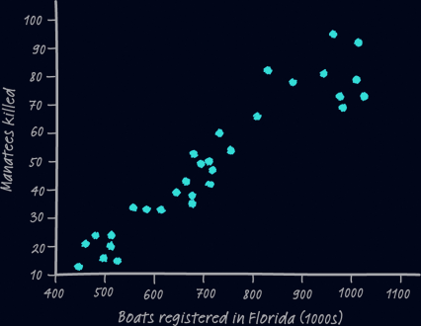
5-Minute Check on Section 2 Part 4
Describe each scatterplot
Identify the explanatory and response variables
A study observes a large group of people over a 10-year period. The goal is to see if overweight and obese people are more likely to die during the study than people who weigh less. Such studies can be misleading because obese people are more likely to be inactive and poor.
Could we conclude that increase weight causes greater risk of dying if the study reveals a strong positive correlation?
Negative
Linear
Strong
none
Positive
Linear
Strong
maybe cluster
RV: death rate EV: weight, activity, wealth
Observational study – cannot determine causation (DOE)
What about activity and wealth??
Click the mouse button or press the Space Bar to display the answers.

Slide 3
Objectives
Construct and interpret a scatterplot for a set of bivariate data.
Compute and interpret the correlation, r, between two variables.
Demonstrate an understanding of the basic properties of the correlation r.
Explain the meaning of a least squares regression line.
Given a bivariate data set, construct and interpret a regression line.
Demonstrate an understanding of how one measures the quality of a regression line as a model for bivariate data.

Slide 4
Vocabulary
None new

Slide 5
Step-by-Step
Plot your data. Scatterplot
r = linear correlation coefficient
(how appropriate is the linear model)
+/- give direction
value give strength -1 ≤ r ≤ 1
Interpret what you see:
direction, form, strength, outliers
Numerical summary:
x, y, s_{x}, s_{y}, and r
Mathematical model:
regression line?
r² = coefficient of determination
(how much of the variance of the data is explained by the linear model)
How well does it fit?
Residuals and r²

Slide 6
Drawing Scatter Plots by Hand
Plot the explanatory variable on the x-axis. If there is no explanatory-response distinction, either variable can go on the horizontal axis.
Label both axes
Scale both axes (but not necessarily the same scale on both axes). Intervals must be uniform.
Make your plot large enough so that the details can be seen easily.
If you have a grid, adopt a scale so that you plot uses the entire grid

Slide 7
Interpreting Scatterplots
Just like distributions had certain important characteristics (Shape, Outliers, Center, Spread)
Scatter plots should be described by
  Direction
  positive association (positive slope left to right)
  negative association (negative slope left to right)
  Form
  linear – straight line,
  curved – quadratic, cubic, etc, exponential, etc
  Strength of the form
  weak
  moderate (either weak or strong)
  strong
  Outliers (any points not conforming to the form)
  Clusters (any sub-groups not conforming to the form)

Slide 8
Prediction and Extrapolation
Regression lines can be used to predict a response value (y) for a specific explanatory value (x)
Extrapolation, prediction beyond the range of x values in the model, can be very inaccurate and should be done only with noted caution
Extrapolation near the extreme x values generally will be less inaccurate than those done with values farther away from the extreme x values
Note: you can’t say how important a relationship is by looking at the size of the regression slope

Slide 9
Residuals
The sum of the least-squares residuals is always zero
Residual plots helps assess how well the line describes the data
A good fit has
  no discernable pattern to the residuals
  and the residuals should be relatively small in size
A poor fit violates one of the above
  Discernable patterns:
  Curved residual plot
  Increasing / decreasing spread in residual plot

Slide 10
Outliers vs Influential Observation
Outlier is an observation that lies outside the overall pattern of the other observations
  Outliers in the Y direction will have large residuals. but may not influence the slope of the regression line
  Outliers in the X direction are often influential observations
Influential observation is one that if by removing it, it would markedly change the result of the regression calculation

Slide 11
Summary and Homework
Summary
  Data analysis begins with graphs of the data; scatterplots show the relationship between an explanatory and the response variables
  Correlation describes the strength of a linear relationship
  Least-squares regression fits a line to data
  Residual plots and r² help us assess how well the linear model fits the data
  Lurking variables can hide or alter the relationship between two variables
  Outliers and influential points can drastically affect our interpretations or correlation and regression results
Homework
  R7, 8, 9

