Slide 1
Lesson 4 - 1
Samples and Surveys

Slide 2
Objectives
Identify the population and sample in a statistical study
Identify voluntary response sampling and convenience sampling and explain how these sampling methods can lead to bias
Describe how to select a simple random sample with technology or a table of random digits
Describe how to select a sample using stratified random sampling and cluster sampling, distinguish stratified random sampling from cluster sampling and give an advantage of each method
Explain how undercoverage, nonresponse, question wording, and other aspects of a sample survey can lead to bias

Slide 3
Vocabulary
Anecdotal – data based on casual observation, not scientific research
Bias – a statistical study that is very likely to underestimate or overestimate the value you want to know
Census -- data is collected from every individual in the population
Cluster – a group of individuals in the population that are located near each other
Cluster sampling – selects a sample by randomly choosing clusters and including each member of the selected clusters in the sample
Control group – group receiving the placebo
Convenience sampling – selects individuals from the population who are easy to reach
Data – fact or propositions used to draw a conclusion or make a decision
Descriptive statistics – organizing and summarizing the information collected

Slide 4
Vocabulary (cont)
Double-blind – experiment where neither the receiver of the item or the giver of the item knows who is in each group
Experimental group – group receiving item being studied
Inferential statistics – methods that take results obtained from a sample, extends them to the population, and measures the reliability of the results
Information – data
Nonresponse – occurs when an individual chosen for the sample can’t be contacted or refuses to participate
Placebo – innocuous drug such as a sugar tablet
Population – the entire collection of individuals
Random sampling – using a chance process to determine which members of a population are included in the sample
Response bias – occurs when there is a systematic pattern of inaccurate answers to a survey question

Slide 5
Vocabulary (cont)
Sample survey – a study that collects data from a sample that is chosen to represent a specific population
Simple random sample – is chosen in such a way that every group of n individuals in the population has an equal chance to be selected as the sample
Strata (stratified random sample) – groups of individuals in a population who share characteristics thought to be associated with the variables being measured in a study
Stratified random sampling – selects a sample by choosing an SRS from each stratum and combining the SRSs into one overall sample
Statistics – science of collecting, organizing, summarizing and analyzing information to draw conclusions or answer questions
Undercoverage – when some members of the population are less likely to be chosen or cannot be chosen in a sample
Variables – characteristics of individuals within the population
Voluntary response sampling – allows people to choose to be in the sample by responding to a general invitation

Slide 6
Four Sources of Data
Observational Studies
  Census
  Existing sources
    Previous study’s data
    Data collections from other activities
  Survey sampling
Designed experiments

Slide 7
Populations and Samples
The distinction between population and sample is basic to statistics. To make sense of any sample result, you must know what population the sample represents
Definition:
The population in a statistical study is the entire group of individuals about which we want information.
A sample is the part of the population from which we actually collect information. We use information from a sample to draw conclusions about the entire population.
Population
Collect data from a representative Sample...
Sample
Make an Inference about the Population.

Slide 8
The Idea of a Sample Survey
We often draw conclusions about a whole population on the basis of a sample.
Choosing a sample from a large, varied population is not that easy
Step 1: Define the population we want to describe.
Step 2: Say exactly what we want to measure.
A “sample survey” is a study that uses an organized plan to choose a sample that represents some specific population.
Step 3: Decide how to choose a sample from the population.

Slide 9
Observational Study
Studies individuals in a sample or census
Does not manipulate any variables involved
Cannot determine cause and effect
Why use observational studies?
  Useful for determining if further study is needed
    Association between two variables
    Further study would likely be an experiment
  Learn characteristics of a population
  Sometimes it’s the only ethical way to proceed

Slide 10
Designed Experiments
Applies treatments to individuals
Attempts to isolate effects of treatment on a response variable
Can determine cause and effect relationships
Focus of the next section

Slide 11
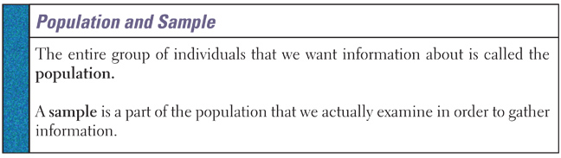
Samples and Populations
To measure an entire population we conduct a census (data from everyone). It is expensive and hard to contact everyone in a population
A sample -- a small group is contacted and is used to gather information about the whole population.

Slide 12
How to Sample Badly
How can we choose a sample that we can trust to represent the population? There are a number of different methods to select samples
Definition:
Choosing individuals who are easiest to reach results in a convenience sample.
Convenience samples often produce unrepresentative data…why?
Definition:
The design of a statistical study shows bias if it systematically favors certain outcomes.

Slide 13
How to Sample Badly
Convenience samples are almost guaranteed to show bias. So are voluntary response samples, in which people decide whether to join the sample in response to an open invitation
Definition:
A voluntary response sample consists of people who choose themselves by responding to a general appeal. Voluntary response samples show bias because people with strong opinions (often in the same direction) are most likely to respond.

Slide 14

Bias
From Sullivan:
Bias – nonsampling error introduced by giving preference to selecting some individuals over others, by giving preference to some answers by wording the questions a particular way, etc
Key is systematically favoring something (not being a random selection)

Slide 15
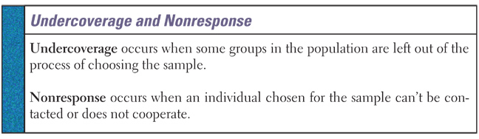
Sources of Bias
Undercoverage results from an incomplete frame on the surveyor’s part
Nonresponse can be from either the surveyor (can’t find the person) or the person’s unwillingness to answer
Response bias (lies) can result from either the respondent or the influence of the interviewer

Slide 16
Errors in Sampling
Sampling Error
Non sampling Error
Designer
Incomplete Frame
Questionnaire Design
  Poorly worded questions
  Inflammatory words
  Question order
  Response order
sample gives incomplete information about the population
Subject
Nonresponse
Misrepresented answers
Sampling
Process
Iceberg
Interviewer errors
Collection Execution
Data-entry (input) errors
Analysis
Process

Slide 17
Sources of Nonsampling Error
Incomplete Frame (not all of population)
Nonresponse (not getting information)
Data Collection errors
  Interviewer error
  Misrepresented answers
  Data-entry (input) errors
Questionnaire Design
  Poorly worded questions
  Inflammatory words
  Question order
  Response order

Slide 18
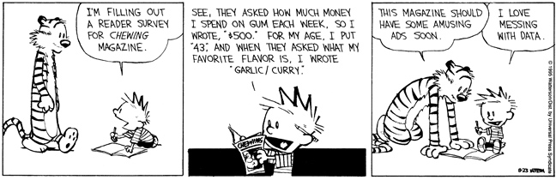
Example Problems
Determine is the survey design is flawed
If flawed, is it due to the sampling method of the survey itself
For flawed surveys, identify the cause of the error
Suggest a remedy to the problem

Slide 19
Example 1
MSHS wants to conduct a study regarding the achievement of its students. The principal selects the first 50 students who enter the building on a given day and administers the survey.
Flawed sampling method
Early-bird students will be sampled with a greater proportion
Survey 25 students in cafeteria and 25 student in auditorium would now miss the Early-bird students

Slide 20
Example 2
The Marion town council wishes to conduct a study regarding the income level of households in Marion. The town manager selects 10 homes in one neighborhood and sends an interviewer to the homes to determine household incomes.
Flawed sampling method
Most neighborhoods have similar household incomes
Select randomly ten neighborhoods and sample a couple of houses in each

Slide 21
Example 3
An anti-gun advocacy group wants to estimate the percentage of people who favor stricter gun laws. They conduct a nation-wide survey of 1,203 randomly selected adults 18 years old and older. The interviewer asks the respondents, “Do you favor harsher penalties for individuals who sell guns illegally?”
Poorly worded question
Need to combine it with other questions, since almost all people want penalties for illegal activities.

Slide 22
Example 4
Cold Stone Creamery is considering opening a new store in Marion. Before opening the store, the company would like to know the percentage of households in Marion that regularly visit an ice cream shop. The market researcher obtains a list of households in Marion and randomly selects 150 of them. He mails a questionnaire to the households that asks about their ice cream eating habits and flavor preferences. Of the 150 questionnaires mailed, 14 are returned.
Nonresponse
Probably need to get permission from a local business to sample their customers as they come into the store to guarantee a reasonable response rate

Slide 23
Example 5
The owner of shopping mail wishes to expand the number of shops available in the food court. She have a market researcher survey mall customers during weekday mornings to determine what types of food the shoppers would like to see added to the food court.
Flawed sample method
Incomplete Frame
People who don’t eat at the food court won’t be included

Slide 24
Example 6
The owner of radio station wants to know what their listeners think of the new format. He has the announcers invite the listeners to call in and voice their opinion.
Flawed sample method –
convenience or self-selection sample

Slide 25
Sampling Methods
Sampling method is key to be able to infer sample information back to the entire population
Sampling errors gives incomplete information about the population (bias)
  Incomplete Frame – people you are most interested in aren’t included
  Lack of Response – not enough people respond
Poor sampling methods can produce misleading conclusions
  Voluntary Response Sampling – people choose themselves by responding to a general appeal
  Convenience Sampling – choosing individuals who are easiest to reach

Slide 26
Summary and Homework
Summary
  Sources of Bias from survey design
    Voluntary and convenience samples
    Undercoverage, and poorly worded questions
  Sources of Bias from survey conduct
    Nonresponse and response bias
    Intimidation
Homework
  1, 3, 5, 7, 9, 11

Slide 27

5-Minute Check on Section 4-1a
Identify the following types of poor sampling techniques
A radio show does a call-in presidential poll
Mr. Davidson surveys the first 50 students coming into school
The school board surveys students in the library about what books does the library need to get more students to read more books
Gallup polls peoples presidential candidate choices by calling random names in a phone book from 9 am to 3 pm.
The school surveys Beta club members on how to improve ISS.
voluntary survey – only those with strong opinions are heard
convenience sample
wrong population: students already in the library are already reading!
incomplete frame: not every body has a land line and who is
home during those hours?
wrong population: not many Beta club members in ISS
Click the mouse button or press the Space Bar to display the answers.

Slide 28
Basic Sampling Techniques
Simple random sampling (SRS)
  Everyone has an equal chance at selection
Stratified sampling
  Some of all
Cluster sampling
  All of some
Systematic sampling
  Using an algorithm to determine who to sample
Multi-stage sampling
  Dividing the sampling into stages
  Perhaps using different techniques at different stages

Slide 29
How to Sample Well: Random Sampling
The statistician’s remedy is to allow impersonal chance to choose the sample. A sample chosen by chance rules out both favoritism by the sampler and self-selection by respondents.
Random sampling, the use of chance to select a sample, is the central principle of statistical sampling.
Definition:
A simple random sample (SRS) of size n consists of n individuals from the population chosen in such a way that every set of n individuals has an equal chance to be the sample actually selected.
In practice, people use random numbers generated by a computer or calculator to choose samples. If you don’t have technology handy, you can use a table of random digits.

Slide 30
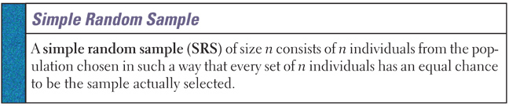
Simple Random Sampling (SRS)
Simple random sampling (SRS)
  Most important sampling technique we study
    Many of the inference techniques we will study have it as a requirement
    Often times it is assumed or given in the problem
  All possible samples of a given size must be equally likely

Slide 31
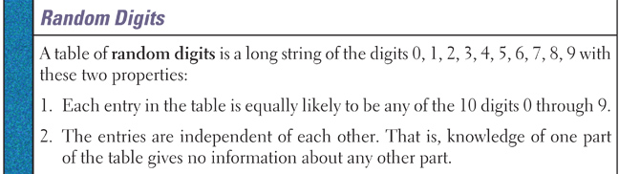
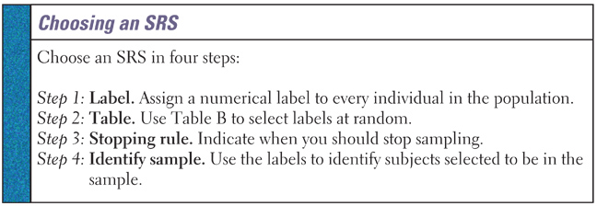
SRS and Random # Table
In order to have students get the same results in a SRS, questions ask students to use a random number table

Slide 32

Spring Break in Cancun

Slide 33
Example: How to Choose an SRS
Problem: Use Table D at line 130 to choose an SRS of 4 hotels
01 Aloha Kai 08 Captiva 15 Palm Tree 22 Sea Shell
02 Anchor Down 09 Casa del Mar 16 Radisson 23 Silver Beach
03 Banana Bay 10 Coconuts 17 Ramada 24 Sunset Beach
04 Banyan Tree 11 Diplomat 18 Sandpiper 25 Tradewinds
05 Beach Castle 12 Holiday Inn 19 Sea Castle 26 Tropical Breeze
06 Best Western 13 Lime Tree 20 Sea Club 27 Tropical Shores
07 Cabana 14 Outrigger 21 Sea Grape 28 Veranda
69051 64817 87174 09517 84534 06489 87201 97245
69 05 16 48 17 87 17 40 95 17 84 53 40 64 89 87 20
Our SRS of 4 hotels for the editors to contact is: 05 Beach Castle, 16 Radisson, 17 Ramada, and 20 Sea Club.

Slide 34
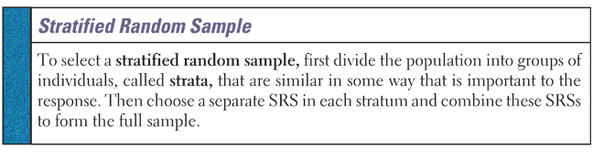
Stratified Random Sample
If the individuals in each stratum are less varied than the population as a whole, a stratified sample can produce better information than an SRS
Break into groups and SRS within each group
  Groups must be homogenous in some characteristic
  Examples: Sex, Grade, Age
Very similar to something we will see in experiments called blocking

Slide 35
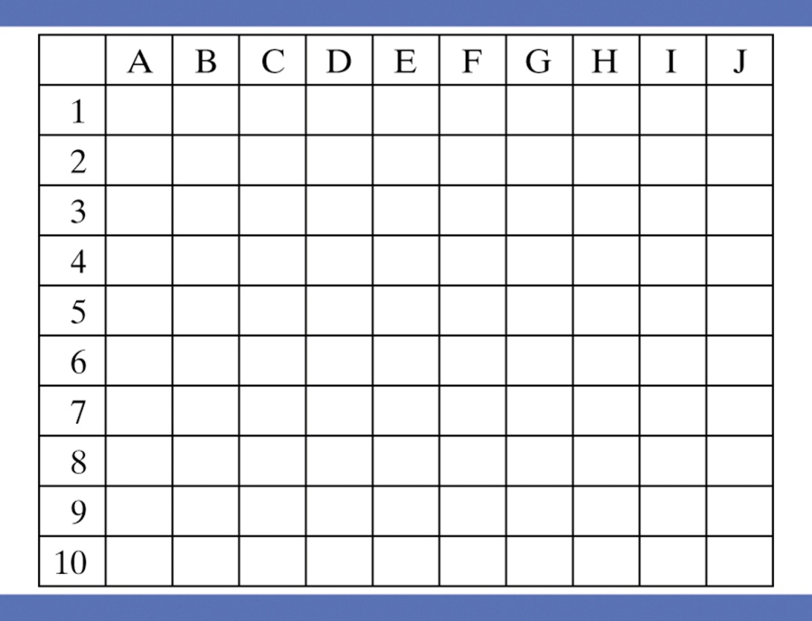

Sampling Sunflowers
Use Table D or technology to take an SRS of 10 grid squares using the rows as strata. Then, repeat using the columns as strata.

Slide 36
Example 1
Describe how a university can conduct a survey regarding its campus safety. The registrar of the university has determined that the community of the university consists of 6,204 students in residence, 13,304 nonresident students, and 2,401 staff for a total of 21,909 individuals. The president has funds for only 1000 surveys to be given and then analyzed. How should she conduct the survey?
Since there are 3 distinct groups (students – resident and nonresident and staff), first divide up the 1000 surveys into 3 groups based on the group’s proportions (283, 607, 110). Then conduct an SRS within each group (stratified samples) using those sample sizes; sampling about 4.5% of each group.

Slide 37
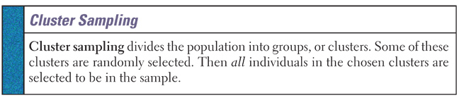
Cluster Random Sample
Break into groups and census (not an SRS) within randomly selected groups
Same rules apply to groups as in stratified sample

Slide 38
Example 2
Sociologists want to gather data regarding the household income within Smyth County. They have come to the high schools for assistance. Describe a method which would disrupt the fewest classes and still gather the data needed.
Since we want to minimize the impact within the school, we could census (use English class) to survey everyone.
However, since English classes get hit often for this type of thing, we could cluster sample across all scheduled classes. Randomly select some classes from all classes meeting 4th period (to include Trade School), and census the entire class.

Slide 39
Systematic Sampling
A sampling technique where an algorithm (mathematical formula) dictates the selection criteria
Not a SRS (don’t need a frame)
Randomness comes into play from the hope that there is no systematic differences between people selected
Examples:
  Survey every 5th person that enters a store
  Online surveys every 100th person coming to the site

Slide 40
Example 3
The manager of Ingles wants to measure the satisfaction of the store’s customers. Design a sampling technique that can be used to obtain a sample of 40 customers.
Since different groups of customers shop at different times during the day, we need to spread the sampling out throughout the day.
If on an average day, Ingles gets 800 customers come into the store and make a purchase, then we would want to sample every 20th customer.

Slide 41
Multi-Stage Sampling
Sampling process is broken down into several stages
Each stage could potentially use different survey methods
Cluster Sampling and Stratified Sampling could be considered to be simple examples of multi-stage sampling

Slide 42
Example 4
The Independent Organization of Political Activity, IOPA, wants to conduct a survey focusing on the dissatisfaction with the current political parties. Several state-wide businesses have agreed to help. IOPA has come to you for advice. Describe a multi-stage survey strategy that will help them.
Lots of different ways to do this. Stratify based on percentages of likely voters; pick out certain participating businesses locations based on an SRS corresponding to the stratification; and conduct a systematic sampling at each location.

Slide 43
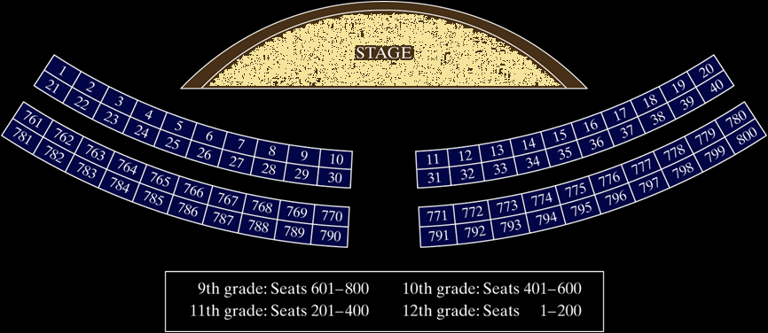
Sampling at a School Assembly
Describe how you would use the following sampling methods to select 80 students to complete a survey.
(a) Simple Random Sample
(b) Stratified Random Sample
(c) Cluster Sample

Slide 44
Learning Summary
A sample survey selects a sample from the population of all individuals about which we desire information.
Random sampling uses chance to select a sample.
The basic random sampling method is a simple random sample (SRS).
To choose a stratified random sample, divide the population into strata, then choose a separate SRS from each stratum.
To choose a cluster sample, divide the population into groups, or clusters. Randomly select some of the clusters for your sample.

Slide 45
Learning Summary
Failure to use random sampling often results in bias, or systematic errors in the way the sample represents the population.
Voluntary response samples and convenience samples are particularly prone to large bias.
Sampling errors come from the act of choosing a sample. Random sampling error and undercoverage are common types of error.
The most serious errors are nonsampling errors. Common types of sampling error include nonresponse, response bias, and wording of questions.

Slide 46
Summary and Homework
Summary
  Experiments: can detect cause and effect
  Observational Studies: suggest further work
  Sampling Methods (Probabilistic)
    Simple Random Sample
    Cluster Sample
    Stratified Random Sample
    Multi-stage Sample
Homework
  17, 19, 21, 23, 25

