Slide 1

5-Minute Check on Section 4-1b
observational studies
Surveys are an example of ____________ _______.
What can detect “cause-and-effect” between variables?
Define the types of surveys used in the following situations:
Every 15th person entering the store is asked to take a survey
Four English classes are selected at random and everyone in the class is given a survey on cafeteria food
Ten MSHS teachers are selected at random to take a survey on ISS
All student who live in Sugar Grove are surveyed about weather
Fifty students from each class year are surveyed about uniforms
designed experiment
systematic sample
cluster sample
simple random sample (SRS)
census
stratified sample (similar to blocking)
Click the mouse button or press the Space Bar to display the answers.

Slide 2
Lesson 4 - 2
Designing Experiments

Slide 3
Objectives
Explain the concept of confounding and how it limits the ability to make cause-and-effect conclusions
Distinguish between an observational study and an experiment, and identify the explanatory and response variables in each type of study
Identify the experimental units and treatments in an experiment
Describe the placebo effect and the purpose of blinding in an experiment
Describe how to randomly assign treatments in an experiment using slips of paper, technology, or a table of random digits

Slide 4
Objectives (cont)
Explain the purpose of comparison, random assignment, control and replication in an experiment
Describe a completely randomized design for an experiment
Describe a randomized block design and a matched pairs design for an experiment and explain the purpose of blocking in an experiment

Slide 5
Vocabulary
Observational study – observes individuals and measures variables of interest but does not attempt to influence the responses
Response variable – measures an outcome of a study
Explanatory variable – may help explain or predict changes in a response variable
Confounding – occurs when two variables are associated in such a way that their effects on a response variable cannot be distinguished from each other
Experiment – imposes some treatment on individuals to measure their response
Placebo – a treatment that has no active ingredient, but is otherwise like other treatments; like a “sugar pill”
Treatment – a specific condition applied to the individuals in an experiment
Experimental unit – the object to which a treatment is randomly assigned

Slide 6
Vocabulary (cont)
Subjects – humans as experimental units in an experiment
Factor – a variable that is manipulated and may cause a change in the response variable
Level – different values of a factor
Control group – used to provide a baseline for comparing the effects of other treatments; depending on the experiment, the control group could be given no treatment, a placebo or an active treatment
Placebo effect – describes the fact that some subjects in an experiment will respond favorably to any treatment, even an inactive treatment (placebo)
Double-blind – neither the subjects nor those who interact with them and measure the response variable know which treatment a subject received.
Single-blind – either the subjects don’t know which treatment they are receiving or those who interact with them and measure the response variable don’t know which treatment a subject received.

Slide 7
Vocabulary (cont)
Random assignment – experimental units are assigned to treatments using a chance process
Control – means keeping other variables constant for all experimental units
Replication – using enough experimental units to distinguish a difference in the effects of the treatments from chance variation due to the random assignment; number of units receiving the same treatment within the experiment

Slide 8
Vocabulary (cont)
Completely randomized design – experimental units are assigned to the treatments completely by chance
Block – a group of experimental units that are known before the experiment to be similar in some way that is expected to affect the response to the treatments
Randomized block design – the random assignment of experimental units to treatments is carried out separately within each block
Match pairs design – compares two treatments in blocks of 2; sometimes two very similar experimental units are paired (like twins) and the treatments are randomly assigned within each pair; in others, each experimental unit receives both treatments in a random order

Slide 9
Observational Study vs Experiment
In contrast to observational studies, experiments don’t just observe individuals or ask them questions. They actively impose some treatment in order to measure the response.
Definition:
An observational study observes individuals and measures variables of interest but does not attempt to influence the responses.
An experiment deliberately imposes some treatment on individuals to measure their responses.
When our goal is to understand cause and effect, experiments are the only source of fully convincing data.
The distinction between observational study and experiment is one of the most important in statistics.

Slide 10
Confounding
Observational studies of the effect of one variable on another often fail because of confounding between the explanatory variable and one or more lurking variables.
Definition:
A lurking variable is a variable that is not among the explanatory or response variables in a study but that may influence the response variable.
Confounding occurs when two variables are associated in such a way that their effects on a response variable cannot be distinguished from each other.
Well-designed experiments take steps to avoid confounding.

Slide 11
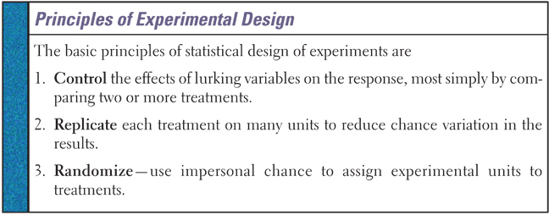
Basic Parts of Experiments
Experimental units – individuals on which experiment is done
  Subjects – experiment units that are human beings
Treatment – specific experimental condition applied to units
  Factors – the explanatory variables in the experiment
  Level – the combination of specific values of each of the factors

Slide 12
The Language of Experiments
An experiment is a statistical study in which we actually do something (a treatment) to people, animals, or objects (the experimental units) to observe the response. Here is the basic vocabulary of experiments.
Definition:
A specific condition applied to the individuals in an experiment is called a treatment. If an experiment has several explanatory variables, a treatment is a combination of specific values of these variables.
The experimental units are the smallest collection of individuals to which treatments are applied. When the units are human beings, they often are called subjects.
Sometimes, the explanatory variables in an experiment are called factors. Many experiments study the joint effects of several factors. In such an experiment, each treatment is formed by combining a specific value (often called a level) of each of the factors.

Slide 13

How to Experiment Badly
Experiments are the preferred method for examining the effect of one variable on another. By imposing the specific treatment of interest and controlling other influences, we can pin down cause and effect. Good designs are essential for effective experiments, just as they are for sampling.
A high school regularly offers a review course to prepare students for the SAT. This year, budget cuts will allow the school to offer only an online version of the course. Over the past 10 years, the average SAT score of students in the classroom course was 1620. The online group gets an average score of 1780. That’s roughly 10% higher than the long- time average for those who took the classroom review course. Is the online course more effective?
Students -> Online Course -> SAT Scores

Slide 14
How to Experiment Badly
Many laboratory experiments use a design like the one in the online SAT course example:
Experimental Units
Treatment
Measure Response
In the lab environment, simple designs often work well.
Field experiments and experiments with animals or people deal with more variable conditions.
Outside the lab, badly designed experiments often yield worthless results because of confounding.
Remember: Voluntary response surveys. Who would take an on-line class?

Slide 15
Example 1
Two toothpastes are being studied for effectiveness in reducing the number of cavities in children. There are 100 children available for the study.
A) What are the test subjects?
What is the response variable?
What are the treatments?
What are the factors or levels?
What are the possible confounding variables?
The children’s teeth
number of cavities
toothpastes
two different toothpaste brands (?)
diet (candies and soft drinks), economics, family history

Slide 16
Example 2
A baby-food producer claims that her product is superior to that of her leading competitor, in that babies gain weight faster with her product. As an experiment, 30 healthy babies are randomly selected. For two months, 15 are fed her product and 15 are feed the competitor’s product. Each baby’s weight gain (in ounces) was recorded.
A) What are the test subjects?
What is the response variable?
What are the treatments?
What are the factors or levels?
What are the possible confounding variables?
The 30 babies
weight gain
baby food
two different competitor’s products (very undefined in statement)
family history, disease during experiment,

Slide 17
Example 3
A statistics class wants to know the effect of a certain fertilizer (0, 2, 4 oz) and water levels (2, 4, 6 oz) on tomato plants. They get 60 plants of the same type.
A) What are the test subjects?
What is the response variable?
What are the treatments?
What are the factors or levels?
What are the possible confounding variables?
tomato plants (experiment units since they are not human)
yield of tomatoes in ounces
amounts of fertilizer and amounts of water
fertilizer (0, 2, 4) and water (2, 4, 6)
soil, sunlight, weather, goats

Slide 18
Summary and Homework
Summary
  Parts of an Experiment:
    Experimental units
    Treatment
      Factors
      Levels
  Confounding Variables
    Extraneous (don’t use lurking) variables
Homework

Slide 19
5-Minute Check on Section 4-2a
Is it an observational study or an experiment:
A) Researchers divide stats class volunteers into two groups. First group does homework and the second does not. Final grade averages of the two groups are then compared at the end of the semester.
B) Researchers divide stats class volunteers into two groups, those who say they study and those who don’t. First group records the time they spend on homework each night and the second group does the same. At the end of the semester averages are compared between groups that studied a lot and those that did not.
For the experiment listed above, detail the test subjects, treatment applied and the measured data.
experiment
observational study – no treatment
In part a: students were the test subjects, homework was the treatment, and final grade averages were measured.
Click the mouse button or press the Space Bar to display the answers.

Slide 20
Principles of Experimental Design
Randomized comparative experiments are designed to give good evidence that differences in the treatments actually cause the differences we see in the response.
Principles of Experimental Design
Control for lurking variables that might affect the response: Use a comparative design and ensure that the only systematic difference between the groups is the treatment administered.
Random assignment: Use impersonal chance to assign experimental units to treatments. This helps create roughly equivalent groups of experimental units by balancing the effects of lurking variables that aren’t controlled on the treatment groups.
Replication: Use enough experimental units in each group so that any differences in the effects of the treatments can be distinguished from chance differences between the groups.

Slide 21
Basic Principles of DoE
Control
  Overall effort to minimize variability in the way the experimental units are obtained and treated
  Attempts to eliminate the confounding effects of extraneous variables (those not being measured or controlled in the experiment, aka lurking variables)
Randomization
  Rules used to assign the experimental units to the treatments
  Uses impersonal chance to assign experimental units to treatments
  Increases chances that there are no systematic differences between treatment groups
Replication
  Use enough subjects to reduce chance variation
  Increases the sensitivity of the experiment to differences between treatments

Slide 22
Experimental Variability
Any experiment is likely to involve three kinds of variability:
Planned, systematic variability. This is the kind we want since it includes the differences due to the treatments.
Chance-like variability. This is the kind our probability models allow us to live with. We can estimate the size of this variability if we plan our experiment correctly.
Unplanned, systematic variability. This kind threatens disaster! We deal with this variability in two ways, by randomization and by blocking. Randomization turns unplanned, systematic variation into planned, chance-like variation, while blocking turns unplanned, systematic variation into planned, systematic variation.
The management of these three sources of variation is the essence of experimental design.
Taken from In Introduction to the Design and Analysis of Experiments, George Cobb (1998)

Slide 23
Steps in Experimental Design
Identify the problem to be solved
Determine the Factors that Affect the Response Variable
Determine the Number of Experimental Units
  Time
  Money
Determine the Level of Each Factor
  Control – fix level at one predetermined value
  Manipulation – set them at predetermined levels
  Randomization – tries to control the effects of factors whose levels cannot be controlled
  Replication – tries to control the effects of factors inherent to the experimental unit
Conduct the Experiment
Test the claim (inferential statistics)

Slide 24
Randomized Comparative Experiment
The remedy for confounding is to perform a comparative experiment in which some units receive one treatment and similar units receive another. Most well designed experiments compare two or more treatments.
Comparison alone isn’t enough, if the treatments are given to groups that differ greatly, bias will result. The solution to the problem of bias is random assignment.
Definition:
In an experiment, random assignment means that experimental units are assigned to treatments at random, that is, using some sort of chance process.

Slide 25
Randomized Comparative Experiment
Definition:
In a completely randomized design, the treatments are assigned to all the experimental units completely by chance.
Some experiments may include a control group that receives an inactive treatment or an existing baseline treatment.
Group 1
Treatment 1
Compare Results
Experimental Units
Random Assignment
Group 2
Treatment 2

Slide 26
Randomization Methods
For the AP test (and ours in class) you need to come up with a stock way to randomization the assignment or selection process in experimentation.
What’s wrong with flipping a coin or rolling a dice?
My stock method:
Select as many different colored poker chips as you have groups to assign. Put an equal number of each color that sums to the total number of experimental units into a bag. Shake up and draw one out. Assign first EXU to the group corresponding to that color. Repeat until all EXU have been assigned (and all chips have been drawn out).

Slide 27
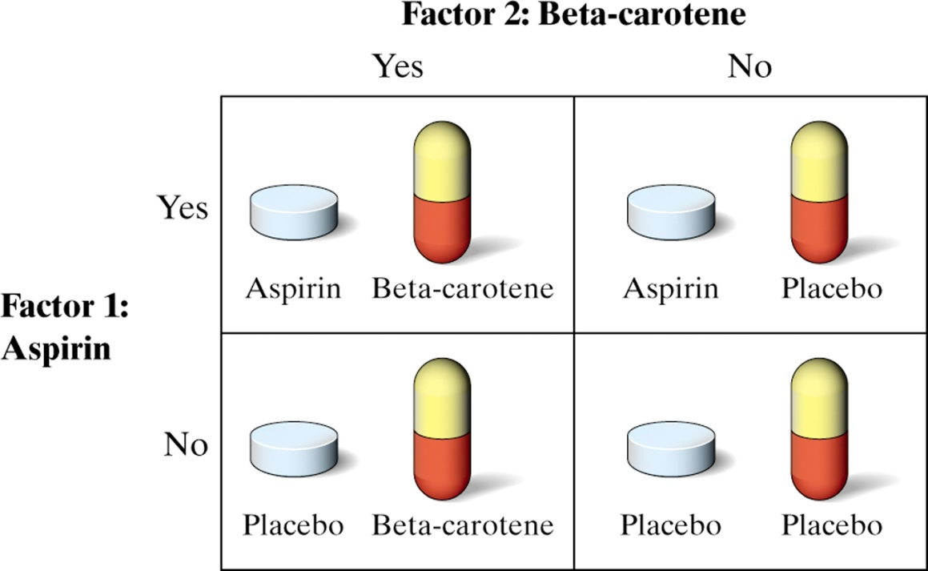
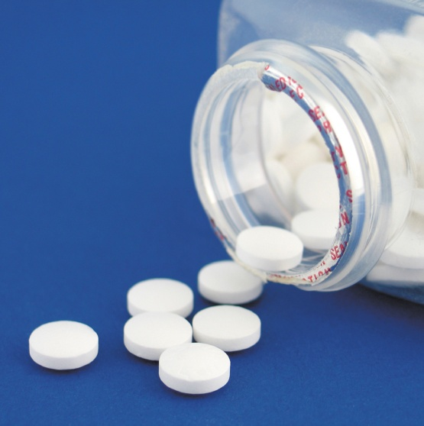
Physicians’ Health Study
Read the description of the Physicians’ Health Study on page 241. Explain how each of the three principles of experimental design was used in the study.
A placebo is a “dummy pill” or inactive treatment that is indistinguishable from the real treatment.

Slide 28
Physicians’ Health Study
Control: Effects of lurking variables were controlled by using placebos and active ingredients for comparisons and by having all subjects follow the same schedule for pill-taking.
Randomization: Test subjects were randomly assigned to one of four treatment groups to ensure groups were roughly equivalent.
Replication: Each treatment group had over 5000 test subjects to ensure that any sizable differences were due to the treatments and not just chance.

Slide 29
Example 1
Draw a picture detailing the following experiment:
A statistics class wants to know the effect of a certain fertilizer on tomato plants. They get 60 plants of the same type. They will have two levels of treatments, 2 and 4 teaspoons of fertilizer. Someone suggests that they should use a control group.
The picture should include enough detail for someone unfamiliar with the problem to understand the problem and be able to duplicate the experiment. Picture must address the randomization in detail.

Slide 30
Example 1 cont
Random Assignment of plants to treatments:
Lay plants out in a line. Draw out of a bag one colored chip (20 chips each of three colors). All plants of the same color assigned to one group below.
Experimental Units:
tomato plants
Group 1 (red)
receives 20 plants
Group 2 (blue)
receives 20 plants
Group 3 (white)
receives 20 plants
Explanatory Variable:
amount of fertilizer
Treatment A
No Fertilizer
Treatment B
2 teaspoons
Treatment C
4 teaspoons
Control
Group
Compare Yield
total ounces
Response Variable:
total ounces produced

Slide 31
Example 2
We wish to determine whether or not a new type of fertilizer is more effective than the type currently in use. Researchers have subdivided a 20-acre farm into twenty 1-acre plots. Wheat will be planted on the farm, and at the end of the growing season the number of bushels harvested will be measured.
A) How do you assign the plots of land?
B) What is the explanatory variable?
C) What is the response variable?
D) How many treatments are there?
E) Are there any possible lurking variables that would confound the results?
randomly assigning plots - your method??
Types of fertilizer
Number of bushels of wheat harvested
Two – new fertilizer and old (possibly none as a control group)
Soil composition, rainfall, animal destruction effects

Slide 32
Summary and Homework
Summary
  Parts of an Experiment:
    Experimental units
    Treatment
      Factors
      Levels
  Experimental Design Factors:
    Control
    Replication
    Randomization
Homework

Slide 33
5-Minute Check on Section 4-2b
What are the principles of experimental design?
Replication: is it within the experiment, or is it repeating the experiment?
Describe how to randomize the application of four treatments to two groups of 20 each.
Describe how to randomly break 40 people into five groups.
Randomization, replication and control
Replication is within (number of times a treatment is repeated)
Have five of each of four different color poker chips. Let each person draw out of the bag a chip.
Use your calculator to generate 40 unique random integers, 1 to 40. Assign 1-8 to group 1, 9-16 to group 2, 17-24 to group 3, 25-32 to group 4 and 33-40 to group 5.
Click the mouse button or press the Space Bar to display the answers.

Slide 34
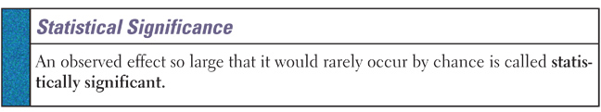
Statistically Significant
Large sample sizes can force results that statistically significant but are not practically significant
Example: Milk consumption doubles your risk for a certain type of cancer from 1 in 10 million to 1 in 5 million
Remember our definition of unusual results (less than a 5% chance of occurrence

Slide 35
Inference for Experiments
In an experiment, researchers usually hope to see a difference in the responses so large that it is unlikely to happen just because of chance variation.
We can use the laws of probability, which describe chance behavior, to learn whether the treatment effects are larger than we would expect to see if only chance were operating.
If they are, we call them statistically significant.
Definition:
An observed effect so large that it would rarely occur by chance is called statistically significant.
A statistically significant association in data from a well-designed experiment does imply causation.

Slide 36
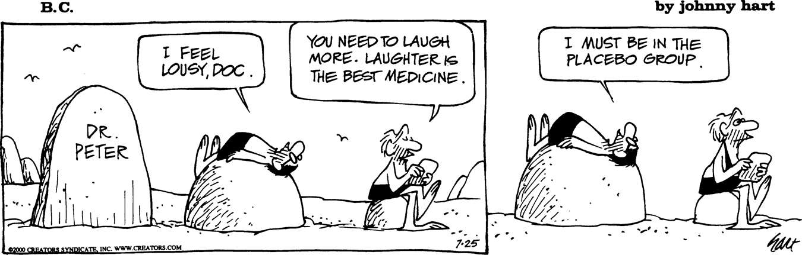
Experiments: What Can Go Wrong?
The logic of a randomized comparative experiment depends on our ability to treat all the subjects the same in every way except for the actual treatments being compared.
A response to a dummy treatment is called a placebo effect. The strength of the placebo effect is a strong argument for randomized comparative experiments.
Whenever possible, experiments with human subjects should be double-blind.
Definition:
In a double-blind experiment, neither the subjects nor those who interact with them and measure the response variable know which treatment a subject received.

Slide 37
Statistical “Blindness”
In some studies we don’t want the person giving or getting the treatment to influence the results of the experiment.
To avoid the effects of subject behavior
  Subjects not given any medication are often given a placebo such as a sugar tablet
  The subjects will not know which treatment they get
To avoid the effects of administrator behavior
  The administrators are not told which drug they are administering
When both the subjects and the researchers do not know which treatment, this is called double-blind

Slide 38
Problem in a Random Design Example
We are testing the effects of treatments A, B, and C on soybean plants
Assume that group 1 is treated with A and group 2 is treated with B
Assume that Chemgro plants have higher yields than Pioneer plants
Assume that group 1 has more Chemgro plants (happens because of randomization) than group 2

Slide 39
Confounding
If group 1 (treatment A) has higher yields than group 2 (treatment B)
  Is this because treatment A is more effective than B?
  Is this because there are more Chemgro plants in group 1?
It is not possible to distinguish
  The effects of Treatment A versus B
  The effects of Chemgro versus Pioneer
When two effects cannot be distinguished, this is called confounding

Slide 40
Summary and Homework
Summary
  Placebo effect can influence (mask) treatment results
  Experiments can be single-blinded (person receiving treatment doesn’t know) and double-blinded (both receiver and giver doesn’t know)
  Statistically versus Practically significant results
    Large sample sizes can deceive
    Five percent rule of thumb
Homework
  57, 63, 65, 67

Slide 41
5-Minute Check on Section 4-2c
What is the standard “threshold” level for significance?
If participants in a study and the treatment administrator do not know which treatment is being given, then the study is _____ ?
What is the other form of “blindness”?
Can a study not be “blinded”?
When two variables effects are indistinguishable, we call it ?
Typically it is 5% (or 1 in 20).
Double blinded
Single blinded: generally the subject doesn’t know which treatment that they are getting
Yes; lots of studies cannot be blinded
Confounding
Click the mouse button or press the Space Bar to display the answers.

Slide 42
Completely Randomized Design
A completely randomized design is when each experimental unit is assigned to a treatment completely at random
Examples:
  Randomly assign 10 people to get the new drug and 10 people to get the old drug; compare results
  A farmer wants to test the effects of a fertilizer; we choose a set of plants to receive the treatment; and we randomly assign plants to receive different levels of fertilizer
This has similarities to completely random sampling

Slide 43
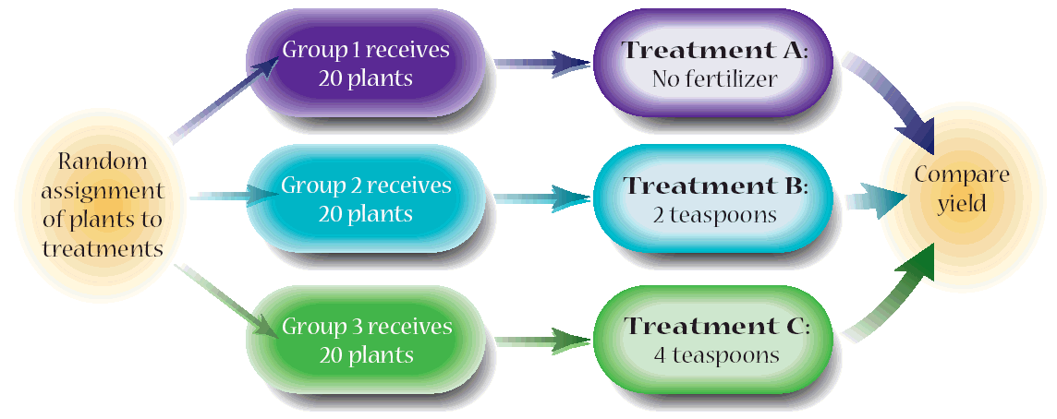
Randomized Design Example
We control as many factors as we can
  Amount of watering
  Method of tilling
  Soil acidity
Randomization decreases the effects of uncontrolled factors
  Rainfall
  Sunlight
  Temperature

Slide 44
Blocking
Completely randomized designs are the simplest statistical designs for experiments. But just as with sampling, there are times when the simplest method doesn’t yield the most precise results.
Definition
A block is a group of experimental units that are known before the experiment to be similar in some way that is expected to affect the response to the treatments.
In a randomized block design, the random assignment of experimental units to treatments is carried out separately within each block.
Form blocks based on the most important unavoidable sources of variability (lurking variables) among the experimental units.
Randomization will average out the effects of the remaining lurking variables and allow an unbiased comparison of the treatments.
Control what you can, block on what you can’t control, and randomize to create comparable groups.

Slide 45
Randomized Block Design
A randomized block design is when the experimental units are grouped and then each group is assigned a treatment at random
The groups are called blocks
  Blocks must be homogenous groupings
    All males and all females
    10-19 years old; 20-19 years old; etc
    Large dog breeds; medium dog breeds; small dog breeds
    Very fertile soil; moderately fertile soil; low fertility soil
    College graduates; High school graduates; others
This design will reduce confounding
This has similarities to stratified sampling

Slide 46
Randomized Block Design
In our soybean experiment
  We apply treatment A to one third of the Chemgro plants, chosen at random
  We apply treatment B to one third of the Chemgro plants, chosen at random
  We apply Treatment C to one third of the Chemgro plants, chosen at random
We apply the same method to the Pioneer plants
With this randomized block design
  Insures a balance of the treatments to the type of soybean plants
  Plant type does not affect the value of our response variable
  The effect of treatment A versus B and the effect of Chemgro versus Pioneer are no longer confounded
This has similarities to stratified sampling

Slide 47
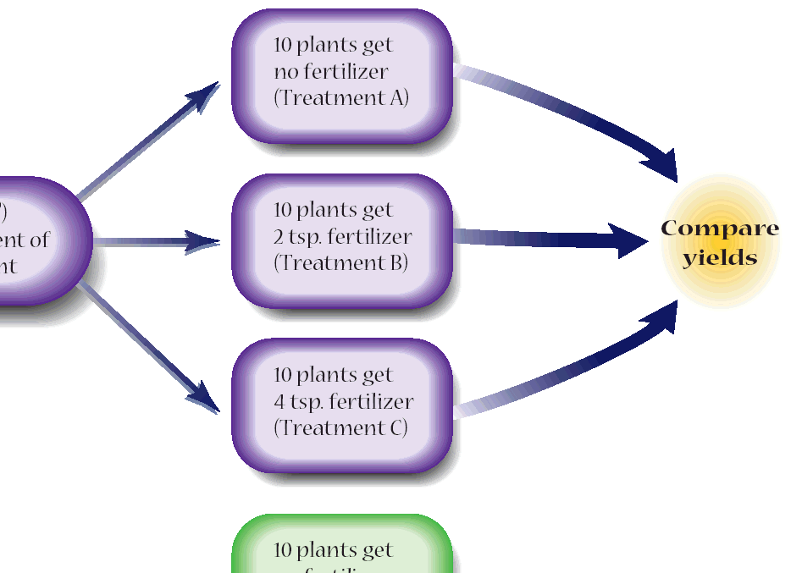
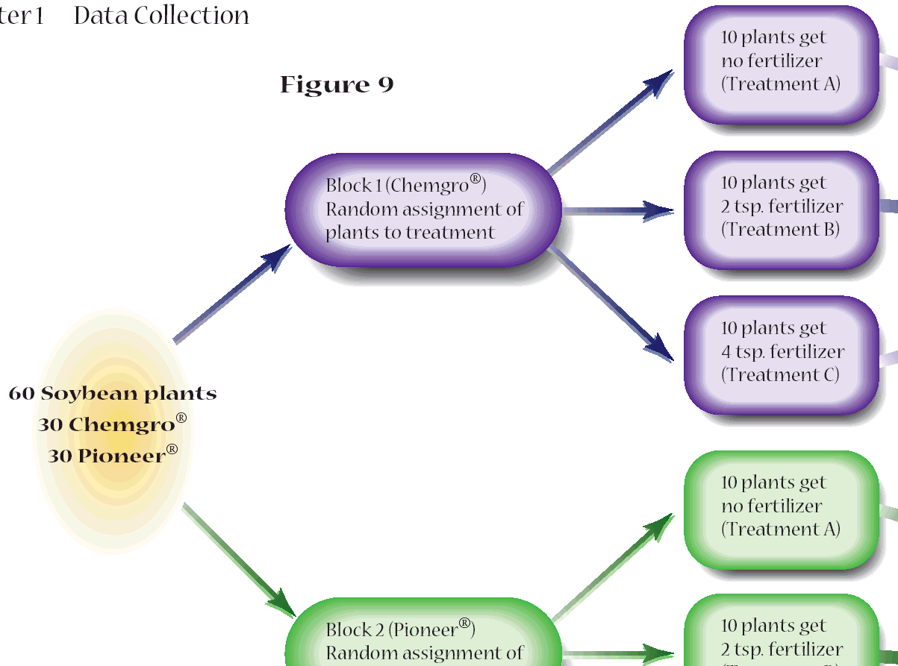
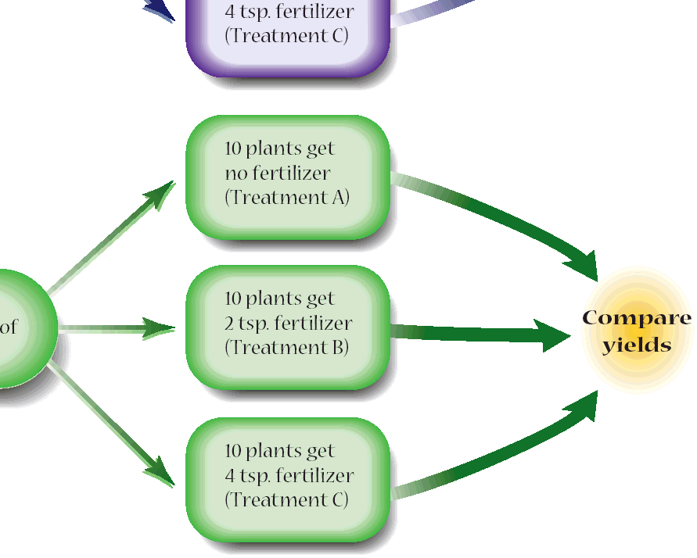
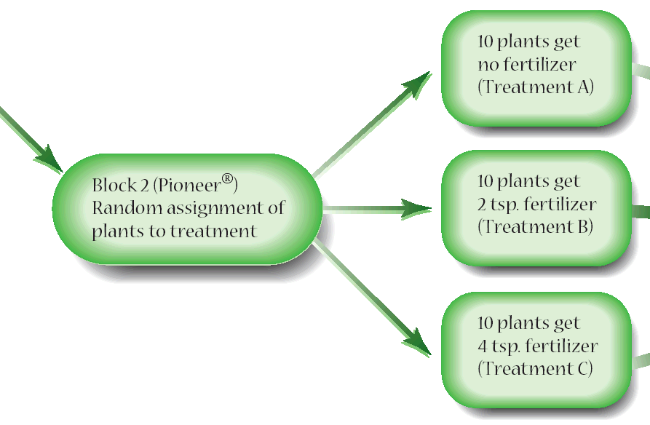
Randomized Block Design
Blocks should be homogenous: made up of the same attribute

Slide 48
Matched-Pairs Design
A matched-pair design is when the experimental units are paired up and each of the pair is assigned to a different treatment
A matched pair design requires
  Units that are paired (twins, the same person before and after the treatment, …)
  Only two levels of treatment (one for each of the pair)
Examples:
  New sock on right foot and old sock on left foot; and the wear-time until a hole develops is recorded
  A subject before receiving the medication and then the same subject after receiving the medication

Slide 49
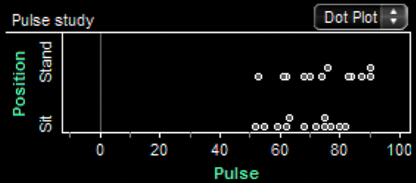
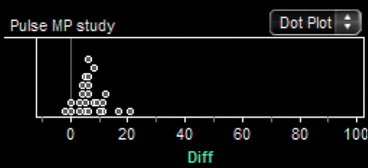
Standing and Sitting Pulse Rate
Consider the Fathom dotplots from a completely randomized design and a matched-pairs design. What do the dotplots suggest about standing vs. sitting pulse rates?

Slide 50
Matched-Pairs Design
A common type of randomized block design for comparing two treatments is a matched pairs design. The idea is to create blocks by matching pairs of similar experimental units.
Definition
A matched-pairs design is a randomized blocked experiment in which each block consists of a matching pair of similar experimental units.
Chance is used to determine which unit in each pair gets each treatment.
Sometimes, a “pair” in a matched-pairs design consists of a single unit that receives both treatments. Since the order of the treatments can influence the response, chance is used to determine which treatment is applied first for each unit.

Slide 51
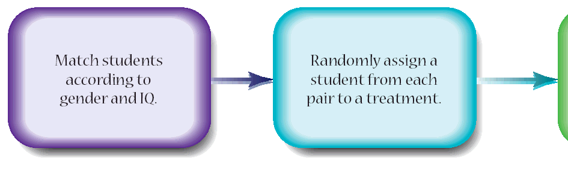
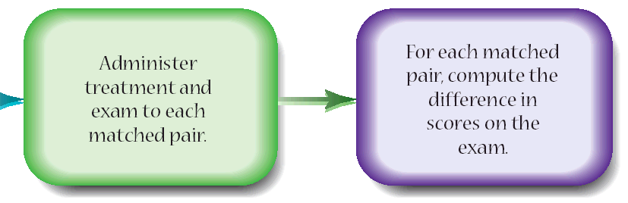
Matched-Pair Design Example
Test whether students learn better while listening to music or not
  Match students by IQ and gender (to control those factors)
  Randomly choose one of each pair (to decrease the effects of other uncontrolled factors
  Assign that one to a quiet room and the other to a room with music (the treatment)
  Administer the test and analyze the test scores

Slide 52
Example 1
An agronomist wishes to compare the yield of five corn varieties. The field, in which the experiment will be carried out, increases in fertility from north to south. Outline an appropriate design for this experiment. Identify the explanatory and response variables, the experimental units, and the treatments. If it is a block design, identify the blocks.

Slide 53
Example 1
Explanatory Variable:
Response Variable:
Experimental Unit:
Treatment:
variety of corn and soil fertility
yield (bushels per acre)
each planted area of a type of corn
variety of corn and soil fertility
Distance away from north edge of field would be our blocking variable. Randomly assign varieties within each block.
East to West | Block 1 | Block 2 | Block 3 | Block 4 | Block 5

Slide 54
Example 2
You are participating in the design of a medical experiment to investigate whether a calcium supplement in the diet will reduce the blood pressure of middle-aged men. Preliminary work suggests that calcium may be effective and that the effect may be greater for African-American men than for white or Hispanic men. Forty randomly selected men from each ethnic category are available for the study. Outline the design of an appropriate experiment. What kind of design is this? Can this experiment be blinded?

Slide 55
Example 2
Explanatory Variable:
Response Variable:
Experimental Unit:
Treatment:
calcium supplement and race
measure of blood pressure
each patient
calcium supplement or placebo
Since race may make a difference we need to block on it.
Randomly assign pills (treatments) within blocks.
Yes the experiment can be double-blinded
pill | AA | WA | HA
 | 20 – p | 20 - p | 20 – p
 | 20 - c | 20 - c | 20 – c

Slide 56
Example 3
An educational psychologist wants to test two different memorization methods to compare their effectiveness to increase memorization skills. There are 120 subjects available ranging in age from 18 to 71. The psychologist is concerned that differences in memorization capacity due to age will mask (confound) the differences in the two methods. What would the design look like?

Slide 57
Example 3
Explanatory Variable:
Response Variable:
Experimental Unit:
Treatment:
method and age
some measure of memory
each patient
method
Since age may make a difference we need to “block” on it.
Group patients into 60 pairs from youngest two to the oldest two.
Randomly assign each method to each of the pairs.
Pairs by age | Y | O
 | 1 | 2
 | 2 | 1
 | 1 | 2
 | 1 | 2

Slide 58
Example 4
Men and women experience different physiological differences among diseases. In a study of blood pressure three different methods (a drug, yoga, and meditation) will be tried on both men and women randomly selected from a large company to see which is most effective in reducing high blood pressure. Construct an appropriate design diagram. Would a control group be necessary? Explain. Can this experiment be blinded? What is the parameter of interest in this experiment? What is the population of interest in this problem?

Slide 59
Example 4
Explanatory Variable:
Response Variable:
Experimental Unit:
Treatment:
method and gender
measure of blood pressure
each patient
one of 4 methods (N, D, Y, M)
Since gender may make a difference we need to “block” on it.
Control group necessary to see if company’s stress level went up or down.
Experiment can not be blinded.
Population is this particular company only.
(possible problems if self selected groups)
Assign same # to each group |  | M | F
 | N
 | D
 | Y
 | M

Slide 60
Analyzing Experiments Template
Topic | Answers
Research Question: | What is the question the researchers are trying to answer?
Subjects / Experimental Units: | What are the experimental units?
Explanatory Variable(s) / Factor(s): | Type of variable: Quantitative or Categorical
Treatment(s): | What are the Factor(s) and their Levels?
Response Variable(s): | Type of variable: Quantitative or Categorical
Experimental Design Description: | Using words or diagrams describe the experimental design
Experimental Design Principles: | Explain how these design principles apply in this study
Control: | Eliminate confounding effects of extraneous variables
Randomization: | No systematic difference between the groups
Replication: | Reducing role of chance in results
Blocking: | If blocking used, describe the blocking / why it was used.
Blinding: | If blinding used, describe it in context.
Concerns: | What concerns about the experimental design?
Statistical Analysis Technique(s): | What statistical analysis techniques are appropriate?
Conclusions: | What conclusions can be drawn from the study?

Slide 61
Experimental Problem Outline
Experimental Units – what are our experimental units
Response Variable – what are we measuring and how to determine good vs bad results
Explanatory Variables – what other variables are we measuring, or changing to affect the response
  These should include any factors and their levels
Assignment to Groups (blocking) – how do you randomly assign experimental units into groups
  Must be detailed enough for someone to duplicate
Assignment of Treatments – how do you assign treatments to experimental units
  Must be detailed enough for someone to duplicate
  Double blindness can be discussed here if appropriate

Slide 62
Summary and Homework
Summary
  The planning for designed experiments is crucial to the success of the experiment
  A double-blind implementation of experiments reduces the amount of changes in behavior
  There are different good methods for assigning treatments to experimental units
    Completely random
    Matched-pairs
    Randomized blocks
Homework
  problems

