Slide 1

5-Minute Check on Chapter 4
What can help detect “cause-and-effect” relationships?
What DOE concept is similar to stratified sampling?
What is taken after random selection in a cluster sample?
Give an example of a blocking variable and a reason why?
Who knows which treatment is done in a double-blind DOE?
Describe a method of random selection of 15 people into 3 groups.
a designed experiment
blocking
census
gender; because it may confound the treatment results
only the statistician; patient and administrator don’t
place 5 poker chips from each of 3 colors in a bag and have the volunteers select one
Click the mouse button or press the Space Bar to display the answers.

Slide 2
Lesson 5 – 1
Randomness, Probability and Simulation

Slide 3
Objectives
Interpret probability as a long-run relative frequency.
  Explain how the behavior of a chance event differs in the short- and long-run.
  Explain what is meant by random phenomenon.
  Explain what it means to say that the idea of probability is empirical.
Use simulation to model chance behavior
  Use a table of random digits to carry out a simulation.
  Given a probability problem, conduct a simulation in order to estimate the probability desired.
  Use a calculator or a computer to conduct a simulation of a probability problem.

Slide 4
Objectives
DESCRIBE the idea of probability
DESCRIBE myths about randomness
DESIGN and PERFORM simulations

Slide 5
Vocabulary
Probability model – calculates the theoretical probability for a set of circumstances
Probability – describes the pattern of chance outcomes
Simulation – imitation of chance behavior, based on a model that accurately reflects the phenomenon under consideration
Trials – many repetitions of a simulation or experiments
Independent – one repetition does not affect the outcome of another

Slide 6
Odds are ….
1 : 576,000 of being hit by lightning | 1 : 800,000 of dating a supermodel
1 : 3,000,000 of seeing a UFO | 1 : 14,000,000 of winning a scratch-off lottery
From a Numbers episode

Slide 7
Odds are in a given year ….
1 in 400 of dying of a heart attack | 1 in 5,000. of being killed in a car accident
1 in 2,067,000 of being killed in a plane crash | 1 in 292,201,338 of winning PowerBall
From the web

Slide 8
3 Methods Involving Chance
Calculating relative frequencies using observed data
Theoretical Probability Model
Simulation

Slide 9
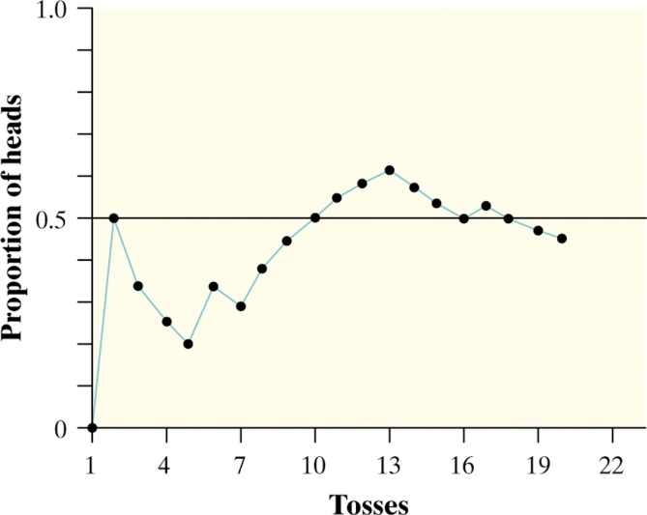
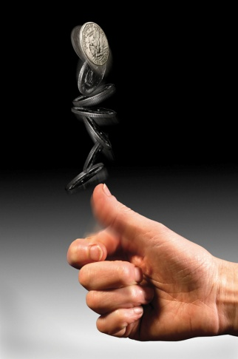
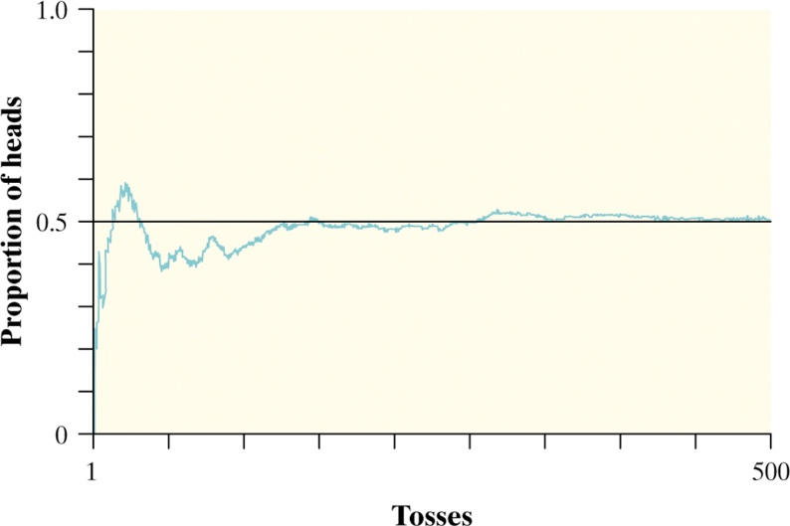
The Idea of Probability
Chance behavior is unpredictable in the short run, but has a regular and predictable pattern in the long run.
The law of large numbers says that if we observe more and more repetitions of any chance process, the proportion of times that a specific outcome occurs approaches a single value.
Definition:
The probability of any outcome of a chance process is a number between 0 (never occurs) and 1(always occurs) that describes the proportion of times the outcome would occur in a very long series of repetitions.

Slide 10
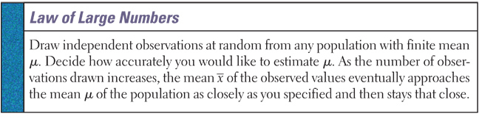
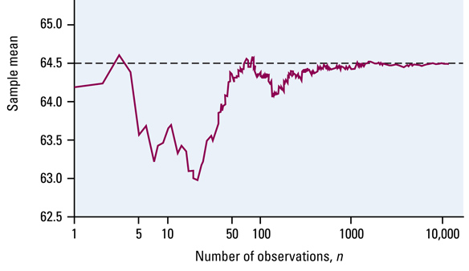
Law of Large Numbers
Sample mean, x, approaches population mean, μ, as sample size increases

Slide 11
Law of Small Numbers ??
People incorrectly believe that the long-term random behavior seen should also be seen in the short-term
We don’t expect to see long runs in the short-term because of this misperception
Intuition does not do a good job of distinguishing random behavior from systematic influences

Slide 12
Probability Laws
Law of Large Numbers – True
  Sample mean, x, approaches population mean, μ, as sample size increases
Law of Small Numbers – False
  Random behavior in short term does not mimic long-term behavior
Law of Averages – Bad Statistics
  eventually everything evens out

Slide 13
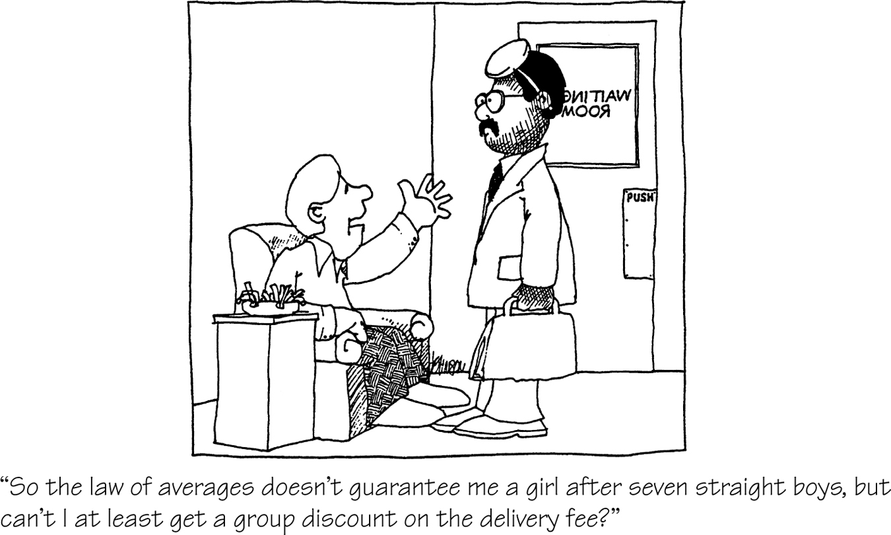
Myths about Randomness
The idea of probability seems straightforward. However, there are several myths of chance behavior we must address.
The myth of short-run regularity: (No law of short numbers)
The idea of probability is that randomness is predictable in the long run. Our intuition tries to tell us random phenomena should also be predictable in the short run. However, probability does not allow us to make short-run predictions.
The myth of the “law of averages”: (no one is “due”)
Probability tells us random behavior evens out in the long run. Future outcomes are not affected by past behavior. That is, past outcomes do not influence the likelihood of individual outcomes occurring in the future.

Slide 14
Relative Frequency
Relative frequency is the percentage that the observed makes up of the whole
Its found by dividing the number of a given category by the total number of values
It is equivalent to the Experimental Probability

Slide 15
Probability
Experimental Probability
  Based on observed frequencies of events
Theoretical Probability
  Based on theoretical frequency of events
frequency of the event
Probability of an event = -------------------------------------------
total number of observations
number of outcomes of the event
Probability of an event = ---------------------------------------------------
total number of possible outcomes

Slide 16
Laws of Probability
Let P(x) be the probability that event x occurs
Collection of all possible outcomes is called the sample space
0 ≤ P(x) ≤ 1 for all events x in sample space
Sum of all P(x) for all events x must equal 1
P( impossibility ) = 0
P( certainty ) = 1

Slide 17
Probability Project
Use your calculator’s PROBSIM application to simulate 100, 500, 1000 and 5,000 rolls of two n-sided dice (8, 10, 12, 20)
Work in pairs
Prepare charts for presentation in class

Slide 18
Summary and Homework
Summary
  A chance process has outcomes that we cannot predict but have a regular distribution in many distributions.
  The law of large numbers says the proportion of times that a particular outcome occurs in many repetitions will approach a single number.
  The long-term relative frequency of a chance outcome is its probability between 0 (never occurs) and 1 (always occurs).
  Short-run regularity and the law of averages are myths of probability.
Homework
  5-1, 3, 7, 9, 11

Slide 19
5-Minute Check on Chapter 5-1a
What can help detect “cause-and-effect” relationships?
a designed experiment
Click the mouse button or press the Space Bar to display the answers.

Slide 20
Simulation
Imitation of chance behavior based on a model that accurately reflects the phenomenon under consideration
Can use our calculator in many ways
  ProbSim application
  Random number generation
Can use a random number table (table b in book)

Slide 21
Steps of Simulation
State the problem or describe the random phenomenon
State the assumptions
Assign digits to represent outcomes
Simulate many repetitions (trials)
State your conclusions

Slide 22
Golden Ticket Parking Lottery
Read the example on page 290.
What is the probability that a fair lottery would result in two winners from the AP Statistics class?
Students | Labels
AP Statistics Class | 01-28
Other | 29-95
Skip numbers from 96-00
Reading across row 139 in Table D, look at pairs of digits until you see two different labels from 01-95. Record whether or not both winners are members of the AP Statistics Class.
55 | 58 | 89 | 94 | 04 | 70 | 70 | 84 | 10|98|43 | 56 | 35 | 69 | 34 | 48 | 39 | 45 | 17
X | X | X | X | ✓ | X | X | X | ✓|Sk|X | X | X | X | X | X | X | X | ✓
No | No | No | No | No | No | No | No | No
19 | 12 | 97|51|32 | 58 | 13 | 04 | 84 | 51 | 44 | 72 | 32 | 18 | 19 | 40|00|36 | 00|24|28
✓ | ✓ | Sk|X|X | X | ✓ | ✓ | X | X | X | X | X | ✓ | ✓ | X|Sk|X | Sk|✓|✓
Yes | No | No | No | No | No | Yes | No | Yes
Based on 18 repetitions of our simulation, both winners came from the AP Statistics class 3 times, so the probability is estimated as 16.67%.

Slide 23
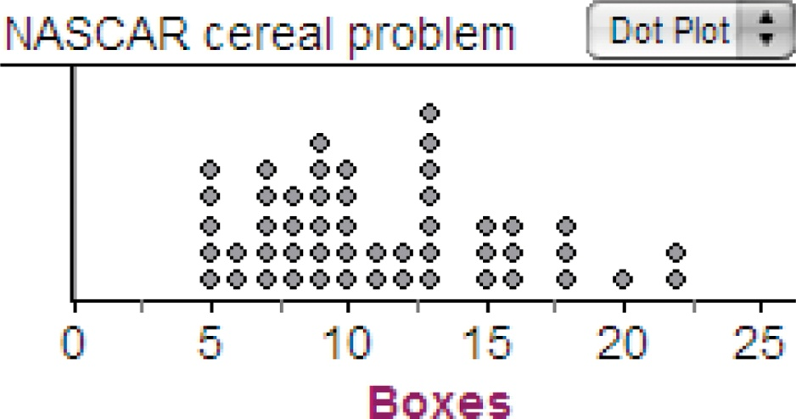
NASCAR Cards and Cereal Boxes
Read the example on page 291.
What is the probability that it will take 23 or more boxes to get a full set of 5 NASCAR collectible cards?
Driver | Label
Jeff Gordon | 1
Dale Earnhardt, Jr. | 2
Tony Stewart | 3
Danica Patrick | 4
Jimmie Johnson | 5
Use randInt(1,5) to simulate buying one box of cereal and looking at which card is inside. Keep pressing Enter until we get all five of the labels from 1 to 5. Record the number of boxes we had to open.
3 5 2 1 5 2 3 5 4 9 boxes
4 3 5 3 5 1 1 1 5 3 1 5 4 5 2 15 boxes
5 5 5 2 4 1 2 1 5 3 10 boxes
We never had to buy more than 22 boxes to get the full set of cards in 50 repetitions of our simulation. Our estimate of the probability that it takes 23 or more boxes to get a full set is roughly 0.

Slide 24
Example 1
Suppose you left your statistics textbook and calculator in you locker, and you need to simulate a random phenomenon (drawing a heart from a 52-card deck) that has a 25% chance of a desired outcome. You discover two nickels in you pocket that are left over from your lunch money. Describe how you could use the two coins to set up you simulation.
State the problem or describe the random phenomenon:
State the assumptions:
Assign digits to represent outcomes:
Simulate many repetitions (trials):
State your conclusions:
Drawing a heart from a 52-card deck
none
HH – heart; HT – diamond; TH – spade; TT – club
not needed
not needed

Slide 25
Example 2
Suppose that 84% of a university’s students favor abolishing evening exams. You ask 10 students chosen at random. What is the likelihood that all 10 favor abolishing evening exams? Describe how you could use the random digit table to simulate the 10 randomly selected students.
State the problem or describe the random phenomenon:
State the assumptions:
Assign digits to represent outcomes:
Simulate many repetitions (trials):
State your conclusions:
Sampling 10 random students
84% are in favor of abolishing
00 – 83 represent in favor; 84 – 99 represent against
read the first 10 pairs of numbers from Table B
line 141: A; F; F; F; F; F; F; F; F; F ➔ 90% in favor

Slide 26
Using the TI83 to Simulate
MATH → PRB →
randInt(lbound, ubound, number of trials)
example: randInt(1,6,500) STO L1
generates 500 uniform random numbers between 1 and 6 and stores in L1
Remember, CATALOGHELP App. (plus sign to see the parameters)

Slide 27
Example 3
Use your calculator to repeat example 2
State the problem or describe the random phenomenon:
State the assumptions:
Assign digits to represent outcomes:
Simulate many repetitions (trials):
State your conclusions:
Sampling 10 random students
84% are in favor of abolishing
00 – 83 represent in favor; 84 – 99 represent against
randInt(0,99,10)
calculator: F; F; F; F; F; F; F; F; A; F ➔ 90% in favor

Slide 28
Summary and Homework
Summary
  Carefully designed simulation can approximate things
    State the problem or describe the random phenomenon
    State the assumptions
    Assign digits to represent outcomes
    Simulate many repetitions (trials)
    State your conclusions
Homework
  15, 17, 19, 23, 25

